Slide 1
WELCOME
Good Afternoon Everyone, My name is Rajat Kodape, I am here to present my data analysis project on In-Out-Patinet.
The aim of this project was to analyze a mix Inpatient and Outpatient dataset and determine how it can assist stakeholder in separating and understanding the data. Using Python and Power BI, I was able to extract, clean and analyze the data to identify pattern and trends that can help us make better decisions.
During the analysis process, I used various techniques, such as filling in missing values, to uncover insights and create meaningful visualizations. I then exported the data to Power BI to create dashboards and reports that are easy to understand.
Today, I will share the key findings from my analysis and explain how they can help us determine which crop products to produce and the most effective seasons for them. I will also guide you through some visualizations and show how they can be used to gain a deeper understanding of the data.
Thank you for joining me today, and I hope you find this presentation informative and engaging.

Slide 2
We Have Data Of Patients In Hospital
We have data of patients with in and out categories.
There are 63 types of Speciality.
Here we have three cases which have Inpatient, Outpatient and Day Case.
Date is starting from 2018 to 2020.

Slide 3
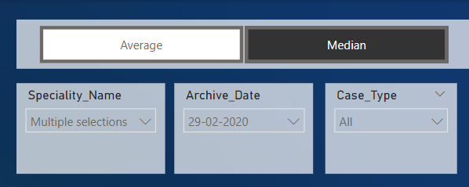

Lets First Understand the Dashboard
Select Speciality
Name
Drawdown Select Case Type
Select Date

Slide 4

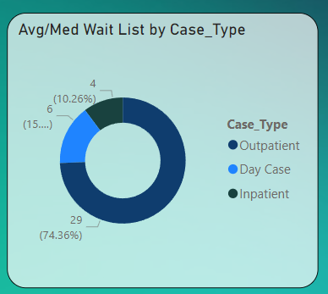
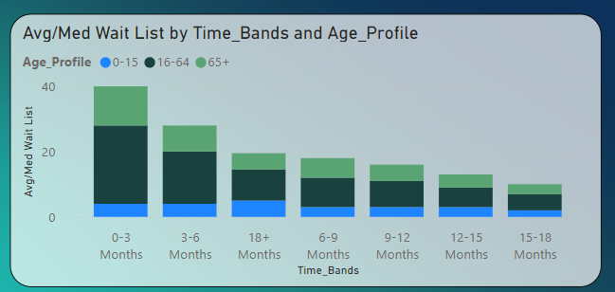

On Left Side We are able to see that Avg/Medium by Case type Where 74.36% Outpatient, 15.38% Day & 10.26 Inpatient
Also here we are able to see that Avg/Medium Wait List by Time Bands and Age Profile

Slide 5
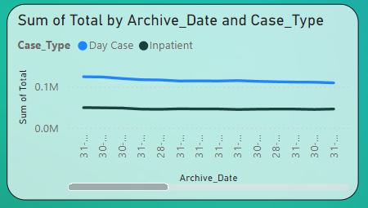
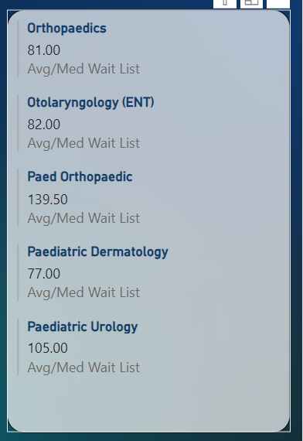
In that Tiles we can see a archive date with a sum of total patients.
Here we are able to see top five Speciality Name.

Slide 6
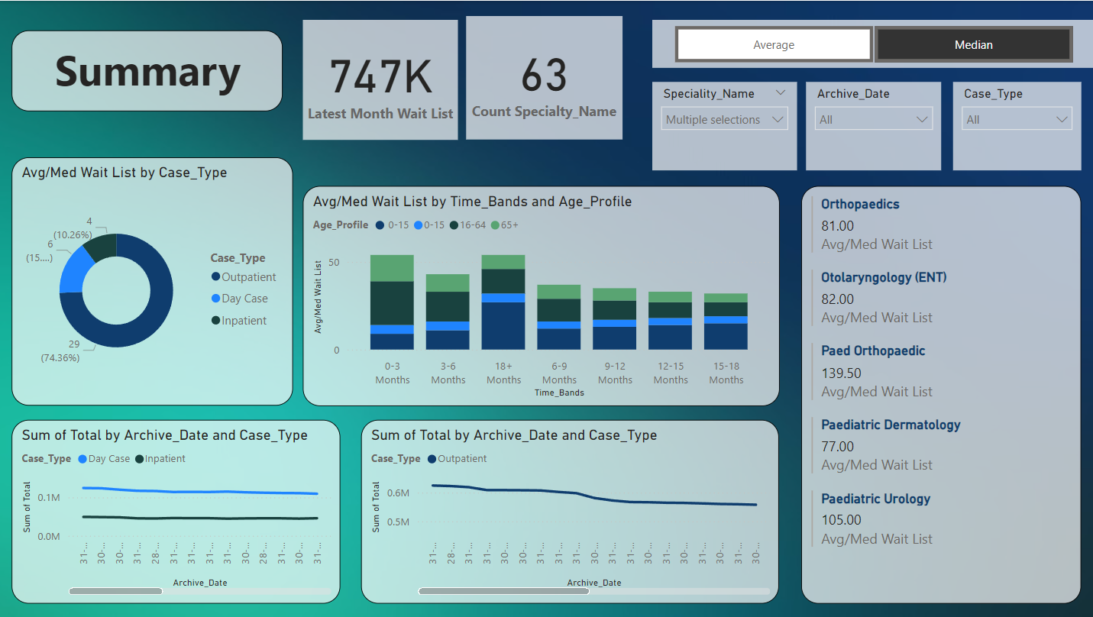
Now Our Dashboard Is Ready

Slide 7
Now We Understand the dashboard
Lets See The Dashboard On
Power BI, Where We Will See Report.

