Slide 1

CELONIS PROCESS MINING VIRTUAL INTERNSHIP
by
RAJESH B
Roll No. 224G1A3377
Department of Computer Science and Engineering (AI-ML)
Srinivasa Ramanujan Institute of Technology
(Affiliated to JNTUA & Approved by AICTE) (Accredited by NAAC with ‘A’ Grade & Accredited by NBA (EEE, ECE & CSE)
Rotarypuram Village, B K Samudram Mandal, Ananthapuramu – 515701.
2024-2025
224G1A3377 DEPT. COMPUTER SCIENCE AND ENGINEERING (AI-ML) SRINIVASA RAMANUJAN INSTITUTE OF TECHNOLOGY 1

Slide 2
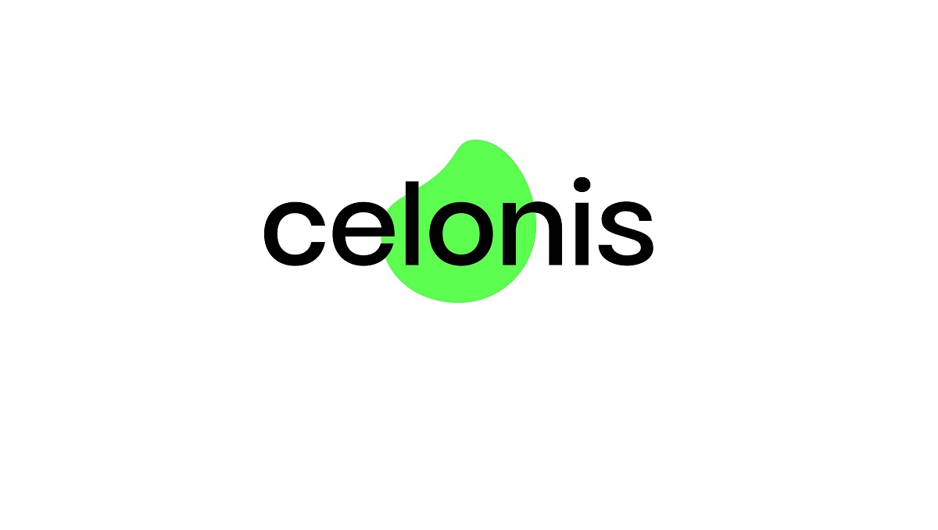

CELONIS PROCESS MINING VIRTUAL INTERNSHIP
CONTENTS
Course Objective
Introduction
Technology
Applications
Modules
Real Time applications
Learning outcomes
GitHub Link
Queries
224G1A3377 DEPT. COMPUTER SCIENCE AND ENGINEERING (AI-ML) SRINIVASA RAMANUJAN INSTITUTE OF TECHNOLOGY 2

Slide 3

CELONIS PROCESS MINING VIRTUAL INTERNSHIP
Course Objective
Develop Proficiency in Process Mining :
Gain a deep understanding of process mining concepts and techniques, including process discovery, conformance checking, and enhancement, to analyze and optimize business processes effectively.
Practical Application Using CELONIS :
Acquire hands-on experience with the CELONIS platform, learning to navigate its tools, perform data analysis, and derive actionable insights for process improvement in real-world business scenarios.
224G1A3377 DEPT. COMPUTER SCIENCE AND ENGINEERING (AI-ML) SRINIVASA RAMANUJAN INSTITUTE OF TECHNOLOGY 3

Slide 4

CELONIS PROCESS MINING VIRTUAL INTERNSHIP
INTRODUCTION
Process mining is a data analytics technique that helps organizations visualize and analyze their business processes.
Celonis is a leading software provider in the process mining space, offering tools to enhance process optimization.
The virtual internship by Eduskills provides learners with hands-on experience in using Celonis for real-world applications.
224G1A3377 DEPT. COMPUTER SCIENCE AND ENGINEERING (AI-ML) SRINIVASA RAMANUJAN INSTITUTE OF TECHNOLOGY 4

Slide 5

CELONIS PROCESS MINING VIRTUAL INTERNSHIP
TECHNOLOGY
CELONIS Process Mining Platform :
A leading software platform for process mining, designed to visualize and analyze business processes based on data logs. It helps in discovering inefficiencies, improving processes, and driving business performance.
Additional Technologies :
Data Integration Tools : For importing and preparing data from various sources.
Analytics Tools : For creating visualizations and dashboards to communicate insights effectively.
SQL and Data Querying : Used for data manipulation and querying within the CELONIS environment.
224G1A3377 DEPT. COMPUTER SCIENCE AND ENGINEERING (AI-ML) SRINIVASA RAMANUJAN INSTITUTE OF TECHNOLOGY 5

Slide 6

CELONIS PROCESS MINING VIRTUAL INTERNSHIP
APPLICATIONS
Supply Chain Optimization :
Improve procurement, logistics, and inventory management for better supply chain efficiency
Compliance and Risk Management :
Ensure adherence to regulatory requirements and minimize compliance risks.
Cost Reduction:
Identify opportunities to reduce operational costs and improve resource utilization.
Customer Service Improvement :
Optimize service processes to reduce response times and enhance customer satisfaction.
224G1A3377 DEPT. COMPUTER SCIENCE AND ENGINEERING (AI-ML) SRINIVASA RAMANUJAN INSTITUTE OF TECHNOLOGY 6

Slide 7
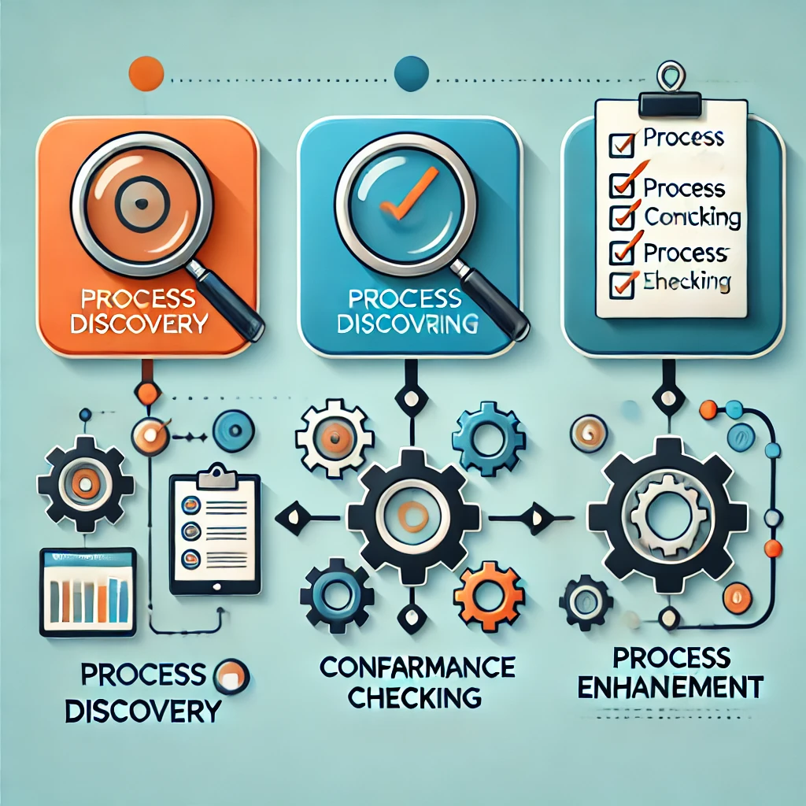
CELONIS PROCESS MINING VIRTUAL INTERNSHIP
MODULES
Process Discovery:
Generates a process model from event logs to visualize the actual workflow.
Conformance Checking :
Compares event logs with an existing process model to detect deviations.
Process Enhancement :
Refines existing models using event logs for process optimization and improvement.
224G1A3377 DEPT. COMPUTER SCIENCE AND ENGINEERING (AI-ML) SRINIVASA RAMANUJAN INSTITUTE OF TECHNOLOGY 7

Slide 8
CELONIS PROCESS MINING VIRTUAL INTERNSHIP
REAL TIME APPLICATIONS
Supply Chain Management
Use Case: Monitor and analyze supply chain processes like inventory management, logistics, and order fulfillment.
Benefit: Enhanced visibility into supply chain operations, reduced delivery times, and better supplier collaboration.
Customer Service Improvement
Use Case: Analyze service desk and call center interactions to understand customer behavior and agent performance.
Benefit: Improved customer satisfaction, faster issue resolution, and optimized service processes.
Healthcare Process Analysis
Use Case: Track patient flow, resource utilization, and treatment processes in hospitals.
Benefit: Better patient care, efficient resource allocation, and reduced treatment delays.
224G1A3377 DEPT. COMPUTER SCIENCE AND ENGINEERING (AI-ML) SRINIVASA RAMANUJAN INSTITUTE OF TECHNOLOGY 8

Slide 9
CELONIS PROCESS MINING VIRTUAL INTERNSHIP
LEARNING OUTCOMES
Process Understanding and Analysis:
Ability to interpret and analyze complex business processes using real-time data logs.
Data Integration and Management:
Skills in integrating and preparing data from multiple sources for process analysis.
Enhanced Decision-Making:
Improved decision-making through data-driven insights and visual analytics.
Application of Process Mining Techniques:
Practical knowledge of process discovery, conformance checking, and process enhancement.
224G1A3377 DEPT. COMPUTER SCIENCE AND ENGINEERING (AI-ML) SRINIVASA RAMANUJAN INSTITUTE OF TECHNOLOGY 9

Slide 10

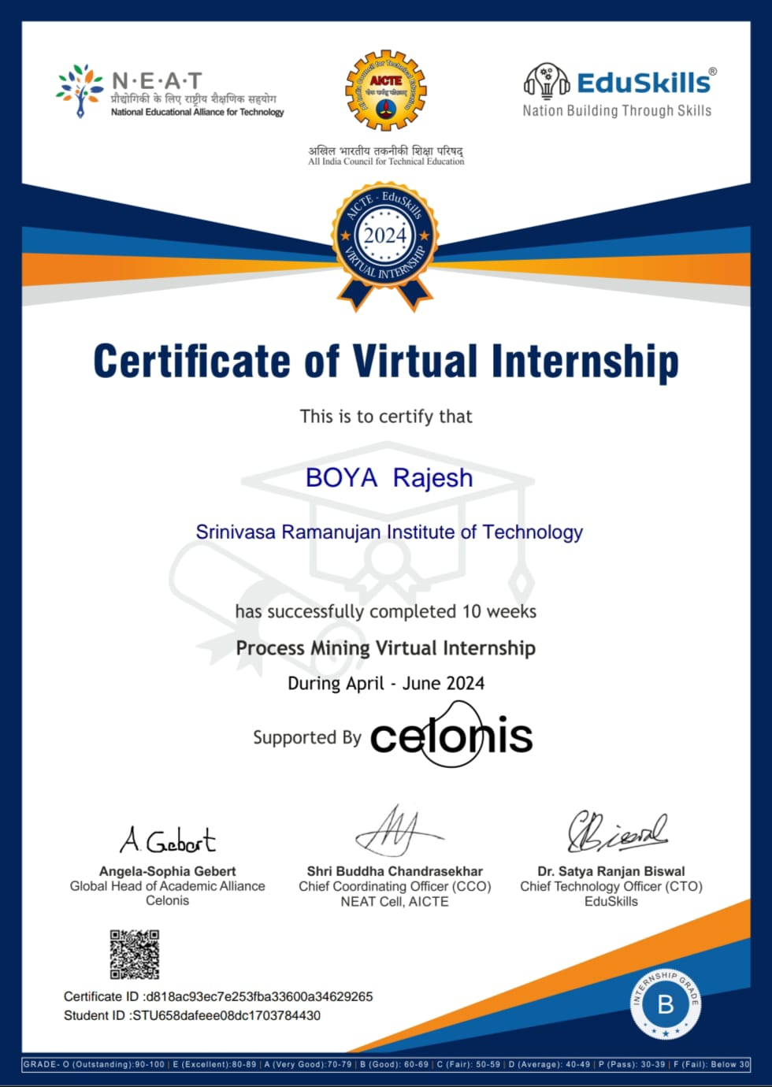
CELONIS PROCESS MINING VIRTUAL INTERNSHIP
CERTIFICATE :
224G1A3377 DEPT. COMPUTER SCIENCE AND ENGINEERING (AI-ML) SRINIVASA RAMANUJAN INSTITUTE OF TECHNOLOGY 10

Slide 11

CELONIS PROCESS MINING VIRTUAL INTERNSHIP
CLICK HERE
224G1A3377 DEPT. COMPUTER SCIENCE AND ENGINEERING (AI-ML) SRINIVASA RAMANUJAN INSTITUTE OF TECHNOLOGY 11

Slide 12


CELONIS PROCESS MINING VIRTUAL INTERNSHIP
THANK YOU !!
224G1A3377 DEPT. COMPUTER SCIENCE AND ENGINEERING (AI-ML) SRINIVASA RAMANUJAN INSTITUTE OF TECHNOLOGY 12

