Slide 1
ENVIRONMENT MONITORING IN PARK
SUBMITTEDBY:
1.S.RAJESH
2.P.BHUVANESHWARAN
3.K.KARTHIK
4.M.ANBUMANI
5.A.MUHAMED

Slide 2
Abstract:
This abstract provides a concise overview of the importance and methods of environmental monitoring in parks. Parks and natural reserves serve as vital ecosystems, offering recreation and habitat to a variety of species. However, the delicate balance of these environments can be disrupted by factors such as pollution, climate change, and human activities. To safeguard these natural treasures, environmental monitoring systems are essential. This abstract discusses the significance of monitoring parks, the key parameters involved, and the technology and methodologies employed. It emphasizes the need for real-time data collection, analysis, and proactive management to ensure the long-term sustainability and conservation of these valuable ecosystems.

Slide 3
introduction:
Parks and natural reserves are not only places of aesthetic beauty and recreational respite but also crucial ecosystems that support diverse flora and fauna. The delicate balance of these environments, however, is constantly threatened by various factors, including pollution, climate change, and human activities. To effectively protect and conserve these natural treasures, it is imperative to implement robust environmental monitoring systems within these areas.

Slide 4
*Define Objectives:*
Clearly outline the goals of your monitoring project. Are you focusing on air quality, water quality, wildlife, or a combination?
2. *Select Monitoring Parameters:*
Choose the specific environmental parameters you want to measure, such as temperature, humidity, pollution levels, or species diversity.
3. *Data Collection:*
Set up monitoring equipment like weather stations, sensors, or cameras to collect data. Consider real-time monitoring for immediate results.
4. *Data Analysis:*
Process and analyze the collected data to identify trends, anomalies, and potential issue

Slide 5
Reporting:*
Create regular reports or a public dashboard to share the results with park authorities and the public.
6. *Environmental Impact Assessment:*
Assess the impact of human activities in the park and propose mitigation strategies if necessary.
7. *Biodiversity Monitoring:*
Keep track of flora and fauna to understand the park's ecological health.
8. *Community Engagement:*
Involve the local community and educate them about the importance of environmental monitoring.

Slide 6
*Sustainability Initiatives:
Use the data to inform and support sustainability efforts, such as waste reduction and conservation programs.
10. *Adaptation and Action:*
Make informed decisions and take actions based on the monitoring data to protect and improve the park's environment.

Slide 7
Program:
import random
import time
import datetime
# Simulated sensor data (replace with real sensor data)
def read_sensor_data():
temperature = random.uniform(10.0, 30.0)
humidity = random.uniform(20.0, 80.0)
air_quality = random.uniform(0, 100)
return temperature, humidity, air_quality
# Save data to a CSV file
def save_data_to_csv(timestamp, temperature, humidity, air_quality):
with open('environment_data.csv', 'a') as file:
file.write(f"{timestamp},{temperature},{humidity},{air_quality}\n")
# Monitor the environment
def monitor_environment(duration, interval):
start_time = datetime.datetime.now()
end_time = start_time + datetime.timedelta(seconds=duration)

Slide 8
while datetime.datetime.now() < end_time:
timestamp = datetime.datetime.now().strftime('%Y-%m-%d %H:%M:%S')
temperature, humidity, air_quality = read_sensor_data()
save_data_to_csv(timestamp, temperature, humidity, air_quality)
print(f"{timestamp} - Temperature: {temperature}°C, Humidity: {humidity}%, Air Quality: {air_quality}")
time.sleep(interval)
if __name__ == '__main__':
duration = 3600 # Monitor for 1 hour (in seconds)
interval = 60 # Record data every 1 minute (in seconds)
monitor_environment(duration, interval)

Slide 9
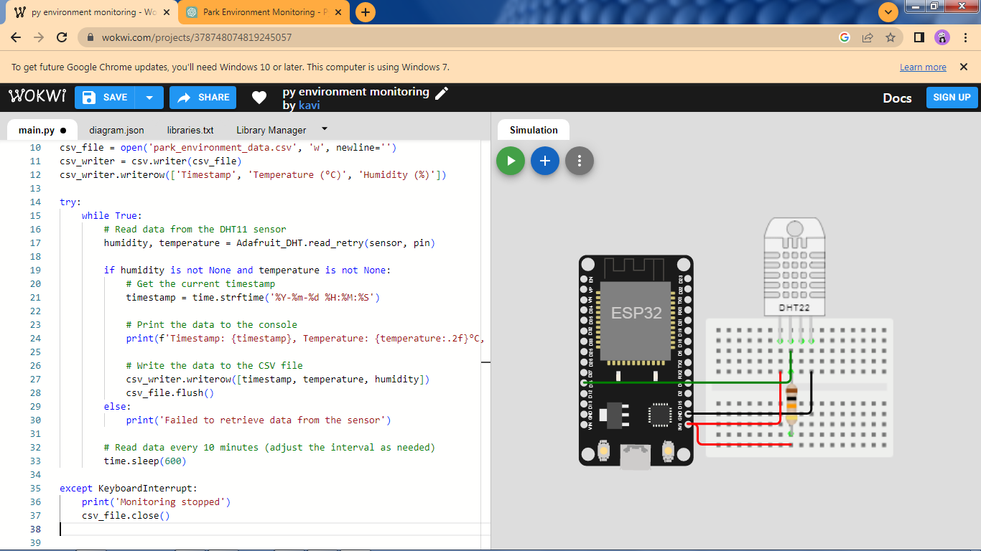

Slide 10
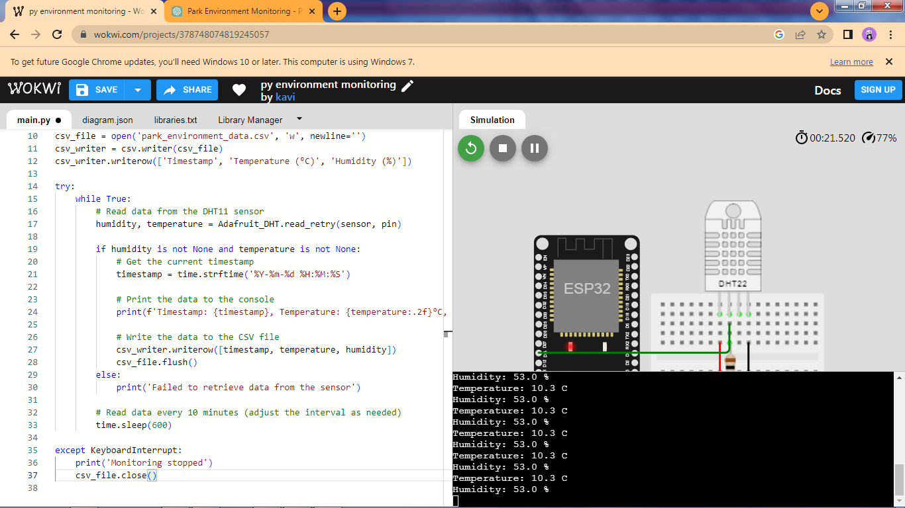

Slide 11
Conclusion:
Monitoring the environment in a park is crucial for preserving its natural beauty and ecological balance. In conclusion, regular monitoring allows us to assess air and water quality, track wildlife populations, and address any potential issues, ensuring that the park remains a sustainable and enjoyable place for both visitors and the local ecosystem. This information aids in informed decision-making and conservation efforts to maintain the park's health and biodiversity.

Slide 12


