Slide 1

Covid Cases in Germany
Made By Rajesh Sriram

Slide 2



Data from different sources are preprocessed to obtain the required data format
It is done with the help of merge command
Which can be seen in the report

Slide 3
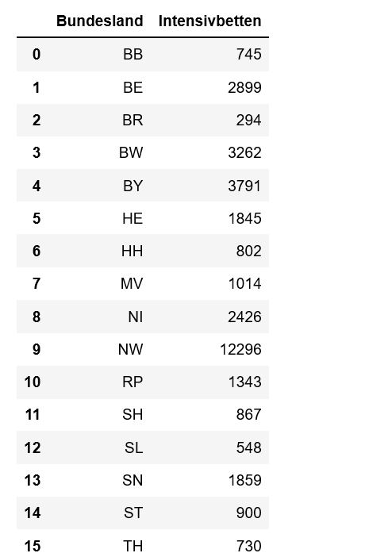
Result
Total Intensivbeds in each State

Slide 4
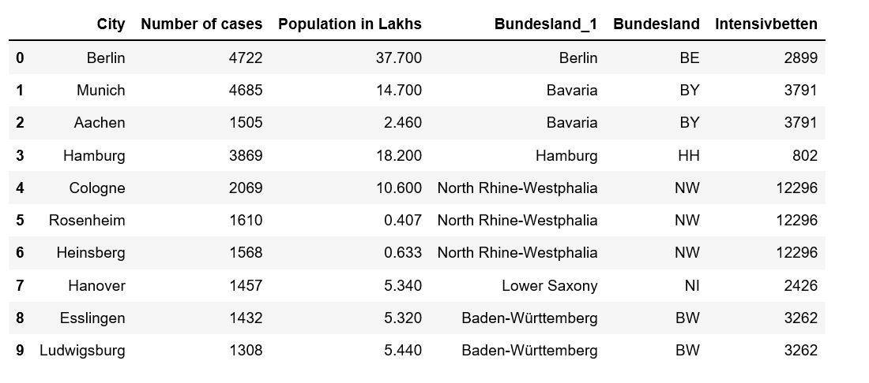
Result
Bundesland means state.
Here both the tables from different sources are merged and this results in this table which can be also found in the code

Slide 5
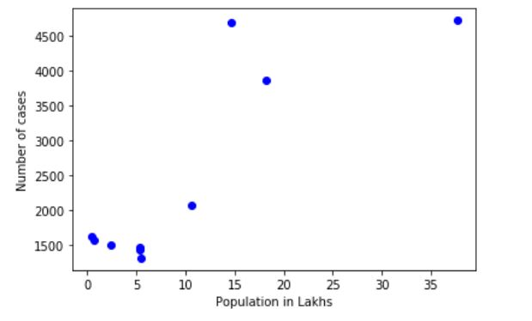
Result
This shows that the Corona Cases doesn’t follow a linearity curve . So it is not directly proportional to the Population

Slide 6
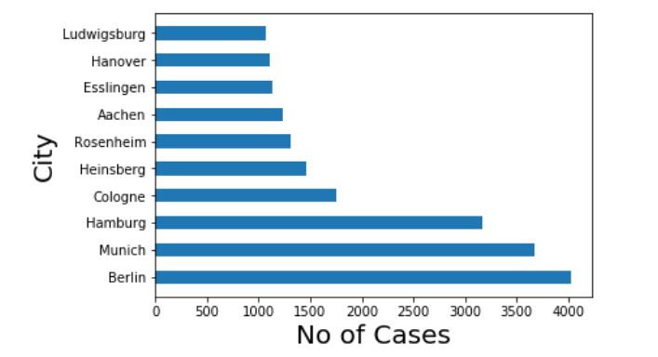
Result
Bar Graph Showing the no of cases for each individual city. Here
Berlin has the highest no of Covid 19 Cases

Slide 7
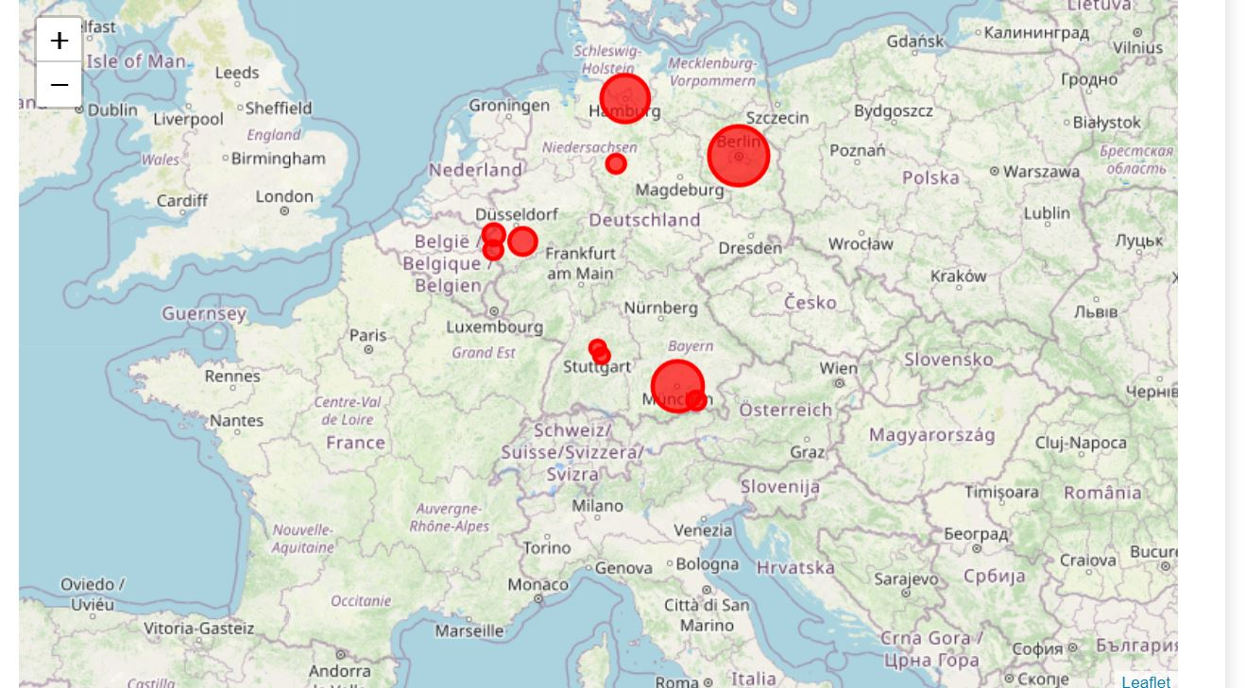
Result
Buuble Graph showing the visualization of the covid cases. Bubbles of large size here indicate a high number of Covid Cases

Slide 8
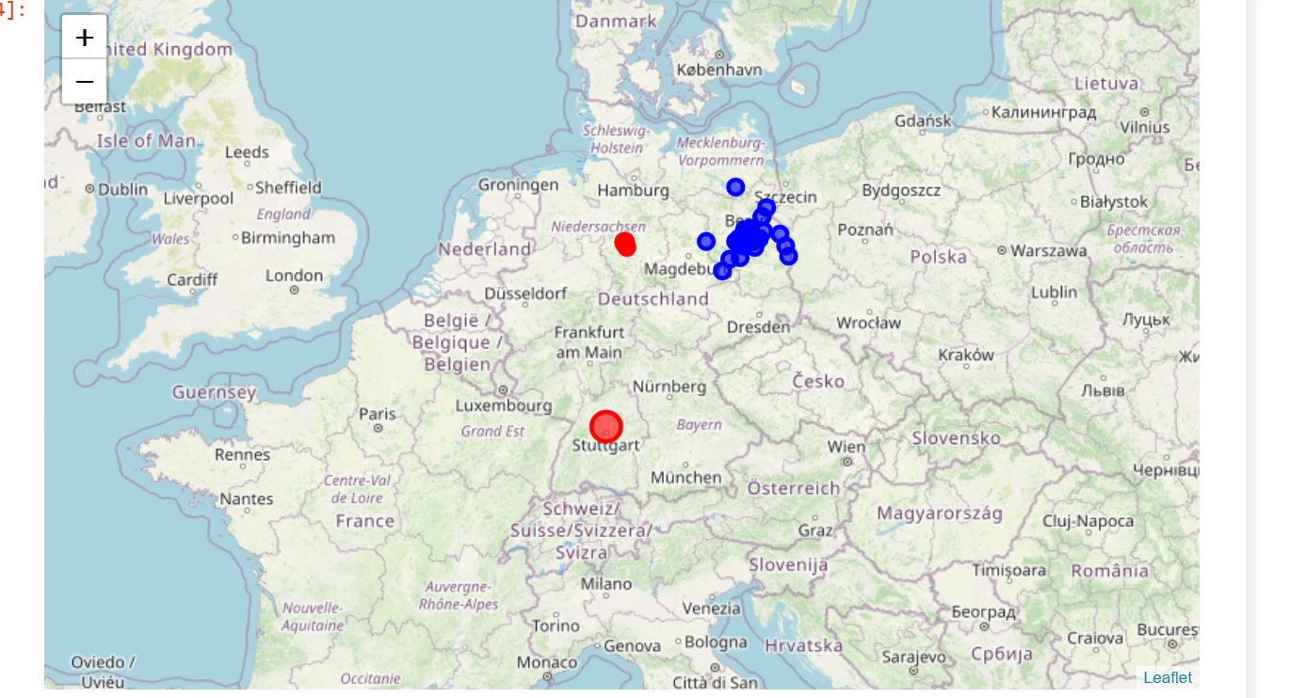
Result
Graph showing the total number of Covid Cases in Berlin

