Slide 1
Quality, OBE, and Accreditation
Hyderabad, 19th October 2019

Slide 2
Idea of Quality of Education can be
Very Illusive
Perception
Based on Indirect Evidence
…
Notes:
Institutional record,, Bright Infrastructure, Media influence etc someone said

Slide 3
Qu. Can we do Better?
OBE is a very promising way!

Slide 4
Over time, Learning Outcomes have come to Play a Crucial Role in the Accreditation Processes
{It gives Assurance on Quality}
{Almost} the World Over.

Slide 5
One Question (?)
In an Institution, all the inputs - Infrastructure, students, faculty, curriculum- are Good.
Qu. Will the graduates be “NOT GOOD*?”?
Ans. “May be- May be Not:” We just don’t know!
In OBE, we determine {By Measurement}
Notes:
Twin question marks. In OBE we answer both the questions. What do we understand by “Good” and then determine How Good?

Slide 6
In OBE, We
Define “Good”.
and then
How to determine “How Good”?

Slide 7
As Accreditation is all about
Quality Assurance,
We need to be Sure
Which Implies OBE is a Good basis for it.

Slide 8
Of Course, OBE is not only for Accreditation It is about “Quality of Education”
Curriculum
OBE
Curriculum &
Teaching/Learning
Assessment

Slide 9
A Bit of History

Slide 10
In the beginning, general feeling about OBE was:
It appears to be very promising, But
It needs is a more clear, and thoughtful exposition of what Outcome -Based Education really is,
why is it needed, and how it operates

Slide 11


Confusion
Yes, it is needed, But what is it?

Slide 12

William Spady, (Father? OBE)

Slide 13
“Outcome-Based Education: Critical Issues and Answers” by William G Spady
Qu. What does the term "Outcome-Based Education" really mean?

Slide 14
Outcome-Based Education means clearly focusing and organizing every-thing in an educational system around what is essential for all students to be able to do** successfully at the end of their learning experiences.
This means starting with a clear picture of what is important for students to he able to do, then organizing curriculum, instruction, and assessment to make sure this learning ultimately happens.

Slide 15

In Engineering, OBE Leads to:
Defining of the Graduate Profile
Through Learning Outcomes
Defining “Good”
Notes:
How do we do it?

Slide 16
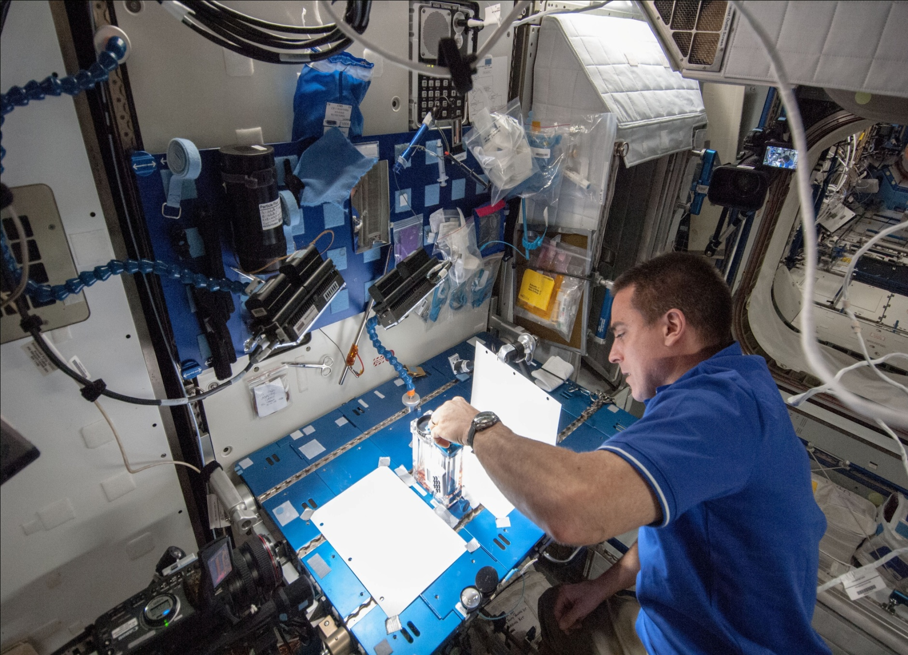
Engineer?
Notes:
How do we do it?

Slide 17
A Couple of more Questions:
Qu.1. Who Defines the Learning Outcomes?
Ans. The Stakeholders of that Program.
Then,
Qu.2. Who are the Stakeholders?
Ans. In Engineering- Industry and Academia, Govt., Students

Slide 18
As per OBE,
Curriculum and Teaching Learning; and
Assessment
Are the Focal Points

Slide 19
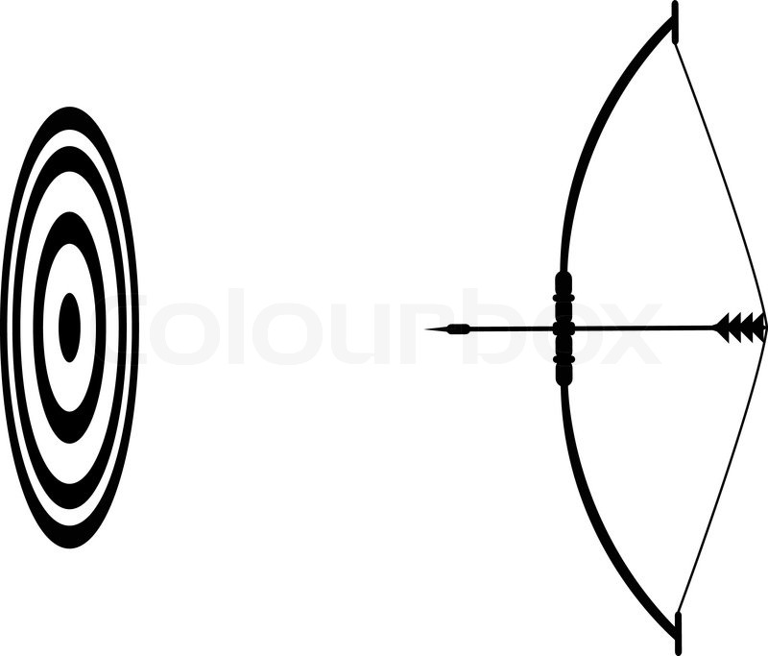
Curriculum &
Teaching/Learning
Assessment
Qu. What are the Roles of these two components?

Slide 20
Roles of the two components
Curriculum and the Teaching/ Learning processes are the basis on which the program is built
Attainment of Outcomes indicates that the job is well done
Notes:
PC and PO are completely different in their roles.

Slide 21
NBA-Learning Outcomes
1. Engineering Knowledge,
2. Problem Analysis
3. Design/development of solutions,
4. Conduct investigations of complex Problems,
5. Modern tool usage,
6. The engineer and society,
7. Environment and sustainability,
8. Ethics,
9. Individual and team work,
10. Communication,
11. Project management and finance,
12. Life-long learning
Notes:
Criteria 2

Slide 22
Qu. Why are the NBA’s POs , What they are?
Notes:
Not arbitrary

Slide 23
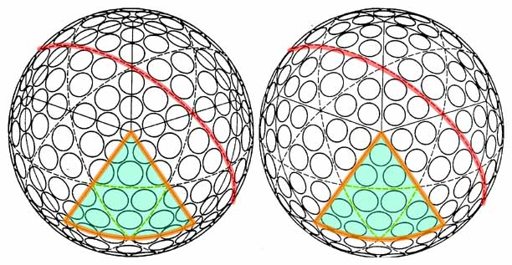
If you compare WA – Graduate Attributes and NBA- Program Outcomes, These are About the SAME
Actually, True The World Over
Notes:
WA defined the profile of the graduates by articulating precisely a series of attributes, and NBA’s Pos are derived from these attributes.

Slide 24
WA – Graduate Attributes and NBA- Program Outcomes
Washington Accord Attributes | NBA Program Outcomes.
1.Engineering knowledge, Apply knowledge of mathematics, science, engineering fundamentals and an engineering specialization to the solution of complex engineering problems. | 1.Engineering knowledge, Apply the knowledge of mathematics, science, engineering fundamentals, and engg. specialization to the solution of complex engineering problems
2. Problem Analysis, Identify, formulate, research literature and analyze complex engineering problems reaching substantiated conclusions using first principles of mathematics, natural sciences and engineering sciences | 2. Problem Analysis, Identify, formulate, research literature, and analyze engineering problems to arrive at substantiated conclusions using first principles of mathematics, natural, and engineering sciences.
Notes:
WA defined the profile of the graduates by articulating precisely a series of attributes, and NBA’s Pos are derived from these attributes.

Slide 25
Clearly, Outcomes have to be
(and Are) Measurable
“make sure”
Notes:
Term in an introductory slide

Slide 26
Let us take another Look at the Outcomes

Slide 27
Program Outcomes - POs
Have to be Understood
Some are difficult to Attain
Also, difficult to Assess and Evaluate
There is a need to reach out to Everyone on these Issues

Slide 28
Key Terms
Accreditation Criteria
Program Educational Objectives – PEO
Course Outcomes – CO
Program Outcomes – PO
Assessment
Evaluation

Slide 29
Accreditation is a Judgment on the Program- Acceptable/ Not Acceptable
Has to be Objective & Consistent Criteria
Notes:
To make consistent and objective we need criteria to base the judgment. It should not depend on who are the Evaluators.

Slide 30


How to make the judgment?
Criteria-Rule book
Evidence on Record
As dictated by the Accreditation Criteria and Evidence on record
Notes:
Criteria is your rule book. You examine evidence only in the light of these criteria and then arrive at a judgment. Why this slide? Because, your judgment has to be on the basis of criteria and on the evidence available. Not on any perceptions. This brings in uniformity. Does not depend upon the individual evaluator.

Slide 31

Evidence
"Not a particle of evidence, Pip," said Mr. Jaggers, shaking his head. "Take nothing on its looks; take everything on evidence. There's no better rule."
Notes:
What is true in life is also true for accreditation.

Slide 32
SAR-Evaluations – Major Factors
Vision and Mission & PEO
Curriculum & Teaching- Learning
{Program Outcomes (PO)
Course Outcomes (CO)}
Consistency and Interactions Amongst These- Matrices
Notes:
Correspondence matrices

Slide 33
Short Definitions of CO, PO
Program Outcomes- POs
These are knowledge and skill sets that the graduates have at the time of graduations**
Course Outcomes- COs
Again, these are knowledge and skills that are attained by the graduates in a course {Could be a part of a PO}
COs are mapped onto POs { CO-PO matrix}

Slide 34
Assessment
For Evaluators
It is one or more processes that identify, collect, and prepare data to evaluate the achievement of Program Outcomes and program educational objectives
Important for both, SAR and the Evaluators

Slide 35
Evaluation
For Evaluators
These are processes for interpreting the data and evidence accumulated through assessment practices.
Evaluation determines the extent to which POs or PEOs are being achieved, and results in decisions and actions to improve the program as also for accreditation.

Slide 36
Attainment of PO1 to PO4

Slide 37
Why place these four POs in one Basket?
The Statements show that one part {That of (complex) Engineering Problem CEP} is common to all.
Though, individually each PO deals with a different aspect of CEP. Recognizing this commonality makes the discussion easier.
Notes:
So, there will be many points that are to all; and then the differences.

Slide 38
The different aspects of CEP
Application of Mathematics and sciences- PO1
Identify and Research to Solve – PO 2
Design and Development of Solutions – PO 3
Conducting Investigations and Research PO 4

Slide 39
Choices – Not Easy {Hints Continued}
Qu. What are the available Choices?
{Open Ended}
Requires: Experience, Engineering Knowledge, Understanding, Ability to define and manage constraints that are Applicable, and manage these.
These make it a Complex Engineering Problem

Slide 40
Tier -1 and Tier-2
For tier 1 , (2) could read as- only skeletal details provided in the problem, and student is required make out the rest. Such a problem could require amongst others defining constraints in terms of power, cost, weight, life span, different engineering choices, etc. For such problems, there are, in all probability multiple valid solutions.
Difference between Tier-2 and Tier 1, in this respect, is in the degree of complexity and numbers

Slide 41
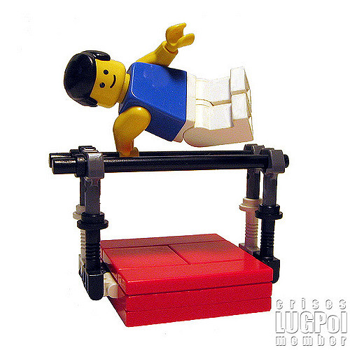
Difficult vs. Complex

Slide 42
According to the CEAB, a complex engineering problem is defined by the following characteristics:
1. It must require the application of in-depth knowledge
2. It must satisfy at least one of the following additional characteristics:
• involves wide-ranging or conflicting issues
• has no obvious solution such that originality is required
• involves infrequently encountered issues
• is outside accepted standards and codes
• involves diverse stakeholders and needs
• is posed at a high-level with many components or sub-problems

Slide 43
The Sequence
From Which CO?
From Which Course?
A Given PO
Look for Evidence In that Course!

Slide 44
Every Course Leads to Some Outcomes. All the courses must cover the stated list of outcomes. One way of verifying this to prepare a match matrix as shown below. In the table below * could also be a number- typically in (0,1) indicating level of attainment.
Course PO | PO 1 | PO 2 |  | PO 9
EE 111 | * |  | *
EE 212 |  | * | *
HS 101 |  | * |  | *
Notes:
There is considerable difference between planning of this matrix, and evaluation of it’s attainment.

Slide 45
Qu. Why is PO 1 needed?
Modern Engineering Practice requires a very good Understanding of Mathematics, Physics, and Basic Engineering Sciences.
Such an understanding helps in tackling problems encountered in professional practice as well as development tasks that have to be carried out.
PO 1 essentially proves these abilities.

Slide 46
The First Step
Towards Assessment: { We recognize that POs are attained through the COs. So we determine the corresponding set COs. These COs in turn lead us to courses - the places where we find information and evidences}
This step is pictured in the next slide. We will need the CO-PO matrix for this. It is there in the SAR

Slide 47
Assessment Procedure
Step 1- Collect information from question papers, assignments, tutorials, answer scripts, etc {Mostly in course files}
Step 2- SAR might also furnish projects {mini and major} and Lab work as evidence towards attainment
The two steps together give assessment.

Slide 48

Complex Engineering Problem
Cambridge Dictionary meaning of the word “Complex” –
Definition: 1. involving a lot of different but related parts
2. difficult to understand or find an answer to
We will spend a little extra time on it

Slide 49
Another (?) Example
Course is Electronic Circuits, CO: Apply Knowledge engineering specialization to the solution of complex engineering problems
Judgment needed:
(a) Is it a complex problem ?
(b) Does the solution require knowledge of engineering specialization?
Notes:
Here it knowledge of “engineering specialization”. COs can be many permutation combination. Not the entire PO may appear in a single CO.

Slide 50
A question as a Complex Engineering Problem
Design an amplifier using BJT(s). Given: Signal source: 500mV (peak to peak), impedance 100KΩ;
Load:1KΩ, Output required 1V (peak to peak)
Problem does not state:
(a) What amplifier configuration?
(b) Reasoning behind the choice
(c) What would be the typical device characteristics you visualize, etc
For Tier -2 such a question could appear in a home assignment. For Tier-1,it could be design & build
Notes:
This is hard core engineering.

Slide 51
Analysis of the question
The question does not state many aspects like:
What amplifier configuration would be good for the given situation?
Whether feedback should be applied?
Answers to these questions require, “knowledge of engineering specialization (Electronics)” {PO 1}
May be, also use of “Electronics Engineer’s Handbook”
Attainment to be determined as given earlier
Notes:
Student may use electronics handbook. Reach different parts of a PO in different ways.

Slide 52
For Evaluators
Could you set a CEP Exam question (If the time permits) in Your Domain?
It will allow us to enrich our content, and the consequent discussion will bring in greater clarity.

Slide 53
PO- Evaluation by Indirect Means
Feedback from the Students
After all they have undergone the Course

Slide 54
Assessment Format
Course EE 101 Course Title ___
Course Outcome - CO | Attainment Level Scale 1 - 5
CO 1 – (Statement)
CO 2 – (Statement)
CO 3 – (Statement)
CO 4 – (Statement)
CO 5 – (Statement)

Slide 55
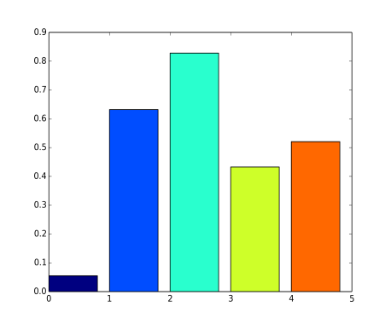

Format for Evaluation
Attain CO | 1 | 2 | 3 | 4 | 5
CO 1
CO 2
CO 3
CO 4
CO 5
Mean η, Std. Dev. σ, Median μ
Any suggestion for a metric? Please provide!

Slide 56
Presumption
Instructor has Explained the COs to the Students at the Start of the Course!
{To be verified by the Evaluators}

Slide 57
Projects and Assignments
Projects and Assignments can often lead to attainment of PO 1 and PO 2 and some other POs as well.
Assessment: In Project Reports, Project Labs., and in the associated Marking Schemes.
Evaluation will look for the following:

Slide 58
Evaluation of Projects
Evaluation of Project Topics
Method of Allotment (if any)
Progress Seminars (during project execution)- Records of these.
Evaluation of the state of the project in the final submission {This includes marking scheme used, level of completion, level of understanding in a study project, etc}

Slide 59
We look for evidence for all the POs (claimed in SAR) along with the bullets of the previous slide
Typically among the POs could be (Other than PO1 to PO4): PO5, PO7, PO9, and PO11.
Evidence for these POs could also be from Project assessment and Evaluation.
One needs take a holistic view in this evaluation.
This task can be a bit demanding
Notes:
Typically

Slide 60
Sample fourth year indicators for Problem analysis and Design*
Identifies problem, known and unknown information, uncertainties, and biases
Creates process for solving problem including justified approximations and assumptions
Selects and applies appropriate model and analysis to solve problems
Evaluates validity of results and model for error, uncertainty
Identify problem and constraints including health and safety risks, applicable standards, economic, environmental, cultural and societal considerations *From Queens University report, Canada

Slide 61
In Conclusion
OBE Approach is very promising.
But it calls for many changes in:
Teaching and Learning ways
Assessment and Evaluation Methodologies {By far the most demanding of Faculty}
Determination of the profile of the Graduates through PO attainment.
This was the proverbial “Tip of the iceberg”

Slide 62
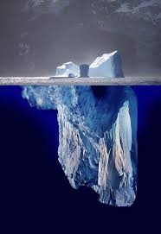
Thanks

Slide 63
A Question
>
R>0
C1
C2
Capacitors are of the same value, 1F; Initially, C1 is charged to V volts, and C2 is in a fully discharged state. The switch s closed at
t = 0. Determine the energy dissipated in R at t = infinity

