Slide 1

National Institutional Ranking Framework Ministry of Human Resource Development Government of India
NIRF Ranking 2019:
Preparedness of Pharmacy School
SVKM’S NMIMS, Mumbai

Slide 2
Overview
The National Institutional Ranking Framework (NIRF) was approved by the MHRD and launched by Honourable Minister of Human Resource Development on 29th September 2015.
This framework outlines a methodology to rank institutions across the country. The methodology draws from the overall recommendations broad understanding arrived at by a Core Committee set up by MHRD, to identify the broad parameters for ranking various universities and institutions. The parameters broadly cover
“Teaching, Learning and Resources,”
“Research and Professional Practice,”
“Graduation Outcomes,”
“Outreach and Inclusivity,” and
“Perception”.
India Rankings – 2018 based on this framework were released on 3rd April 2018.

Slide 31
Score Comparison of Top 13 Institutes
AIR | Institute | TLR | RPP | GO | OI | Perception | Overall Score
1 | Jamia Hamdard | 72.99 | 90.70 | 76.64 | 53.42 | 86.49 | 78.43
2 | Panjab University | 71.04 | 88.14 | 72.91 | 71.22 | 86.49 | 78.10
3 | National Institute of Pharmaceutical Education and Research | 73.50 | 69.00 | 82.27 | 59.19 | 94.74 | 74.59
4 | Institute of Chemical Technology | 78.95 | 69.55 | 82.04 | 58.48 | 75.22 | 74.32
5 | Birla Institute of Technology & Science | 79.85 | 60.57 | 66.76 | 68.53 | 67.60 | 69.09
6 | National Institute of Pharmaceutical Education and Research | 79.95 | 55.53 | 83.48 | 65.19 | 44.17 | 68.29
7 | Manipal College of Pharmaceutical Sciences | 77.00 | 46.32 | 70.26 | 70.07 | 91.50 | 67.20
8 | JSS College of Pharmacy | 75.70 | 24.45 | 84.20 | 73.49 | 89.43 | 63.17
9 | National Institute of Pharmaceutical Education and Research | 87.61 | 31.66 | 74.53 | 72.08 | 42.02 | 62.10
10 | JSS College of Pharmacy | 68.48 | 31.43 | 72.43 | 68.66 | 100.00 | 61.33
11 | Birla Institute of Technology | 71.46 | 47.17 | 55.06 | 52.45 | 73.18 | 59.16
12 | Annamalai University | 68.78 | 58.94 | 51.58 | 37.83 | 53.52 | 57.76
13 | SVKM`s Narsee Monjee Institute of Management Studies | 79.90 | 35.49 | 75.21 | 62.32 | 15.06 | 57.40
Notes:
Done

Slide 32
Performance of SPPSPTM @ 2019 Ranking
Parameters | AIR | Score | Top 3 Institute | Score of Top 3
TLR | 3rd | 79.90 | National Institute of Pharmaceutical Education and Research | 87.61
 |  |  | National Institute of Pharmaceutical Education and Research | 79.95
 |  |  | SVKM`s Narsee Monjee Institute of Management Studies | 79.9
RPP | 15th | 35.49 | Jamia Hamdard | 90.7
 |  |  | Panjab University | 88.14
 |  |  | Institute of Chemical Technology | 69.55
GO | 7th | 75.21 | JSS College of Pharmacy | 84.2
 |  |  | National Institute of Pharmaceutical Education and Research | 83.48
 |  |  | Banasthali Vidyapith | 83.03
OI | 10th | 62.32 | Banasthali Vidyapith | 74.54
 |  |  | JSS College of Pharmacy | 73.49
 |  |  | National Institute of Pharmaceutical Education and Research | 72.08
Perception | 60th | 15.06 | JSS College of Pharmacy | 100
 |  |  | National Institute of Pharmaceutical Education and Research | 94.74
 |  |  | Manipal College of Pharmaceutical Sciences | 91.5
Notes:
Done

Slide 33
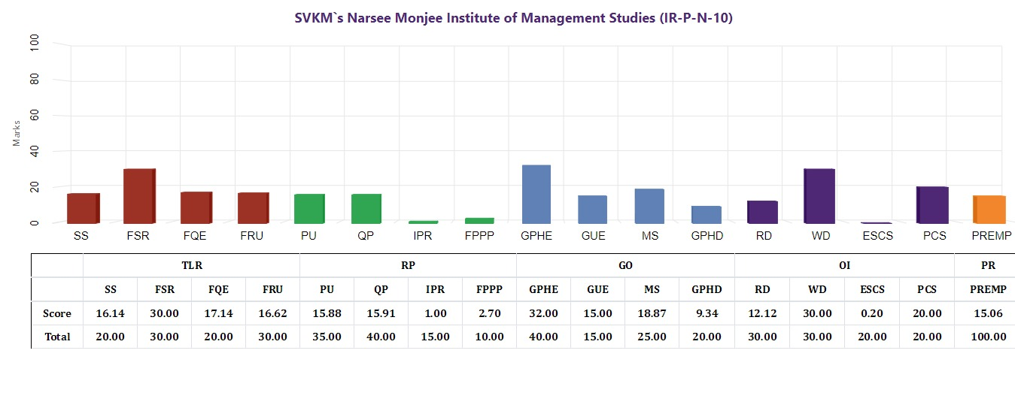
Performance of SPPSPTM @ 2019 Ranking
Notes:
Done

Slide 34
TLR Data Comparison of 2018 and 2019 Ranking
 | Teaching, Learning and Resources (TLR)
 | SS | FSR | FQE | FRU | Total
Expected Score 2020
Actual Score 2019 | 16.14 | 30.00 | 17.14 | 16.62 | 79.90
Expected Score 2019 | 18.53 | 30.00 | 18.66 | 14.40 | 81.59
Total | 20.00 | 30.00 | 20.00 | 30.00 | 100.00
SS: Student Strength including Doctoral Students
FSR: Faculty-student Ratio with emphasis on permanent faculty
FQE: Combined metric for Faculty with PhD and Experience
FRU: Financial Resources and their Utilization
Notes:
Done

Slide 35
RPP Score Comparison of Top 10 Institutes with their data (2018 Ranking)
Rank RPP | Institute | RPP Score | Scopus Publications | Citations | Grants | Patents Published
1 | Jamia Humdard | 85.63 | 492 | 2794 | 8.5 Cr | 12
2 | Panjab University | 82.97 | 313 | 2025 | 8 Cr | 33
3 | NIPER Mohali | 78.13 | 206 | 1603 | 6 Cr | 43
4 | ICT, Mumbai | 71.20 | 147 | 1347 | 7 Cr | 35
5 | BITS Pilani | 64.98 | 242 | 1589 | 3.5 Cr | 10
6 | ISF Moga | 63.41 | 213 | 2024 | 3 Cr | 7
7 | NIPER Hyderabad | 58.75 | 150 | 1298 | 2 Cr | 0
8 | Punjabi University | 58.53 | 162 | 1272 | 1.5 Cr | 3
9 | SRM University | 50.98 | 142 | 231 | 1.2 Cr | 7
10 | BIT Rachi | 48.43 | 212 | 692 | 1.0 Cr | 6
23 | SPPSPTM | 30.96 | 124 | 291 | 87 Lakh | 0
 | SPPSPTM (2019 Ranking) |  | 148 | 375 | 1.47 Cr | 8
Notes:
Data not available on nirf portal

Slide 36
RPP Score Comparison of 2018, 2019 Ranking
 | Research and Professional Practice (RPP)
 | PU | QP | IPR | FPPP | Total
Actual Score 2019 | 15.88 | 15.91 | 1.00 | 2.70 | 35.49
Expected Score 2019 | -- | -- | -- | -- | 40.00
Actual Score 2018 | 15.44 | 12.78 | 0.00 | 2.74 | 30.96
Predicted Score 2018 | -- | -- | -- | -- | 25.00
Total | 35.00 | 40.00 | 15.00 | 10.00 | 100.00
PU: Combined metric for Publications
QP: Combined metric for Quality Publications
IPR: Patents published and granted
FPPP: Footprint of projects, Professional Practice and Executive development program
Notes:
Done

Slide 37
RPP Data Comparison of 2018 and 2019 Ranking
 | 2017-18 | 2016-17 | 2015-16 | 2014-15
No. of Publications |  | Web of Science: 66 (citations-196) Scopus Index: 124 (citations-291)
 | Web of Science: 82 (citations-224) Scopus Index: 148 (citations-375)
Research grants received (In Rs.) | 1,47,69,408 | 87,35,310 | 55,71,110 | 49,32,168
Consultancy (In Rs.) | 4,00,000 | 4,00,000 | 12,00,000 | 10,00,000
No. of Patents (Published) | 5 | 2 | 1 | 1
No. of Patents (Granted) | 0 | 0 | 1 | 0

Slide 38
GO Score Comparison of 2018 and 2019 Ranking
 | Graduate Outcomes (GO)
 | GPHE | GUE | GMS | GPHD | Total
Actual Score 2019 | 32.00 | 15.00 | 18.87 | 9.34 | 75.21
Expected Score 2019 | 27.47 | 15.00 | 25.00 | 15.83 | 83.30
Actual Score 2018 | 36.19 | 15.00 | 22.18 | 8.94 | 82.30
Predicted Score 2018 | 36.38 | 15.00 | 17.66 | 7.60 | 76.64
Total | 40.00 | 15.00 | 25.00 | 20.00 | 100.00
GPHE: Combined metric for placement, higher studies and entrepreneurship
GUE: Metric for University examination
GMS: Group median salary
GPHD: Metric for number of Ph. D students graduated
Notes:
Done

Slide 39
GO Data Comparison of 2018 and 2019 Ranking
B. Pharm – 4 year UG Program | No. of Students
 | 2017-18 | 2016-17 | 2015-16 | 2014-15
Batch Size | 20 | 20 | 20 | 23
Placed | 4 | 4 | 5 | 3
Higher studies | 15 | 16 | 15 | 20
Entrepreneurship | 1 | 0 | 0 | 0
Median salary (In Lakhs) | 3,30,000 | 5,50,000 | 3,50,000 | 3,50,000
No. of Recruiters | 4 | 2 | 3 | 2

Slide 40
GO Data Comparison of 2018 and 2019 Ranking
M. Pharm + MBA – 3 year PG Program | No. of Students
 | 2017-18 | 2016-17 | 2015-16 | 2014-15
Batch Size | 27 | 30 | 40 | 39
Placed | 24 | 22 | 36 | 35
Higher studies | 1 | 2 | 1 | 1
Entrepreneurship | 0 | 2 | 3 | 2
Median salary (In Lakhs) | 5,75,000 | 5,50,000 | 6,00,000 | 5,50,000
No. of Recruiters | 16 | 10 | 16 | 15

Slide 41
GO Data Comparison of 2018 and 2019 Ranking
B. Pharm +MBA – 5 year UG Program | No. of Students
 | 2017-18 | 2016-17 | 2015-16 | 2014-15
Batch Size | 52 | 55 | 56 | 54
Placed | 35 | 42 | 42 | 40
Higher studies | 4 | 2 | 4 | 6
Entrepreneurship | 4 | 2 | 2 | 4
Median salary (In Lakhs) | 5,50,000 | 5,50,000 | 5,90,000 | 5,50,000
No. of Recruiters | 25 | 22 | 18 | 20

Slide 42
OI Data Comparison of 2018 and 2019 Ranking
 | Outcome and Inclusivity (OI)
 | RD | WD | ESCS | PCS | Total
Actual Score 2019 | 12.12 | 30.00 | 0.20 | 20.00 | 62.32
Expected Score 2019 | 8.73 | 25.00 | 13.97 | 20.00 | 67.70
Actual Score 2018 | 9.46 | 30.00 | 0.30 | 20.00 | 59.76
Predicted Score 2018 | 7.69 | 25.00 | 15.39 | 20.00 | 68.08
Total | 30.00 | 30.00 | 20.00 | 20.00 | 100.00
RD: Region Diversity
WD: Woman diversity
ESCS: Economically and socially challenged students
PCS: Facilities for physically challenged students
Notes:
Done

Slide 43
Perception Data Comparison of 2018 and 2019 Ranking
 | Perception
 | PREMP | Total
Actual Score 2019 | 15.06 | 15.06
Expected Score 2019 | 40.00* | 40.00*
Actual Score 2018 | 32.43 | 32.43
Predicted Score 2018 | 40.00 | 40.00
Total | 100.00 | 100.00
* Predicted
PREMP: Peer Perception: Employers and Research Investors
Notes:
Done

Slide 44
Data Comparison of 2018 and Prediction of 2019 Ranking
AIR |  | TLR | RPP | GO | OI | Perception | Overall Score
AIR 13 | Score 2019 | 79.90 | 35.49 | 75.21 | 62.32 | 15.06 | 57.40
Expected in Top 10 | Expected Score 2019 | 81.59 | 40.00 | 83.30 | 67.70 | 40.00 (assumed) | 63.90
AIR 09 | Score 2018 | 75.46 | 30.96 | 82.30 | 59.76 | 32.43 | 57.61
Predicted in Top 15 | Predicted Score 2018 | 81.86 | 25.00 | 76.64 | 68.08 | 40.00 | 58.19
Notes:
Done . Do not have expected in 2020

Slide 45


