Slide 1


PRESENTED BY
Dr. Sohan Chitlange
Principal
Dr. D. Y. Patil Institute of Pharmaceutical Sciences and Research, Pimpri, Pune - 411 018
eMail : principal.pharmacy@dypvp.edu.in

Slide 2
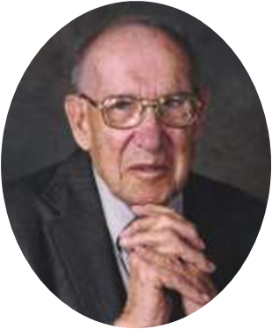
Ranking does not confer privilege or give power, it imposes responsibility”….
Peter Ducker
Father of Management Thinking

Slide 3
WHAT IS NIRF
5
Parameters of NIRF Ranking
This is an umbrella framework that constitutes a methodology to rank higher education institutes across the country. It ranks institutes based on five parameters.
1
Teaching Learning and Resources
2
Research and Professional Practice
3
Graduation Outcome
4
Outreach and Inclusivity
5
Perception

Slide 4
These parameters have a certain weightage. There are also a few sub-parameters.
Majority parameters are calculated based upon the data for previous 3 years.
These parameters have the following marks and weightages:
Sr. | Parameter | Marks | Weightage
1 | Teaching, Learning & Resources (TLR) | 100 | 0.3
2 | Research and Professional Practice (RP) | 100 | 0.3
3 | Graduation Outcomes (GO) | 100 | 0.2
4 | Outreach and Inclusivity (OI) | 100 | 0.1
5 | Perception | 100 | 0.1

Slide 5
TEACHING AND LEARNING RESOURCES (TLR)
100 MARKS (0.3 WEIGHTAGE)
This parameter deals with the basic activities related to any place of learning. It deals with the teaching and learning resources available to the institute and how they are being utilized.
Teaching Learning and Resources
04 Sub Parameters
1
Student Strength Including Ph.D Students
2
Faculty Student Ratio with Emphasis on Permanent Faculty
3
Combined Metric for Faculty with Ph.D ( or Equivalent ) and Experienced
4
Financial Resources and Their Utilization

Slide 6
STUDENT STRENGTH INCLUDING PHD STUDENTS :
(SS) 20 MARKS
This is calculated based on the total number of students enrolled in the UG and PG programmes in the institute and the number of doctoral students in the institute
SS = f(NT, NE) × 15 + f(NP) × 5
The functions f(NT ,NE) and f(Np) are functions to be determined by NIRF.
NT = Total sanctioned approved intake in the institution (UG+PG)
NE = Total number of students enrolled in the institution (UG+PG)
Np = Total number of students enrolled for the doctoral program till previous academic year.
The ratio i.e function is 1 if the number of admission is equal to no of approved intake

Slide 7
II) FACULTY-STUDENT RATIO WITH EMPHASIS ON PERMANENT FACULTY (FSR)- 30 MARKS
It is calculated based on the total number of students, enrolled in all programmes, and the number of permanent/regular faculty in the institute.
The optimum expected ratio is 1:15 ( 1 teacher for every 15 students) to get maximum marks.
For ratios lesser than 1:50, FSR will be set to zero.
FSR = 30 × [15 × (F/N)]
N = NT+ Np (Total no of UG, PG and PhD students of all courses)
F = Full time regular faculty in the institution in the previous year.

Slide 8
III) COMBINED METRIC FOR FACULTY WITH PHD (FQ) (OR EQUIVALENT) AND EXPERIENCE (FE) (FQE)-20 MARKS
This is calculated based on the percentage of faculty with a PhD or an equivalent degree and the years of experience they have.
FQ - 10 Marks
FE - 10 Marks
FQ: Thumb rule is that higher the no of faculty members with PhD qualification higher will be the marks
FE: To score a maximum of 10 marks, each among one third of total faculty should be with experience up to 8 years, between 8+ to 15 years and greater than 15 years respectively.

Slide 9
COMBINED METRIC FOR FACULTY WITH PHD (FQ) (OR EQUIVALENT) AND EXPERIENCE (FE) (FQE)-20 MARKS
FQE = FQ + FE
FQ = 10 × ( FRA / 95 ) , FRA < 95%
FQ = 10, FRA ≥ 95%. i.e if 95% faculty members having PhD degree marks=10
FE = 3 (3F1, 1) + 3 (3F2, 1) + 4 (3F3, 1)
F1 = Fraction with Experience up to 8 years;
F2 = Fraction with Experience between 8+ to 15 years;
F3 = Fraction with Experience > 15 years.
Rationale: Full marks for a ratio of 1:1:1

Slide 10
IV) FINANCIAL RESOURCES AND UTILIZATION (FRU): 30 MARKS
It has following sub parameters which has to be put in the formula and marks will be calculated;
FRU = 7.5 × f(BC ) + 22.5 × f(BO)
BC: Average Annual Capital Expenditure per student (25%)
BO: Average Annual Operational (or Recurring) Expenditure(75%)

Slide 11
SUMMARY & QUALITY ENHANCEMENT NOTES
Sr. | Parameter and max marks | Quality Enhancement notes
01 | Student Strength (SS) (20 Marks) | To get maximum marks student admission should equal to approved intake. If no doctoral program 05 marks set to be zero.
02 | Faculty Student Ratio (FSR) (30 Marks) | 1:15 ratio for SFR needs to be maintained Better than this (eg:1:14;1:13 fetch maximum marks)
03 | Combined matric for faculty with PhD and Experience (FQE) (20 Marks) | Maximum faculty members are with PhD qualification Motivate faculty members for PhD degree. Also maintain the cadre ratio as 1:1:1 in terms of experience. (Many private institutes looses marks here)
04 | Financial resources and utilisation (30Marks) | To secure maximum marks major expenditure should be on BO (75% of total budget)(Operational budget includes salary and other academic expenditures); For BC (Capital expenditure)should be limit to 25%

Slide 12
2. Research and Professional Practice (RP) 100 marks (0.3 weightage)
This parameter measures the quality of research being carried out
The following are the sub-parameters based on which RP is calculated:
4
Sub Parameters of Research and Professional Practice
1
Combined Metric for Publications
2
Combined Metric for Quality of Publications
3
IPR and Patents : Patents Published / Granted
4
Footprint of Projects, Professional Practice

Slide 13
(I) Combined metric for Publications (PU): 35 marks
This is calculated based on the total number of publications reported in Web of Science, Scopus, divided by the nominal number faculty calculated on the basis FSR.
The data will be fetched through Third Party Sources such as Scopus/WoS
The publications indexed in Scopus and WoS may only consider
PU = 35 × f(P/FRQ)
F is the function calculated by NIRF (Based on top ranked institute)
• P is weighted number of publications as ascertained from suitable third party sources.
• FRQ is total no of faculty members of your institute

Slide 14
II) Combined metric for Quality of Publications (QP): 40 Marks
These metrics judge the quality of publications.
Having two major sub parameters as
Total no of citation received (CC) – 20 marks
Number of publications in the top 25 percentile averaged- 20 marks
QP = 20 × f (CC/FRQ) + 20× f (TOP25P/P)
Here CC is Total Citation Count
FRQ is the FSR of 1:15 or the available faculty in the institution.
TOP25P: Number of citations in top 25 percentile averaged
P is as computed for PU. (No of publications)

Slide 15
III) IPR AND PATENTS: PATENTS PUBLISHED, GRANTED (IPR): 15 MARKS
Having two parameters
IPG: No of patents granted: 10 marks
IPP: No of patents published: 05 Marks
For filing of patent no weightage taken into account so merely filing a patent/s will not help to improve the performance.
IPR = IPG + IPP
IPG= 10X f(PG)
PG is the number of patents granted
IPP = 5 × f ( PP )
PP: No. of patents published

Slide 16
IV) FOOTPRINT OF PROJECTS AND PROFESSIONAL PRACTICE (FPPP): 10 MARKS
It is calculated based on;
The average research funding earning received at the institute level
Average consultancy funding earnings at institute level
Note : The funding and consultancy from sister institution NO weightage will be given
FPPP = FPR + FPC
FPR = 7.5 × f (RF)
RF is average annual research funding earnings (amount actually received in rupees) per faculty at institute level
FPC = 2.5 × f (CF)
CF is average annual consultancy amount (amount actually received in rupees) per faculty at institute level

Slide 17
SUMMARY & QUALITY ENHANCEMENT NOTES
Sr. | Parameter and marks | Quality Enhancement notes
01 | Combined metric for publication (PU) 35 Marks | Need to Publish in Scopus/WoS indexed Journals only. Contribution of each faculty member is needed Research facilities of institute needs to be uplifted
02 | Combined matric for quality of publication (QP) 40 marks | Increase the Impact of Your Manuscript Explain Why Your Research Matters Promote Your Work through Social Media. Describe the Evolution of Your Research in review Cite, your colleagues, peers in your field and You will be Cited

Slide 18
SUMMARY & QUALITY ENHANCEMENT NOTES
Sr. | Parameter | Quality Enhancement notes
03 | IPR and Patents (IPR) 15 Marks | Good quality research should be carried out with some novelty so that it can have patentability value. Efforts towards industrial collaboration for joint research projects/ sponsored research projects are needed.
04 | Footprint of projects and professional practice (FPPP) 10 marks | Every faculty member should be inculcated with the research aptitude Explore the full range of grant opportunities in your area Put your research question into context Apply without fear of failure The academic structure of the institute should be upgraded to fetch consultancy and advisory services. Use digital platforms to showcase your faculty expertise and available facilities of research.

Slide 19
GRADUATION OUTCOME (GO): 100 MARKS (0.2 WEIGHTAGE)
4
Sub Parameters of Graduation Outcome
This parameter judges the ultimate goal of students, graduation.
1
Combined Metric for Placement, Higher Studies and Entrepreneurship
2
Metric for University Examinations
3
Median Salary
4
Metric for Number of Ph.D. Students Graduated

Slide 20
Combined Metric for Placement, Higher Studies (GPH): 40 marks
It is calculated based on;
The percentage of graduating students placed through campus placement
The number of graduating students ( both UG and PG) selected for higher education
GPH = 40 × (Np/100 +Nhs/100)
Np = % of graduating students (in UG/PG programs) placed in the previous three years.
Nhs = % of graduating students (in UG/ PG programs) who have been selected for higher studies in the previous three years.

Slide 21
METRIC FOR UNIVERSITY EXAMINATIONS (GUE): 15 MARKS
This is the number of students as a fraction of the approved intake who have passed the university exam within the stipulated time for the course they had enrolled in.
GUE = 15 × min [(Ng/80), 1]
Ng is the percentage of Students (as a fraction of the approved intake)
If 80 % of students passed in the stipulated time then the value comes to 1.

Slide 22
III) MEDIAN SALARY(GMS) : 25 MARKS
It is the median salary of graduates who have passed from the institution.
GMS = 25 × f (MS)
MS = median salary of graduates (in UG /PG programs) in the previous three years from an institution.

Slide 23
IV). Metric for Number of Ph.D. Students Graduated (GPHD): 20 Marks
It is the average number of PhD students who have graduated from your institution.
GPHD = 20 × f(Nphd)
Nphd = Average no. of Ph.D. students graduated (awarded Ph.D.) over the previous 03 years.

Slide 24
SUMMARY & QUALITY ENHANCEMENT NOTES
Sr. | Parameter and maximum marks | Quality Enhancement notes
01 | Combine matrix for Placement and Higher Studies (GPH) 40 marks | Train students to sharpen employability skills so that placement will get improved. Guest Lectures MoU’s with companies for placement Development of specially designed modules for placements Make digital presence of your institutions. Also, motivate the students to opt for the higher studies. Work for overall development of students to excel.
02 | Metric for university Examinations (GUE) 15 marks | Teach well. Identify slow learners and advance learners Plan your curriculum delivery as per the need of the students. Arrange mentoring sessions

Slide 25
03 | Median Salary (GMS) 25 marks | If you work well in GPH more number of companies will be visited to your campus for placement and also offer jobs with notable packages.
04 | Metric for PhD students gratuated (GPHD) 20 marks | This point is applicable only when your institution is having research centre. More number of PhD graduation will improve your RP parameter too.

Slide 26
4. Outreach and Inclusivity (OI): 100 marks
This is the parameter that deals with the representation of women, marginalized and minorities in the institution.
4
Sub Parameters of Outreach and Inclusivity
1
% Students from Other State / Countries
2
% of Women
3
Economically and Socially Challenged Students
4
Facilities for Physically Challenged Students

Slide 27
I) Percentage Students from other states/ countries (Region Diversity RD) 30 marks
This is calculated by the addition fraction of total students from other states and the fraction of total students from other countries.
RD = 25 × fraction of total students enrolled from other states + 5 × fraction of students enrolled from other countries

Slide 28
II) Percentage of Women (Women Diversity WD) 30 marks
It consist of -
% of Woman students ( NWS ) - 15 marks
% of Woman faculty members ( NWF ) - 15 marks
The ideal expectation to score maximum WD is 50% women students, 20% women faculty
WD = 15 × (NWS/50) + 15 × (NWF/20)
• NWS are the percentage of Women students.
• NWF are the percentage of Women Faculty including the women members in senior administrative positions, such as Heads of Departments, Deans or Institute Heads.

Slide 29
(III) Economically and Socially Challenged Students (ESCS) 20
marks
It is the percentage of economically and socially challenged students, ideally, it should be 50% of economically and socially challenged students to score maximum marks.

Slide 30
(IV) Facilities for Physically Challenged Students (PCS) 20 marks
The institute will score full marks if it provides all facilities for physically challenged students
PCS = 20 marks
If the Institute provides full facilities for physically challenged students, as outlined.
Else, in proportion to facilities marks will be calculated as -
If facilities available in more than 80% of building then 20 marks
if in 60% of building then 15 marks

Slide 31
SUMMARY & QUALITY ENHANCEMENT NOTES
Sr. | Parameter | Quality Enhancement notes
01 | Region Diversity (RD) 30 marks | More no. of students from other states more will be the marks. Digital presence of your institution to attract other state students If your institution is having PIO/foreign national quota you can secure maximum marks here.
02 | Woman Diversity (WD) 30 Marks | More no of woman students and faculty, higher will be the marks.
03 | Economically and socially challenged students (ESCS) (20 marks) | Expectation: 50% economically and socially challenged students should be admitted to score maximum marks.
04 | Facilities for Physically challenged students (PCS ) 20 marks | To secure maximum marks 80% of building having PCS facilities like rams, lift, Disabled friendly washrooms, Screen reading software, mechanized equipments etc.
 | Total

Slide 32
5. Perception (PR): 100 marks (01 weightage)
This parameter judges the overall perception of the institute by industry, peers and researchers.
This is to be done through a survey conducted over a large category of Employers, Professionals from Reputed Organizations and a large category of academics to ascertain their preference for graduates of different institutions.
Comprehensive list will be prepared taking into account various sectors, regions, etc.
These lists are updated periodically

Slide 33
HOW TO IMPROVE PR SCORE :
Building Public relationship department for your institution -
The responsibility of this dept. is to communicate to the world what the institution, its alumni, its professors are doing. Their achievements, their work and the impact they have had. This can be done via any medium whether it is social media, snail mail, TV, radio or print. Whatever works and fits the institutions budget.
Building a Milestone Campaign -
For many established colleges, advertising feels embarrassing as it looks like a call for admissions. However, with the right partners you can build a campaign around milestones that your college may be reaching and use it as an excuse to celebrate and inform.

Slide 34
Building your digital presence
Your digital presence plays a vital role in building your perception. Having an updated website and social media platform which is handled by a dedicated team / agency can help you improve your perception, specially with the younger audience.

Slide 35
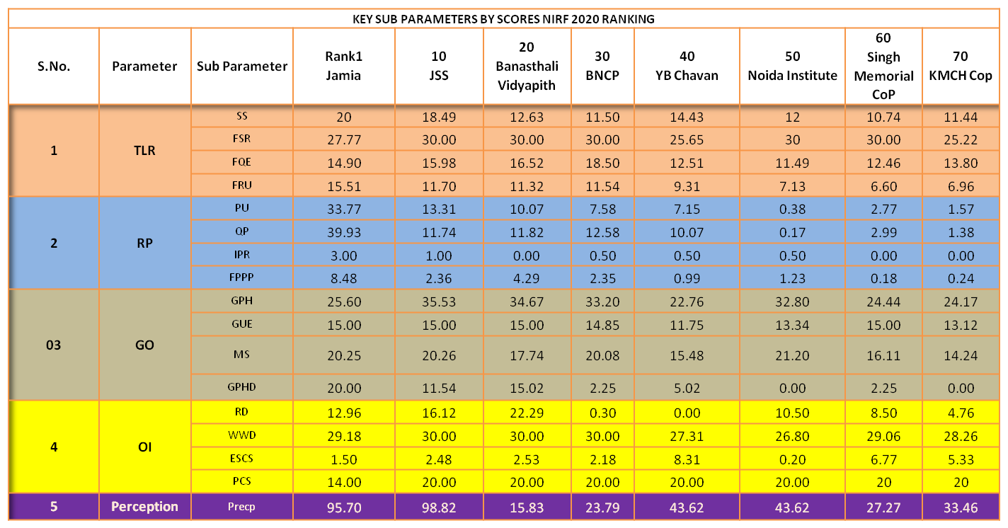

Slide 36

Pete Sampras
American tennis player

Slide 37


