Slide 1

NIRF - Future Challenges to Higher Educational Institutions in India
Presented By
Dr. Yajulu Medury Vice Chancellor

Slide 2
NIRF Parameters
Teaching, Learning & Resources
Student strength including Doctoral students
Faculty-student ratio with emphasis on permanent faculty
Combined metric for faculty with PhD (or equivalent) and experience
Financial Resources and their utilisation
Research and Professional Practice
Combined metric for publications
Combined metric for quality of publications
IPR and Patents: published and granted
Footprint of projects and professional practice

Slide 3
NIRF Parameters
Graduation outcomes
Metric for university examinations
Metric for number of Ph.D. students graduated
Outreach and Inclusivity
Percentage of students from other states/countries
Percentage of women
Economically and socially challenged students
Facilities for physically challenged students
Peer Perception
Academic Peers and Employers

Slide 4
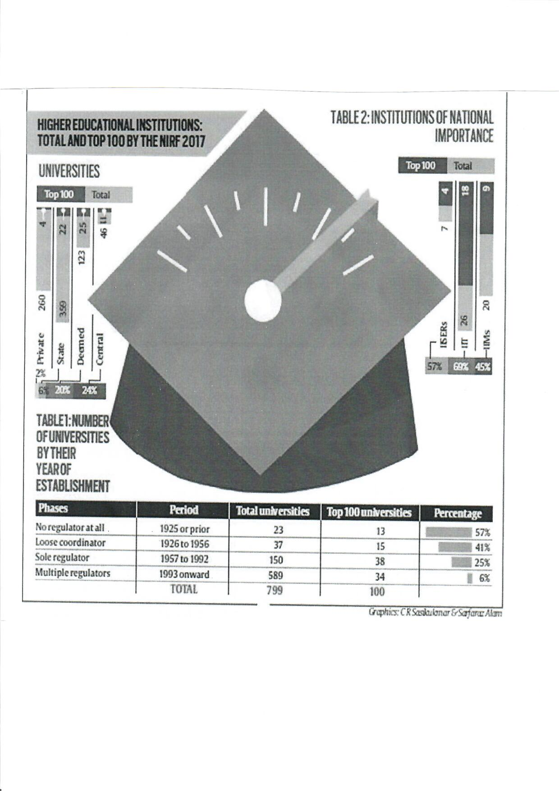
Higher Education & NIRF

Slide 5
Showcase the quality of our top institutions
A good Indian ranking will spur the competition to get better
Rankings are useful information for the stake holders

Slide 6
Higher Education Stakeholders
Faculty / Non-faculty
INTERNAL
ACADEMIC/
RESEARCH
Academic & research Bodies etc
University Based Stakeholders (VC etc)
STUDENT BASED
LOCAL ETC
OTHER INDIRECT NATIONAL
Students / Parents / Student Bodies etc
Geographical / Locality Stakeholders
Media / NGOs / Employers etc
National – Government, Partner Institutes etc

Slide 7
Institutions to take rankings seriously
Information available can be used by students and parents to take admission decisions
Discipline based ranking does not help beyond a point
look at programs more deeply
courses on offer
program flexibility
culture and environment

Slide 8
Ranking criteria created by
Created by academics – so we could see a bias
Education quality important
Weightage to post-program outcomes (such as GATE etc)
Number of PhD faculty
Inclusiveness

Slide 9
Proxy Metrics Misleading
Metrics account for
graduation rate
placement rate
Inclusion
research
But do they give an idea of what a students has actually learnt?

Slide 10
Dangers of Losing out
“The Cobra Effect occurs when an attempted solution to a problem makes the problem worse”
- Cobra Effect - Wikipedia

Slide 11
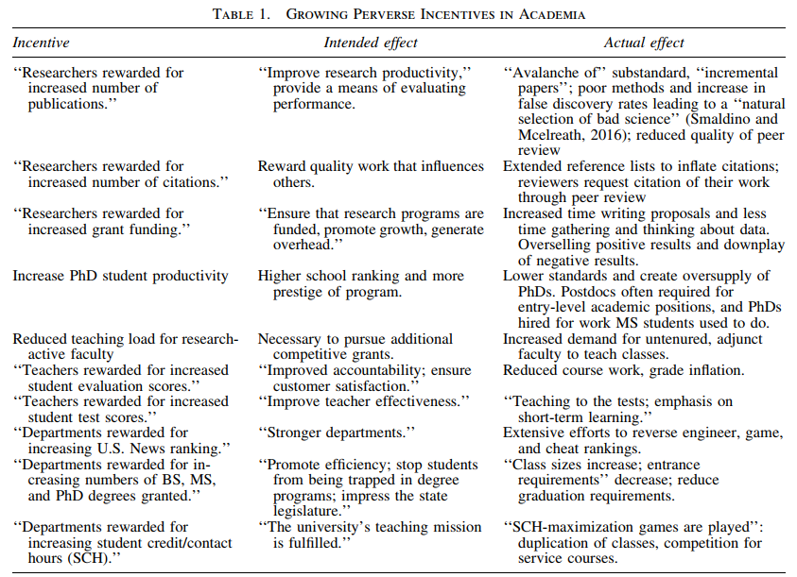
NIRF – Academic Incentives

Slide 12
One framework does not fit all
“The more any quantitative social indicator is used for social decision-making, the more subject it will be to corruption practices and the more apt it will be to distort and corrupt the social processes it is intended to monitor”
- Campbell’s Law

Slide 13
Sensible Advice?
“Rate, don’t rank, academic institutions”
- Professor Ashish Nanda (IIM Ahmedabad)

Slide 14
So what’s the way forward?
Evaluating HE institutions and publicizing how they stand on various criteria useful
Reliable, independent evaluation socially beneficial
Academic institutions should be measured against yadsticks and not against one another (?)

Slide 15
Thank You
COLLEGIATE EDUCATION & TECHNICAL EDUCATION DEPARTMENT, GOVERNMENT OF TELANGANA
KAB EDUCATIONAL CONSULTANTS
INSTITUTE FOR ACADEMIC EXCELLENCE

