Slide 1
Over view of Drive Test
Vinay kumar.M,
DT Engineer,

Slide 2
Drive Test
What is Drive Test ?
Drive Test is a most common and may be the best way to analyze network performance by means of coverage evaluation ,network capacity and call quality.

Slide 3
Why we are conducting the Drive Test Drive test is performed to verify if the site is ON-AIR or NOT. To check the Physical verification Types of antenna Signaling strength. Coverage area. Signal quality. Data transferring speed. Coverage capacity.

Slide 4
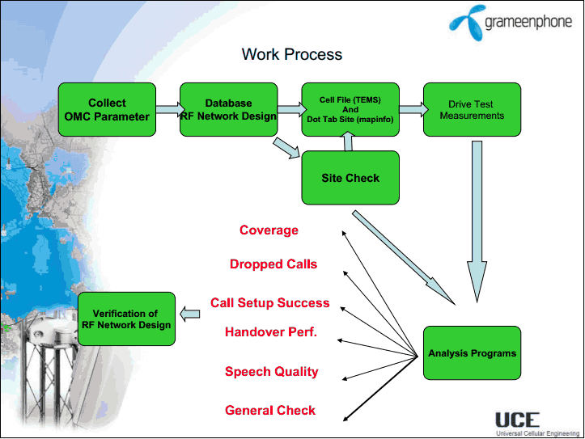

Slide 5
Drive Test Tool
GPRS
GSM TEST MOBILE
LAPTOP
POST PROCESSING ANALYSIS SOFTWARE

Slide 6
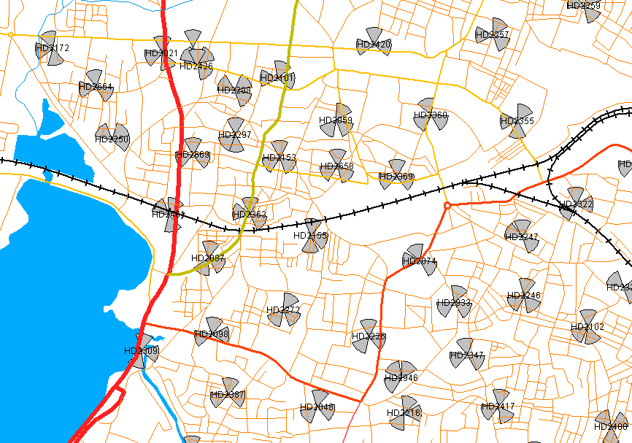
Over view of site’s

Slide 7
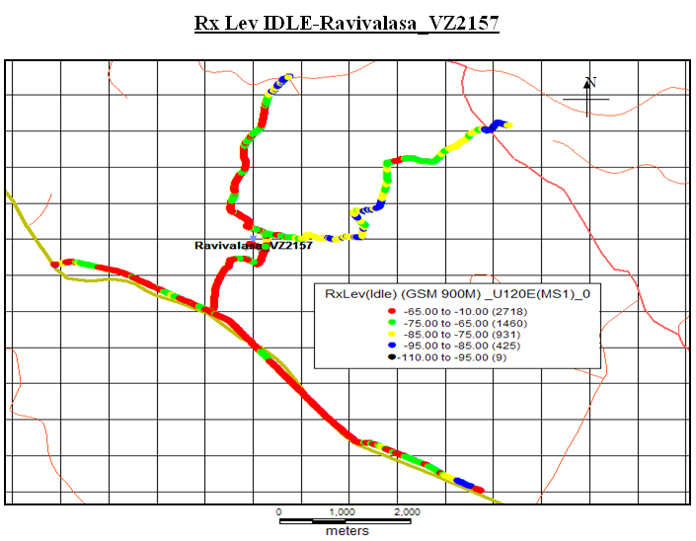
After conducting drive

Slide 8
Output of Drive Test tells you about:- Unsuccessful calls. Dropped calls. Coverage Poor received quality Hand over indication Hand over failure. Failure signaling message

Slide 9
THANK YOU

