Slide 1
HSIR13 INDUSTRIAL ECONOMICS AND FOREIGN TRADE

Slide 2
Course Objectives
To provide a thorough understanding of the principles of economics that apply to the decisions of individuals and the application of these principles to the world around them and a framework for consistent reasoning about international flows of goods, factors of production, and financial assets, and trade policy.

Slide 3
Course Content
Demand Analysis and Forecasting
Production, cost and Market Structure
Types, Location, Efficiency and Finance
Introduction to International Trade
Terms of trade
Free Trade, Protection and Tariffs, Balance of Payments
Regional Economic Groupings and International Institutions

Slide 4
The Economic Way of Thinking

Slide 5
Contents
What economics is about?
What is managerial economics?
Economic concepts, theories and tools that contribute managerial economics
How economics can be applied to managerial decision making?
Nature and scope of managerial economics

Slide 6
What is Economics??
The word economics comes from the Greek word ‘oikonomia’, which means “household management”.
Man is a bundle of desires. Goods and services satisfy these wants. But almost all the goods are scarce.
To produce goods, factors of production are needed and these are all scarce
Economics – the study of how society manages its scarce resources. ie,.,the study of how individuals and societies make decisions about ways to use scarce resources to fulfill wants and needs.
Economics is ‘an inquiry into the nature and causes of wealth of nations’ (Adam Smith, 1976)
Economics is the social science that studies economic behavior of the people, the individuals, households, firms and government.

Slide 7
Foundations of Economics- Major Economic Problem
Scarcity and Choice
The excess of wants resulting from having limited resources (land, labor, capital and entrepreneurs) in satisfying the endless wants of people.
It is a universal problem for societies – it is not limited to poor countries.
To the economist, all goods and services that have a price are relatively scarce. This means that they are scarce relative to people’s demand for them.

Slide 8
The Economic Problem
Because economic resources are limited, every society must answer 3 economic questions…..

Slide 9
What goods and services should be produced?
What to Produce?
What should our society produce to satisfy our needs and wants?
Because of our limited resources, each production decision that a society makes comes at an opportunity cost.

Slide 10
How should these goods and services be produced?
How to Produce?
All things produced require land labor and capital
How should they be combined to produce different goods and services?

Slide 11
Who consumes these goods and services?
Whom to produce?
Who gets to drive luxury cars and who can only afford to ride the bus?
Societies must decide how to distribute the available goods and services.

Slide 12
Scope of Economics
Microeconomics is the branch of economics that examines the functioning of individual industries and the behavior of individual decision-making units—that is, business firms and households.
Macroeconomics is the branch of economics that examines the economic behavior of aggregates— income, output, employment, and so on—on a national scale

Slide 13
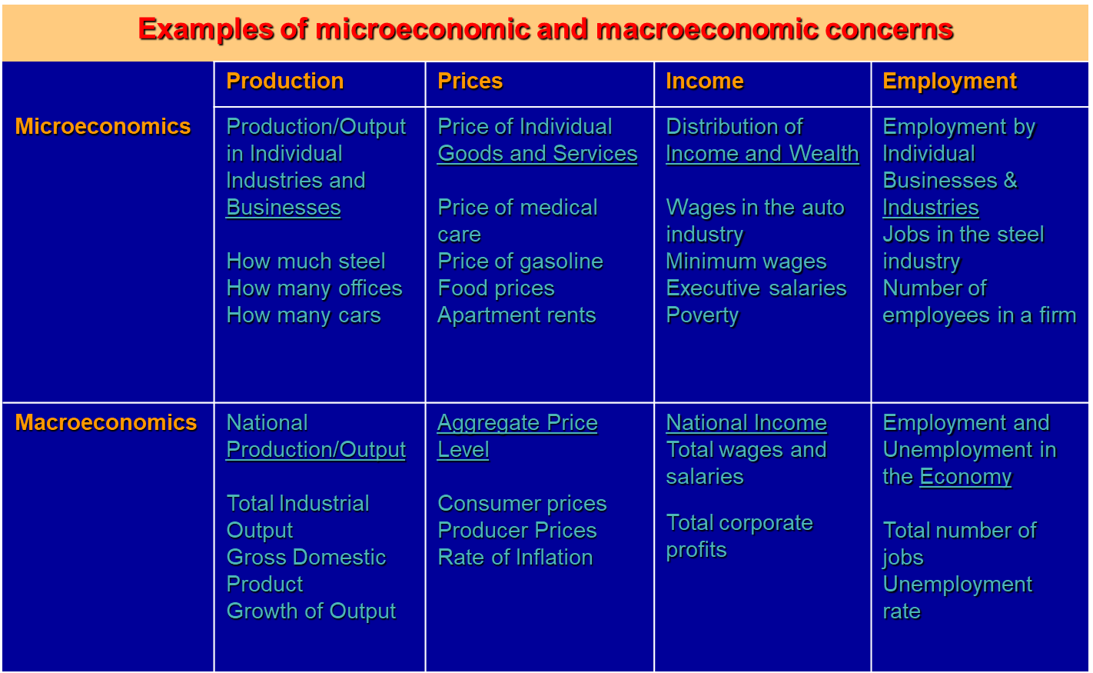
Diverse Fields of Economics

Slide 14
The Factors of Production
Labour
Capital
Land
Organization
Product

Slide 15
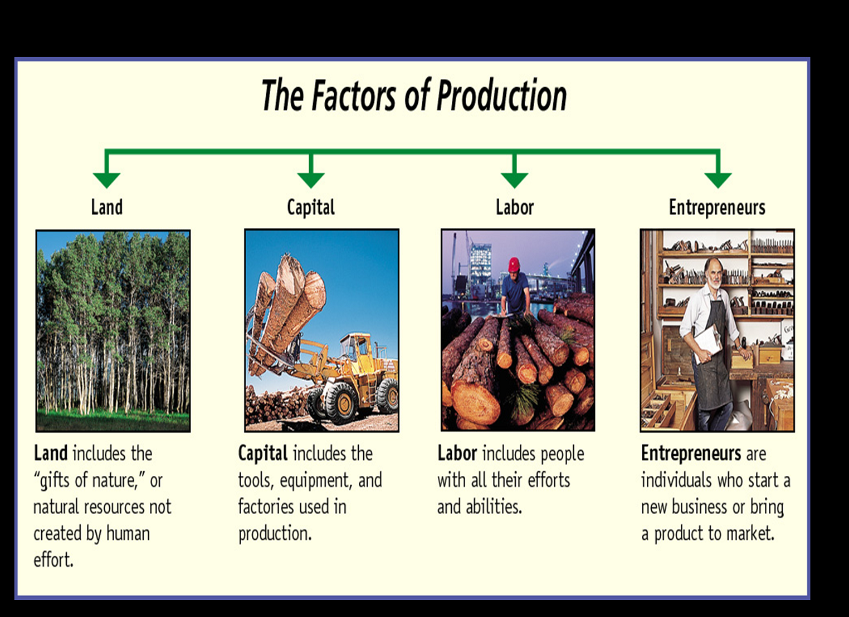

Slide 16
Factors of Production
Land
- natural resources available for production
- renewable resources: those that replenish
- non-renewable resources: cannot be replaced
Labor
- physical and mental effort of people used in production
Capital
- all non-natural (manufactured) resources that are used in the creation and production of other products
Enterprise (Entrepreneurship)
- refers to the management, organization and planning of the other three factors of production

Slide 17
Factors of Production
Payments
to factors
of Production
Land
Labor
Capital
Enterprise
Rent
Wages
Interest
Profit
INCOME

Slide 18
Opportunity Cost
Definition – the cost expressed in terms of the next best alternative sacrificed
The cost of anything in terms of other things given up or sacrificed.

Slide 19
Assumptions and Models
Assumptions simplify the complex world, make it easier to understand.
Example: To study international trade, assume two countries and two goods.
Unrealistic, but simple to learn and gives useful insights about the real world.
Model: a highly simplified representation of a more complicated reality. Economists use models to study economic issues.

Slide 20
Circular Flow of Income
Refers to a simple economic model which describes the reciprocal circulation of income between producers and consumers.
In the circular flow model, the inter-dependent entities of producer and consumer are referred to as "firms" and "households" respectively and provide each other with factors in order to facilitate the flow of income.
Real Flow and Money Flow. Real Flow- In a simple economy, the flow of factor services from households to firms and corresponding flow of goods and services from firms to households s known to be as real flow.

Slide 21
We are all Interdependent
A market economy works through a process of voluntary exchange or interaction between willing parties in the system. This circular flow of goods and services is what creates a country’s wealth.
The key factor in this circular flow is the market. The market is the place where buyers and sellers meet to exchange goods and services for money.
Interdependent- we are mutually dependent in a market economy. A decision made by one individual affects other participants in intended and unintended ways.
Interact- to act in a way that affects another

Slide 22
Lets identify each participant in the market
Individuals/Households- This is your role in the circular flow. You provide a service, labor to the factor market in exchange for wages. You also purchase goods and services from the product market using your income.
Factor or Resource Market- This is where factors of production are bought and sold. The Factor Market gives productive resources (goods used to produce other goods; like capitol goods) to Businesses in exchange for payment.

Slide 23
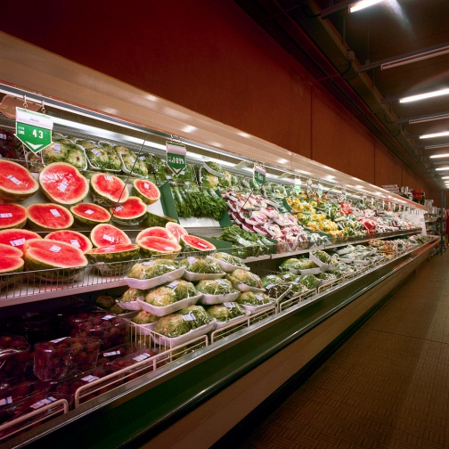
Lets identify each participant in the market cont..
Businesses- Businesses buy productive resources from factor markets to create a product that they sell to the Product Market.
Product Market- the Product Market receives products from businesses and provides goods and services directly to the individual consumer in exchange for payment.

Slide 24
Circular Flow Chart Participants
The Circular Flow Chart is a diagram that illustrates the circular flow of goods and services and money in a market.
Participants
Government
Product Market
Individual
Business
Factor /Resource
Market
Individual
Factor/Resource Market
Business
Product Market
Government
in a market economy, the government plays an indirect role by regulating for fairness and equality

Slide 25
Our First Model
The Circular-Flow Diagram: Model that traces the flow of resources, products and income and revenue among economic decision makers.
Refers to a simple economic model which describes the reciprocal circulation of income between producers and consumers.
Two types of “actors”:
households
firms
Two markets:
the market for goods and services
the market for “factors of production”

Slide 26
The Circular-Flow Diagram
Revenue
Spending
Market for
Goods
and Services
Goods & Services sold
Goods & Services bought
Firms
Households
Inputs for production
Labor, land, and capital
Market for
Factors
of Production
Wages, rent, and profit
Income
Notes:
7

Slide 27
Two Sector Model
In the simple two sector circular flow of income model the state of equilibrium is defined as a situation in which there is no tendency for the levels of income (Y), expenditure (E) and output (O) to change,
Y = E = O
This means that the expenditure of buyers (households) becomes income for sellers (firms). The firms then spend this income on factors of production such as labour, capital and raw materials, "transferring" their income to the factor owners. The factor owners spend this income on goods which leads to a circular flow of income.

Slide 28
Production Possibilities Frontier (PPF)
The Production Possibilities Frontier (PPF): a graph that shows the combinations of two goods the economy can possibly produce given the available resources and the available technology
Example:
Two goods: computers and wheat
One resource: labor (measured in hours)
Economy has 5000 labor hours per month available for production.

Slide 29
PPF Example
Point on graph | Production
 | Com-puters | Wheat
A | 5000 | 0
B | 400 | 1,000
C | 250 | 2,500
D | 100 | 4,000
E | 0 | 5,000
E
D
C
B
A
Notes:
29

Slide 30
Opportunity cost principle
Related to alternative uses of scarce resources
Opportunity cost of availing an opportunity is the expected income foregone from second best alternative
Opportunity cost is the next best alternative foregone
Difference between actual earning and its opportunity cost is called economic gain.

Slide 31
Marginal Principle
Refers to change (increase or decrease) in total of any quantity due to a unit change in its determinant.
MC= TCn - TCn-1
MR = TRn-TRn-1
Decision Rule FOR Profit Maximization: MR=MC

Slide 32
Marginal value
The marginal value of a dependent variable is the change in this dependent variable associated with a one unit change in a particular independent variable.

Slide 33
Time Perspective Principle
Short run & Long run time periods play an important role in Business decisions
Short run mean that period within which some of inputs cannot be altered (fixed inputs).
However in long run all inputs can be altered so they are variable in long run
Determination of time perspective is of great significance where projections are involved

Slide 34
Variables and Functions
Variable
By definition, any economic quantity , value or rate that varies on its own or due to a change in its determinant(s) is an economic variable.

Slide 35
Functions
A function is a mathematical technique of stating the relationship between any two variables having cause and effect relationship
When a relation is established between two or more variables, it is said that they are functionally related
When two variables are involved it is bi-variate and more than two it is Multi-variate

Slide 36
Functions
Of the two one is independent variable which may change on its own independently and other is dependent which changes in relation to changes in the assigned independent variable in a given function
In mathematical terms, Y= f (X)

