Slide 1
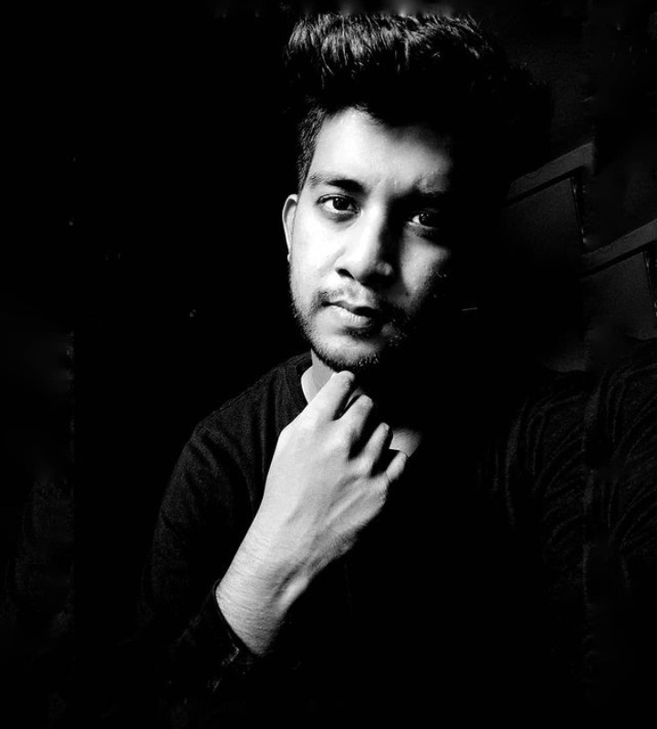

RAJNISH MISHRA
Full stack Developer
ABOUT ME
As a passionate full-stack developer, I design and develop complex interfaces with expertise in React and Node .
COMPLETED PROJECTS
CONTACT ME
9/10
8/10
Address
Total Number of Projects
B 4/13 , Varanasi
6
Web development
CREATIVE DESIGN
E-mail
rajnish.mshraa@gmail.com
9/10
7/10
Phone
+917000593081
Front-end
Backend
MY SKILLS
WORK EXPERIENCES
React
FRONTEND DEVELOPER
Node
2019 - 2021
JavaScript
Merck Group-Bangalore
Typescript
Worked on Front end react, JavaScript , typescript and frontend tools for better optimized application.
Web app
SCSS
2022 - present
Senior software Developer
Tredence- Bangalore
Industry Exp
Got opportunity and hands on experience on node , react with full responsibility of project. EX- TALP
Healthcare-Merck& Cerner
EDUCATION BACKGROUND
Retail-Tredence
20YY - 20YY
B.E in Computer science
SSGI, Chhattisgarh
Soft Skills
Add text based on your courses
Communication skill
2013 - 2014
Senior secondary
Problem solving
Tulsi Vidya Niketan
Creative
Physics, Chemistry , Math

