Slide 1

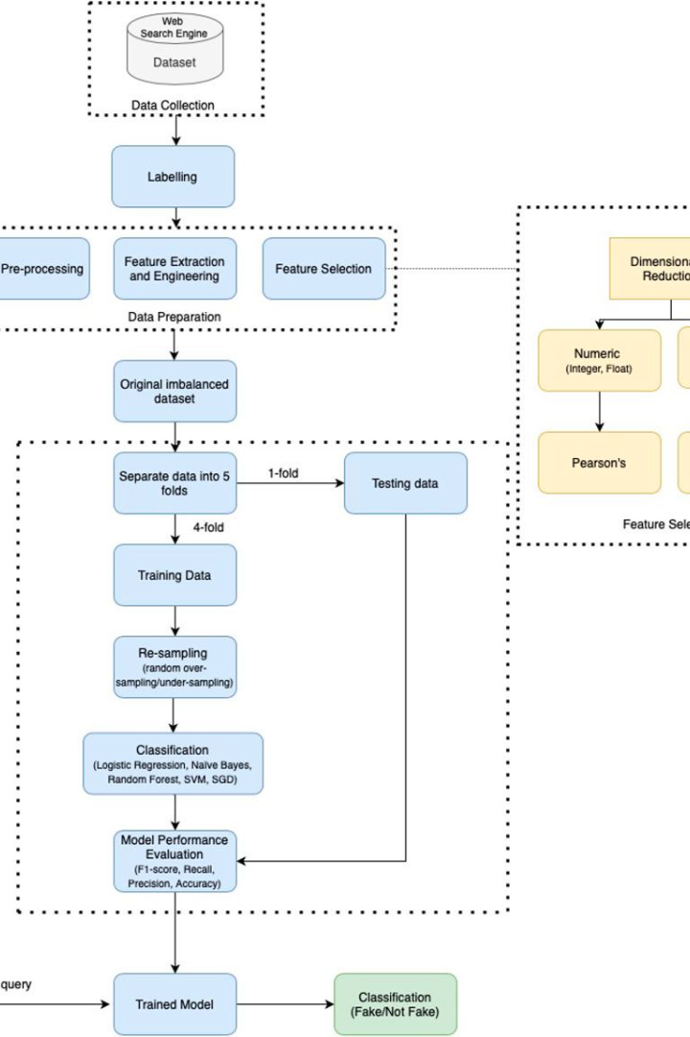
Introduction to Gmail spam detection project
This project focuses on developing an efficient machine learning (ML) model to detect and filter out spam emails in Gmail. The aim is to enhance user experience by reducing the impact of unwanted and potentially harmful emails.

Slide 2
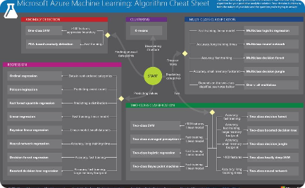
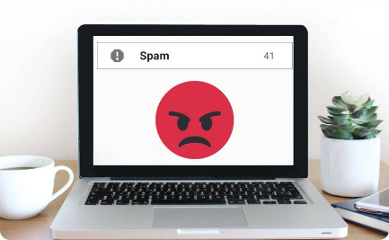
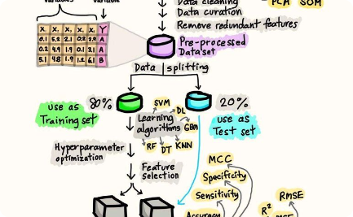
Overview of machine learning in spam detection
Diverse ML Algorithms
Filtering Techniques
Training Processes
Explore a variety of machine learning algorithms used in spam detection, including Naive Bayes, Support Vector Machines, and Neural Networks.
Discover the different techniques and methodologies employed in machine learning for effective spam filtering and classification.
Understand the process of training machine learning models to identify and differentiate between spam and legitimate emails.

Slide 3
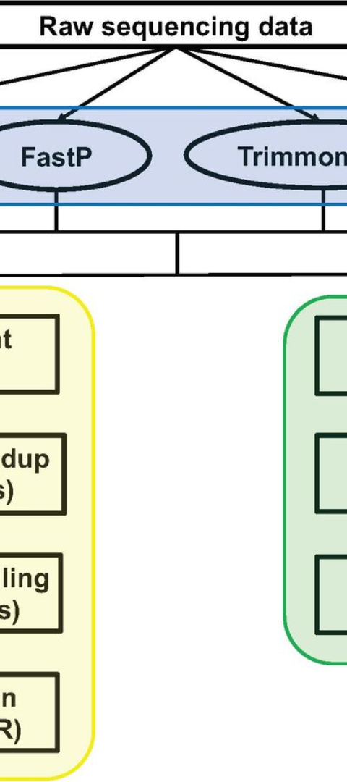
Data collection and preprocessing
Data Gathering
Data Cleaning
Learn about the methods and tools used for collecting large-scale email datasets to facilitate spam detection training.
Explore the techniques involved in cleaning and pre-processing email data to ensure quality and integrity for accurate model training.
Feature Extraction
Understand the process of extracting insightful features from email content and metadata for improved spam detection accuracy.

Slide 4
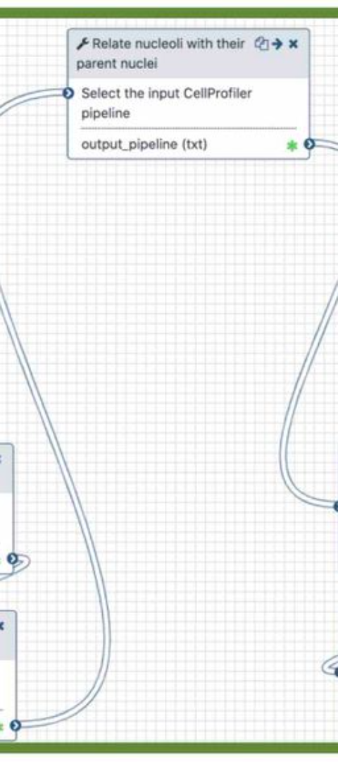
Feature extraction and selection
1
Content-based Features
Identify key content-based features such as keywords, URLs, and text patterns used in the extraction process.
2
Metadata Features
Explore the selection and utilization of metadata features like sender’s address, subject line, and timestamp for spam detection.
3
Dimensionality Reduction
Learn about techniques for reducing feature dimensions to improve model performance and computational efficiency.

Slide 5
Training and evaluation of machine learning models
Model Training
Cross-Validation
Model Selection
Understand the process of training machine learning models using labeled data to make accurate predictions about new email samples.
Explore the use of cross-validation techniques to evaluate model performance and ensure generalizability to new, unseen email data.
Learn about the selection of the most suitable ML model based on performance metrics like accuracy, precision, and recall.

Slide 6
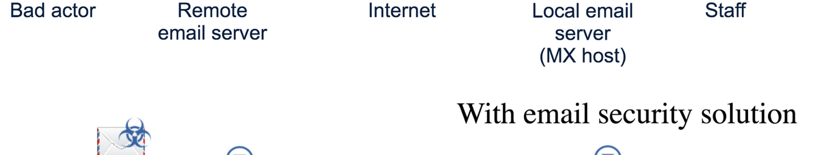

Performance metrics for spam detection
1
Accuracy
2
Precision and Recall
3
F1 Score
Measure the percentage of correctly identified spam and non-spam emails to evaluate the overall accuracy of the model.
Understand the trade-off between precision (relevant emails correctly identified as spam) and recall (spam emails correctly identified).
Explore the F1 score as a combined metric to assess the balance between precision and recall in spam detection models.

Slide 7




Challenges and limitations of Gmail spam detection
Data Imbalance
Address the challenge of imbalanced datasets, which can lead to biased model performance and inaccurate spam classification.
Evolution of Spam
Explore the constantly evolving tactics used by spammers, requiring continuous adaptation of detection models.
Privacy Concerns
Understand the importance of respecting user privacy while implementing effective spam detection measures within Gmail.

Slide 8

Future directions and improvements
Enhanced AI Integration
User Feedback Integration
Discuss the potential incorporation of advanced artificial intelligence techniques to further improve spam detection accuracy.
Explore the use of user feedback mechanisms to continually enhance and fine-tune spam filtering algorithms.
Adaptive Learning Models
Consider the development of adaptive models capable of dynamically learning and adapting to emerging spam patterns.

Slide 9

THANK YOU
SUMIT KUMAR SINGH
Click Here => https://spam-detection-ml.streamlit.app/

