Slide 1

An Introduction to Artificial Intelligence
Problem solving and searching
Ajeet Jain

Slide 2


Outline
Problem-solving agents (Goal Based)
Problem types
Problem formulation
Example problems
Basic search algorithms

Slide 3
Assumptions
World States
Actions as transitions between states
Goal Formulation: A set of states
Problem Formulation:
  The sequence of required actions to move from current state to a goal state

Slide 4
Example: Romania
On holiday in Romania; currently in Arad.
Flight leaves tomorrow from Bucharest
Formulate goal:
  be in Bucharest
Formulate problem:
  states: various cities
  actions: drive between cities
Find solution:
  sequence of cities, e.g., Arad, Sibiu, Fagaras, Bucharest

Slide 5

Example: Romania

Slide 6
Setting the scene…
Problem solving by searching
  Tree of possible actions sequences.
Knowledge is Power!
  States
  State transfers

Slide 7

Example: Vacuum World
Single-state Problem:
  You know all.
Start in #5
  Solution? [Right, Clean]

Slide 8
Example: vacuum world
Multiple State Problem
  Sensorless
Start in {1,2,3,4,5,6,7,8}
  Solution?
  [Right, Clean, Left, Clean]

Slide 9
Example: vacuum world
Contingency
  Nondeterminism: Cleaning may
  dirty a clean carpet.
  Partially observable: Location, dirt at current location.
  Percept: [L, Clean], i.e., start in #5 or #7
  Solution?
  [Right, if dirt then Clean]

Slide 10
Single-state problem formulation
A problem is defined by four items:
initial state e.g., "at Arad"
actions or successor function S(x) = set of action–state pairs
  e.g., S(Arad) = {<Arad → Zerind, Zerind>, <Arad → Timisoara, Timisoara>, … }
goal test, can be
  explicit, e.g., x = "at Bucharest"
  implicit, e.g., Checkmate(x)
path cost (additive)
  e.g., sum of distances, number of actions executed, etc.
  c(x,a,y) is the step cost, assumed to be ≥ 0
A solution is a sequence of actions leading from the initial state to a goal state

Slide 11
Selecting a state space
Real world is absurdly complex
  → state space must be abstracted for problem solving
(Abstract) state = set of real states
(Abstract) action = complex combination of real actions
  e.g., "Arad → Zerind" represents a complex set of possible routes, detours, rest stops, etc.
For guaranteed realizability, any real state "in Arad“ must get to some real state "in Zerind"
(Abstract) solution =
  set of real paths that are solutions in the real world
Each abstract action should be "easier" than the original problem

Slide 12

Vacuum world state space graph
States? Dirt and robot location
Actions? Left, Right, Clean
Goal test? No dirt at all locations
Path cost? 1 per action

Slide 13

Example: The 8-puzzle
States? Locations of tiles
Actions? Move blank left, right, up, down
Goal test? Given
Path cost? 1 per move

Slide 14

Example: robotic assembly
States? real-valued coordinates of robot joint angles parts of the object to be assembled
Actions? continuous motions of robot joints
Goal test? complete assembly
Path cost? time to execute

Slide 15
Example Cryptarithmatic
FORTY Solution: 29786 F=2,
+ TEN + 850 O=9,
+ TEN + 850 R=7,
------- ----- etc.
SIXTY 31486
States? A cryptharithmetic puzzle w/ some letters replaced with digits.
Actions? Replacing a letter with an unused digit.
Goal test? Puzzle contains only digits.
Path cost? ZERO. All solutions equally valid.

Slide 16

Tree search algorithms
Basic idea:
  offline, simulated exploration of state space by generating successors of already-explored states (a.k.a.~expanding states)

Slide 17

Tree search example

Slide 18

Tree search example

Slide 19

Tree search example

Slide 20

Implementation: states vs. nodes
A state is a (representation of) a physical configuration
A node is a data structure constituting part of a search tree includes state, parent node, action, path cost g(x), depth
The Expand function creates new nodes, filling in the various fields, using the SuccessorFn of the problem to create the corresponding states.

Slide 21

Implementation: general tree search

Slide 22
Search strategies
A search strategy is defined by picking the order of node expansion
Strategies are evaluated along the following dimensions:
  completeness: does it always find a solution if one exists?
  time complexity: number of nodes generated
  space complexity: maximum number of nodes in memory
  optimality: does it always find a least-cost solution?
Time and space complexity are measured in terms of
  b: maximum branching factor of the search tree
  d: depth of the least-cost solution
  m: maximum depth of the state space (may be ∞)

Slide 23
Uninformed search strategies
Uninformed search strategies use only the information available in the problem definition
  Breadth-first search
  Uniform-cost search
  Depth-first search
  Depth-limited search
  Iterative deepening search

Slide 24

Breadth-first search
Expand shallowest unexpanded node
Implementation:
  fringe is a FIFO queue, i.e., new successors go at end

Slide 25

Breadth-first search
Expand shallowest unexpanded node
Implementation:
  fringe is a FIFO queue, i.e., new successors go at end

Slide 26

Breadth-first search
Expand shallowest unexpanded node
Implementation:
  fringe is a FIFO queue, i.e., new successors go at end

Slide 27

Breadth-first search
Expand shallowest unexpanded node
Implementation:
  fringe is a FIFO queue, i.e., new successors go at end

Slide 28
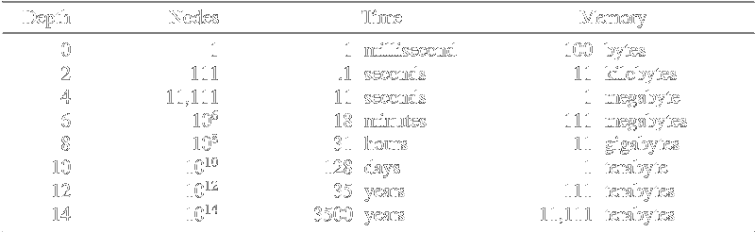
Properties of breadth-first search
Complete? Yes (if b is finite)
Time? 1+b+b²+b³+… +b^{d} + b(b^{d}-1) = O(b^{d+1})
Space? O(b^{d+1}) (keeps every node in memory)
Optimal? Yes (if cost = 1 per step)

Slide 29
Uniform-cost search
Expand least-cost unexpanded node
Implementation:
  fringe = queue ordered by path cost
Equivalent to breadth-first if step costs all equal

Slide 30
Uniform-cost search Sample
0

Slide 31
Uniform-cost search Sample
75
X
140
118

Slide 32
Uniform-cost search Sample
146
X
X
140
118

Slide 33
Uniform-cost search Sample
146
X
X
140
X
229

Slide 34
Uniform-cost search
Complete? Yes
Time? # of nodes with g ≤ cost of optimal solution, O(b^{ceiling(C*/ ε)}) where C* is the cost of the optimal solution
Space? # of nodes with g ≤ cost of optimal solution, O(b^{ceiling(C*/ ε)})
Optimal? Yes

Slide 35

Depth-first search
Expand deepest unexpanded node
Implementation:
  fringe = LIFO queue, i.e., put successors at front

Slide 36

Depth-first search
Expand deepest unexpanded node
Implementation:
  fringe = LIFO queue, i.e., put successors at front

Slide 37

Depth-first search
Expand deepest unexpanded node
Implementation:
  fringe = LIFO queue, i.e., put successors at front

Slide 38

Depth-first search
Expand deepest unexpanded node
Implementation:
  fringe = LIFO queue, i.e., put successors at front

Slide 39

Depth-first search
Expand deepest unexpanded node
Implementation:
  fringe = LIFO queue, i.e., put successors at front

Slide 40

Depth-first search
Expand deepest unexpanded node
Implementation:
  fringe = LIFO queue, i.e., put successors at front

Slide 41

Depth-first search
Expand deepest unexpanded node
Implementation:
  fringe = LIFO queue, i.e., put successors at front

Slide 42

Depth-first search
Expand deepest unexpanded node
Implementation:
  fringe = LIFO queue, i.e., put successors at front

Slide 43

Depth-first search
Expand deepest unexpanded node
Implementation:
  fringe = LIFO queue, i.e., put successors at front

Slide 44

Depth-first search
Expand deepest unexpanded node
Implementation:
  fringe = LIFO queue, i.e., put successors at front

Slide 45

Depth-first search
Expand deepest unexpanded node
Implementation:
  fringe = LIFO queue, i.e., put successors at front

Slide 46

Depth-first search
Expand deepest unexpanded node
Implementation:
  fringe = LIFO queue, i.e., put successors at front

Slide 47
Properties of depth-first search
Complete? No: fails in infinite-depth spaces, spaces with loops
  Modify to avoid repeated states along path
    → complete in finite spaces
Time? O(b^{m}): terrible if m is much larger than d
  but if solutions are dense, may be much faster than breadth-first
Space? O(bm), i.e., linear space!
Optimal? No

Slide 48

Depth-limited search
= depth-first search with depth limit l,
i.e., nodes at depth l have no successors
Recursive implementation:

Slide 49

Iterative deepening search

Slide 50

Iterative deepening search l =0

Slide 51

Iterative deepening search l =1

Slide 52

Iterative deepening search l =2

Slide 53

Iterative deepening search l =3

Slide 54
Iterative deepening search
Number of nodes generated in a depth-limited search to depth d with branching factor b:
N_{DLS} = b⁰ + b¹ + b² + … + b^{d-2} + b^{d-1} + b^{d}
Number of nodes generated in an iterative deepening search to depth d with branching factor b:
N_{IDS} = (d+1)b⁰ + d b^¹ + (d-1)b^² + … + 3b^{d-2} +2b^{d-1} + 1b^{d}
For b = 10, d = 5,
  N_{DLS} = 1 + 10 + 100 + 1,000 + 10,000 + 100,000 = 111,111
  N_{IDS} = 6 + 50 + 400 + 3,000 + 20,000 + 100,000 = 123,456
Overhead = (123,456 - 111,111)/111,111 = 11%

Slide 55
Properties of iterative deepening search
Complete? Yes
Time? (d+1)b⁰ + d b¹ + (d-1)b² + … + b^{d} = O(b^{d})
Space? O(bd)
Optimal? Yes, if step cost = 1

Slide 56
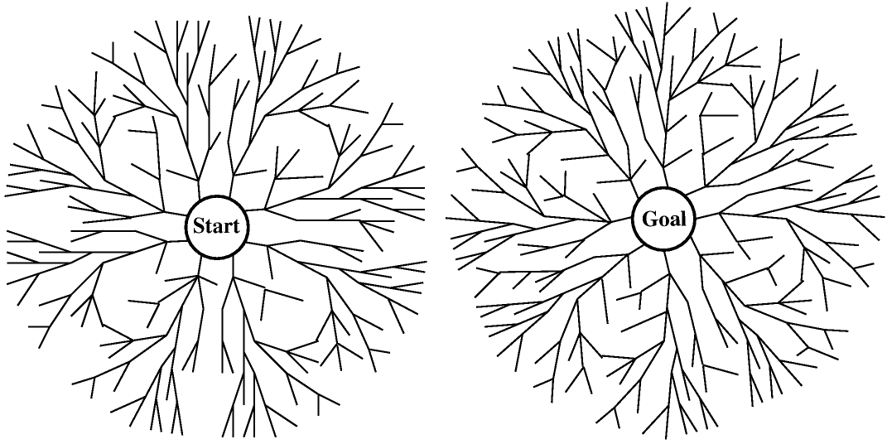
Bidirectional Search
To go both ways, Top Down and Bottom Up.

Slide 57
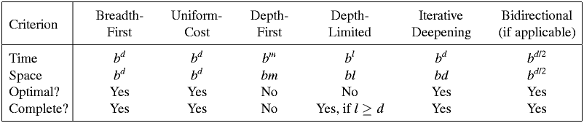
Summary of algorithms

Slide 58

Repeated states
Failure to detect repeated states can turn a linear problem into an exponential one!

Slide 59
Repeated states
Do not return to the state you just came from.
Do not create paths with cycles in them.
Do not generate any state that was ever generated before.
  Hashing

Slide 60
Constraint Satisfaction Search
Constraint Satisfaction Search:
  a special kind of search problem.
  States: a set of variables
  Goal Test: a set of constraints that the values must obey.
  Absolute/Preferred Constraints
  Variable Domain
  Back Tracking
  Forward Checking / Arc Consistency

Slide 61
Summary
Problem formulation usually requires abstracting away real-world details to define a state space that can feasibly be explored
Variety of uninformed search strategies
  Breadth First Search
  Depth First Search
  Uniform Cost Search (Best First Search)
  Depth Limited Search
  Iterative Deepening
  Bidirectional Search
Constraint Satisfaction as search

Slide 62
ExERCiSES!
Exercises 3.9:
  Implement the missionaries and cannibals problem and use an a search method to find the shortest path. Is it useful to keep track of repeated cases?
Exercise 3.X:
  Assume a set of N chain links with some a priory connections. Assuming an operator that connects/disconnects two links. Formulate a search problem and find the optimal solution from a given initial state to a given goal state.
Due: Esfand, 15th
Language: C++ / Java
Mail To: n_ghanbari@ce.sharif.edu
Subject: AIEX-CANNIBALS, AIEX-CHAINS

