Slide 1

RENALIS
Evidence-aware
dialysis digital twin
Competing explanations.
A better next measurement question.
TEAM SIGMOID
Rehaan / JSS University, Noida
Notes:
Team details supplied by entrant. Research prototype. Conceptual generated cover illustration, not a real device or patient. Built-in patients/device streams are fictional. Artwork prompt and provenance: public/presentation-assets/provenance.json.

Slide 2
One BP trace can support several explanations
An observation can narrow uncertainty without identifying a unique physiological cause.
The missing variable
Is the pressure change
more compatible with
volume, vascular or
cardiac response?
Synthetic replay at minute 90
Elapsed session minutes
RENALIS / Team Sigmoid / Research prototype
02
Notes:
Trace contains actual non-null available observations from film-data.json before cutoff90. No interpolation beyond the released data is shown. Clinical motivation: KDIGO BP and Volume Management in Dialysis Conference Report2020, https://kdigo.org/wp-content/uploads/2017/02/KDIGO-BP-Volume-Management-in-Dialysis-Conference-Report.pdf . Competing mechanisms remain authored research models.

Slide 3
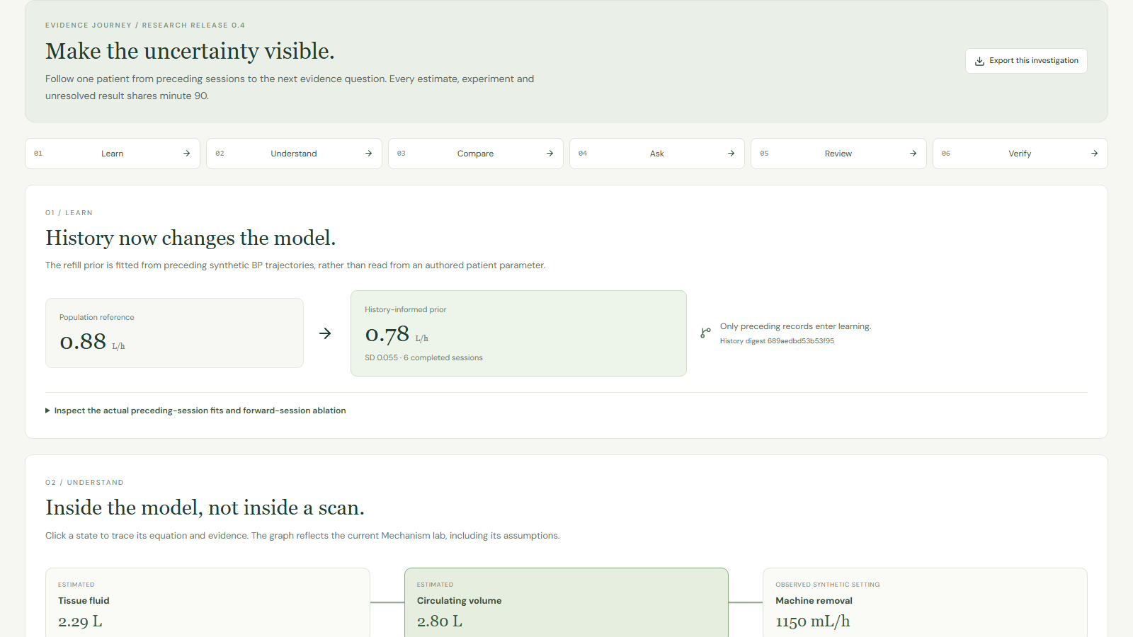
The research workspace
One evidence cutoff connects the patient replay, hypotheses and acquisition history.
01
Learn
02
Understand
03
Compare
04
Ask
05
Review
06
Verify
RENALIS / Team Sigmoid / Research prototype
03
Notes:
Actual captured interface on an isolated synthetic database. Source: src/EvidenceJourney.tsx and video/submission_v05/capture.cjs. Patient RNL-014 at minute 90. Six journey sections are implemented, not a UI mockup.

Slide 4





System containers
Current local implementation. Browser requests stay separate from offline evaluation.
LOCAL RESEARCH WORKSPACE
Function calls
Twin + planner
User
React workspace
HTTP
JSON
FastAPI service
History, state, hypotheses
Information + action loss
Research review
Acquire + save
TypeScript + Vite
Browser :5173
Python + NumPy
HTTP JSON :8000
SQLite evidence store
Synthetic inputs
Published artifacts
Requests, readings, corrections
Saved experiment revisions
Authored BP/device replay
Six preceding sessions
Explicit acquisition fixtures
Aggregate JSON, PDF/PPTX
Fictional FHIR collection
Versioned source + model card
Transactions
Observed HEMOBP modeling runs offline and supplies evaluation reports, not the synthetic twin state.
RENALIS / Team Sigmoid / Research prototype
04
Notes:
Current implementation. Sources: backend/app.py PROJECT_DOCUMENTS, DB schema and endpoints; backend/model.py, history.py, mechanisms.py, discrimination.py, insights.py; src/api.ts; vite.config.ts. API functions run in one Python process, not separate microservices. SQLite is a local database. No NGINX, PostgreSQL, container orchestration, cloud deployment, authentication or live hospital integration is claimed.

Slide 5



The prior comes from preceding sessions
Six completed synthetic sessions inform refill estimation before the current replay.
Session trajectories
Likelihood fit
Patient prior
Raw BP + machine settings
Completed before current start
Refill / compensation grid
Uncertainty floor + shrinkage
Estimate + uncertainty
Source digest and fit lineage
What the interface exposes
6
Per-session fits, the fitted prior and the forward-session ablation make the learner inspectable.
preceding completed sessions
RENALIS / Team Sigmoid / Research prototype
05
Notes:
Source: backend/history.py and history_fixtures.py. History contains authored synthetic sessions. Shrinkage, source lineage and ablation expose assumptions; no clinical parameter identification is established.

Slide 6



The physiological model
Estimated compartments connect removal, refill and family-specific pressure response.
Tissue fluid
Refill
Circulating volume
Removal
Fluid removal
Estimated compartment
Estimated compartment
Observed machine setting
Current BP readings
constrain the hidden state.
Pressure response
A model state estimate
can remain ambiguous.
Volume sensitivity + compensation
Four authored response families
RENALIS / Team Sigmoid / Research prototype
06
Notes:
Source: backend/model.py advance/pressure and backend/mechanisms.py infer/project/sensor_prediction. The schematic is a computational compartment model, not an anatomical diagram or a clinically validated whole-body simulator.

Slide 7

Four families fit the available past
Similar fit does not imply the same projected response.
Volume / refill
Vascular response
Cardiac response
Mixed response
24.9%
25.0%
25.0%
25.1%
relative model support
relative model support
relative model support
relative model support
1.87 mmHg
1.86 mmHg
1.83 mmHg
1.80 mmHg
past-fit RMSE
past-fit RMSE
past-fit RMSE
past-fit RMSE
RENALIS / Team Sigmoid / Research prototype
07
Notes:
Values: film-data.json before, Meera/RNL-014 minute 90, hypothetical constant650mL/h. Each family has48 particles. Weights quantify relative compatibility inside this model bank, not diagnostic probabilities. Physiology outside the bank may be absent.

Slide 8
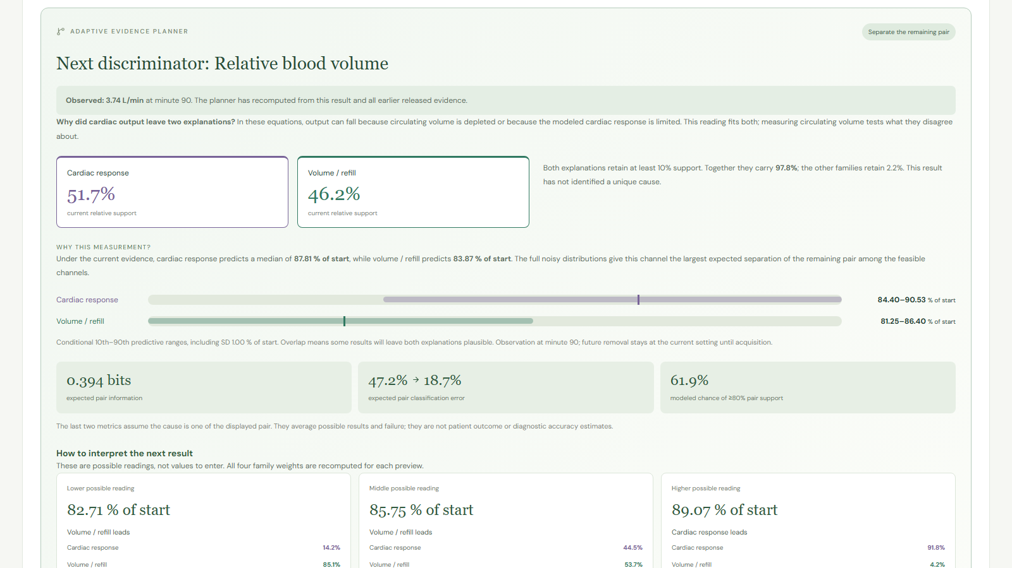
Cardiac output narrows the disagreement
An acquired low-output result still fits both volume depletion and limited cardiac response.
3.74
L/min acquired cardiac output
Cardiac 51.7%
Volume 46.2%
Current model support
RENALIS / Team Sigmoid / Research prototype
08
Notes:
Actual synthetic acquisition and posterior: film-data.json afterCO and interface capture. Source backend/measurement_fixtures.py. Output can fall with depleted circulation or limited modeled cardiac response. This reading does not identify a unique cause.

Slide 9
How the acquired evidence changes support
The planner recomputes the full bank after each result. Residual ambiguity remains visible.
Support is conditional on the authored model bank. It is not a probability of clinical diagnosis.
RENALIS / Team Sigmoid / Research prototype
09
Notes:
All four series and all three states are literal values from film-data.json. Percentages may have minor rounding error. New editable chart and embedded workbook snapshot preserve the source values. Cardiac51.66% / volume46.17% afterCO; volume66.93% / cardiac31.78% afterRBV.

Slide 10
Why the next measurement is relative blood volume
The remaining families predict different noisy RBV distributions. Their ranges still overlap.
Volume / refill
Median 83.87%
10th–90th: 81.25–86.40%
Cardiac response
Median 87.81%
10th–90th: 84.40–90.53%
0.39378 bits
80
82
84
86
88
90
92
expected pair information
% of starting blood volume
RENALIS / Team Sigmoid / Research prototype
10
Notes:
AfterCO snapshot adaptive planner. Volume median 83.87, 10th–90th81.25–86.40; cardiac87.81,84.40–90.53. Includes declared sensor SD 1.00% of start. Expected pair information0.39378 bits vs cuff0.00004 bits. Native range diagram represents displayed quantiles, not a fitted Gaussian curve. It does not promise resolution or treatment benefit.

Slide 11
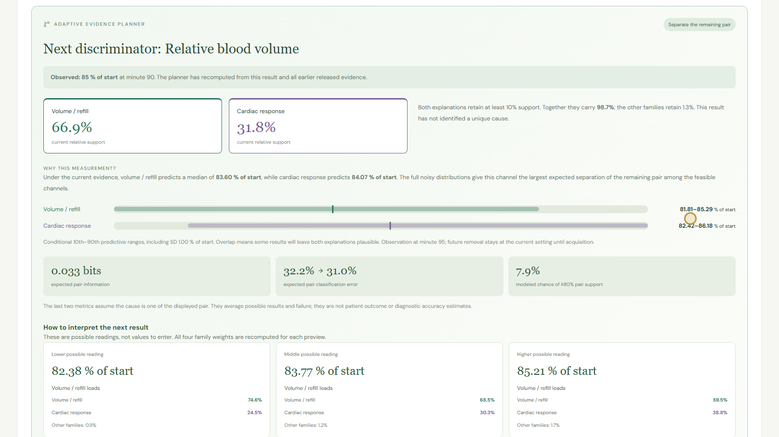
The device returns 85.0%
The acquired RBV shifts the balance toward volume / refill without eliminating cardiac support.
66.9%
volume / refill support
31.8%
cardiac response support
RENALIS / Team Sigmoid / Research prototype
11
Notes:
Actual synthetic RBV85.0 result from film-data.json afterRBV. No manually chosen resolving5.4 is required. The newly recomputed planner may continue or stop depending on feasible expected separation and guards. This example remains ambiguous.

Slide 12


Information and action value answer different questions
Both use current beliefs, but only one includes the modeled consequence of a decision.
Information
Action value
Expected uncertainty reduction
Expected modeled loss reduction
Which feasible observation could
separate the remaining explanations?
Could the result improve the comparison
after waiting, failure and burden?
Units: bits
Units: declared research loss
RENALIS / Team Sigmoid / Research prototype
12
Notes:
Source: backend/discrimination.py and mechanisms.py measurement_value. Information bits and action loss are separate units and should not be subtracted from each other. A useful discriminator can have nonpositive net action value. Clinical utility has not been elicited or validated.

Slide 13
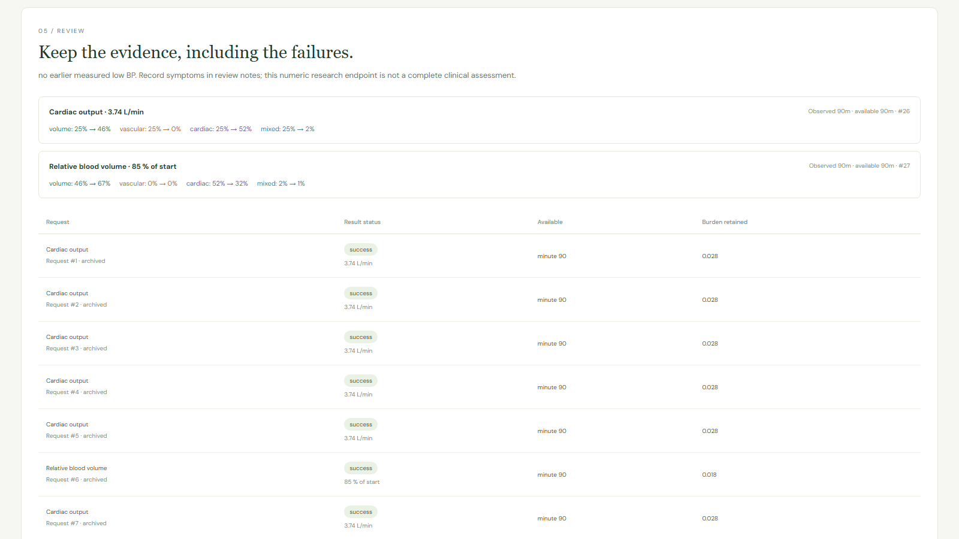
Every observation has a lineage
Failures, artifacts and corrections remain distinguishable from evidence used in inference.
01
Observe
Record physiological time and quality.
02
Release
Make evidence available after delay.
03
Correct
Append a reason and supersedes link.
04
Save
Keep revision and evidence in a snapshot.
RENALIS / Team Sigmoid / Research prototype
13
Notes:
Source: backend/app.py measurements, acquisitions and lab_runs schema; corrections endpoint. Observation and availability time have different meanings. Artifact values are retained but excluded from assimilation. Saved report revisions do not change after later corrections.

Slide 14
History adds a small retrospective signal
HEMOBP v3. 61,947 test windows from 176 patients, with no patient overlap between splits.
−0.1665
mmHg paired history increment
95% patient-cluster interval
[−0.2298, −0.1099]
Clinical importance
remains unestablished.
RENALIS / Team Sigmoid / Research prototype
14
Notes:
Source docs/observed-v04.json models and history_increment. History increment compares history+dynamic with demographics+dynamic on the same cohort. MAE12.194,11.356,11.328,11.161mmHg. Empirical clock shift and exclusions constrain interpretation. DOI10.6084/m9.figshare.6260654.v3; https://www.nature.com/articles/s41597-019-0319-8 .

Slide 15
The evaluation still has material limits
A retrospective prediction result does not establish physiological identification or clinical benefit.
61.25%
13.51%
86.74%
event sensitivity
positive predictive value
coverage of nominal 90% range
Clock alignment
Cohort exclusions
Endpoint scope
The empirical 8-hour shift needs
independent confirmation.
2,516,989 of 4,366,298 packets
match the declared checks.
Next measured BP differs from
continuous hypotension.
RENALIS / Team Sigmoid / Research prototype
15
Notes:
Source docs/observed-v04.json audit, interval and event_model. Endpoint requires currently non-low SBP and next distinct measured reading within5–35minutes. Missing events, false alerts and undercoverage remain visible. Raw observed data is not redistributed.

Slide 16
Decision value does not beat cuff overall
Independent synthetic holdout: 192 cases, four policies and one acquisition per policy.
0.22170
fixed cuff
0.24145
decision value
Lower is better.
RENALIS / Team Sigmoid / Research prototype
16
Notes:
Source docs/policy-validation-v04.json. Mean regret0.23078no observation,0.22170fixed cuff,0.24472information gain,0.24145decision value. Earlier one-acquisition study. It does not validate current sequential selection. Paired decision-value delta vs cuff0.01975, interval[-0.00981,0.05996]. All768records and the metric amendment are retained.

Slide 17



Authority changes with evidence quality
The service withholds scenario authority when the replay cannot support it.
Current low BP
Stale or missing BP
Current event is already present.
No advance-warning claim.
Refresh the available evidence
before comparing scenarios.
Completed session
Contradictory evidence
Do not compare new removal
profiles after session completion.
Show poor fit and residual
uncertainty in the model bank.
RENALIS / Team Sigmoid / Research prototype
17
Notes:
Sources backend/app.py scenario guards, model.py alert states, mechanisms.py support_state, tests/test_model.py and test_discrimination.py. Current events, stale evidence and session completion block ranked scenario mutations. Poor model fit remains explicit. These are software guards, not a medical alarm specification.

Slide 18



Extensions expose the next integration boundary
Current exports and transport experiments remain inspectable research components.
FUTURE EXTERNAL INTEGRATION
Current compartments
Longitudinal transport
Evidence-weighted volume state
Authored intake / output
Mass-balance checks
Clinical systems
Live EHR access, governance
and ABDM conformance
require independent work.
Synthetic FHIR R4
Patient / Device / BP Observation
Reference + unit checks
RENALIS / Team Sigmoid / Research prototype
18
Notes:
Implemented backend/longitudinal.py, backend/fhir.py and app.py /longitudinal and /fhir. Compartment transport does not predict future BP or identify renal function. FHIR R4 collection is fictional and not certified for ABDM. Source standard https://hl7.org/fhir/R4/observation.html and https://nrces.in/ndhm/fhir/r4/ . Future integration is dashed and not an implemented connection.

Slide 19
The next evidence gates
The strongest next work tests the assumptions that limit interpretation.
01
02
03
04
05
Source timing
Human interpretation
Matched physiology
Independent policies
External silent study
Confirm HEMOBP clocks
and reproduce the cohort.
Test whether reviewers
understand ambiguity.
Calibrate the model against
paired clinical measurements.
Predeclare multi-acquisition
budgets and correlated noise.
Measure calibration and
workflow burden externally.
RENALIS / Team Sigmoid / Research prototype
19
Notes:
Proposed work, not completed studies. Sources: docs/clinical-study-protocol.md, data-capture-schema.json, implementation-decisions-v04.md and model-card.md. Clinical collaborators, approvals, enrollment and prospective impact are not claimed.

Slide 20
A clearer next evidence question
RENALIS makes the model disagreement, the next observation and the remaining uncertainty visible.
See the actual
20-minute demonstration
Team Sigmoid
Rehaan
JSS University, Noida
youtu.be/ZcWNYMtM1tI
Evidence and methods
github.com/RAK2315/RENALIS
Model card + source modules
Observed and policy reports
Research dossier + study protocol
RENALIS / Team Sigmoid / Research prototype
20
Notes:
Public source https://github.com/RAK2315/RENALIS and unlisted video https://youtu.be/ZcWNYMtM1tI . Sources and interpretations are in per-slide notes and README, docs/model-card.md, docs/observed-v04.json, docs/policy-validation-v04.json, research dossier and study protocol. No universal novelty or patient outcome benefit is claimed.

