Slide 1



PRESENTS
FINTECHSTICO
THE FINTECH HACKATHON
Notes:
Organiser cover slide.

Slide 2













Problem Statement
Businesses lose real money every month because their records don't match the government's
1
2
3
4
A shop buys stock
That GST can come back
Only if every record agrees
One mismatch, money gone
Sharma Traders, a Delhi wholesaler, buys goods worth ₹1,00,000 and pays ₹18,000 GST on top to its supplier. Its accountant records the bill in the books.
When the shop later sells goods, it can subtract the ₹18,000 it already paid from the GST it owes. This credit is called input tax credit (ITC), and it works like cash in hand.
The supplier must report the same sale on the GST portal, the bill must charge the right rate, and the shop must pay within 180 days. Books, bank and portal must all tell one story.
If even one detail differs, the credit is denied, the business pays interest, or a tax notice arrives months later. Often it surfaces only when it is too late to fix.
Today, an accountant checks this by hand
1.67 crore
businesses are registered under GST and face this every filing cycle
Every month, four sets of records are downloaded and compared line by line to find what does not match.
GSTN, 30 Jun 2026
Accounting books
GST portal data
of fake tax credit caught in just 7 months, much of it through fake supplier bills
Bank statement
Bills and invoices
Excel sheets
Slow and manual
₹35,132 cr
thousands of rows
and mistakes found late, or never
CBIC, Apr to Oct 2024
The same bill written two ways looks like a mismatch
Problems are listed, but not what each one costs
Bills entered twice and wrong tax rates slip through
Fake suppliers are caught only after a tax notice
Oct 2025
new rules lock returns to what was already reported, so errors can't be fixed at the last minute
GSTN advisories
Who feels it most: small and mid-sized businesses, and the CA firms that file GST for dozens of them every month.
Notes:
Tell it as a story. A shop buys stock and pays 18,000 rupees of GST. It can get that back as input tax credit, but only if every record agrees: the supplier reports the sale, the tax on the bill is right, and the bill is paid within 180 days. One mismatch and the money is gone. Today an accountant checks this by hand in Excel. Scale: 1.67 crore GST businesses, 35,132 crore of fake credit caught in seven months, and since Oct 2025 the rules are stricter.

Slide 3

Team name
Team members
LedgerLens
Your AI assistant for GST checks
M1
M2
M3
M4
Member name
Member name
Member name
Member name
College, year
College, year
College, year
College, year
Role
Role
Role
Role
Problem statement 2: Intelligent tax reconciliation
Notes:
Team slide.

Slide 4










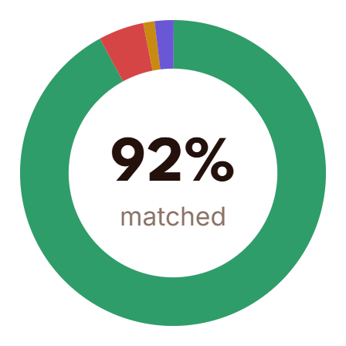




Solution
LedgerLens checks every bill, payment and tax record, shows the money at stake, and tells you what to do
Money at risk
Money to claim
1. Upload
app.ledgerlens.in/recon/2025-09
Drop in the accounting books, bank statement and GST portal downloads. LedgerLens reads them as they are, so nobody retypes a single entry.
Sharma Traders Pvt Ltd
07AAACS1234F1Z5 · September 2025 · 2,002 records
Export
Run reconciliation
Matched
Discrepant
Duplicates
Missing
ITC at risk
ITC found
2. Check
1,842
96
23
41
₹4.82 L
₹1.36 L
Every bill is matched to its payment, its accounting entry and the supplier's GST filing, even when written differently. The tax rate on each bill is checked too.
92.0% of records
amount, rate, split
booked twice
not in 2B or books
₹1.9 L due in 14 days
in 2B, never booked
Matched
ITC at risk by cause
sorted by rupees
Discrepant
Supplier has not filed (16(2))
₹2.10 L
Duplicate
Unpaid past 180 days (Rule 37)
₹1.90 L
3. Explain
Missing
Rate or tax head mismatch
₹0.58 L
Each problem shows the money involved: credit at risk if left unfixed, or credit owed but never claimed. A plain note says why, with both records as proof.
Blocked credit claimed (17(5))
₹0.24 L
Top issues
4 of 160 · ranked by rupees at risk and deadline
4. Fix
Invoice
Supplier
Issue
At risk
Confidence
It drafts the next step, like an email asking the supplier to correct their filing, or the entry that fixes the books. You review and approve in one click.
MT-8821
Om Logistics
Not in GSTR-2B
₹38,700
0.99
Nudge supplier
UB/2526/1187
UltraBuild Cements
Billed 28%, rate is 18%
₹42,000
0.98
Request credit note
RX-1102
Vardhan Enterprises
Unpaid 186 days
₹22,050
1.00
Draft reversal
2025/0915
Delta Paper Mills
Booked twice
₹9,180
0.95
Reverse entry
Covers every requirement in the problem statement
Matches bills and payments
Finds duplicates and mismatches
Checks the tax on every bill
Finds missing records
Flags suspicious patterns
Works out tax payable
Visual dashboard
Notes:
LedgerLens does four things: upload, check, explain, fix. Point at the two coloured numbers: money you could lose, and money you can still claim. Every problem in the list has a rupee value and a next step. The green chips show we cover every requirement in the problem statement.

Slide 5




















Architecture
Step 1
Your records
Step 2
Clean up
Step 3
Match everything
Step 4
Find risk, explain
Step 5
You review, act
files a business already has
every file speaks one language
clear rules, not guesswork
how much, why, what next
one screen, one click
Accounting books
Reads any format
Only same-supplier bills compared
Checks the tax on every bill
Dashboard
Tally, Excel or CSV
broken rows set aside, not lost
GSTIN must match exactly
rate, type, maths, 180-day rule
money at risk, at a glance
GST portal data
Money kept to the exact paisa
Three passes, each explained
Money at risk and tax payable
Problem details with proof
GSTR-2B and GSTR-1
no rounding drift in totals
what you owe after credit
approve, edit or dismiss
Bank statement
exact, cleaned up, close match
Supplier network map
CSV download
Checks every GSTIN is genuine
No record used twice
Spots unusual patterns
see linked fake firms
check digit and owner's PAN
best one-to-one pairing
outlier and Benford's law tests
E-invoices
Rates suppliers, finds fake ones
Ask in plain English
government invoice ID (IRN)
Same bill, different spelling
One payment, many bills
"why is my credit lower?"
Supplier status
INV/25-26/042 is bill 42
and bills paid in parts
shared owner, bank or address
Export
active or cancelled GSTIN
Right tax rate on any date
Sorted by certainty
AI writes the reason and the fix
Excel workpaper, GST draft
knows the 22 Sep 2025 change
matched, needs review, unmatched
Claude, checked by a person
Runs on one laptop
a local database (SQLite) keeps everything together, so the demo works even without internet
Maths by code, words by AI
Proven on test data
Every rupee figure comes from tested rules. The AI only explains and drafts. It can never change a number.
We plant known mistakes in realistic books and count how many we catch, and how often we raise a false alarm.
Notes:
Five steps, left to right: your records, clean up, match everything, find risk and explain, you review and act. Two promises: maths by code and words by AI, so the AI never changes a number; and accuracy proven on test data with known mistakes. It runs on one laptop, even offline.

Slide 6











Technology Used
Next.js
TypeScript
Tailwind CSS
shadcn/ui
clean components
Test data that knows the answers
Website and dashboard
A full year (FY 2025-26) of books for a fictional trading company. Mistakes are planted on purpose and recorded, so we can count exactly what we catch and what we miss.
what users see
Recharts
charts
Cytoscape.js
supplier map
Server and data
Python
FastAPI
connects screen and engine
Pydantic
checks every file
5,197
4,690
9,948
where records live
SQLite
local database
Polars
fast tables
bills and invoices
bank entries
accounting entries
781
30
1,368
RapidFuzz
near-identical bill numbers
SciPy
best one-to-one pairing
planted mistakes
kinds of mistake
honest traps
Matching engine
Honest traps look like errors but are fine, such as bills paid in parts. A good system must leave them alone.
finds and pairs records
scikit-learn
unusual pattern finder
NetworkX
links between suppliers
Examples of planted mistakes
Claude API
reasons and drafts
Sees only the facts of one problem
Bill entered twice
Old tax rate after 22 Sep
Wrong tax type
Tax maths error
AI assistant
Bill number typo
Missing entry
Payment with no bill
Money sent in a circle
explains and drafts
Saved answers
works offline
Human approves every action
Bills split to dodge limits
Invalid GSTIN
Credit over-claimed
We add supplier filings (GSTR-2B) on top, so missing supplier reports and unclaimed credit can be tested too. Tax rates follow the official CBIC schedule.
Reliability
Docker
runs anywhere
pytest
tests for every rule
Playwright
clicks through the demo
so the demo never breaks
Offline demo mode
Catch rate
False alarm rate
share of real mistakes found
honest records wrongly flagged
Why these tools: free, proven and widely used. Numbers are handled in Python, where every rule can be tested. Screens are built in TypeScript, where the experience is polished.
Notes:
Free, proven tools. The test data is a full year of books for a fictional company: about 5,200 bills, 4,700 bank entries and 9,900 accounting entries, with 781 planted mistakes and 1,368 honest traps that look like errors but are not. We score both how many mistakes we catch and how few false alarms we raise.

Slide 7




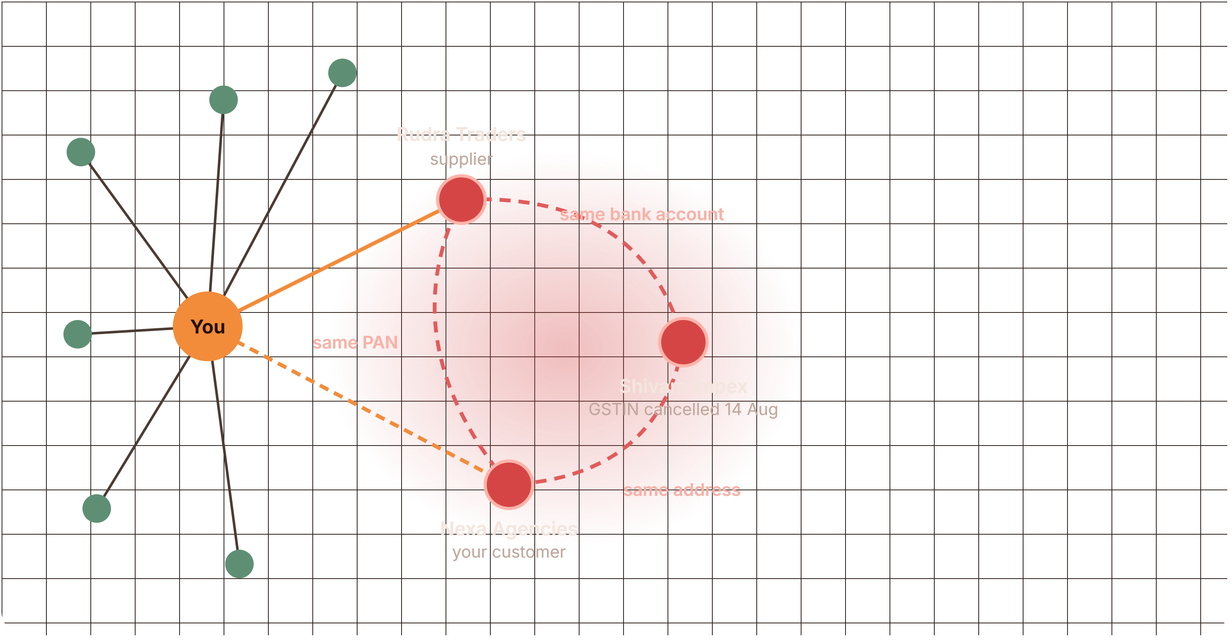




Feature / USP
Shows money,
not rows
Every flag
explains itself
Fixes, not
just finds
Spots fake
suppliers
Every problem shows the rupees at risk and the rupees you can still claim, sorted so the nearest deadline comes first. You fix what costs most, first.
Each flag gives a plain-language reason, the GST rule behind it, both records side by side and how sure we are. Anyone can check it, so there is no black box.
It drafts the supplier email, credit note request or accounting correction for each problem. Nothing is sent until you approve, so you stay in control.
It links suppliers that share an owner (PAN), bank account or address, revealing money moving in circles before the tax department finds it.
app.ledgerlens.in/issues/UB-2526-1187
app.ledgerlens.in/graph
Tax rate mismatch
₹42,000 at risk
98% sure
Money moving in a circle
UltraBuild Cements · UB/2526/1187 · 24 Sep 2025
You buy from Rudra Traders and sell to Nexa Agencies. Both share one PAN, and a third firm with a cancelled GSTIN shares their bank account.
Field
Your books
GSTR-2B
Expected
Why this was flagged
HSN
2523
2523
2523
Cement (HSN 2523) dropped from 28% to 18% on 22 Sep 2025. This invoice is dated 24 Sep but was billed at the old rate. The excess ₹42,000 should be corrected by a credit note before you claim it.
Taxable value
4,20,000
4,20,000
4,20,000
Credit at risk
₹2.23 L
Rate
28%
28%
18%
What to do
Invoices in 60 days
31
IGST
1,17,600
1,17,600
75,600
Ask UltraBuild for a ₹42,000 credit note. Until it arrives, claim credit only on the correct ₹75,600.
Rule: cement moved to 18% under GST 2.0, effective 22 Sep 2025
Drafted for you: credit note request
to accounts@ultrabuild.in
Invoice UB/2526/1187 dated 24 Sep 2025 applies 28% IGST to HSN 2523. The rate from 22 Sep 2025 is 18%. Please issue a credit note for ₹42,000 and refile in GSTR-1.
Approve and send
Edit draft
Dismiss with note
Clean supplier
Ring member
Your trade
Also: it knows the GST rate change of 22 Sep 2025, links one payment to many bills, rates every supplier, and its accuracy is measured on test data, not guessed.
Notes:
Four reasons we are different. We show money, not rows. Every flag explains itself. We fix, not just find. We spot fake suppliers by linking firms that share an owner, bank account or address. The cement example is real: its GST rate dropped from 28 to 18 percent on 22 Sep 2025, and a bill two days later still charged 28.

