Slide 1
AIGNITION 3.0 GRAND FINALE | TOP 5
Probabilistic Revenue
& ROAS Forecasting
~8%
error on total sales
89-94%
range coverage
We predict a realistic range, not one risky number - and we explain it in plain English.
30/30
edge cases passed
Team Sigmoid | Rehaan Ahmad Khan, solo entrant | JSS University, Noida
Notes:
(0:30) "Good evening, and thank you for having me. I'm Rehaan Ahmad Khan, presenting solo for Team Sigmoid. Our project is a probabilistic revenue and ROAS forecasting tool for e-commerce marketing. In one sentence: it reads a store's past advertising data and predicts what the ads will earn over the next one to three months - not as a single risky guess, but as a realistic range - and then explains that prediction in plain English. I'll cover the business problem, show you the working product live, then go through the model, the LLM layer, and what it would take to deploy this properly."

Slide 2
01
BUSINESS PROBLEM
Agencies have to promise results before the money is spent
Stores spend across Google, Bing and Meta. An agency manages that budget for them.
The agency has to commit to a number before the budget is deployed.
Sales move with the seasons, so last quarter is a poor guide to next quarter.
The data is messy and scattered - every platform reports differently.
Most tools give one number, and never explain why it will move.
WHAT IS MISSING
"Here is what to expect, here is how confident we are, and here is why."
OUR OBJECTIVE
Give an agency forward-looking decision support: a calibrated forecast of sales and ROAS it can defend to a client.
2
Notes:
(1:00) "Let me start with the business problem. Every online store spends across Google, Microsoft Bing and Meta, and an agency manages that budget for them. The hard part is that the agency has to commit to a number BEFORE the budget is deployed. That's difficult for two reasons: sales move with the seasons and with customer behaviour, and the underlying data is messy and scattered, with every platform reporting differently. And most tools that exist give you one number, and never explain why performance is about to move. What's missing is decision support - here's what to expect, here's how confident we are, and here's why. That's our objective: a calibrated forecast of sales and ROAS that an agency can actually defend to a client."

Slide 3
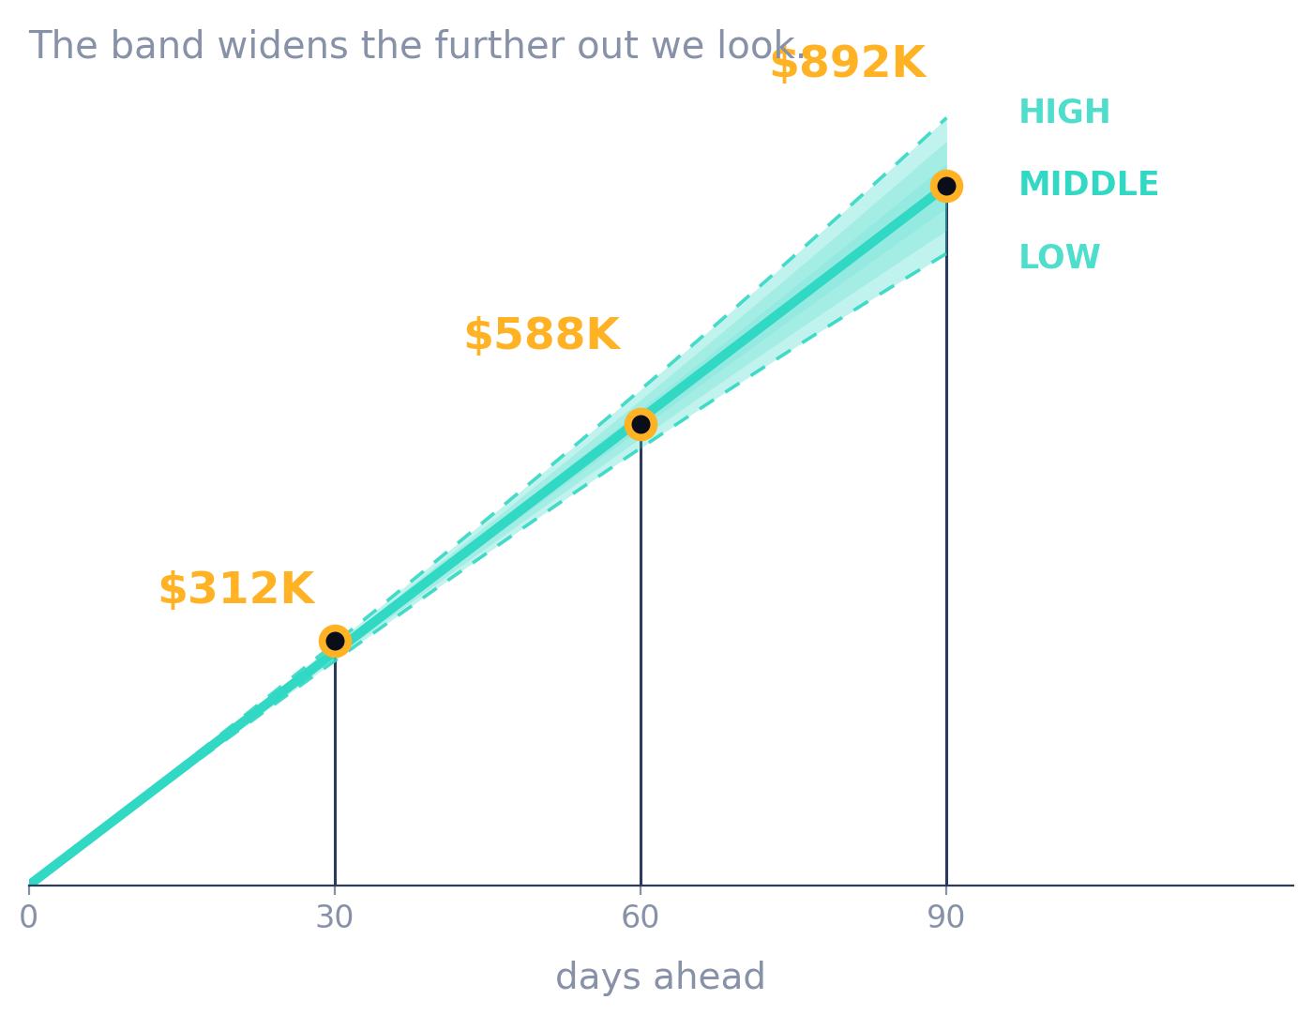
02
PROBLEM FRAMING
What exactly we set out to predict
We predict two things: sales (Revenue) and efficiency (ROAS - dollars back per dollar spent).
Over three horizons a business actually plans on: 30, 60 and 90 days.
As a low, middle and high range, because planning needs a best and a worst case.
Split by channel, campaign type and campaign, so it answers where to put the money.
The one idea to hold on to: we forecast a range, and we can prove it is honest.
3
Notes:
(1:00) "So let me frame precisely what we predict. Two quantities: future sales, which we call Revenue, and ad efficiency, which is ROAS - dollars back per dollar spent. Three horizons: 30, 60 and 90 days, because those are the windows a business plans on. And critically, we predict each one as a low, middle and high range rather than a single figure, because planning needs a best case and a worst case. We break it down by channel, by campaign type, and by individual campaign, so it answers WHERE the money should go. If you take one thing from this talk, take this: we forecast a range, and later I'll show you we can prove that range is honest."

Slide 4
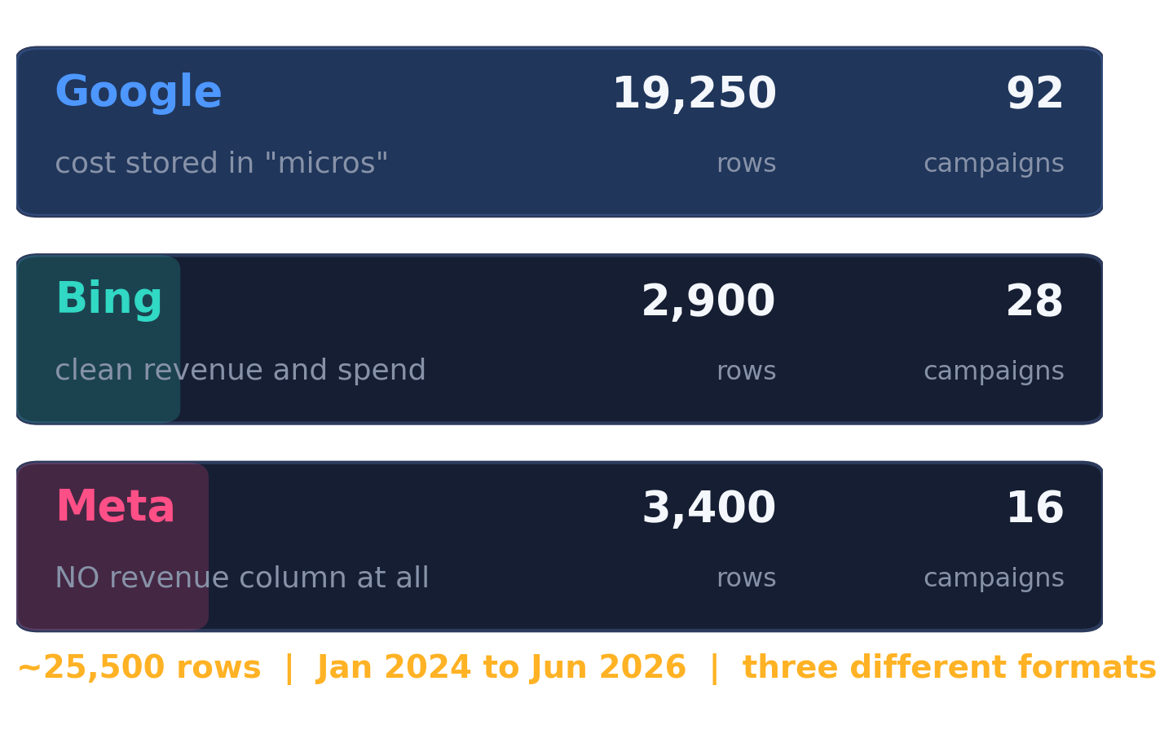
03
THE DATA
Three files, three formats, one trap
Three files of daily ad data, one per channel, and none of them match.
Google is the biggest, and stores cost in "micros" - divide everything by a million.
Bing is small but clean, with usable revenue and spend.
Meta is the problem: no revenue column at all, only a conversion count.
So step one of the pipeline exists purely to make these three into one clean table.
4
Notes:
(1:00) "Here's the data we were given. Three files of daily advertising data, one per channel, roughly 25,500 rows in total, spanning January 2024 to June 2026. They don't match each other. Google is the biggest by far, and it stores cost in 'micros' - millionths - so every cost figure has to be divided by a million before it means anything. Bing is small but clean. And Meta is the problem: no revenue column at all, only a broad conversion count. Which brings me to the most important data decision we made."

Slide 5
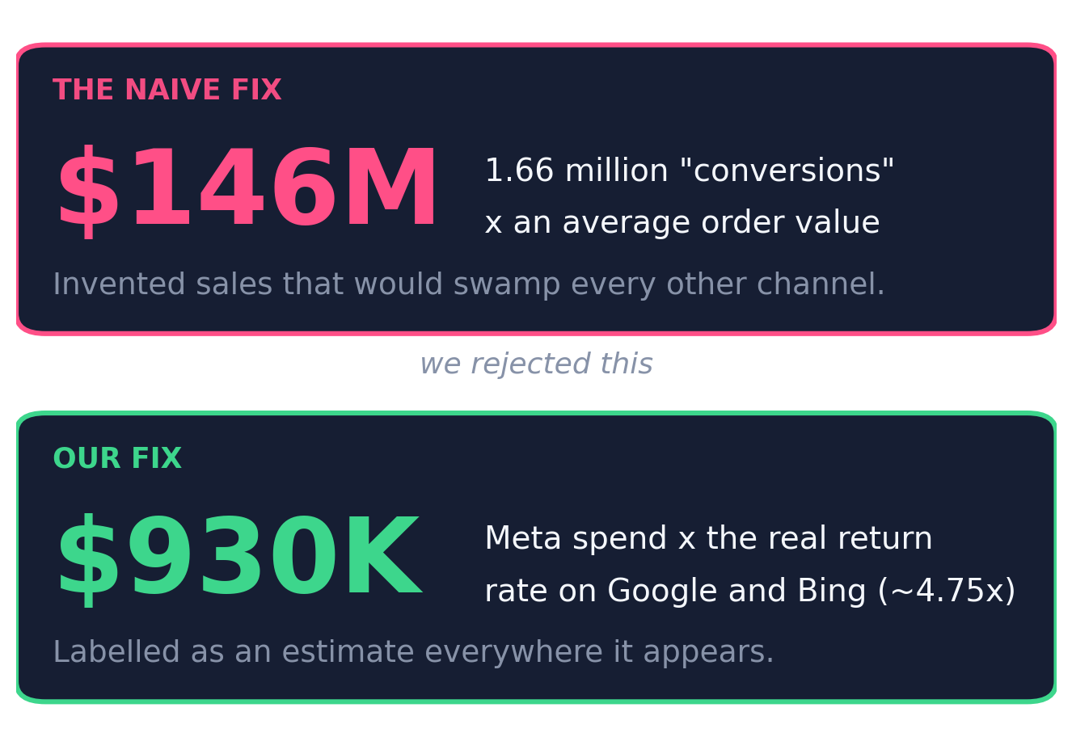
04
KEY DATA DECISION
The Meta trap, and our honest fix
Meta's conversion count totals about 1.66 million. Those are clearly not purchases.
Multiply that by an average order value and you invent roughly $146 million of sales.
That one mistake would swamp Google and Bing and make the forecast meaningless.
We instead use Meta's spend times the real return rate on Google and Bing, about 4.75x.
That gives around $930,000, labelled as an estimate everywhere it appears.
This is the slide that shows we read the data, not just ran a model.
5
Notes:
(1:30) "Meta's conversion count adds up to about 1.66 million. That is clearly not 1.66 million purchases. Now, the naive move is to multiply that count by an average order value. Do that, and you invent roughly a hundred and forty-six MILLION dollars of sales that never happened. That one mistake would swamp Google and Bing completely and make the entire forecast meaningless. So instead, we estimate Meta's revenue as its own spend times the real return rate we actually observe on Google and Bing - about four-point-seven-five times - which gives around nine hundred and thirty thousand dollars. And we label it as an estimate everywhere it appears. I'm dwelling on this because it's the slide that shows we read the data rather than just running a model on it. Now let me show you the product."

Slide 6
LIVE PRODUCT DEMO
WHAT I WILL SHOW
The 90-day forecast with its low-to-high band.
The cone widening further out.
The breakdown by channel and campaign type.
The simulator: Meta up, sales rise, ROAS drops.
The AI briefing, generated live.
The note confirming Meta revenue is an estimate.
Switch to the live app and walk through it in real time.
https://sigmoid-forecaster.streamlit.app/
Code: github.com/RAK2315/netElixir
6
Notes:
=== LIVE DEMO - 4:00 - SWITCH TO THE STREAMLIT APP === Have https://sigmoid-forecaster.streamlit.app/ already open and loaded in a browser tab BEFORE the session starts. 1. Orient them: "This is the live tool, everything updates in real time." 2. KPIs: "Here's the 90-day forecast: about [X] in sales, with a low-high band from [low] to [high], at a blended ROAS of about [Y] times." 3. Cone: "Total sales building up over 90 days. Notice the shaded band WIDENS further out - that's honest uncertainty, not a rendering artefact." 4. Breakdown: "It splits by channel and campaign type, so an agency knows exactly where the money comes from." 5. Simulator: slide Meta up. "Watch - I increase Meta's budget. Sales rise, but look at the ROAS curve, it slowly drops. That's diminishing returns, live." 6. AI briefing: click Generate. "The model reads only these numbers and writes the explanation - what to expect, why, the risks, and what to do." 7. Meta note: "And we're transparent - it states plainly that Meta revenue is an estimate." If the app is slow or the network drops: say "I'll show you the same views as static charts" and go straight to the next slides. Do not debug on stage.

Slide 7
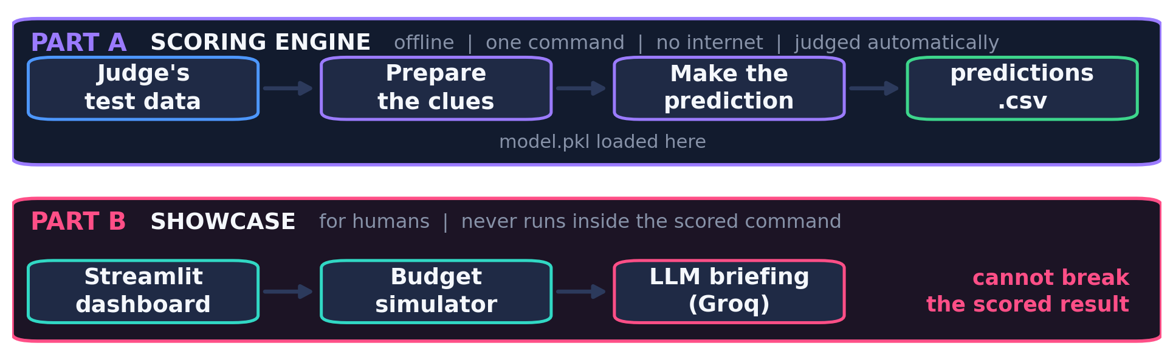
05
ARCHITECTURE
The project is split into two clean parts
Part A is the scoring engine: our code, the judge's secret data, one offline command, graded automatically.
If Part A breaks we score zero, so we kept it simple, fast and bullet-proof.
Part B is the showcase: dashboard, simulator and LLM briefing, for humans.
Part B never runs inside the scored command, so the demo cannot take the score down with it.
7
Notes:
(1:15) "Architecturally the project splits into two clean parts, and this was deliberate. Part A is the scoring engine. An automated pipeline takes our code, swaps in its own secret test data, runs ONE command with no internet access, and grades the output. If anything in Part A breaks, we score zero - so we kept it simple, fast and bullet-proof. Part B is the showcase: the dashboard, the simulator, the LLM briefing. Part B never executes inside the scored command. That means nothing in the demo I just showed you can take the scored result down with it. A lot of teams bolt their AI onto the scored path and fail the automated test - this separation is why ours doesn't."

Slide 8
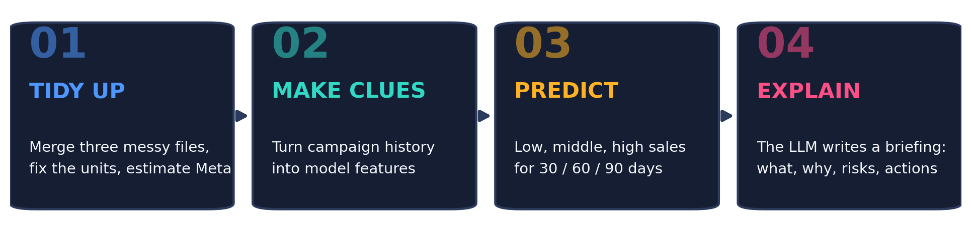
06
THE PIPELINE
How a single forecast is actually made
Tidy up: three messy files become one clean table, units fixed, Meta estimated.
Make clues: each campaign's recent spend, sales, trend and season become model features.
Predict: the model outputs low, middle and high sales per horizon. ROAS is sales over spend.
Explain: the language model reads those numbers and writes the briefing.
8
Notes:
(1:15) "Under the hood there are four steps. One, tidy up: three messy files become one clean table, units get fixed, Meta's revenue gets estimated. Two, make clues - in machine learning these are called features: each campaign's recent spend, sales, trend and season, turned into numbers a model can learn from. Three, predict: the model outputs a low, middle and high sales figure for each horizon, and ROAS falls out as sales divided by spend. Four, explain: the language model reads those numbers and writes a briefing. Let me take step three properly, because that's the technical heart of this."

Slide 9
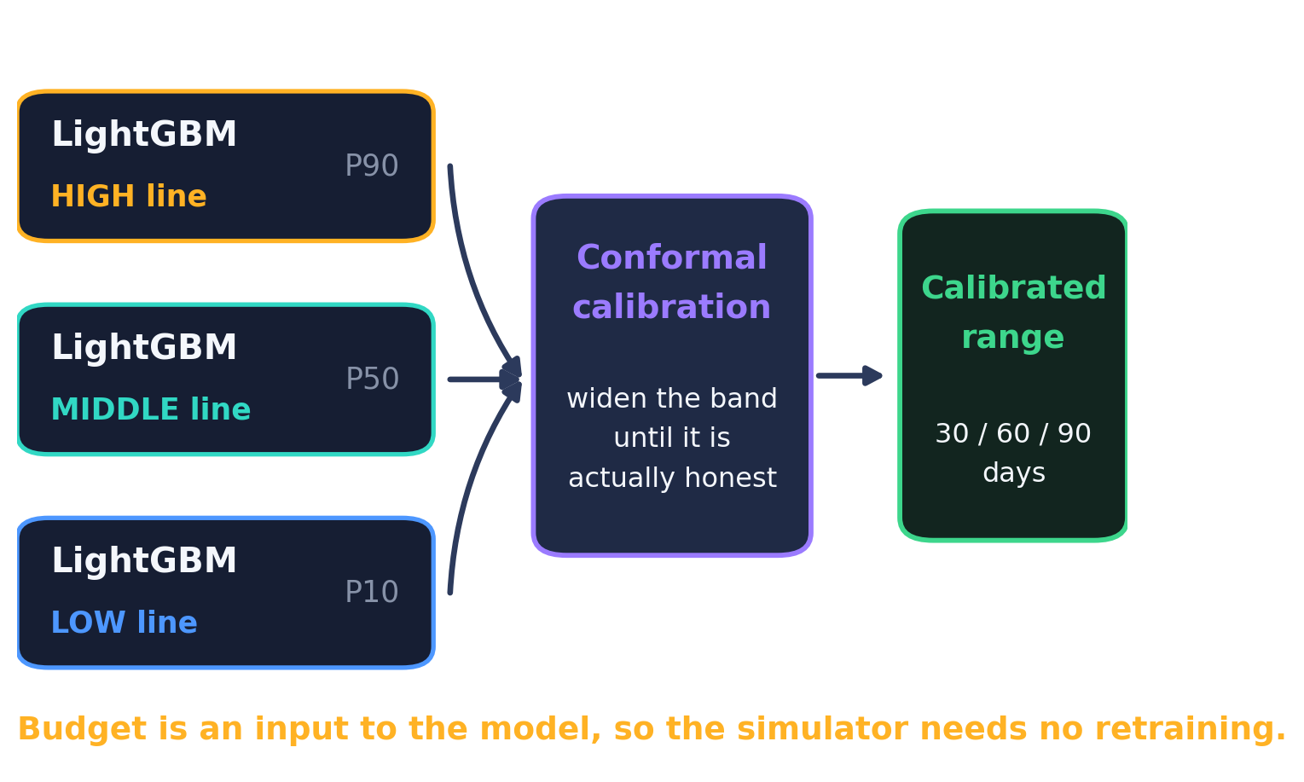
07
MODEL CHOICES
Why three LightGBM models, not one
LightGBM: gradient boosting, fast, well proven, and strong on tabular data.
We deliberately skipped a deep sequence model - at ~25,000 rows, boosted trees fit better.
The key decision: we train three models, not one - low line, middle line, high line.
That is quantile regression, and it is what lets us output a range at all.
Budget is a model input, which is why the simulator responds with no retraining.
9
Notes:
(1:30) "We use LightGBM - gradient boosting, fast, well proven, and strong on tabular data like this. I want to be direct about why we did NOT reach for a deep sequence model: with roughly twenty-five thousand rows across a few hundred campaigns, boosted trees are the better-suited choice, and they're far easier to defend. The important decision is that we train three models rather than one. One learns the low line, one the middle, one the high. That technique is quantile regression, and it's what lets the system output a range at all instead of a single point. One more thing: budget is one of the model's inputs. That's exactly why the simulator you just watched responds instantly, with no retraining."

Slide 10
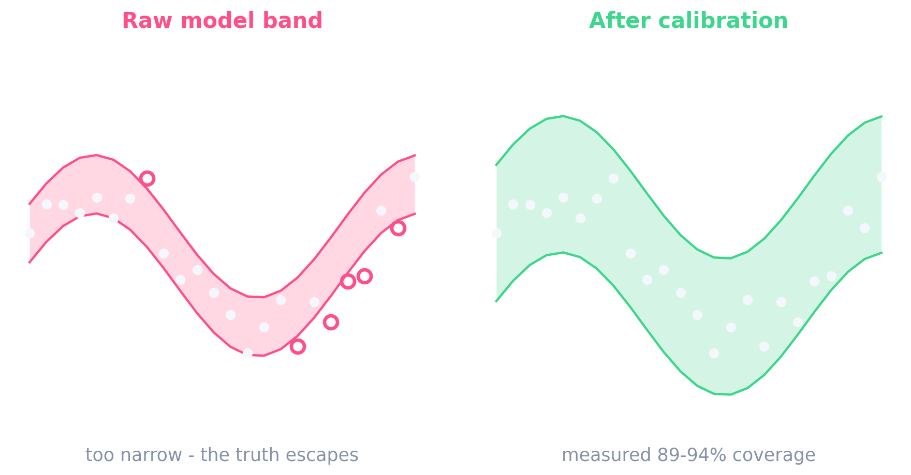
08
MODEL CHOICES
Making the range honest, not just wide
The catch: a raw quantile band is usually too narrow, so the truth escapes it too often.
A dishonest range is worse than no range, because a client plans against it.
So we add conformal prediction: test the band on past data, widen it until it holds up.
That turns a guess into a measured guarantee - which the next slide shows.
10
Notes:
(1:15) "But there's a catch with quantile models, and I want to be honest about it. The raw band they produce is usually too narrow, so the truth falls outside it more often than it should. And a dishonest range is worse than no range at all, because a client plans against it. So we add a calibration step called conformal prediction. In plain terms: we test our low-to-high band against past data, and where it was too narrow, we widen it until it actually holds up. On the left you can see the raw band with the truth escaping it. On the right, after calibration, it holds. That turns the band from a guess into something with a measured guarantee - which is what I can now show you."

Slide 11
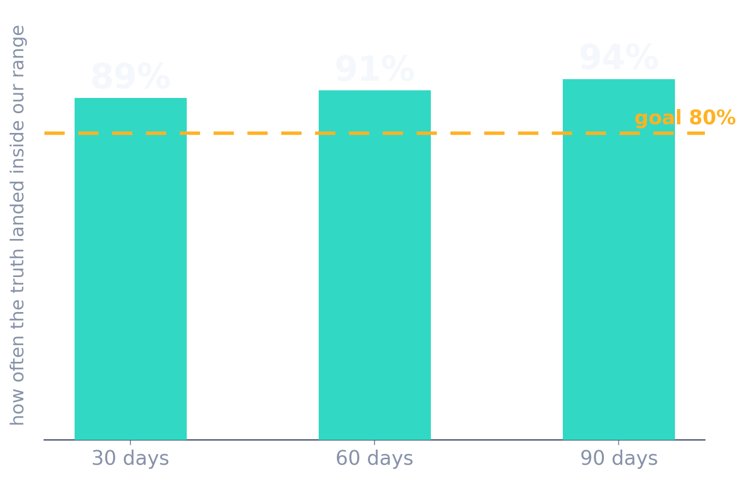
09
RESULTS
How accurate are we, honestly
A fair test: trained on older data, checked against newer data it had never seen.
On total sales, the number a business budgets against, we were off by about 8%.
Our band caught the real answer 89-94% of the time, against a target of 80%.
So it is not vague hedging - it clears the bar at every horizon, slightly on the safe side.
~8%
average error on total sales (P50 WAPE 7.8%)
89-94%
coverage against an 80% goal
11
Notes:
(1:15) "So how accurate is it? We ran a fair test - trained on older data, then checked against newer data the model had never seen. Two results matter. First, on TOTAL sales, the number a business actually budgets against, our middle estimate was off by about eight percent on average. Our precise figure is a P50 WAPE of seven-point-eight percent. For revenue forecasting at this horizon, that's strong. Second, and I'd argue more important: our low-to-high band caught the real answer between eighty-nine and ninety-four percent of the time, against a target of eighty. So the range isn't vague hedging - it's calibrated, it clears the bar at every horizon, and it errs slightly on the safe side."

Slide 12
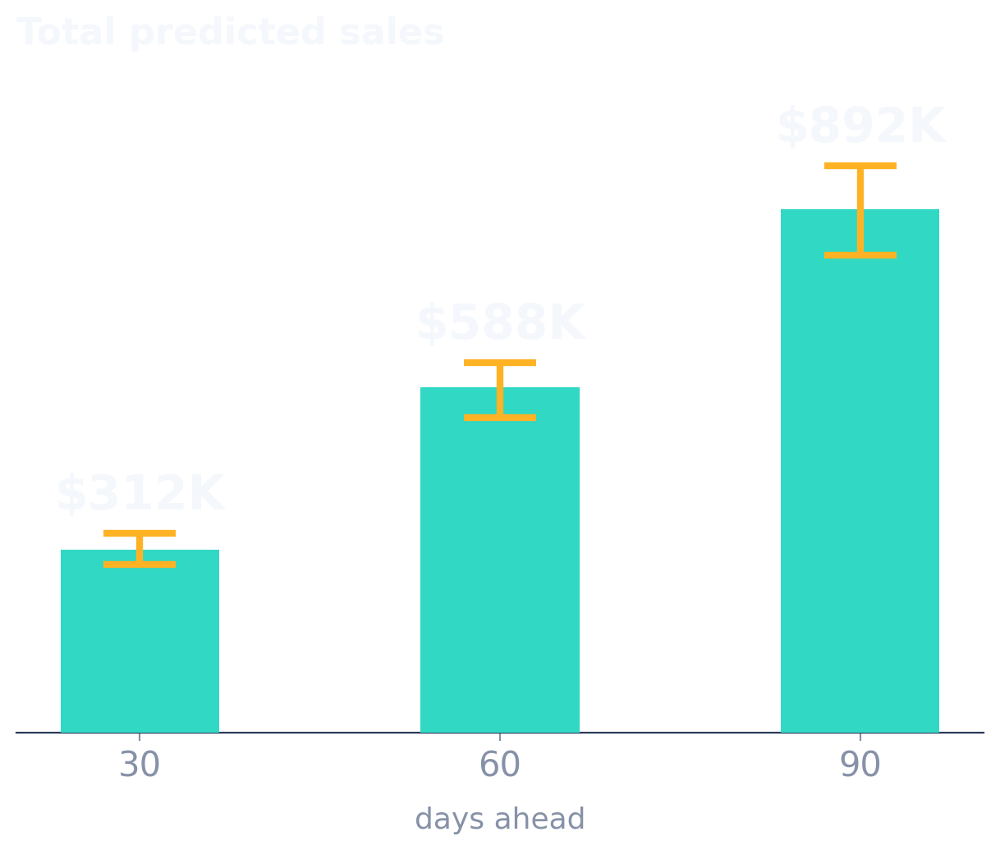
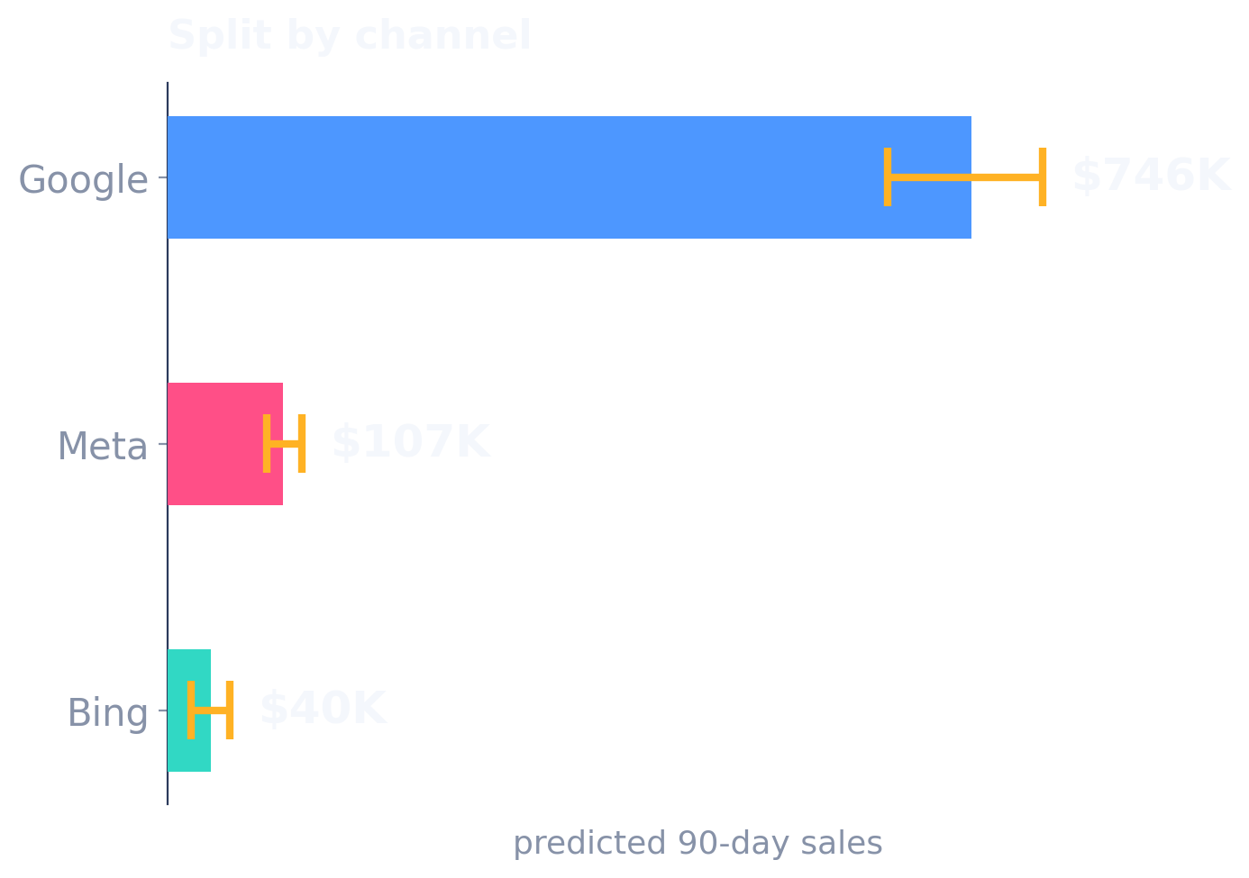
10
RESULTS
The output an agency actually receives
Left: total predicted sales at 30, 60 and 90 days, each with its band. It widens further out.
Right: the same 90-day forecast split by channel, and it goes down to individual campaign.
That second view answers the question an agency is paid to answer - where does the next dollar go.
12
Notes:
(0:45) "This is what an agency actually receives. On the left, the headline: total predicted sales at thirty, sixty and ninety days, each with its low-to-high band. Notice again that the band widens further out - we're honestly less certain about ninety days than about thirty. On the right, the same ninety-day forecast split by channel, each with its own range, and it goes further down still, to campaign type and to individual campaign. That right-hand view is the one that answers the question an agency is actually paid to answer: where should the next dollar go."

Slide 13
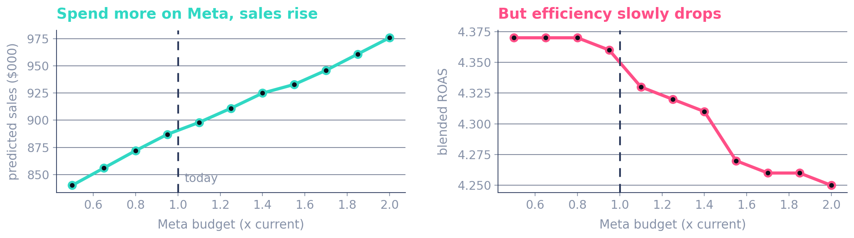
11
DECISION SUPPORT
The budget simulator, and diminishing returns
Push more budget into Meta and predicted sales keep rising - the easy half of the story.
But blended ROAS slowly falls. That is diminishing returns, and most dashboards hide it.
Together they show where the next dollar of budget stops paying for itself.
It updates instantly because budget is a direct model input - no retraining.
13
Notes:
(0:45) "This is the simulator from the demo, summarised. As we push more budget into Meta, predicted sales keep rising - that's the easy half of the story, and it's the half most dashboards show you. But blended ROAS slowly falls. That's the classic diminishing-returns curve. Together, those two curves let an agency find the point where the next dollar of budget stops paying for itself. And it updates instantly because budget is a direct input to the model, so nothing has to be retrained between slider moves."

Slide 14
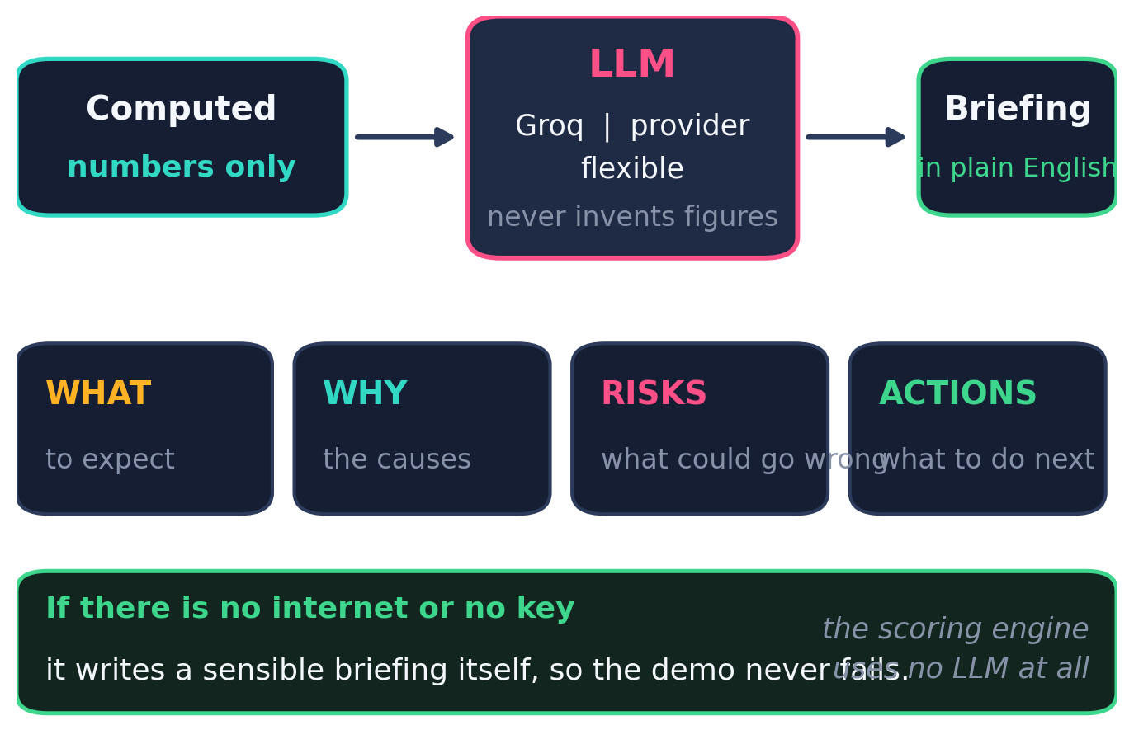
12
THE LLM LAYER
How the language model is integrated
Once the numbers exist, a model served through Groq writes a four-part briefing.
The critical constraint: it only explains numbers we computed. It is never asked for a figure.
Provider-flexible - Groq can be swapped without touching the forecasting code.
With no internet or key, it writes a sensible briefing itself, so the demo cannot fail.
The scoring engine uses no LLM at all. The graded path stays fully deterministic.
14
Notes:
(1:30) "Now the LLM layer, and how it's actually integrated. Once the numbers exist, we pass them to a language model served through Groq, and it writes a short briefing in four parts: what to expect, why, the risks, and what to do next. The critical design constraint is this: it only ever explains numbers we have already computed. It is never asked to produce a figure, so it cannot invent one. That's how we keep it trustworthy. It's provider-flexible, so Groq can be swapped out without touching the forecasting code. If there's no internet or no API key, it falls back to writing a sensible briefing itself - which is precisely why the demo cannot fail on stage. And the scoring engine uses no LLM at all: the graded path stays fully deterministic."

Slide 15
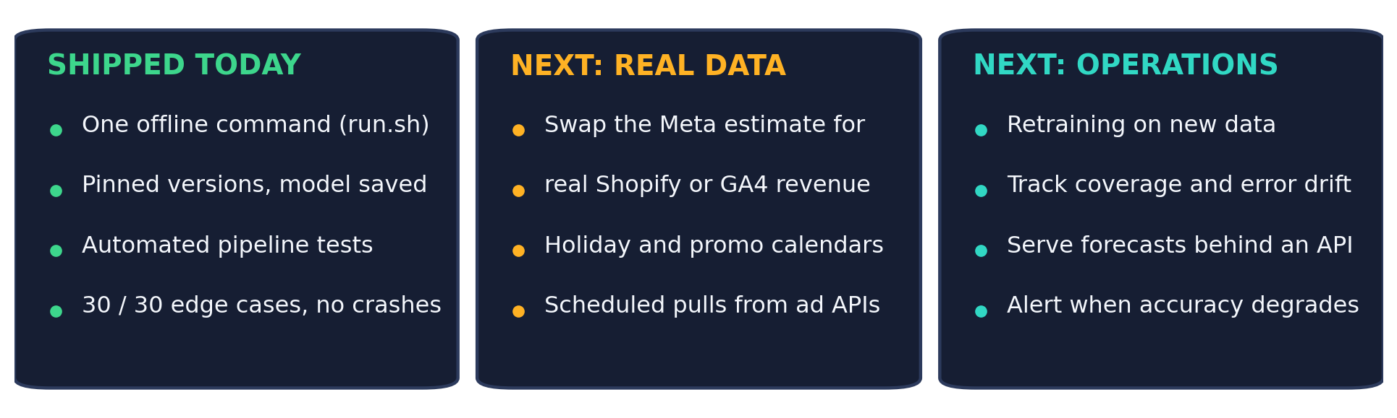
13
PRODUCTION READINESS AND FUTURE SCOPE
What is already solid, and what deployment would need
Already solid: one offline command, pinned versions, model committed - a clean clone reproduces our results.
It has automated pipeline tests, and survived 30 hostile inputs without a crash.
To deploy, first fix the data: real Shopify or GA4 revenue instead of our Meta estimate, plus promo calendars.
Then operations: scheduled retraining, drift monitoring on coverage and error, and an API instead of a local run.
15
Notes:
(1:30) "Finally, production readiness - what it would take to actually deploy this. Let me split it into what already holds up, and what would still be needed. What holds up: the whole thing runs from one offline command, with pinned dependency versions and the trained model committed, so a clean clone reproduces our results exactly. It has automated pipeline tests. And we hardened it against thirty deliberately hostile inputs without a single crash. What deployment would still need, first on data: swap our Meta estimate for real Shopify or GA4 revenue, and add holiday and promotion calendars so seasonality is explicit rather than inferred. Second on operations: scheduled retraining as new data lands, monitoring of live coverage and error so we can actually see the model drifting, and serving the forecast behind an API rather than a local run. I'd rather tell you honestly what's missing than claim it's production-grade today."

Slide 16
14
CHALLENGES AND LEARNINGS
What was hard, and what it taught us
WHAT WAS HARD
WHAT WE LEARNED
Meta reported no revenue at all.
Reading the data mattered more than the model choice.
Three files, three formats, three unit conventions.
Cleaning is not setup work - it is where the accuracy came from.
Our raw model band was too narrow to trust.
An honest range beats a confident single number.
The scored run had to work offline, first time, on unseen data.
Keep the graded path deterministic, keep the AI outside it.
Future scope is on the previous slide: real revenue data, promo calendars, retraining and drift monitoring.
16
Notes:
(1:15) "Before I close, the challenges and what they taught us, because I think that's the more useful part. Four things were genuinely hard. Meta reported no revenue at all. The three files came in three formats with three unit conventions. Our raw model band turned out to be too narrow to trust. And the scored run had to work offline, first time, on data we would never see. And four things we took from that. First, reading the data mattered more than the model choice - the Meta decision moved our numbers far more than any hyperparameter did. Second, cleaning isn't setup work, it's where the accuracy actually came from. Third, an honest range beats a confident single number, and you have to measure that honesty rather than assume it. And fourth, keep the graded path deterministic and keep the AI outside it - that one decision is why our submission runs reliably. Future scope is the previous slide: real revenue data instead of our Meta estimate, promotion calendars, and retraining with drift monitoring."

Slide 17
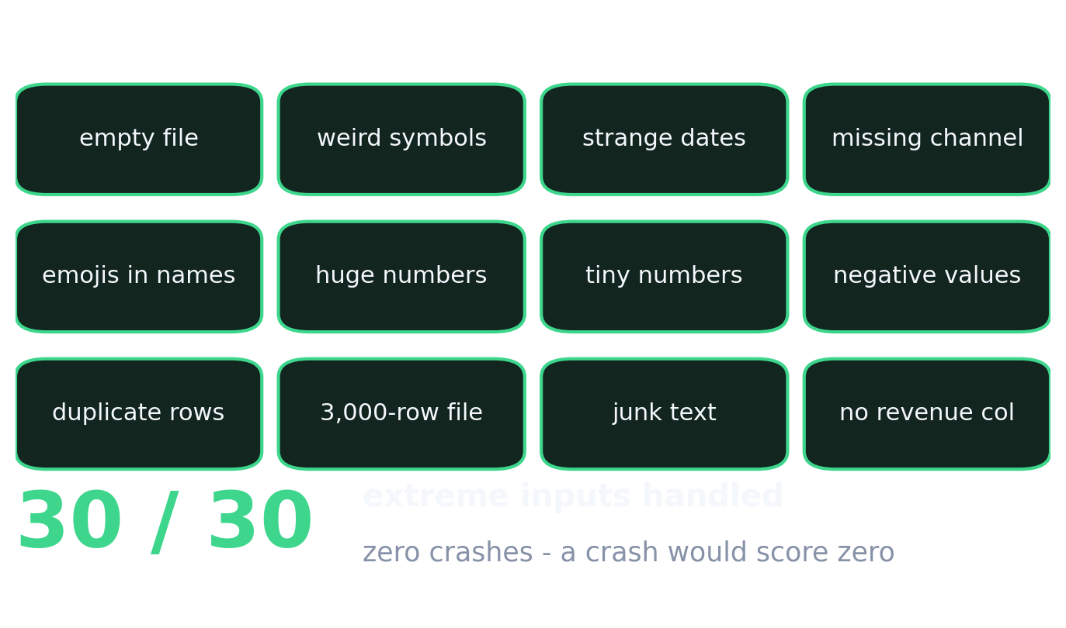
15
WHY US
Reliability, and the five reasons to pick this
01
We predict a calibrated range, not one risky number.
02
We caught and honestly fixed the Meta no-revenue trap.
03
About 8% error on total sales, with 89-94% coverage.
04
It passes the strict offline test, where many projects fail.
05
Live budget simulation plus a grounded AI briefing.
Thank you - happy to take questions.
Live demo: https://sigmoid-forecaster.streamlit.app/ | Code: github.com/RAK2315/netElixir
17
Notes:
(1:00) "Let me close on reliability and then the summary. Because the judges feed in their own data, the tool has to survive whatever it's given - so we deliberately tried to break it thirty different ways: empty files, weird symbols where numbers should be, strange date formats, a missing channel, emojis in campaign names, huge and tiny numbers. All thirty were handled without a single crash. In this competition a crash is an automatic zero, so that's a real competitive advantage, not polish. So, five reasons. One: we predict a calibrated range, not one risky number. Two: we caught and honestly fixed the Meta no-revenue trap. Three: about eight percent error on total sales, with eighty-nine to ninety-four percent coverage. Four: it passes the strict offline test, where many projects fail. Five: live budget simulation plus a grounded AI briefing. It's a useful, honest and reliable forecasting tool - not just a demo. Thank you very much; I'd be glad to take questions. === Q&A BACK-POCKET === - Meta's missing revenue -> spend x blended Google+Bing return rate (~4.75x), labelled as an estimate; avoids a $146M error. - Why a range -> planning needs best and worst case; a single number hides risk. Calibrated to an 80% target, measured 89-94%. - Why LightGBM not deep learning -> ~25,500 rows, tabular, few hundred campaigns; boosted trees fit the data size and are more defensible. - Will it run on our data -> one offline command, pinned versions, model committed, verified on a clean clone and 30 edge cases. - Where does the LLM fit -> explains computed numbers only, never generates figures, sits outside the scored path, has an offline fallback. - What would you improve -> real Shopify/GA4 revenue instead of the Meta estimate; holiday and promo calendars; scheduled retraining with drift monitoring.

