Slide 1


3D SCANNER
CMR COLLEGE OF ENGINEERING & TECHNOLOGY
(Autonomous)
Kandlakoya, Medchal, HYDERABAD
CENTRE FOR ENGINEERING EDUCATION RESEARCH
REVIEW-II
SOCIAL INNOVATION IN PRACTICE (A400507)
IV SEMESTER A.Y 2023-24
Student Team Details
G. Gayathri - 22H51A0484
G. Rakesh - 23H55A0410
M. Shashi Vardhan Reddy - 23H55A0419
N. Revanth - 23H55A0421
Rai Abhishek - 23H55A0424
R. Venkatesh - 23H55A0425
Faculty Mentors
Mr.K. Raju, Asst. Professor
Mr.S. Suresh Ram, Asst. Professor
Mr.K. Nagendra Prasad, Asst. Professor
3D-SCANNER CMR College of Engineering & Technology

Slide 2

CONTENT
Problem Statement
Proposed Solution
Components required
Block Diagram
Flow Chart
Working Principle of all components used/Software modules
Working of the model/Frontend demonstration
Results and Discussions
Plan of Action
References

Slide 3

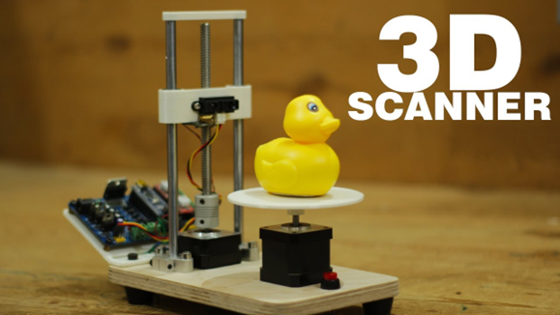
PROBLEM STATEMENT
The issue that encouraged the development of this 3D scanner system is the need for an affordable and efficient solution for 3D scanning applications in various industries such as engineering, architecture, and healthcare. Traditional 3D scanning technologies can be expensive and require specialized expertise, limiting their accessibility to smaller businesses and individuals. This system offers an accessible and customizable solution that can be built and operated by individuals with basic technical skills. The system's real-time scanning capabilities and high-resolution 3D modelling make it a valuable tool for industries that require accurate and detailed scans of complex shapes and geometries.
3D-SCANNER CMR College of Engineering & Technology

Slide 4
PROPOSED SOLUTION
Hardware Setup:
- Arduino: Acts as the controller for the scanning process, coordinating the movement of the laser sensor and data capture.
- Laser Depth Sensor: Measures the distance between the sensor and the object's surface, generating depth data.
- SD Card: Used to store the G-code instructions generated by Arduino.
2. Scanning Process:
- The Arduino controls the movement of the laser depth sensor, possibly on a motorized platform or manually guided.
- As the sensor scans the object, it collects depth information at various points.
- Arduino translates this depth data into G-code instructions, which are then stored on the SD card.
3. Post-Processing:
- The SD card is removed from the Arduino and connected to a computer.
- The G-code file is transferred to the computer.
- Using software on the computer, the G-code file is converted into a 3D file format, such as STL or OBJ.
4. 3D Model Generation:
- The software interprets the G-code instructions to reconstruct the 3D geometry of the scanned object.
- Depending on the complexity of the scanning process and the software used.
5. Finalization:
-The resulting 3D model can be further processed or edited as needed.
- It can be exported in various formats for use in 3D printing, computer-aided design (CAD) software, or visualization applications.
Communicate
Iterate
3D-SCANNER CMR College of Engineering & Technology

Slide 5
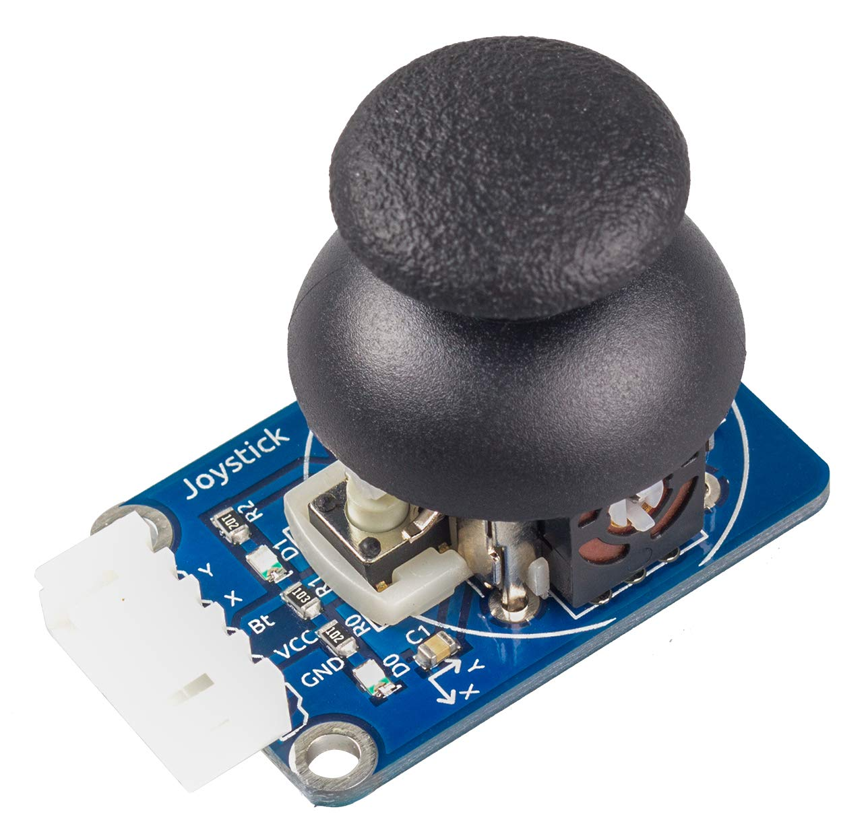
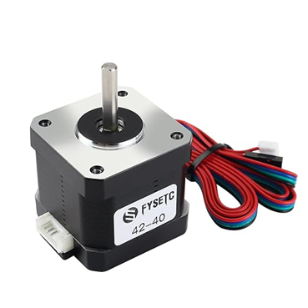
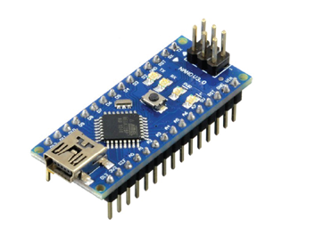
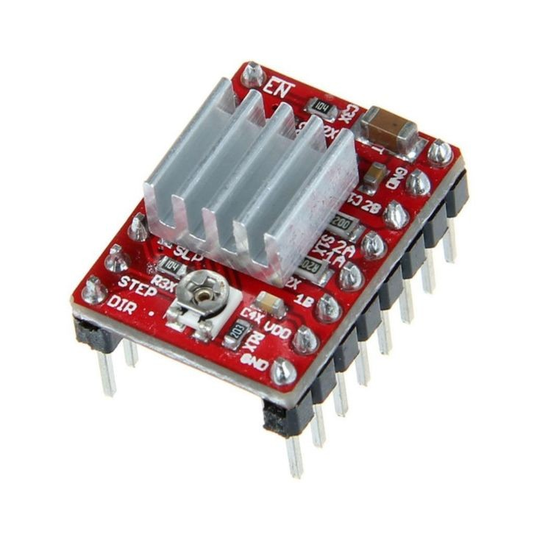
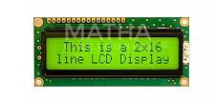
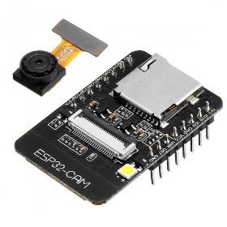
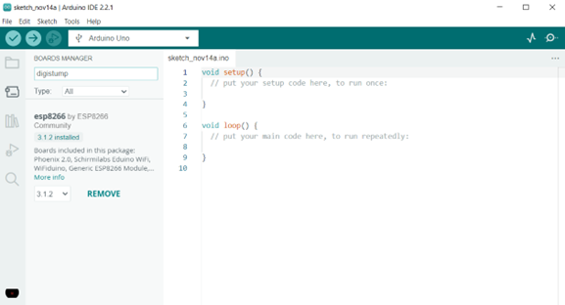
COMPONENTS REQUIRED
JOYSTICK:
A joystick module is a device that converts physical movement into electrical signals that can be used by microcontrollers, computers, or other electronic devices.
Arduino nano:
Arduino Nano is one type of microcontroller board.
Rs. 300
NEMA 17 stepper motors:
They are known for their precision and reliability, and are designed to provide smooth and accurate motion control in demanding applications. Rs. 500
LCD DISPLAY:
A liquid-crystal display is a flat panel display or other electronically modulated optical device that uses the light modulating properties of liquid crystals obtained with polarizes.
A4988 :
is a stepper motor driver board that can control bipolar stepper motors and some unipolar stepper motors.
Rs. 300
OV 2640:
Is a low voltage CMOS image sensor that provides the full functionality of a single-chip UXGA(1632 x 1232)
Rs. 500
Arduino IDE:
The Arduino Integrated Development Environment (IDE) is an open-source software that allows users to write and upload code to Arduino boards.
3D-SCANNER CMR College of Engineering & Technology

Slide 6
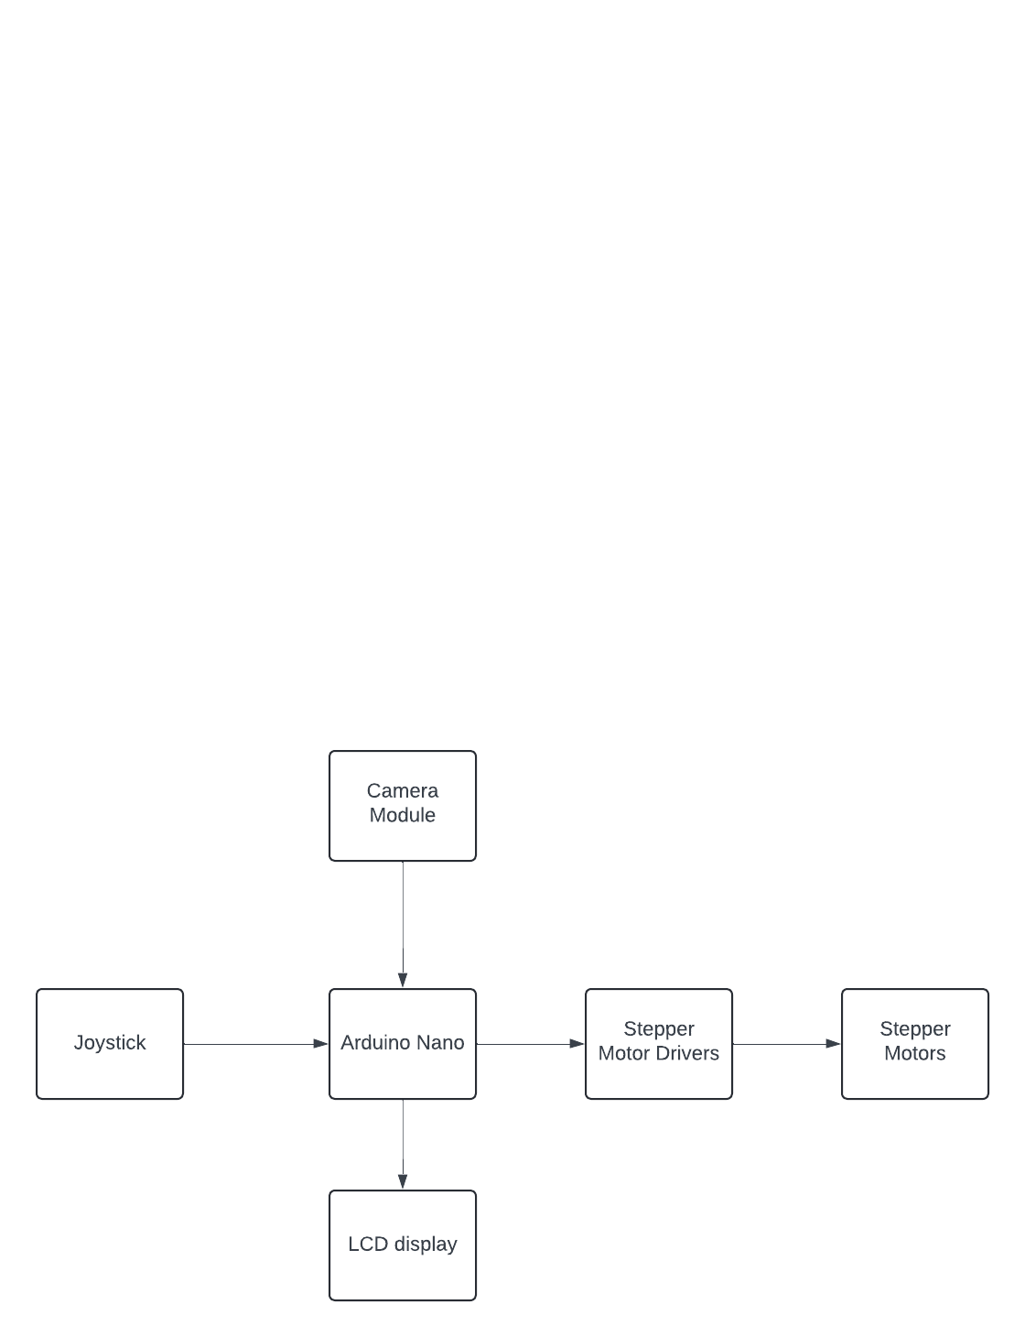
BLOCK DIAGRAM (For Hardware Projects)
3D-SCANNER CMR College of Engineering & Technology

Slide 7
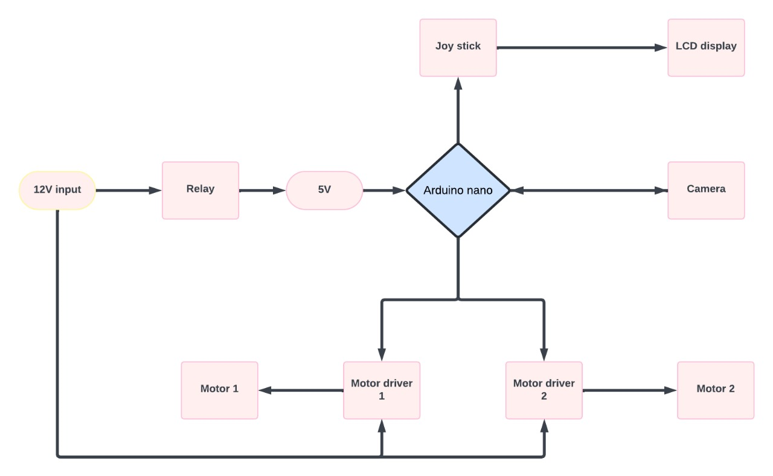
FLOW CHART (For Software Projects)
3D-SCANNER CMR College of Engineering & Technology

Slide 8
WORKING PRINCIPLE OF ALL COMPONENTS USED/SOFTWARE MODULES
NEMA Stepper Motor :NEMA stepper motors are precision motors that divide a full rotation into a large number of steps, allowing for precise control of angular position. They operate by energizing coils in a sequence, creating a rotating magnetic field that causes the rotor to step to each position. Common applications include 3D printers, CNC machines, and robotic.
A4988 Stepper Motor Driver :The A4988 is a microstepping driver for controlling bipolar stepper motors. It simplifies the process of driving stepper motors with its built-in translator, which allows for control through simple step and direction inputs. The driver can provide microstepping resolutions of up to 1/16th of a step, improving the motor’s precision and smoothness.
LCD 12x2 Display : An LCD 12x2 display is a liquid crystal display module with 12 characters on 2 lines. It is commonly used in projects to provide a user interface for displaying information. The display operates by applying an electric field to liquid crystals, which change their orientation and modulate light passing through them to create visible characters.
Joystick : A joystick is an input device that translates physical movement into electrical signals. It typically consists of two potentiometers (for x and y axes) and a push-button. When the stick is moved, the resistance of the potentiometers changes, producing variable voltage outputs that can be read by a microcontroller to determine the direction and magnitude of movement.
3D-SCANNER CMR College of Engineering & Technology

Slide 9
5. 7805 Voltage Regulator : The 7805 is a linear voltage regulator that outputs a steady 5V from a higher input voltage (typically 7-35V). It is widely used in electronic circuits to provide a stable power supply. The regulator works by dissipating excess voltage as heat, ensuring that the output remains at a constant 5V.
6. ESP32:The ESP32 is a low-cost, low-power microcontroller with integrated Wi-Fi and Bluetooth capabilities. It features dual-core processors, a wide range of I/O capabilities, and various peripherals. The ESP32 is ideal for IoT applications, providing connectivity and processing power in a compact package.
7. Capacitors :Capacitors are electronic components that store and release electrical energy. They are used in various parts of electronic circuits, such as filtering, timing, and energy storage. In the context of the components mentioned, capacitors can help smooth out voltage fluctuations and provide stable operation.
8. Integration:To integrate these components in a project:- *ESP32* can be used as the central controller, interfacing with other components.- *NEMA stepper motor* and *A4988 driver* can be controlled by the ESP32 to perform precise movements.- The *LCD 12x2 display* can show system status or user instructions.- A *joystick* can serve as a user input device, sending commands to the ESP32.- The *7805 voltage regulator* ensures a stable 5V supply to components that require it.- *Capacitors* help in stabilizing the power supply and decoupling noise from the ESP32 and other sensitive electronics .This setup could be used in a variety of applications, such as a robotic arm with an intuitive user interface and precise motor control

Slide 10
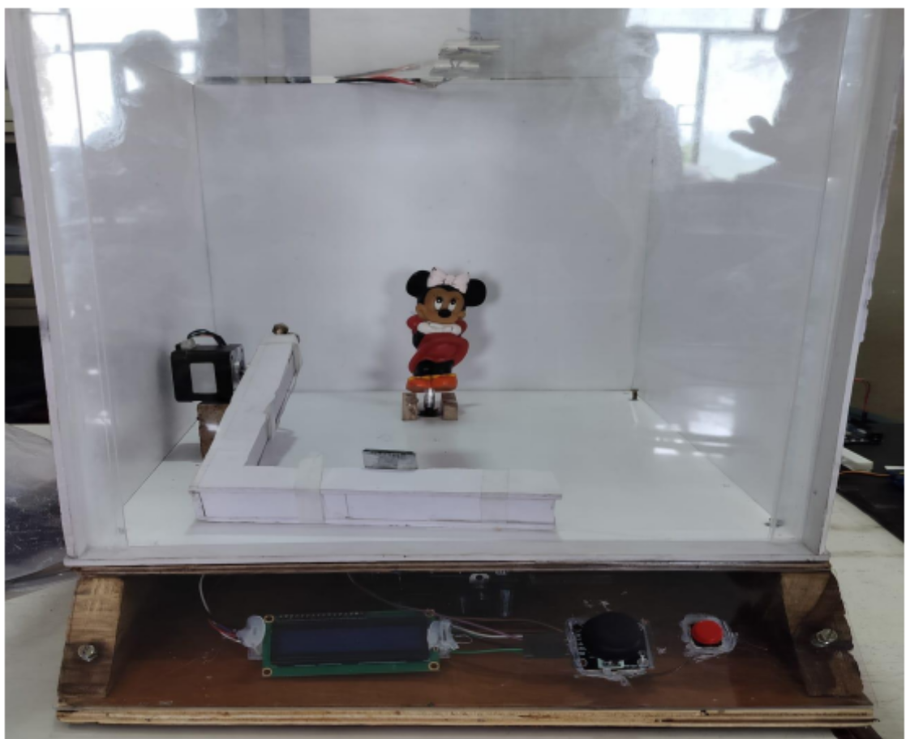
WORKING OF THE MODEL/FRONTEND
DEMONSTRATION
3D-SCANNER CMR College of Engineering & Technology

Slide 11
RESULTS AND DISCUSSIONS
The results and output of a 3D scanner typically consist of:
1.Scanned Data: This includes point clouds, which are collections of points representing the surface of the scanned object, or meshes, which are 3D representations of the object's surface made up of polygons.2.
2.Accuracy Assessment: Measurement of how accurately the scanner reproduces the geometry of the scanned object compared to its actual dimensions.
3. Resolution: Evaluation of the level of detail captured by the scanner, often measured in terms of the smallest features it can accurately capture.
4. Texture Information: Some scanners can capture color or texture information in addition to geometry, which adds realism to the scanned model.
5. Post-Processing: The scanned data often requires post-processing to clean up noise, fill in gaps, and prepare it for use in applications such as 3D printing or computer-aided design (CAD).
6. Application-Specific Outputs: Depending on the intended use of the scanned data, additional outputs may include CAD models, 3D prints, animations, or simulations . These outputs collectively provide a comprehensive representation of the scanned object and serve as the basis for further analysis or application.
3D-SCANNER CMR College of Engineering & Technology

Slide 12
PLAN OF ACTION
Objective: The main objective of this project is to design a 3D model of any object which can be duplicated or replicated easily. This project generates an OBJ file which describes the surface geometry of a 3D object.
Time line: The recognising of the coordinates which is scanned would nearly take some time which is proportional to the size of the object. Basically this project would take atleast 10 minutes to scan and getting an object file or G code as output.
WEEK 1
Get all the components and make a mind mapping of project.
WEEK 2
Assemble all the materials and give the connections.
WEEK 3
Upload the code and start the testing.
WEEK 4
If any changes or improvements.
3D-SCANNER CMR College of Engineering & Technology

Slide 13
REFERENCES
IEEE JOURNALS:
https://ieeexplore.ieee.org/document/8981708
https://ieeexplore.ieee.org/document/6014598
https://ieeexplore.ieee.org/document/9797638
EXISTING SOLUTIONS LINKS:
https://www.3d-scantech.com/product_category/tracking-3d-scanner/
https://www.3d-scantech.com/3d-scanners/
https://www.3d-scantech.com/product/am-desk-3d-workstation/
3D-SCANNER CMR College of Engineering & Technology

Slide 14


Slide 15
Questions…..
1. why we are building this project?
2. what is the unique feature of this project apart from existing scanners?
3. what are the problems in existing scanners? And How this scanner project can solve them?
4. What is the Rate of the Accuracy?
5. For which type of applications this scanner can be suitable?

