Slide 1

DEPARTMENT OF
CSE (ARTIFICIAL INTELLIGENCE AND MACHINE LEARNING)
ACADEMIC YEAR 2025 - 2026
SEMESTER III
ARTIFICIAL INTELLIGENCE LABORATORY
MINI PROJECT REVIEW spam email clasiffer.using logistic regression
REGISTER NUMBER | 2117240030053
NAME | Rakesh jc
YEAR | 2 year
SECTION | A
FACULTY IN-CHARGE | Mrs. M. Divya

Slide 2
PROBLEM STATEMENT
Introduction
Artificial Intelligence (AI) helps machines think and make decisions like humans.
Machine Learning (ML) allows systems to learn from data and improve automatically.
Millions of emails are sent daily — many are spam, which waste time or may contain harmful links.
This project uses Logistic Regression to classify emails as Spam or Not Spam.
Aim: To build a simple, accurate, and efficient spam detection model.
Problem Statement
Spam emails cause inconvenience, phishing, and data theft.
Manual filtering is not practical.
Need for an automated system that detects spam based on content.
Statement: “Build a Machine Learning model that classifies emails as spam or not spam using Logistic Regression.”
Goal / Expected Result
Develop an Email Spam Classifier using Logistic Regression.
Expected Outcomes:
  Accurate spam detection.
  Reduced unwanted messages.
  Improved email security and productivity.
Shows how AI and ML solve real-world communication problems.

Slide 3
THEORETICAL BACKGROUND
Theoretical Background & Algorithm Explanation
Spam email classification is a Machine Learning application used to detect unwanted or harmful emails automatically.
This project uses Logistic Regression, a simple and effective algorithm for binary classification (Spam / Not Spam).
Other algorithms like Naive Bayes, SVM, and Decision Trees have been used, but Logistic Regression is preferred for its simplicity, speed, and accuracy.
Algorithm Steps:
Input email dataset (Spam / Not Spam).
Preprocess text – remove stopwords, convert to lowercase, and vectorize text.
Train the Logistic Regression model.
Predict new emails as Spam or Not Spam based on probability.
Example:
“Win a free iPhone!” → Spam
“Meeting at 10 AM.” → Not Spam
Logistic Regression provides reliable results and is suitable for small datasets, making it ideal for this project.
.

Slide 4
IMPLEMENTATION AND CODE
Link to code in Git-hub Repository
List | Git-hub Repository Links
Implementation of Code Link | https://github.com/RAKI-MAX/Email-Spam-Classifier/commit/c5cc28aea7f698a63c49c80ded2f317b0b6ad639
Word Document Report Link | https://github.com/RAKI-MAX/Email-Spam-Classifier/blob/main/Ai%20mini%20project.docx
PPT Link

Slide 5
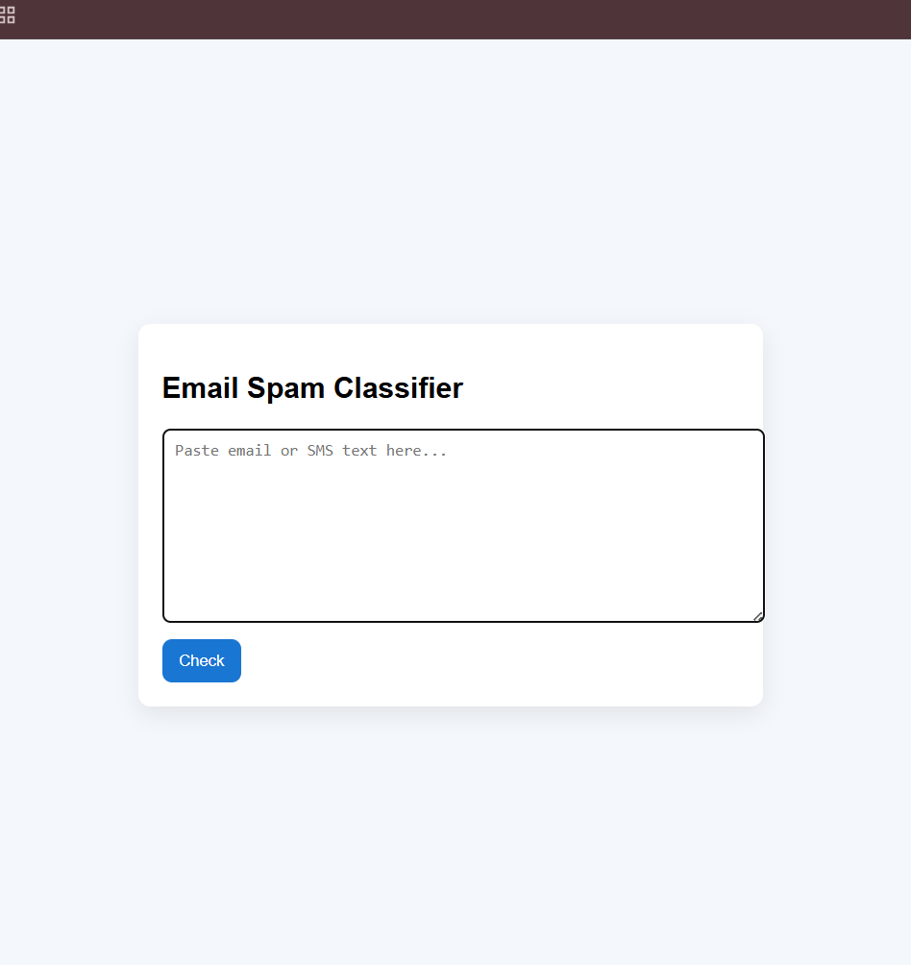
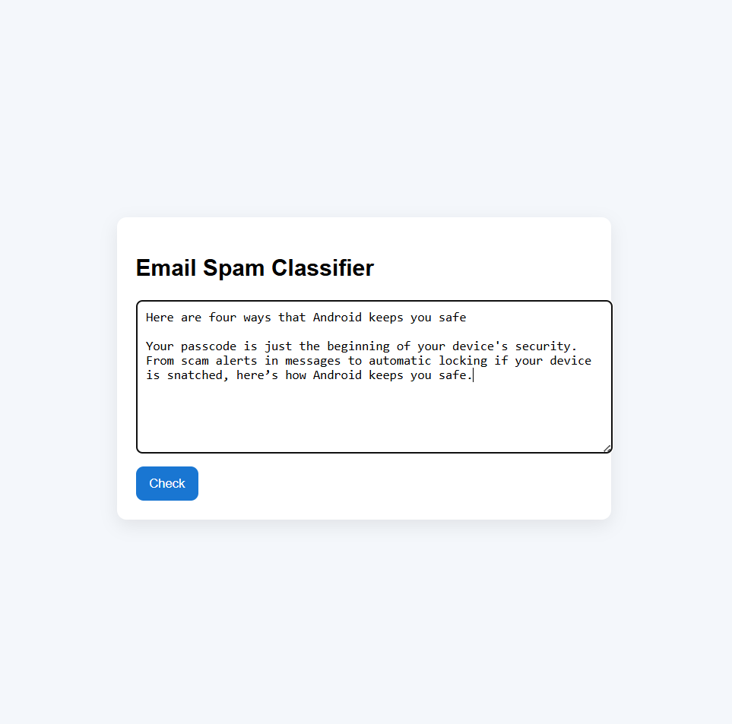
OUTPUT AND RESULTS
Outputs:

Slide 6
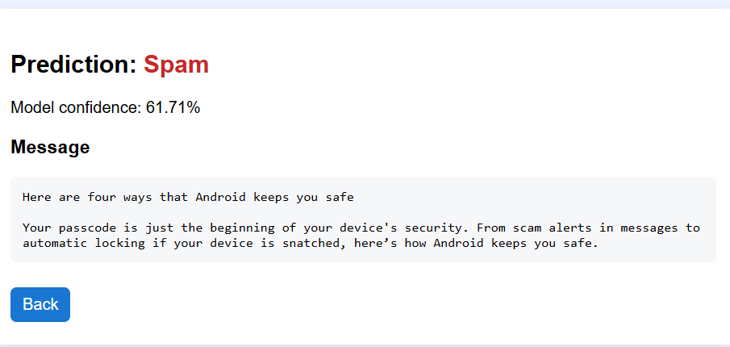
OUTPUT AND RESULTS

Slide 7
REFERENCES
Sebastian Raschka, “Python Machine Learning,” 3rd Edition, Packt Publishing, 2019.
Explains text classification, Logistic Regression, and model evaluation techniques used in spam detection.
Scikit-learn Official Documentation — Text Classification Tutorial
Source: https://scikit-learn.org/stable/tutorial/text_analytics/working_with_text_data.html
Provides detailed steps for using TF-IDF and Logistic Regression to classify text such as emails or SMS messages.
UCI Machine Learning Repository – SMS Spam Collection Dataset
Source: https://archive.ics.uci.edu/ml/datasets/sms+spam+collection
A real-world dataset of SMS messages labeled as spam or ham (not spam), used to train and test spam classifiers.

