Slide 1
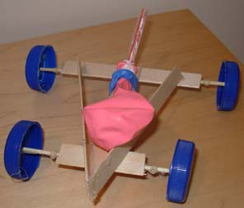
ENGINEERING BALLOON CARS: THE BRIEF
GOAL: Make a car powered by balloon(s) and/or elastic bands. The car must be able to carry the payload. The winning car will be the one which travels furthest in a straight line.
TIMING: You have
5 minutes for planning
15 minutes for making your car
10 minutes for testing
10 minutes for improving your car
5 minutes presentations
Notes:
Split the group into teams (4-5 per team) before starting. Then explain that the aim of the activity is to make a car that’s capable of carrying something (e.g. a fridge magnet – if you want to make it harder you can make it a marble, as they then have to also build a receptacle for the marble). Our apprentices made an electric go-kart – this version is a little less high-tech. The car must be powered by balloon(s). The winning team has the car which goes furthest in a straight line.
For the first five minutes the team are ONLY allowed pen and paper – they have to decide on their design. They can then chose their materials and start building. Stress the importance of testing – this can be linked to testing for space. Instruments destined for space can only use the shaker table/vacuum chamber for a constrained amount of time.
Five minutes for presentations: each team must ‘pitch’ why their car is best before racing it.
Times can be altered to suit the length of the session. Remember to leave time for racing and discussion.

Slide 2
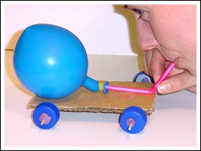
BALLOON CARS: THE BRIEF
RESOURCES: Each team will have
Cardboard, sellotape and scissors
‘wheels’ (cotton reels, polystyrene balls, plastic cups)
straws
kebab sticks
balloons
Pen and paper
5 minutes for planning
15 minutes for making your car
10 minutes for testing
10 minutes for improving your car
5 minutes presentation
Notes:
Teams are allowed as much cardboard and sellotape as they like. They can chose whichever resources they can afford. They can put as many balloons on their car as they want, but they don’t get a replacement if it pops! They also can’t trade broken straws/wheels/kebab sticks!
Note: they can make their own wheels by cutting circles of cardboard (covering the rims with sellotape reduces friction). This can work very well, and they can make as many as they like!

Slide 3
Budget and Costing
5 minutes for planning
20 minutes for making your car
10 minutes for testing
10 minutes for improving your car
5 minutes presentations
Team Budget: £100
Cardboard: £20
Wheels: £10 each
Straws: £5 each
Kebab sticks: £10 each
Balloons: £10 each
Cotton wool: £5
Elastic Bands: £5 each

