Slide 1
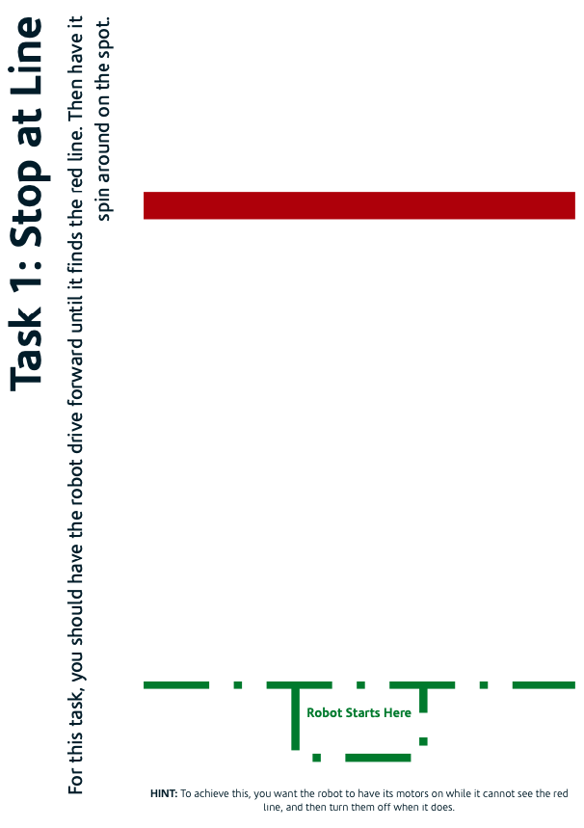

Task 1: Stop at Line
This task involves programming the Mindstorms robot to drive forwards from the start zone (green) until its colour sensor detects the red line. When the red line is found the robot should spin on the spot and then the program should end.
Here is the process your robot should do:
Program starts
Start driving forward
Star looping forever
If robot sees a red line stop looping
If robot doesn’t see a red line keep looping.
Once stopped looping, spin on the spot for 5 seconds.
Program ends
Above is the task map for this activity.

Slide 2
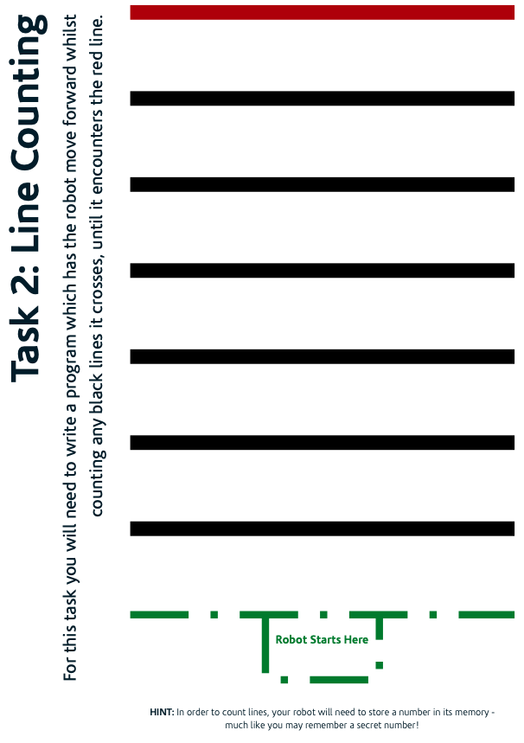
Task 2: Line counting
This task involves programming the Mindstorms robot to drive forwards from the start zone (green) and count how many black lines it crosses until it sees the red line. When it sees the red line it should stop moving and display how many lines it counted. With this activity you need to be careful to make sure the robot only counts each line only once as it passes over them!
Here is the process your robot should do:
Program starts
Create a variable to remember as 0
Start driving forever
Star looping forever
If robot sees a black line increase the variable by 1
If robot sees a red line stop looping
If robot doesn’t see a red line keep looping.
Once stopped looping, display the variable.
Program ends
Above is the task map for this activity.

Slide 3
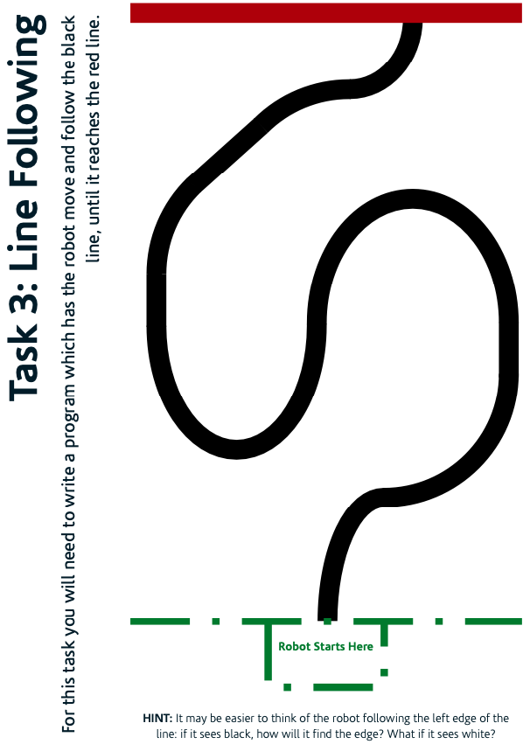
Task 3: Follow the Line
This task involves programming the Mindstorms robot to drive forwards from the start zone (green) and follow a black line until it reaches a red line.
When the robot finds the red line it should stop
moving.
Here is the process your robot should do:
Program starts
Star looping forever
If robot sees the black line it should move to stay on it
If robot sees a red line stop looping
Otherwise move back towards the black line.
Once stopped looping, spin on the spot for 5 seconds.
Program ends
Above is the task map for this activity.

