Slide 1

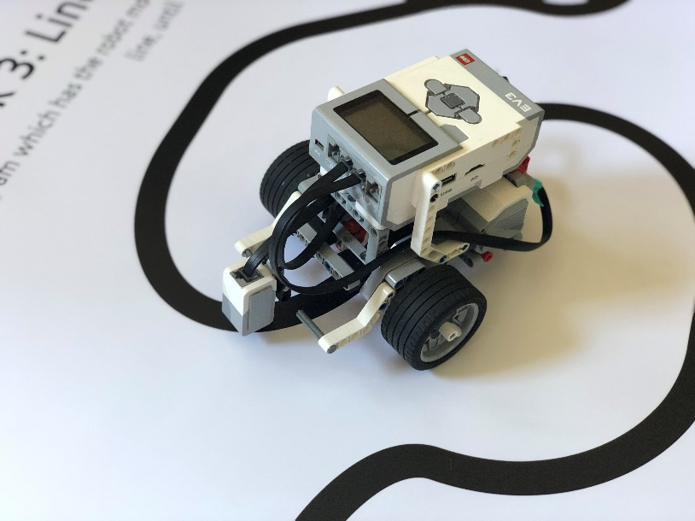
Programming with Lego Mindstorms
Tom Dack
Updated April 2024

Slide 2
What is a Computer Program?
A set of instructions for a computer.
These are typically to complete a task or solve a problem.
A computer needs a program to do anything.

Slide 3
What is a Robot?
A machine which can carry out a set of instructions automatically, often programmed using a computer.
The word Robot comes from “robota”, the Czech word for “forced labour”.
Robots can perform repetitive and dangerous tasks which are either unfit for people or ones which people prefer not to do.

Slide 4

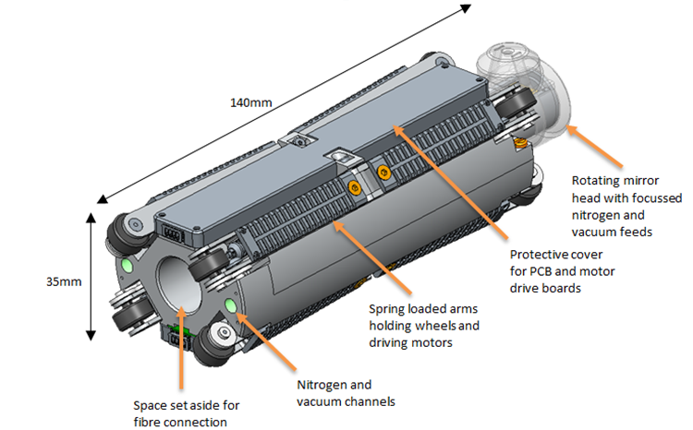
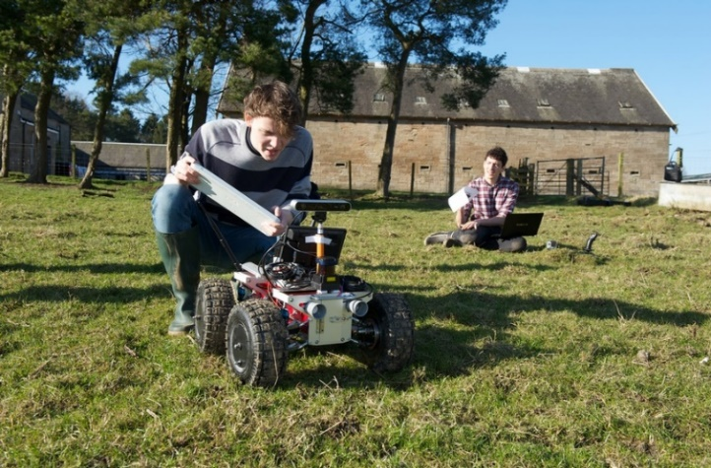
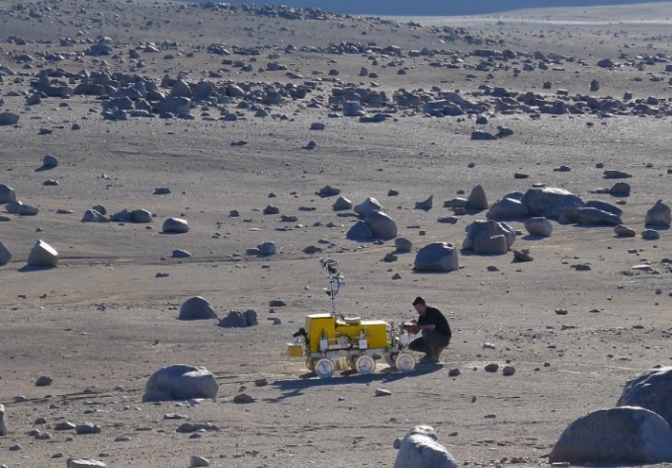
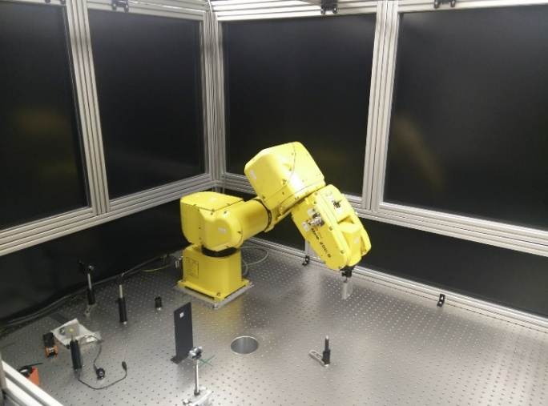
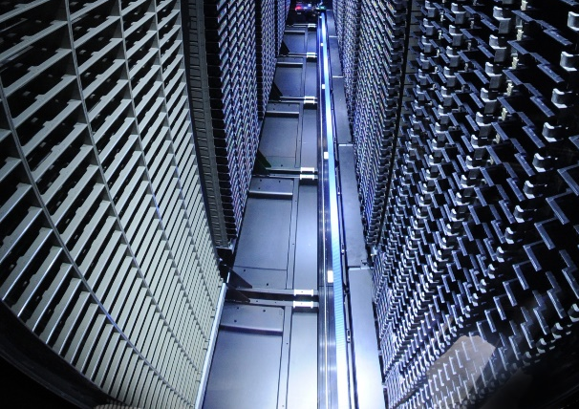
Robots and STFC
Notes:
Phillae: Robotics in environments people can’t go. Exploring a comet in deep space.
LESS (Technology, Daresbury): Laser Engineered Surface Structures. LHC beam pipe. Accurate and repeated tasks in places people can’t go. Confined beam pipe.
Agribot: Robot developed by RALSpace robotics team, robot platform to perform autonomous data collection at farms to improve farming yields.
SAFER: Robotics in environments people can’t go. Testing for Exomars intruments. Searching for life! …or at least places to drill
Robot Arm for Laser Shock Peening (CLF, DiPOLE): Robot arm performs the required repetitive and accurate adjustments of samples.
SCD Machine room: Tape Robots manage and catalogue the library of data tapes. (Repetative, Accurate).

Slide 5
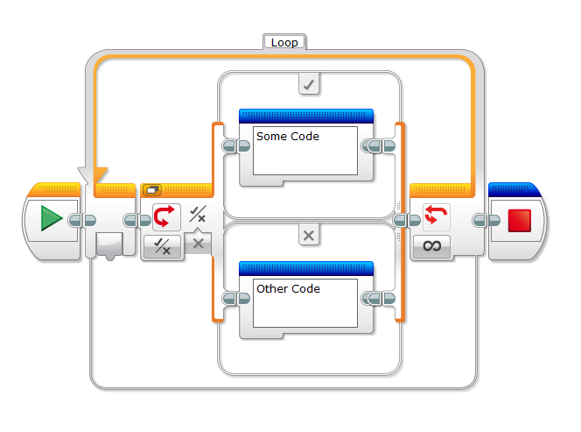
Lego Mindstorms: Labview

Slide 6
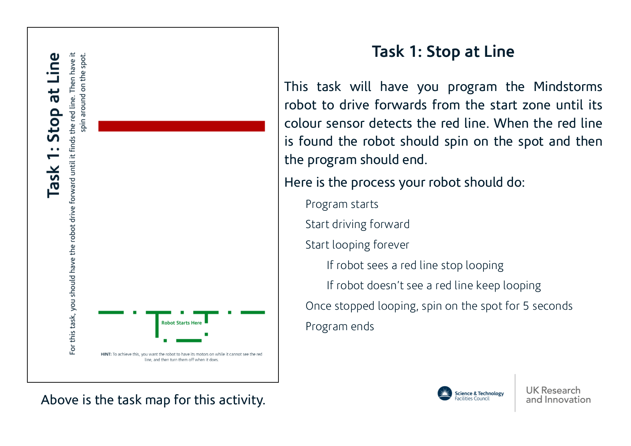

Slide 7
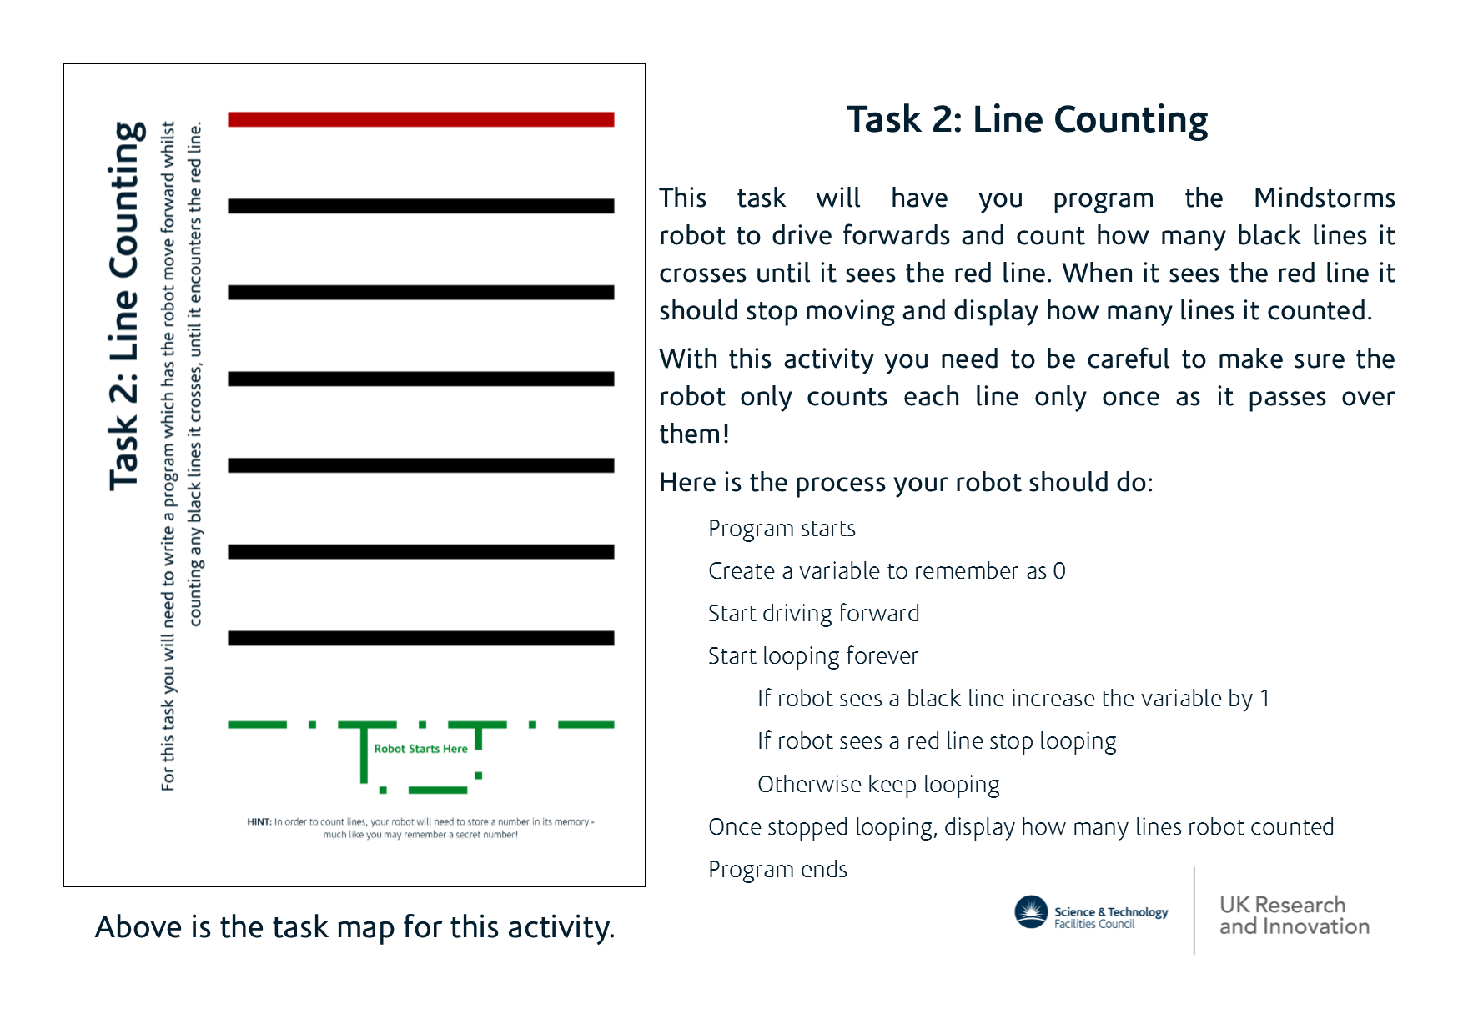

Slide 8
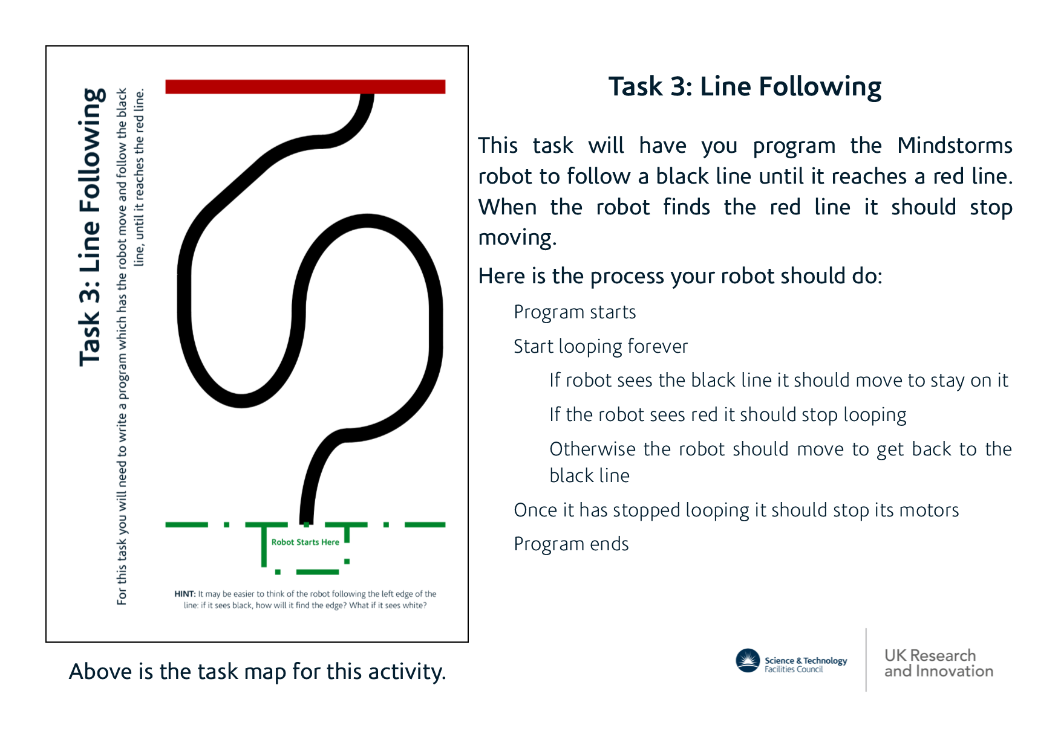

Slide 9
Thank you
Facebook: Science and Technology Facilities Council
Twitter:@STFC_matters
YouTube: Science and Technology Facilities Council

