Slide 1
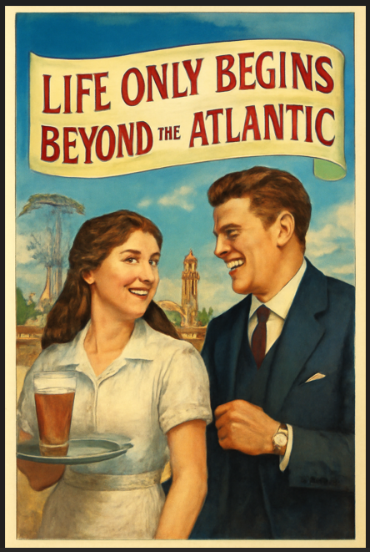


Welcome to the 1920`s in Manhattan
myRomance
Immerse yourself in the
life of an Irish immigrant
who begins a new life in the USA in 1921.
In about an hour of
reading pleasure, 17-year-old Maeve Gallagher offers insights into Manhattan's Hill's Kitchen and Tenderloin neighborhoods during American Prohibition.
Enjoy your own whiskey
in the mysterious, illegal speakeasy.
Read the moving story of Maeve Gallagher
https://ralbersme.github.io/myRomance/
Link works on large screens (such as PC, Laptop), as well as on mobile phone screens.

Slide 2


Welcome to the 1920`s in Manhattan
myRomance
Tauche tief in das Leben einer irischen Auswanderin ein, die 1921 in den USA ein neues Leben beginnt.
In rund einer Stunde Lesevergnügen bietet die
17-jährige Maeve Gallagher Einblicke in Manhattans Stadtteile Hill`s Kitchen und Tenderloin zum Zeitpunkt der amerikanischen Prohibition.
Genießen auch Sie ihren
Whiskey im geheimnisvollen,
illegalen Speakeasy.
Lies die bewegende Geschichte von Maeve Gallagher
https://ralbersme.github.io/myRomance/
Link works on large screens (such as PC, Laptop), as well as on mobile phone screens.

