Slide 1
Employee Management System (MERN Full Stack)
A Full Stack CRUD Web Application
GitHub Repository: RAM-ch-123

Slide 2
Project Overview
This Employee Management System is a full-stack web application built using the MERN stack (MongoDB, Express.js, React.js, and Node.js). It allows users to perform CRUD operations such as creating, reading, updating, and deleting employee records.
The application provides an intuitive user interface and a backend that connects to a MongoDB database.

Slide 3
Key Features
- Add new employee records
- Edit existing employee details
- Delete employee records
- View all employees in a table
- MongoDB database integration
- Responsive React frontend
- Express.js and Node.js backend

Slide 4
Tech Stack
**Frontend:** React.js, HTML, CSS, JavaScript
**Backend:** Node.js, Express.js
**Database:** MongoDB
**Tools:** Postman, Visual Studio Code, GitHub

Slide 5
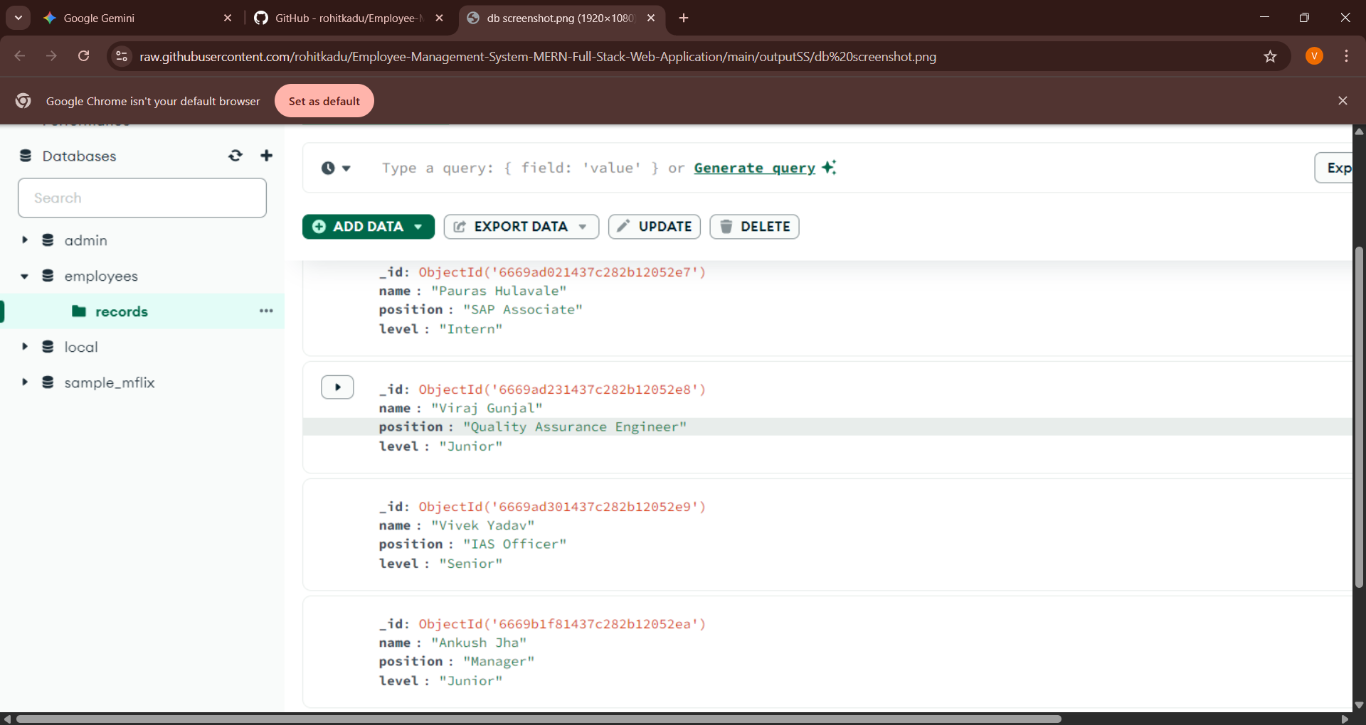
MongoDB Database Records

Slide 6
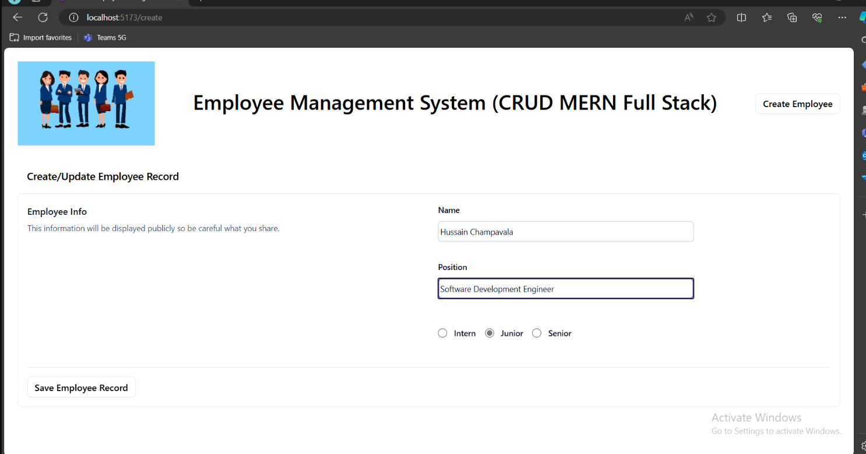
Create Employee Record Form

Slide 7
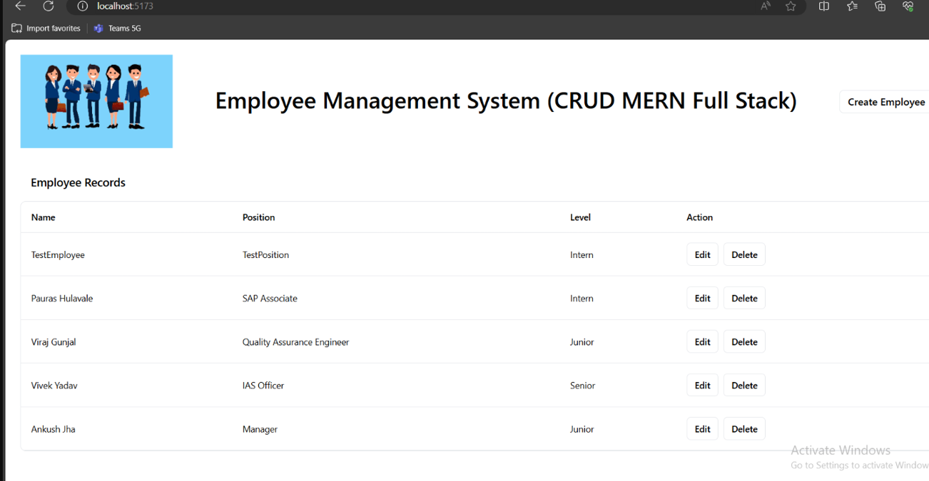
Employee Records Display Page

Slide 8
Conclusion
This MERN-based Employee Management System demonstrates a simple yet effective CRUD web application. It can be extended with authentication, role-based access, and advanced analytics.
Project Link: https://github.com/RAM-ch-123/Employee-Management-System-MERN-Full-Stack-Web-Application

