Slide 1
Web security by Apache and docker
Ryo Moriya

Slide 2
Contents
Apache
Possible attacks and measures
File permission

Slide 3
Apache
Web sever
One service of easiest to make web
High flexibility through several types of config files
Highly secure environment
Easy to install
Notes:
Apacheでcurlを実践 結果をchat-gotに問う
curl --head https://www.okanagan.bc.ca/

Slide 4
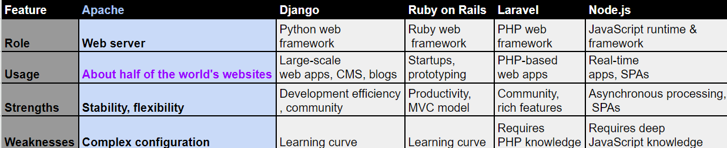
Apache
Notes:
Somethings Apache can do are

Slide 5
Apache modules
Rewrite… Renaming URL
Allowoveride … Controlling access permission
PHP SQL,SQLite module … Allows of them
Error documents… Customization of error page like 404,403
Notes:
Yellow marked category was used my login system.

Slide 6
Apache systems
Root directory
Sub directory
Httpd/Apache file
File permission
providing modules
Setting Documents root
.htacess
Some permission
Setting redirect
URL rewrite
Notes:
Flexible
We can give some files permission like a Linux permission

Slide 7
My system and problems
Requirement
The login system by using SQLite joseph
Develop on virtual environment by Docker
Place front_end and back_end different file
Independent front_end and back_end
Use of http communication

Slide 8


Apache web sever(local host)
Front-end
back-end
User.Pass
Lagniappe
Access
Login page
url,result
User.PassCookie
Cookie
Result,url
Lagniappe
url
Cookie
User.PassCookie
Result,url
url,Cookie
php connect
http connect
redirect
User-page
id.db
Permission

Slide 9
Assumed attacks
SQL injection
To get DB information by entering SQL code in user input field
Cross-site scripting
To steal session ID in surface web page
Replay attack
To steal request in surface web page

Slide 10



Apache web sever(local host)
Front-end
back-end
User.Pass
Lagniappe
Access
Login page
url,result
User.PassCookie
Cookie
Result,url
Lagniappe
url
Cookie
User.PassCookie
Result,url
url,Cookie
php connect
http connect
redirect
User-page
id.db
Permission

Slide 11
SQL injection attack
SQLite Query
SELECT * FROM users WHERE username=‘$username’ AND password=‘$password’;
IF You enter it user1,pass1
SELECT * FROM users WHERE username=‘user1’ AND password=‘pass1’;
IF You enter it admin, ‘or ‘1’=‘1
SELECT * FROM users WHERE username=‘admin’ AND password=‘ ’or’1’=‘1’;

Slide 12
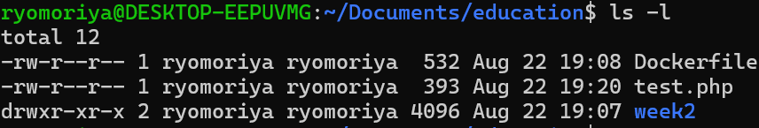
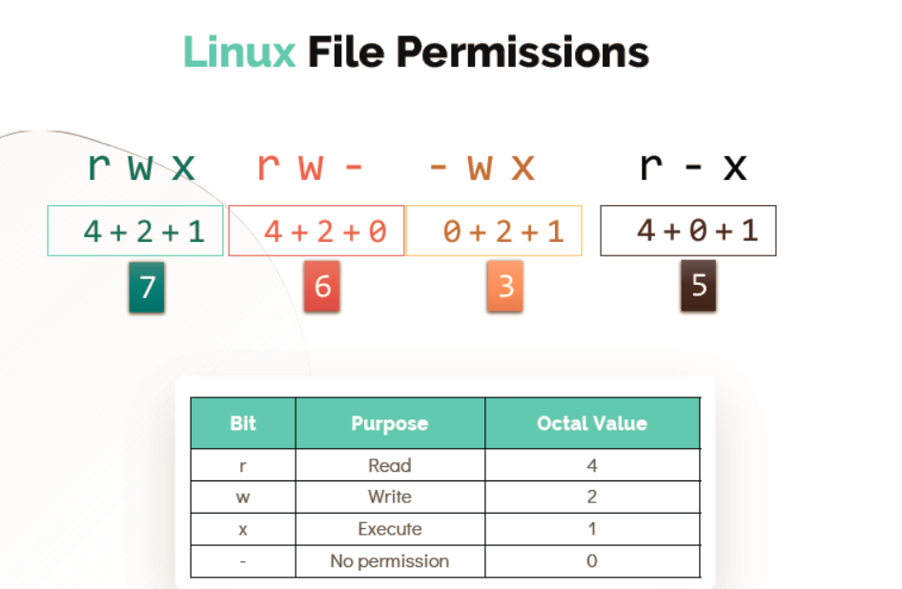
File permission by Linux
Permission
Owner
Group
Hard link

Slide 13
File permission
1.Change the text in read.txt
2.Watch and change the text in read1.txt in read directory

Slide 14
Let’s considering
Permission-test
Permission.html
Owner:read,write,run
Group:read,write,run
Other:Noun
Owner:read,write,run
Group:read,write,run
Other:Noun

Slide 15
Let’s considering
order
Permission-test
Owner:read,write,run
Group:read,write,run
Other:Noun
Owner:read,write,run
Group:read,write,run
Other:Noun
seraph
Owner:read,write,run
Group:read,write,run
Other:Noun

Slide 16
Owner:noun
www-data:read,write,run
Other: noun
Apache web sever(local host)
Owner:noun
Group:noun
Other: run
Front-end
back-end
User.Pass
Lagniappe
Access
Login page
url,result
User.PassCookie
Cookie
Result,url
Lagniappe
url
Cookie
User.PassCookie
Result,url
url,Cookie
php connect
http connect
redirect
User-page
id.db
Permission

Slide 17
Answer
order
Client/other
joseph
Apache2/www-data

Slide 18
Thank you for listening

