Slide 1
Digital Assistant for Legal Awareness and Designing a KYR (Know-Your-Rights) framework in India
PIP 4004 University Project
Review-4
Batch Number: CSE-G03
20211CSE0086 | TULSI RAM REDDY.K
20211CSE0105 | CHALLA PAVAN TEJA
20211CSE0085 | MANDADI VIGNESH
20211CSE0765 | SANNEBOINA ANJANEYALU
Under the Supervision of,
Mr. Jerrin Joe Francis
Assistant Professor
School of Computer Science and Engineering
Presidency University
Roll Number | Student Name
Name of the Program : Computer Science and Engineering (CSE)
Name of the HoD : Dr. Asif Mohammed
Name of the Program Project Coordinator : Mr. Jerrin Joe Francis
Name of the School Project Coordinators : Mr. Jerrin Joe Francis

Slide 2
Introduction
The Digital Assistant for Legal Awareness and Designing a KYR (Know-Your-Rights) Framework aims to bridge this gap by providing an intuitive, easy-to-use platform that offers critical information about legal rights, duties, and processes.
This web application is designed to serve as a comprehensive tool for individuals to understand their legal standing in various contexts, from consumer rights to fundamental rights enshrined in the Indian Constitution.
Key features :
User-friendly Interface - Developed using React (Frontend) for a smooth user experience.
Natural Language Processing (NLP) - Uses Gemini AI for understanding legal queries.
AI-Powered Legal Assistant - Interactive chat for quick answers and legal explanations.
Multilingual Support - Legal guidance in multiple languages for wider accessibility.
Smart Query Processing - Uses FastAPI and Django (Backend) for handling user inputs.

Slide 3
Literature Review
Sl.no | Paper Title | Authors | Proposed Model | Results | Drawbacks
1 | AI-Powered Legal Chatbots for Access to Justice | Gupta R., Sharma P. | AI chatbot using NLP to provide legal information and assistance | Improved accessibility to legal information for marginalized communities | Limited contextual understanding of complex legal cases
2 | Multi-Language Legal Aid Platforms | Patel S., Mehra V. | Legal platform with AI-based multi-language support | Increased legal awareness among non-English speaking users | Challenges in accurate translation of legal terminology
3 | Simplified Legal Information Systems | Bose A., Roy K. | A web-based platform using plain language to explain legal terms | Enhanced comprehension of legal rights and procedures | Oversimplification may lead to loss of legal nuances
4 | Legal Document Automation and Accessibility | Kumar N., Verma T. . | AI-based document generator for legal forms and petitions | Reduced dependency on legal professionals for basic paperwork | Lack of personalization in complex legal cases
5 | AI-Based Legal Query Resolution Systems | Das P., Iyer M. | AI assistant trained on legal FAQs for instant guidance | Faster response times for common legal queries | Inability to provide in-depth legal consultation
6 | Data Privacy Concerns in Digital Legal Platforms | Mishra H., Yadav R. | Encrypted legal assistant for secure user interactions | Increased user trust in legal aid applications | Higher computational costs due to encryption overhead

Slide 4
Literature Review
Sl.no | Paper Title | Authors | Proposed Model | Results | Drawbacks
7 | Mobile-Based Legal Aid for Rural Populations | Naik J., Subramaniam L. | SMS and voice-based legal assistance for remote users | Expanded reach to non-tech-savvy individuals | Limited scope of legal advice through SMS format
8 | Legal Chatbots with Machine Learning | Singh A., Rao D. | ML-based chatbot that adapts responses based on user history | More personalized and accurate legal information | Requires extensive training data for improved accuracy
9 | Crowdsourced Legal Information Hubs | Shah M., Banerjee R. | Community-driven legal knowledge-sharing platform | Increased availability of real-life legal case studies | Risk of misinformation due to non-expert contributions
10 | Blockchain for Secure Legal Aid Services | Bhardwaj K., Sengupta P. | Blockchain-based verification for legal aid requests | Improved authenticity and reduced fraud in legal assistance | High infrastructure costs for blockchain implementation
11 | Interactive Legal Education via Digital Platforms | Menon S., Chatterjee V. | Gamified e-learning modules for basic legal education | Increased engagement and understanding of legal rights | May not replace traditional legal training effectively
12 | AI-Powered Legal Aid in Criminal Justice | Pandey R., Thomas J. | AI assistant providing real-time legal information for accused persons | Faster legal aid for detainees and underprivileged individuals | Ethical concerns regarding AI decisions in criminal cases.

Slide 5
Existing method Drawback
While there are various ways people currently access legal information, they often come with significant limitations. Here are some of the key drawbacks of existing methods:
Complexity of Legal Language - Many legal documents and resources are written in complicated legal jargon, making them difficult for the average person to understand.
Limited Accessibility - Legal information is often scattered across multiple sources, including government websites, legal databases, and physical law books.
High Cost of Legal Consultation - Hiring a lawyer for even basic legal guidance can be expensive, making it unaffordable for many individuals.
No Personalized Legal Guidance - Generic legal information does not always fit individual situations, leaving users uncertain about how laws apply to their specific case.

Slide 6
Proposed Method
To address the shortcomings of existing legal information systems, the Digital Assistant for Legal Awareness & KYR (Know-Your-Rights) Framework offers an AI-powered, user-friendly, and structured approach to legal education and real-time assistance.
AI-Powered Legal Assistant - Interactive chatbot that provides real-time legal guidance based on user queries. Can answer frequently asked legal questions and provide step-by-step guidance for common legal issues.
Know-Your-Rights (KYR) Framework - A structured, topic-wise breakdown of essential rights across different categories.
Legal Action Guide & Case-Based Scenarios - Provides users with step-by-step legal procedures for common legal situations. Case studies and real-world examples to help users understand how legal rights apply.
Multilingual & Inclusive Legal Support - Legal information and AI chatbot available in multiple languages for better accessibility.

Slide 7
Objectives
The Digital Assistant for Legal Awareness aims to empower individuals with legal knowledge, simplify access to justice, and enhance awareness of rights and responsibilities through an AI-driven, user-friendly platform.
Primary Objectives :
Enhance Legal Awareness & Empower Users - Provide easy-to-understand legal information to help users understand their rights and responsibilities.
Provide Real-Time Legal Assistance - Offer AI-powered, interactive legal support that provides instant responses to user queries.
Structure Legal Knowledge Through the KYR Framework - Develop a well-organized Know-Your-Rights (KYR) framework covering key legal areas such as , labor laws , consumer laws etc.
Reduce Dependence on Costly Legal Consultations - Make basic legal information freely available to reduce the financial burden on users.
Ensure Data Privacy and Security - Implement robust privacy measures to protect users' personal information, fostering trust and confidence in the application.

Slide 8
Modules
The app is structured into different modules to ensure comprehensive legal awareness, real-time assistance, and easy navigation of legal rights and procedures.
User Interface (UI Module) - Handles the chatbot screen, buttons, and legal topics display.
Chatbot Logic Module - Processes user queries and sends them to Gemini AI.
AI Processing Module - Connects to Google Gemini AI API for legal query analysis.
Authentication Module - Manages user login/signup (Firebase Auth or OAuth).
Backend API Communication Module - Calls external APIs to fetch legal data.
Legal Topics Module - Manages the list of legal topics & details.

Slide 9
Algorithm
Step – 1 : User Input:
User enters a legal question in the chatbot.
Step – 2 : Query Processing
The chatbot cleans the input (removes unnecessary characters, corrects spelling).
If needed, it translates the query using Google Translator API.
Step – 3 : Understanding the Query
The chatbot sends the question to Gemini API (AI model) to analyze the meaning.
It checks the Legal Knowledge Base (Database) for relevant legal information.
Step – 4 : Generating a Response
If a matching answer is found in the database → return the response.
If no match is found → the chatbot uses AI to generate a legal response.
The response is checked for accuracy.

Slide 10
Step – 5 : Displaying the Response
The chatbot shows the legal answer to the user.
If the user needs it in another language, the chatbot translates the response.
Step – 6 : Feedback & Learning
The chatbot asks, "Was this answer helpful?"
If the user says No, the system logs the issue for improvement.
The chatbot stores the conversation in the database for future learning.
Step – 7 : End or Continue
If the user has more questions, the chatbot continues.
If no more questions, the session ends.

Slide 11
Architecture
User Interface
Query Processing Module
Gemini API NLP Engine (Processes legal queries)
Legal Knowledge Base
Response Generation Module
Google Translator API (For multilingual support)
User Feedback

Slide 12
Software components
Software Requirements :
Programming Languages: Python (NLP, AI Processing), Flutter (dart).
APIs Used:
Gemini API – for NLP-based query understanding.
Google Translator API – for multilingual responses.
Authentication API – for user authentication and security.
Backend Frameworks: FastAPI (for handling API requests) , Django (for API development).
Frontend: Flutter (dart)
Database: Firebase (for real-time user authentication and cloud storage).
Cloud Deployment: Google Cloud (GCP) for scalability.

Slide 13
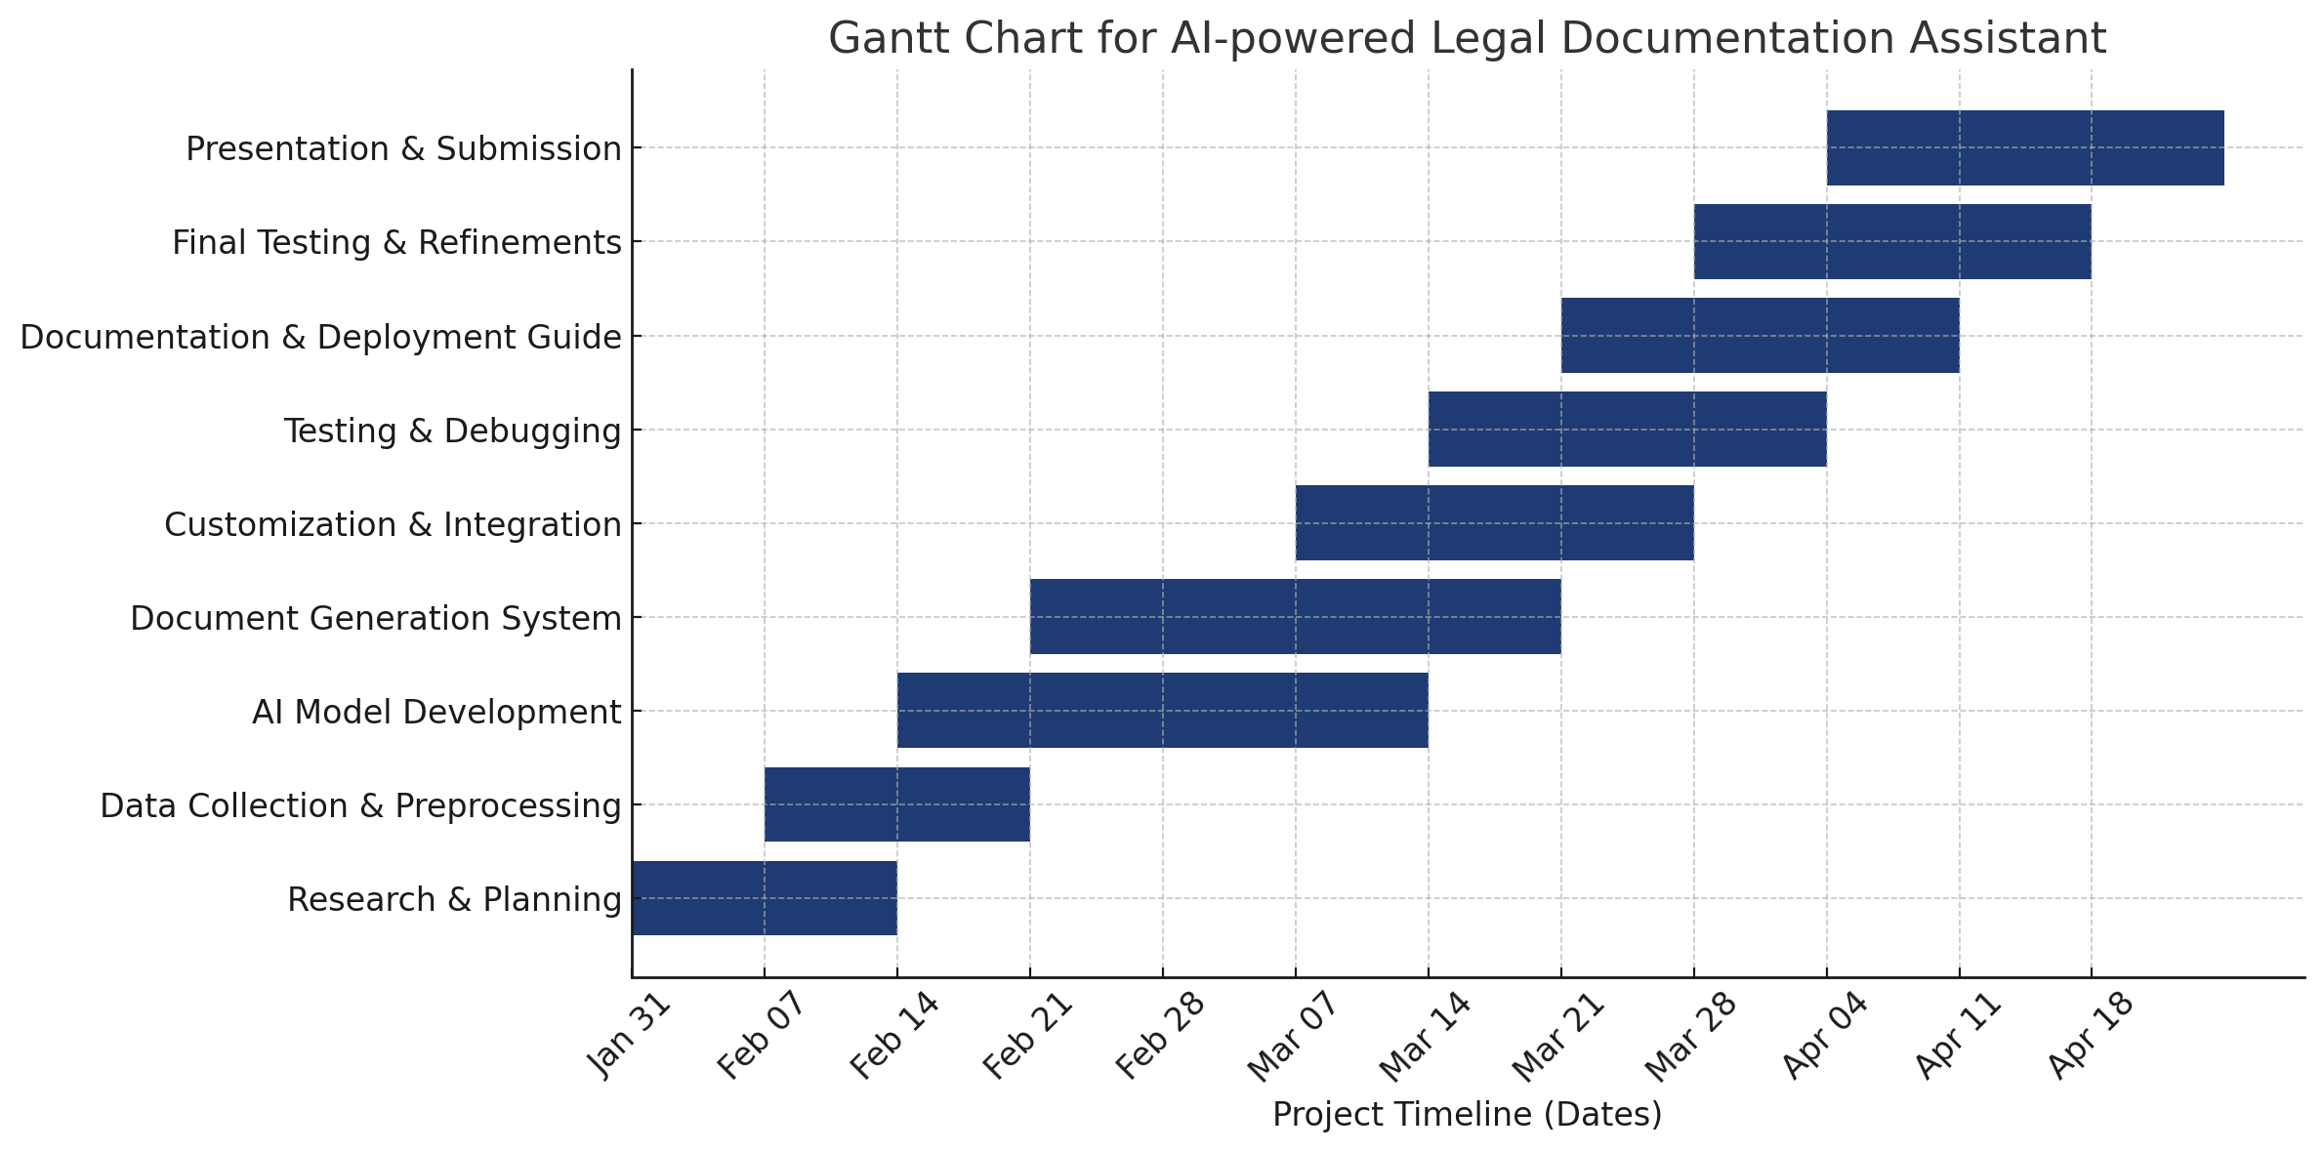
Timeline of Project

Slide 14
Conclusion
The Digital Assistant for Legal Awareness & KYR Framework is a transformative mobile application designed to empower individuals with legal knowledge, enhance access to justice, and provide real-time legal assistance.
By integrating an AI-powered chatbot, structured legal information and multilingual support, the app ensures that users can easily understand and exercise their legal rights.
With a secure and scalable backend, leveraging Firebase, Node.js, and AI-driven models, the app provides real-time responses, secure data handling, and personalized legal guidance.
By reducing legal illiteracy, simplifying complex laws, and providing instant access to legal aid, this application aims to bridge the gap between individuals and the legal system, particularly for marginalized and underserved communities.
Ultimately, this innovative solution has the potential to revolutionize legal awareness, making justice more accessible, affordable, and understandable for everyone.

Slide 15
References
[1] L. Medvedeva, M. Vols, and M. Wieling, "Using Machine Learning to Predict Decisions of the European Court of Human Rights," Artificial Intelligence and Law, vol. 28, no. 2, pp. 237-266, 2020. [DOI: 10.1007/s10506-019-09255-y]
[2] K. Ashley, "Artificial Intelligence and Legal Analytics: New Tools for Law Practice in the Digital Age," Cambridge University Press, 2017. [DOI: 10.1017/9781316691333]
[3] M. J. Bommarito and D. Martin Katz, "A General Approach for Predicting the Behavior of the Supreme Court of the United States," PLOS One, vol. 12, no. 4, 2017. [DOI: 10.1371/journal.pone.0174698]
[4] H. Zhong, Z. Guo, C. Tu, T. Liu, and Z. Sun, "Legal Judgment Prediction via Topological Learning," Proceedings of the AAAI Conference on Artificial Intelligence, 2020. [DOI: 10.1609/aaai.v34i05.6396]
[5] X. Zhang, Y. Ma, and W. Wang, "Legal Document Summarization Using Deep Learning Models," Journal of AI Research, vol. 69, pp. 475-493, 2020. [DOI: 10.1613/jair.1.12148]

Slide 16
References
[6] A. Aletras, D. Tsarapatsanis, D. Preoțiuc-Pietro, and V. Lampos, "Predicting Judicial Decisions of the European Court of Human Rights: A Natural Language Processing Perspective," PeerJ Computer Science, vol. 2, no. e93, 2016. [DOI: 10.7717/peerj-cs.93]
[7] N. H. Khan and S. Khan, "Legal Chatbot Using Natural Language Processing," International Journal of Advanced Research in Computer Science, vol. 10, no. 2, pp. 117-124, 2019. [DOI: 10.26483/ijarcs.v10i2.6463]
[8] B. Casey and M. Lemmer, "Smart Contracts and the Role of AI in Legal Tech," MIT Technology Review, 2021. [Available at: https://www.technologyreview.com/]
[9] M. A. Livermore and D. Rockmore, "Law as Data: Computation, Text, and the Future of Legal Analysis," Cambridge University Press, 2019. [DOI: 10.1017/9781108556988]
[10] J. Surden, "Artificial Intelligence and Law: An Overview," Annual Review of Law and Social Science, vol. 15, pp. 29-50, 2019. [DOI: 10.1146/annurev-lawsocsci-101518-042943]

Slide 17
Thank You

