Slide 1
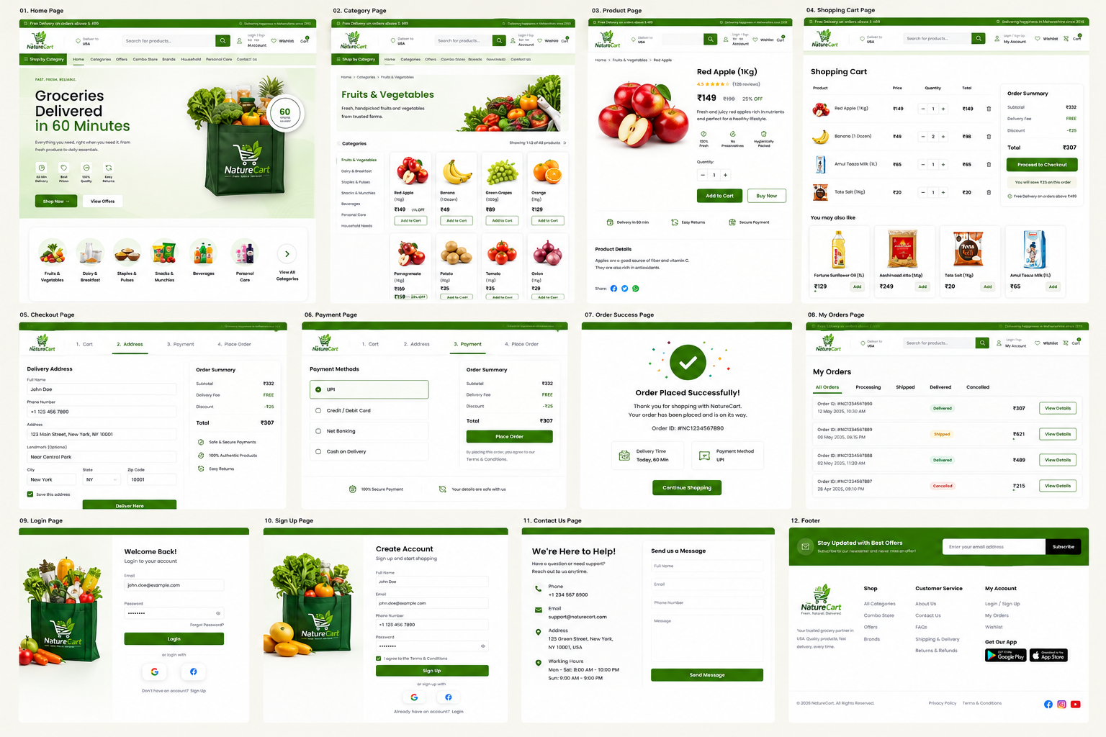
NATURECART — GROCERY E-COMMERCE FRONTEND TASK

Slide 2
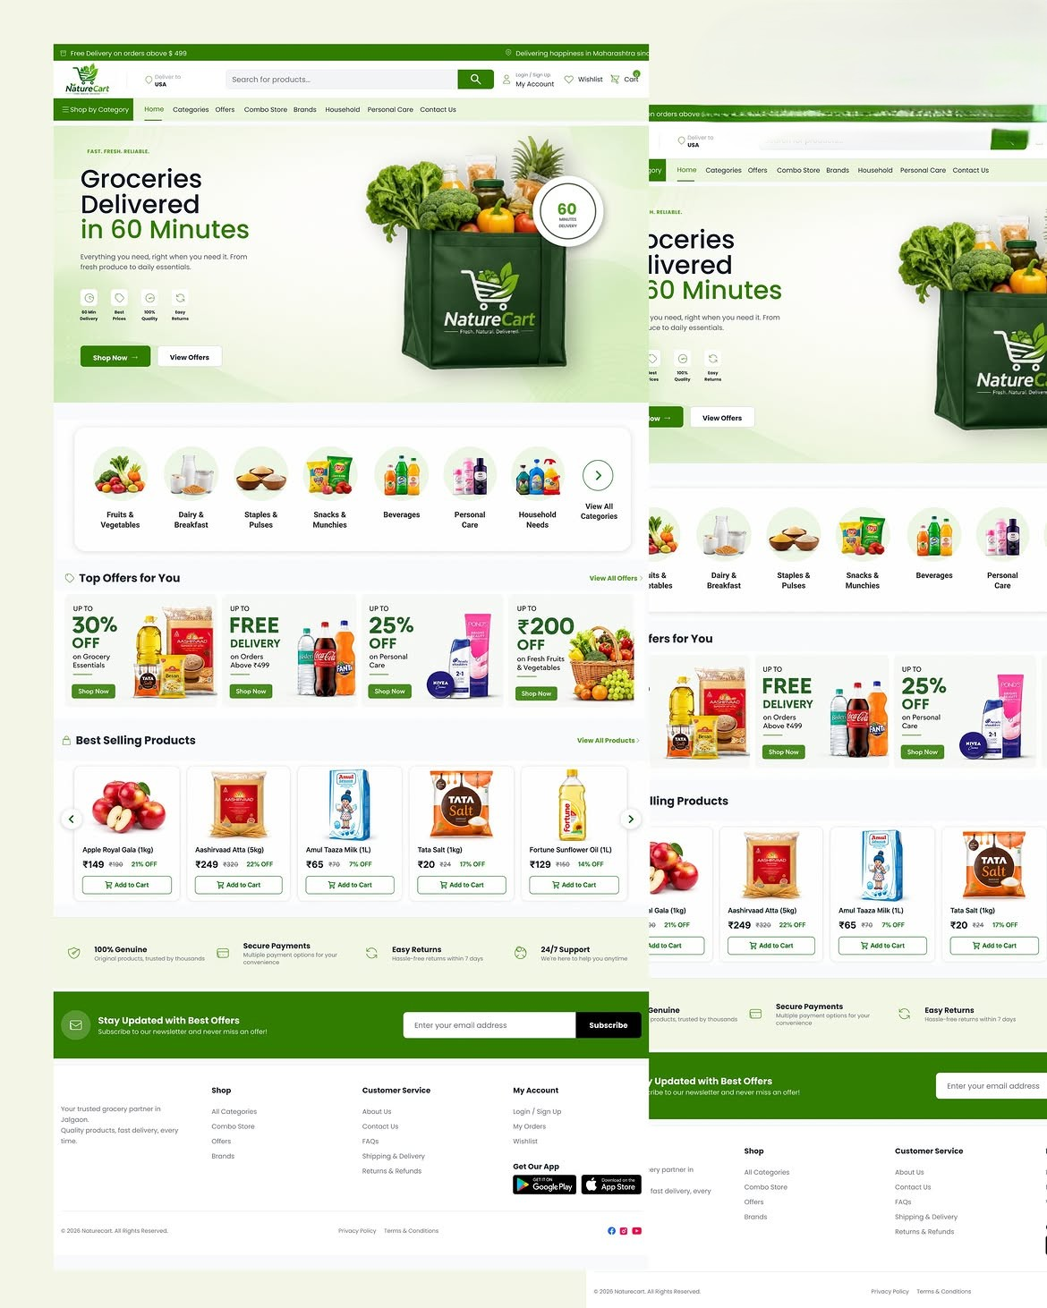
Original Reference Design
Use this screen as the primary visual direction.

Slide 3
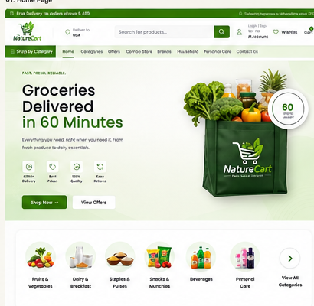
01. Home Page
Individual frontend implementation reference

Slide 4
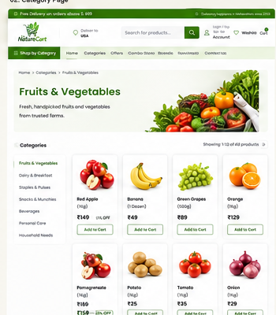
02. Category Page
Individual frontend implementation reference

Slide 5
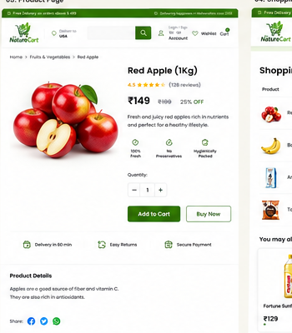
03. Product Page
Individual frontend implementation reference

Slide 6
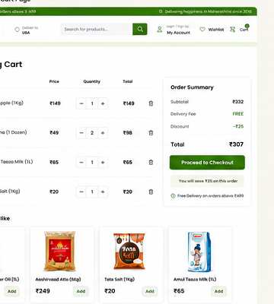
04. Shopping Cart
Individual frontend implementation reference

Slide 7
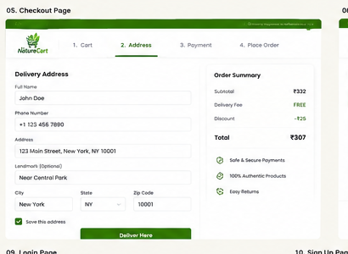
05. Checkout Page
Individual frontend implementation reference

Slide 8
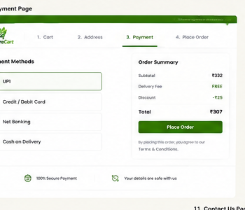
06. Payment Page
Individual frontend implementation reference

Slide 9
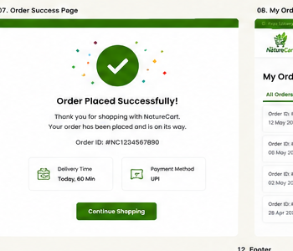
07. Order Success
Individual frontend implementation reference

Slide 10
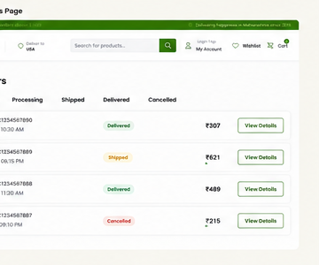
08. My Orders
Individual frontend implementation reference

Slide 11
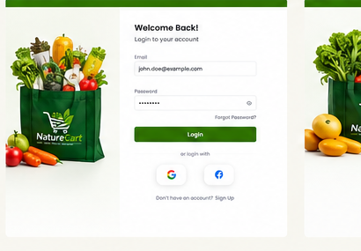
09. Login Page
Individual frontend implementation reference

Slide 12
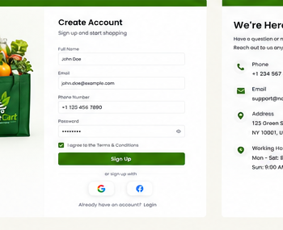
10. Sign Up Page
Individual frontend implementation reference

Slide 13
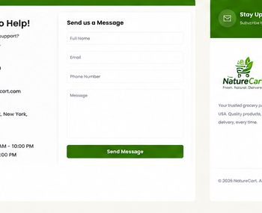
11. Contact Us
Individual frontend implementation reference

Slide 14
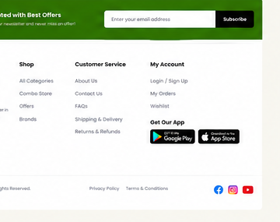
12. Footer
Individual frontend implementation reference

Slide 15
Frontend Implementation Checklist
Expected behavior and quality standards
Build the website using React.js with reusable Header, Navigation, ProductCard, OfferCard, Cart and Footer components.
Use the NatureCart green / white / cream visual system consistently across every page.
Implement responsive layouts for desktop, tablet and mobile.
Create product/category data structures so cards and lists are rendered dynamically.
Implement search, category navigation, filters, quantity controls and Add to Cart interactions.
Implement Cart → Checkout → Payment → Order Success flow with clear validation states.
Implement Login, Sign Up, My Orders and Contact Us pages with form validation.
Include loading, empty, error, success and disabled states for important interactions.
Optimize product images and use lazy loading where appropriate.
Keep typography, spacing, borders, shadows, buttons and icons consistent with the reference.

