Slide 1
RealStart — Real Estate Web Application
12 production-style frontend reference screens

Slide 2
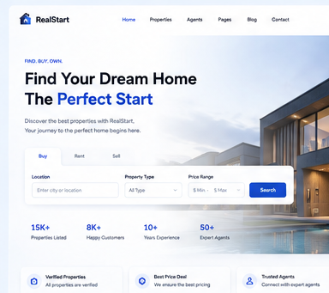
01 — Home Page

Slide 3
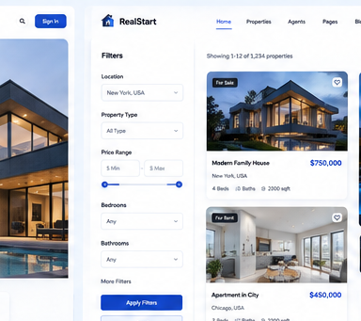
02 — Properties Listing

Slide 4
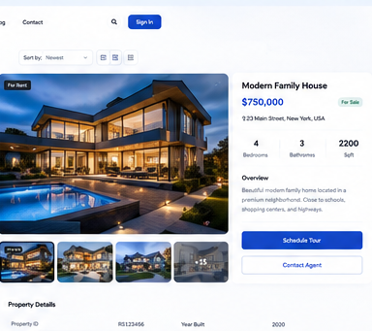
03 — Property Details

Slide 5
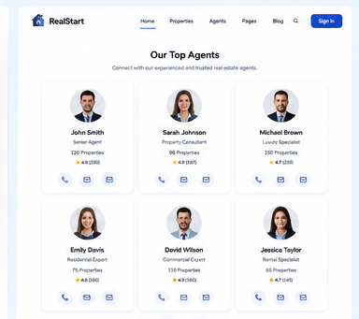
04 — Agents

Slide 6
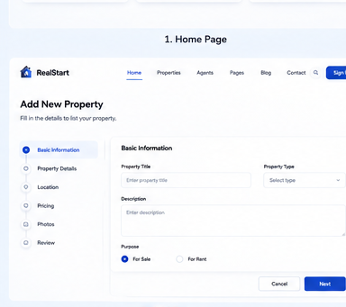
05 — Add Property

Slide 7
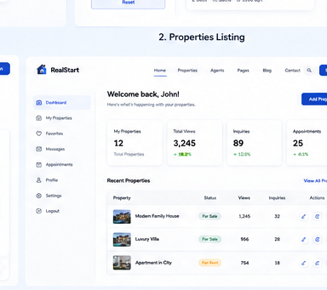
06 — Dashboard

Slide 8
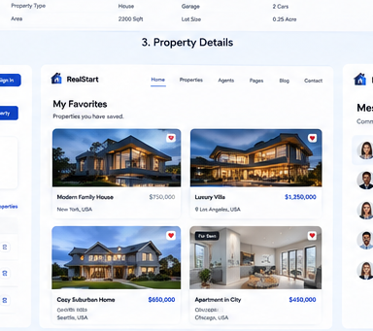
07 — Favorites

Slide 9
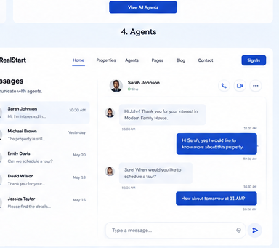
08 — Messages

Slide 10
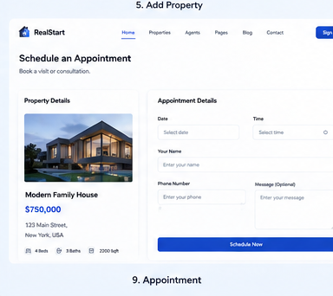
09 — Appointment

Slide 11
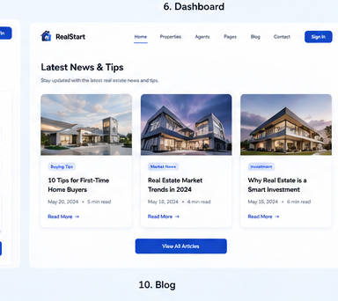
10 — Blog

Slide 12
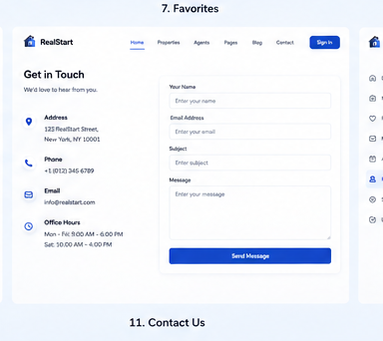
11 — Contact Us

Slide 13
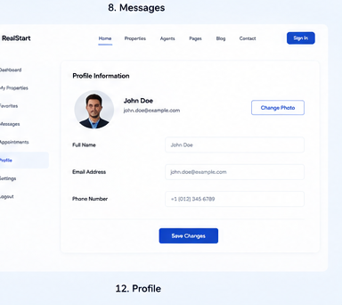
12 — Profile

