Slide 1
CarePlus Healthcare — Frontend Website Screens
12 individual UI reference screens generated from the supplied design

Slide 2

01 — Home Page

Slide 3
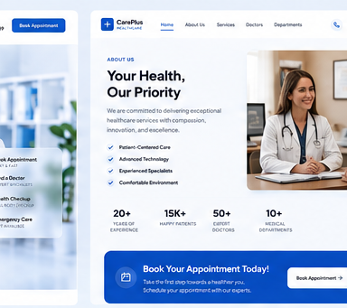
02 — About Us

Slide 4
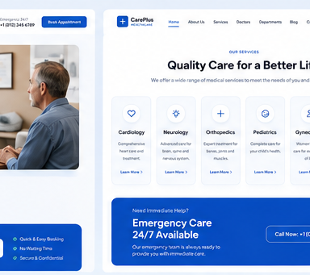
03 — Our Services

Slide 5
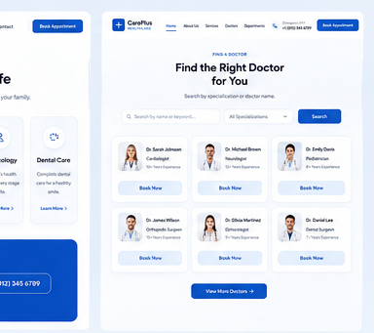
04 — Find a Doctor

Slide 6
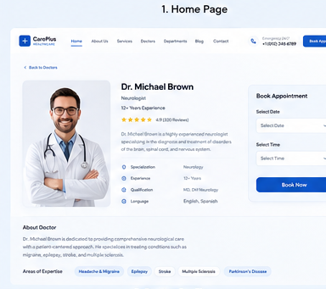
05 — Doctor Profile

Slide 7
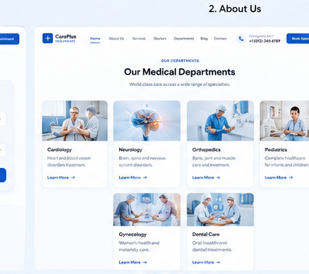
06 — Departments

Slide 8
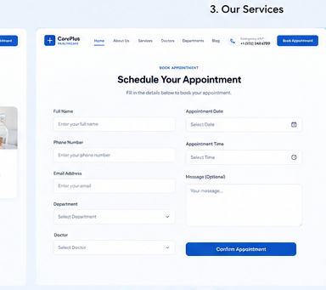
07 — Appointment Booking

Slide 9
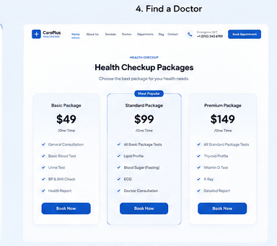
08 — Health Checkup Packages

Slide 10
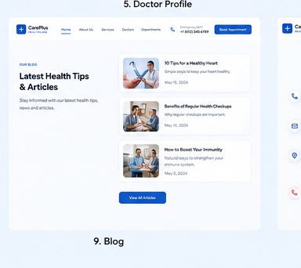
09 — Blog

Slide 11
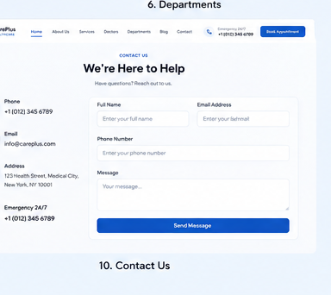
10 — Contact Us

Slide 12
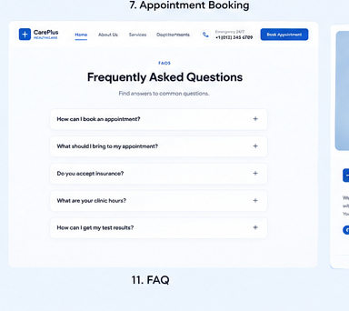
11 — FAQ

Slide 13
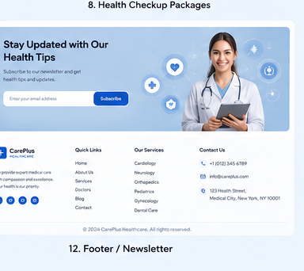
12 — Footer / Newsletter

