Slide 1
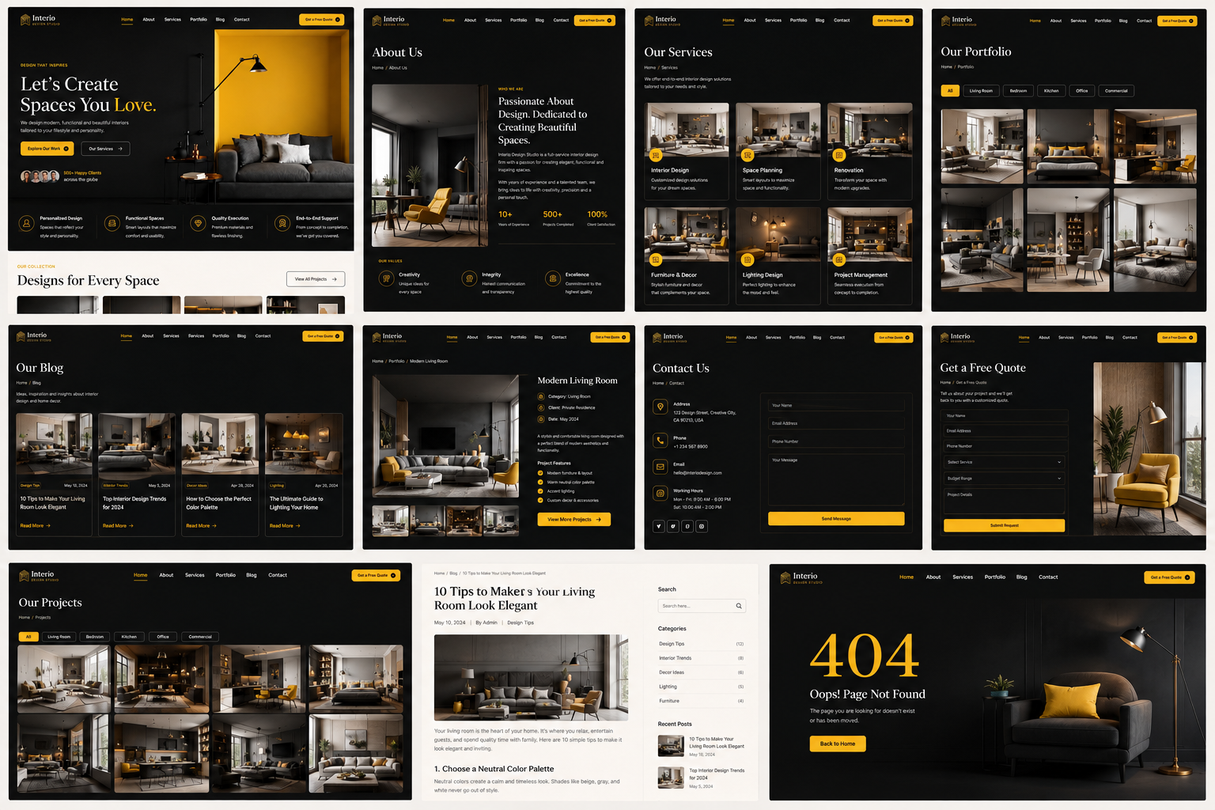
INTERIO DESIGN STUDIO — FRONTEND TASK

Slide 2
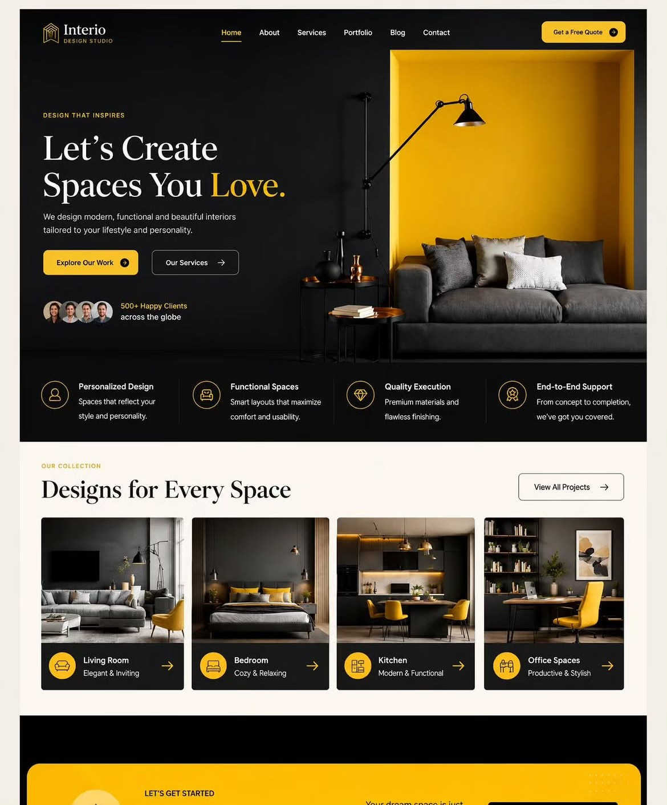
Reference Design
Original reference provided for frontend implementation

Slide 3
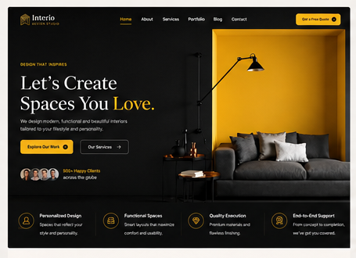
01. Home Page
Frontend implementation reference — maintain the same visual system

Slide 4
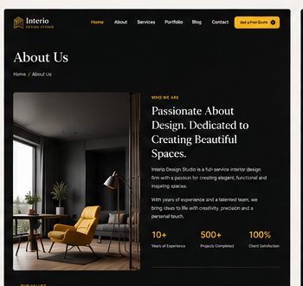
02. About Us
Frontend implementation reference — maintain the same visual system

Slide 5
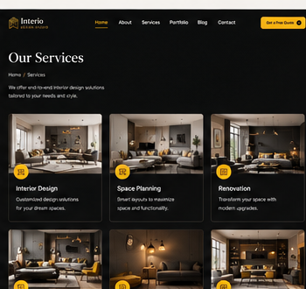
03. Services
Frontend implementation reference — maintain the same visual system

Slide 6
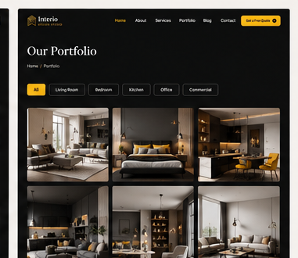
04. Portfolio
Frontend implementation reference — maintain the same visual system

Slide 7
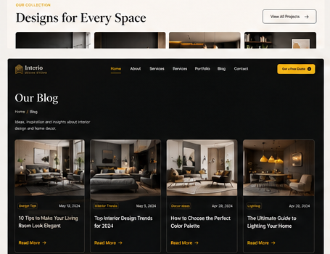
05. Blog
Frontend implementation reference — maintain the same visual system

Slide 8
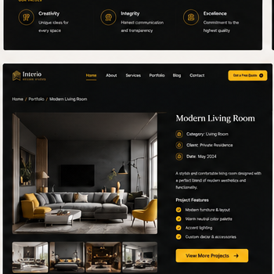
06. Project Details
Frontend implementation reference — maintain the same visual system

Slide 9
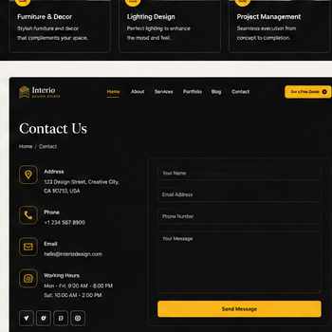
07. Contact Us
Frontend implementation reference — maintain the same visual system

Slide 10
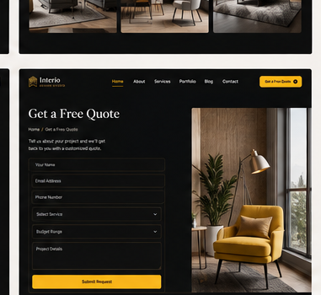
08. Free Quote
Frontend implementation reference — maintain the same visual system

Slide 11
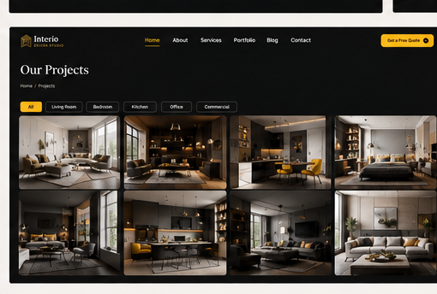
09. Projects Gallery
Frontend implementation reference — maintain the same visual system

Slide 12
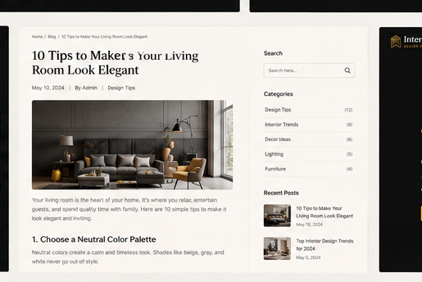
10. Blog Article
Frontend implementation reference — maintain the same visual system

Slide 13
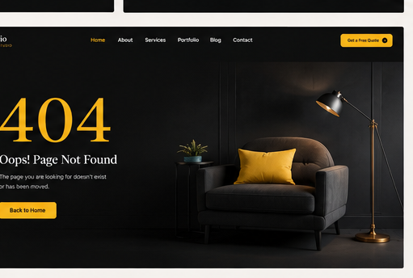
11. 404 Page
Frontend implementation reference — maintain the same visual system

Slide 14
Frontend Implementation Checklist
Use React.js with reusable Header, Footer, Button, Card, Form and Gallery components.
Keep the black / cream / gold visual language consistent across every route.
Implement responsive layouts for desktop, tablet and mobile.
Use reusable project, service, blog and portfolio data instead of duplicating JSX.
Add hover, active, focus, loading, empty and validation states.
Connect navigation and CTA buttons to the correct routes.
Optimize interior images with responsive sizing and lazy loading.
Keep spacing, typography, borders, radii and icon styles consistent with the reference.

