Slide 1

AR Software
Containerization
Month
072021

Slide 2
Docker
VS
Virtual Machines

Slide 3
What are Virtual Machines (VMs)?
A virtual machine (VM) is an operating system that shares the physical resources of one server. It is a guest on the host’s hardware, which is why it is also called a guest machine. There are several layers that make up a virtual machine. The layer that enables virtualization is the hypervisor..

Slide 4
Where Use VMS ?
Manage a variety of operating systems
Manage multiple apps on a single server
Run an app that requires all the resources and functionalities of an OS
Ensure full isolation and security

Slide 5
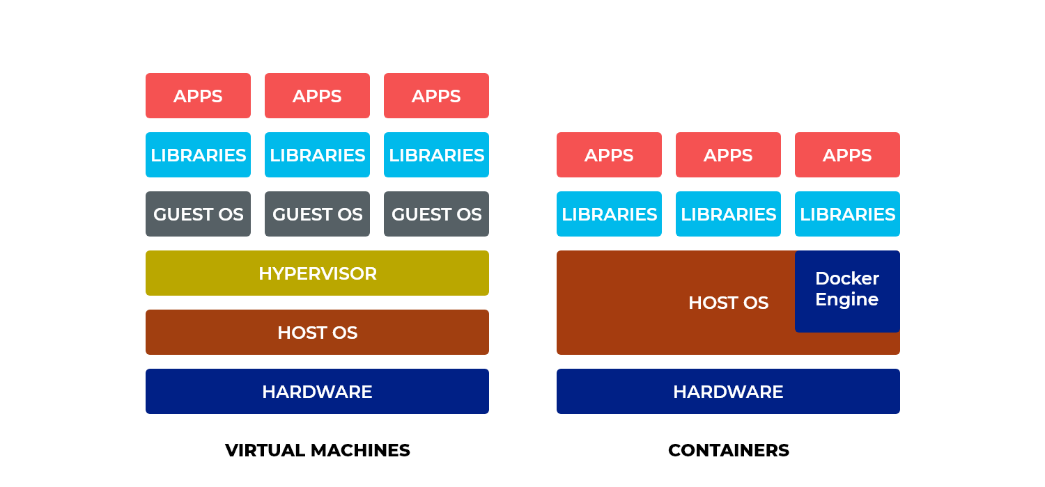

Slide 6
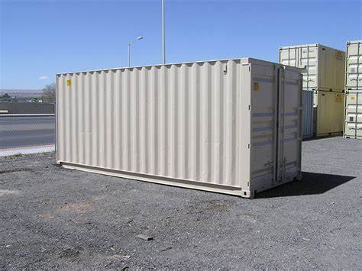
Container

Slide 7
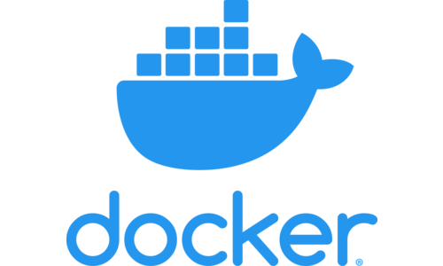
Docker
Docker is a set of platform as a service (PaaS) products that use OS-level virtualization to deliver software in packages called containers. Containers are isolated from one another and bundle their own software, libraries and configuration files; they can communicate with each other through well-defined channels. Because all of the containers share the services of a single operating system kernel, they use fewer resources than virtual machines.

Slide 8
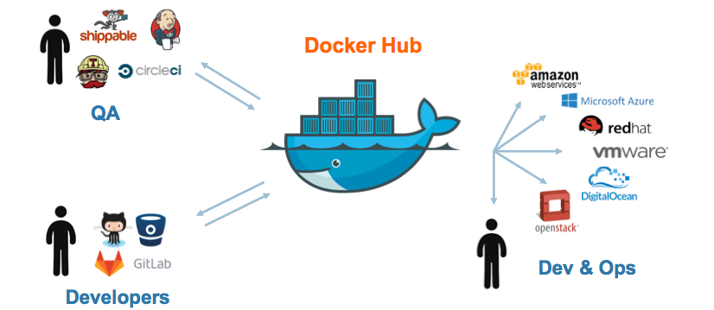

Slide 9
Why Docker use?
Maximize the number of apps running on a server
Deploy multiple instances of a single application
Have a lightweight system that quickly starts
Develop an application that runs on any underlying infrastructure

Slide 10
Docker And Container
Docker is a containerization platform that packages your application and all its dependencies together in the form of a docker container to ensure that your application works seamlessly in any environment.
Docker Container is a standardized unit which can be created on the fly to deploy a particular application or environment. It could be an Ubuntu container, CentOS container, etc. to full-fill the requirement from an operating system point of view. Also, it could be an application-oriented container like CakePHP container or a Tomcat-Ubuntu container etc.

Slide 11
What is Docker Image?
Docker Image can be compared to a template which is used to create Docker Containers. They are the building blocks of a Docker Container. These Docker Images are created using the build command. These Read only templates are used for creating containers by using the run command. We will explore Docker commands in depth in the “Docker Commands blog”.

Slide 12
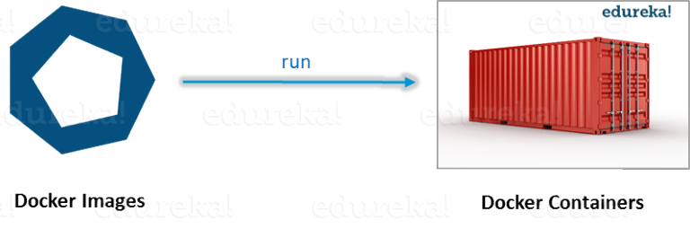
What is Docker Container?
Docker Containers are the ready applications created from Docker Images. Or you can say they are running instances of the Images and they hold the entire package needed to run the application. This happens to be the ultimate utility of the technology.

Slide 13

What is Docker Registry?
Finally, Docker Registry is where the Docker Images are stored. The Registry can be either a user’s local repository or a public repository like a Docker Hub allowing multiple users to collaborate in building an application. Even with multiple teams within the same organization can exchange or share containers by uploading them to the Docker Hub, which is a cloud repository similar to GitHub.

Slide 14
What is Docker Architecture?
Docker Architecture includes a Docker client – used to trigger Docker commands, a Docker Host – running the Docker Daemon and a Docker Registry – storing Docker Images. The Docker Daemon running within Docker Host is responsible for the images and containers.

Slide 15
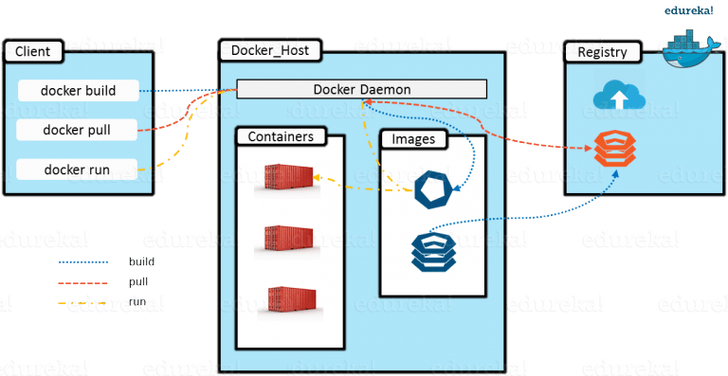

Slide 16
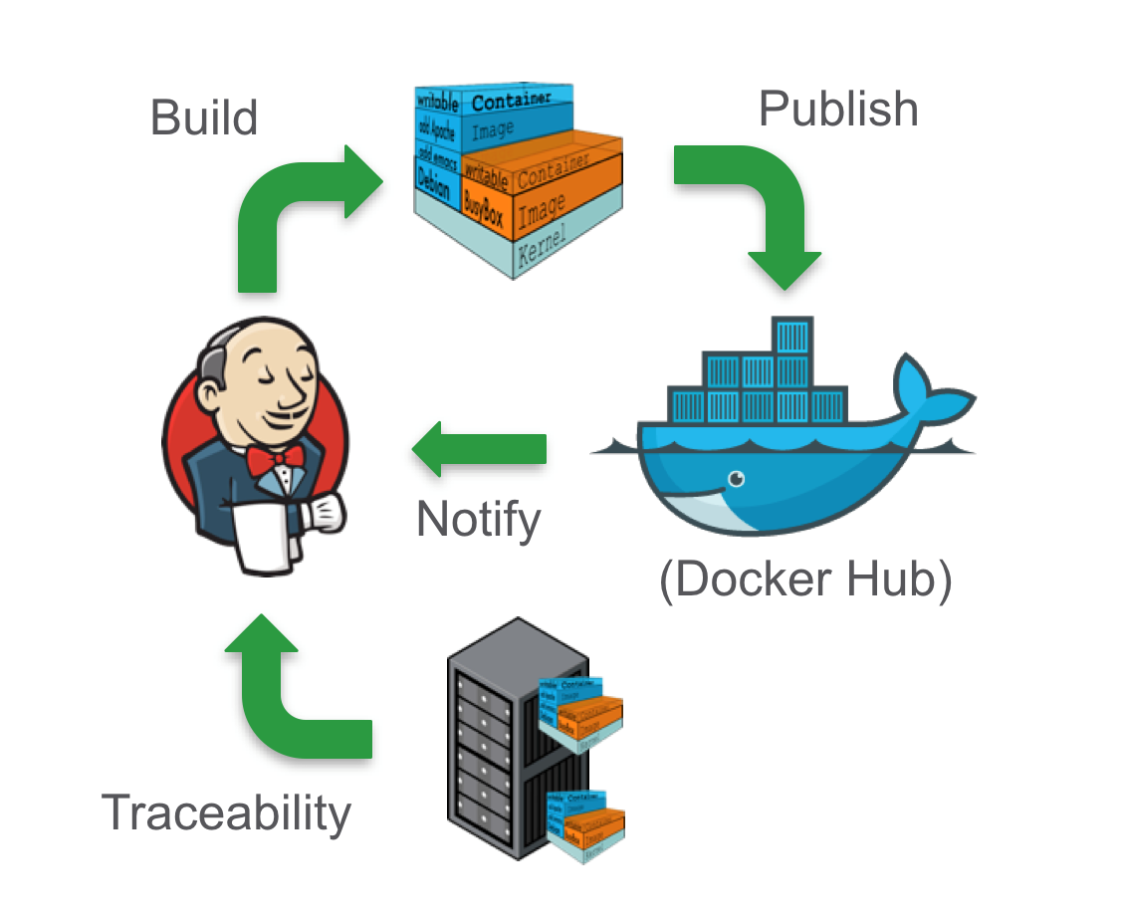
Project

Slide 17
What Is Docker Compose?
Docker Compose is a command-line tool that uses a specially formatted descriptor file to take multiple containers and assemble them into applications which can then be run on a single host.
The application’s services are configured using YAML files. Maybe you wonder what is Docker Compose main benefit? Most certainly the fact that it allows users to run commands on several containers at the same time. This means that developers can write a YAML configuration file for their application service and subsequently use just one command to start it. Originally developed for Linux, this tool is now available to most operating systems, including Windows and macOS.

Slide 18

What is Docker Compose’s most common use-case scenario?
Docker Compose could be considered a workflow improvement tool. As previously stated, it simplifies testing processes by making it possible to use any machine with Docker installed to run applications in an isolated environment. Yet, it now supports deployment and can be used to manage the rolling out of several containers on a host system.

