Slide 1
J2EE
Spring Mvc

Slide 2
Spring MVC
A Spring MVC is a Java framework which is used to build web applications. It follows the Model-View-Controller design pattern.
It implements all the basic features of a core spring framework like Inversion of Control, Dependency Injection.

Slide 3
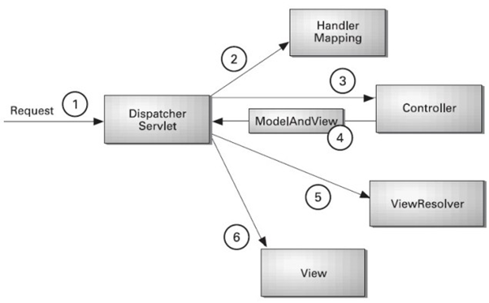
Architecture

Slide 4
Architecture
Model - A model contains the data of the application. A data can be a single object or a collection of objects.
Controller - A controller contains the business logic of an application. Here, the @Controller annotation is used to mark the class as the controller.
View - A view represents the provided information in a particular format. Generally, JSP+JSTL is used to create a view page. Although spring also supports other view technologies such as Apache Velocity, Thyme leaf and Free Marker.
Front Controller - In Spring Web MVC, the Dispatcher-Servlet class works as the front controller. It is responsible to manage the flow of the Spring MVC application.

Slide 5
Web.XML
Spring MVC web applications use the web.xml file as a deployment descriptor file. Also, it defines mappings between URL paths and the servlets in the web.xml file.
This is no longer the case with Spring Boot. If we need a special filter, we can register it in a Java class configuration.

Slide 6
WebApp
<web-app>
<servlet>
<servlet-name>Dispatcher</servlet-name>
<servlet-class> org.springframework.web.servlet.DispatcherServlet</servlet-class>
<load-on-startup>2</load-on-startup>
</servlet>
<servlet-mapping>
<servlet-name>Dispatcher</servlet-name>
<url-pattern>/</url-pattern>
</servlet-mapping>
</web-app>

Slide 7
Dispatcher-servlet
A Spring MVC provides an elegant solution to use MVC in spring framework by the help of Dispatcher-Servlet. Here, Dispatcher-Servlet is a class that receives the incoming request and maps it to the right resource such as controllers, models, and views.

Slide 8
Handler-Mapping
<context:component-scan base-package="com.spring.login"></context:component-scan>
<bean class="org.springframework.web.servlet.view.InternalResourceViewResolver">
<property name="prefix">
<value>/WEB-INF/view/</value>
</property>
<property name="suffix">
<value>.jsp</value>
</property>
</bean>
</beans>

Slide 9
Bean
Bean scope in Spring framework or Spring MVC is scope for a bean managed by Spring IOC container. You may know that Spring is a framework that is based on
Dependency Injection and Inversion of Control and provides bean management facilities to Java application. In Spring-managed environment bean (Java Classes)
are created and wired by the Spring framework. Spring allows you to define how those beans will be created and the scope of the bean is one of those details.
Read more: https://javarevisited.blogspot.com/2012/05/what-is-bean-scope-in-spring-mvc.html#ixzz71Qj7y7by

