Slide 1
Stream(File) Input/Output
Chapter 15
Lecture 10-1

Slide 2
OBJECTIVES
In this chapter you’ll learn:
To use C++ object-oriented stream input/output.
To format input and output.
The stream-I/O class hierarchy.
To use stream manipulators.
To control justification and padding.
To determine the success or failure of input/output operations.
To tie output streams to input streams.

Slide 3
Lecture 10-1
Contents
01
Streams
02
Stream Output
03
Stream Input
04
Unformatted I/O Using read, write and gcount
05
Introduction to Stream Manipulators

Slide 4
01 Streams(Cont.)
C++ standard library input/output capabilities
Many I/O features are object oriented
Type-safe I/O
<< and >> operators are overloaded to accept data of specific types
Attempts to input or output a user-defined type that << and >> have not been overloaded for result in compiler errors
If unexpected data is processed, error bits are set
User may test the error bits to determine I/O operation success or failure
The program is able to “stay in control”
Extensibility allows users to specify I/O for user-defined types
Overloading the stream insertion and extraction operators

Slide 5
01 Streams
C++ I/O occurs in streams – sequences of bytes
Input
Bytes flow from a device to main memory
Output
Bytes flow from main memory to a device
I/O transfers typically take longer than processing the data

Slide 6
01 Streams (Cont.)
“Low-level”, unformatted I/O
Individual bytes are the items of interest
High-speed, high-volume
Not particularly convenient for programmers
“High-level”, formatted I/O
Bytes are grouped into meaningful units
Integers, floating-point numbers, characters, etc.
Satisfactory for most I/O other than high-volume file processing

Slide 7
1.1 Classic Streams vs. Standard Streams
C++ classic stream libraries
Enable input and output of chars (single bytes)
ASCII character set
Uses single bytes
Represents only a limited set of characters
Unicode character set
Represents most of the world’s commercially viable languages, mathematical symbols and more
www.unicode.org

Slide 8
1.1 Classic Streams vs. Standard Streams (Cont.)
C++ standard stream libraries
Enables I/O operations with Unicode characters
Class template versions of classic C++ stream classes
Specializations for processing characters of types char and wchar_t
wchar_ts can store Unicode characters

Slide 9
1.2 iostream Library Header Files
<iostream> header file
Declares basic services required for all stream-I/O operations
Defines cin, cout, cerr and clog
Provides both unformatted- and formatted-I/O services
<iomanip> header file
Declares services for performing formatted I/O with parameterized stream manipulators
<fstream> header file
Declares services for user-controlled file processing

Slide 10
1.3 Stream Input/Output Classes and Objects
Class templates in the iostream library
basic_istream
Supports stream-input operations
basic_ostream
Supports stream-output operations
basic_iostream
Supports both stream-input and stream-output operations

Slide 11
1.3 Stream Input/Output Classes and Objects (Cont.)
typedefs
Declare synonyms for previously defined data types
Example
typedef Card *CardPtr;
Makes CardPtr a synonym for type Card *
Used to create shorter or more readable type names

Slide 12
1.3 Stream Input/Output Classes and Objects (Cont.)
typedefs in <iostream> library
istream
Represents a specialization of basic_istream
Enables char input
ostream
Represents a specialization of basic_ostream
Enables char output
iostream
Represents a specialization of basic_iostream
Enables char input and output

Slide 13
1.3 Stream Input/Output Classes and Objects (Cont.)
Stream-I/O template hierarchy
basic_istream and basic_ostream derive from basic_ios
basic_iostream derives from basic_istream and basic_ostream
Uses multiple inheritance
Stream operator overloading
Stream insertion operator
Left-shift operator (<<) is overloaded for stream output
Stream extraction operator
Right-shift operator(>>) is overloaded for stream input

Slide 14
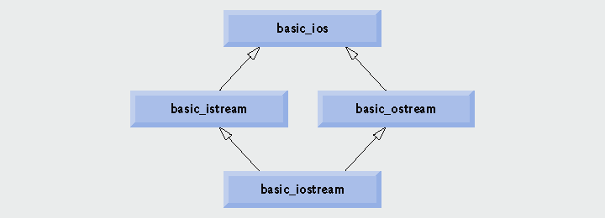
Fig. 15.1 | Stream-I/O template hierarchy portion.

Slide 15
1.3 Stream Input/Output Classes and Objects (Cont.)
Standard stream objects
istream instance
cin
Connected to the standard input device, usually the keyboard
ostream instances
cout
Connected to the standard output device, usually the display screen
cerr
Connected to the standard error device
Unbuffered - output appears immediately
clog
Connected to the standard error device
Buffered - output is held until the buffer is filled or flushed

Slide 16
1.3 Stream Input/Output Classes and Objects (Cont.)
File-Processing Templates
basic_ifstream
For file input
Inherits from basic_istream
basic_ofstream
For file output
Inherits from basic_ostream
basic_fstream
For file input and output
Inherits from basic_iostream
typedef specializations
ifstream, ofstream and fstream

Slide 17
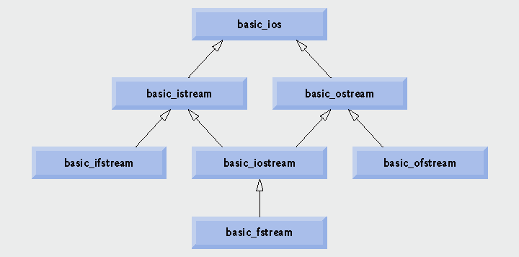
Fig. 15.2 | Stream-I/O template hierarchy portion showing the main file-processing templates.

Slide 18
02 Stream Output
ostream output capabilities
Can output
Standard data types
Characters
Unformatted data
Integers
Floating-point values
Values in fields

Slide 19
2.1 Output of char * Variables
Outputting char * (memory address of a char)
Cannot use << operator
Has been overloaded to print char * as a null-terminated string
Solution
Cast the char * to a void *
Address is printed as a hexadecimal (base-16) number

Slide 20
Fig15_03.cpp
(1 of 1)
Cast the char * to a void *
Address prints as a hexadecimal (base-16) number

Slide 21
2.2 Character Output using Member Function put
ostream member function put
Outputs a character
Returns a reference to the same ostream object
Can be cascaded
Can be called with a numeric expression that represents an ASCII value
Examples
cout.put( 'A' );
cout.put( 'A' ).put( '\n' );
cout.put( 65 );

Slide 22
03 Stream Input
istream input capabilities
Stream extraction operator (overloaded >> operator)
Skips over white-space characters
Returns a reference to the istream object
When used as a condition, void * cast operator is implicitly invoked
Converts to non-null pointer (true) or null pointer (false)
Based on success or failure of last input operation
An attempt to read past end of stream is one such failure
State bits
Control the state of the stream
Failbit : Set if input data is of wrong type
Badbit : Set if stream extraction operation fails

Slide 23
3.1 get and getline Member Functions
istream member function get
With no arguments
Returns one character input from the stream
Any character, including white-space and non-graphic characters
Returns EOF when end-of-file is encountered
With a character-reference argument
Stores input character in the character-reference argument
Returns a reference to the istream object

Slide 24
3.1 get and getline Member Functions (Cont.)
istream member function get (Cont.)
With three arguments: a character array, a size limit and a delimiter (default delimiter is '\n' )
Reads and stores characters in the character array
Terminates at one fewer characters than the size limit or upon reading the delimiter
Delimiter is left in the stream, not placed in array
Null character is inserted after end of input in array
istream member function eof
Returns false when end-of-file has not occurred
Returns true when end-of-file has occurred

Slide 25
Fig15_04.cpp
(1 of 2)
Call eof member function before end-of-file is reached
while loop terminates when get member function returns EOF

Slide 26
Fig15_04.cpp
(2 of 2)
Display character, which currently contains the value of EOF
Call eof member function after end-of-file is reached
End-of-file is represented by Ctrl + z on Microsoft Windows systems, Ctrl + d on UNIX and Macintosh systems.

Slide 27
Fig15_05.cpp
(1 of 2)
Use stream extraction with cin
Call three-argument version of member function get (third argument is default value '\n')

Slide 28
Stream extraction operation reads up to first white-space character
Fig15_05.cpp
(1 of 2)
get member function reads up to the delimiter character '\n'

Slide 29
3.1 get and getline Member Functions (Cont.)
istream member function getline
(Similar to the three-argument version of get
Except the delimiter is removed from the stream)
Three arguments: a character array, a size limit and a delimiter (default delimiter is '\n' )
Reads and stores characters in the character array
Terminates at one fewer characters than the size limit or upon reading the delimiter
Delimiter is removed from the stream, but not placed in the array
Null character is inserted after end of input in array

Slide 30
Fig15_06.cpp
(1 of 1)
Call member function getline

Slide 31
3.2 istream Member Functions peek, putback and ignore
istream member function ignore
Reads and discards a designated number of characters or terminates upon encountering a designated delimiter
Default number of characters is one
Default delimiter is EOF
istream member function putback
Places previous character obtained by a get from the input stream back into the stream
istream member function peek
Returns the next character in the input stream, but does not remove it from the stream

Slide 32
04 Unformatted I/O Using read, write and gcount
istream member function read
Inputs some number of bytes to a character array
If fewer characters are read than the designated number, failbit is set
istream member function gcount
Reports number of characters read by last input operation
ostream member function write
Outputs some number of bytes from a character array

Slide 33
Fig15_07.cpp
(1 of 1)
read 20 bytes from the input stream to buffer
write out as many characters as were read by the last input operation from buffer to the output stream

Slide 34
05 Introduction to Stream Manipulators
Stream manipulators perform formatting tasks
Setting field widths
Setting precision
Setting and unsetting format state
Setting fill characters in fields
Flushing streams
Inserting a newline and flushing the output stream
Inserting a null character and skipping white space in the input stream

Slide 35
5.1 Integral Stream Base: dec, oct, hex and setbase
Change a stream’s integer base by inserting manipulators
hex manipulator
Sets the base to hexadecimal (base 16)
oct manipulator
Sets the base to octal (base 8)
dec manipulator
Resets the base to decimal
setbase parameterized stream manipulator
Takes one integer argument: 10, 8 or 16
Sets the base to decimal, octal or hexadecimal
Requires the inclusion of the <iomanip> header file
Stream base values are sticky
Remain until explicitly changed to another base value

Slide 36
Fig15_08.cpp
(1 of 2)
Parameterized stream manipulator setbase is in header file <iomanip>

Slide 37
Fig15_08.cpp
(2 of 2)
Set base to hexadecimal
Set base to octal
Reset base to decimal

Slide 38
5.2 Floating-Point Precision (precision, setprecision)
Precision of floating-point numbers
Number of digits displayed to the right of the decimal point
setprecision parameterized stream manipulator
precision member function
When called with no arguments, returns the current precision setting
Precision settings are sticky

Slide 39
Fig15_09.cpp
(1 of 2)
Use member function precision to set cout to display places digits to the right of the decimal point

Slide 40
Fig15_09.cpp
(2 of 2)
Use parameterized stream manipulator setprecision to set cout to display places digits to the right of the decimal point

Slide 41
5.3 Field Width (width, setw)
Field width
(for ostream) Number of character positions in which value is outputted
Fill characters are inserted as padding
Values wider than the field are not truncated
(for istream) Maximum number of characters inputted
For char array, maximum of one fewer characters than the width will be read (to accommodate null character)

Slide 42
5.3 Field Width (width, setw) (Cont.)
Field width (Cont.)
Member function width of base class ios_base
Sets the field width
Returns the previous width
width function call with no arguments just returns the current setting
Parameterized stream manipulator setw
Sets the field width
Field width settings are not sticky

Slide 43
Fig15_10.cpp
(1 of 2)

Slide 44
Fig15_10.cpp
(2 of 2)

Slide 45
5.4 Use-Defined Output Stream Manipulators
Programmers can create their own stream manipulators
Output stream manipulators
Must have return type and parameter type ostream &

Slide 46
Fig15_11.cpp
(1 of 2)

Slide 47
Fig15_11.cpp
(2 of 2)

