Slide 1
Stream(File) Input/Output
Chapter 17
Lecture 10-3

Slide 2
OBJECTIVES
In this chapter you’ll learn:
In this chapter you’ll learn:
To create, read, write and update files.
Sequential file processing.
Random-access file processing.
To use high-performance unformatted I/O operations.
The differences between formatted-data and raw-data file processing.
To build a transaction-processing program using random-access file processing.

Slide 3
Lecture 10-3
Contents
01
File Introduction
02
Sequential File
03
Random-Access Files
04
Case Study
05
Overview of Object Serialization

Slide 4
01 File Introduction
Files
Used for data persistence
Permanent retention of large amounts of data
Stored on secondary storage devices
Magnetic disks
Optical disks
Tapes

Slide 5
01 File Introduction(Cont.)
Bits (“binary digits”)
Can assume one of two values, 0 or 1
Smallest data item that computers support
Computer circuitry performs simple bit manipulations
Ultimately all data items are composed of bits
Characters
Include decimal digits, letters and special symbols
Composed of bits (1s and 0s)
A character set is the set of all characters used on a particular computer
chars are stored in bytes (8 bits)
wchar_ts are stored in more than one byte

Slide 6
01 File Introduction(Cont.)
Fields
Composed of characters
Conveys some meaning
Example
Uppercase and lowercase letters can represent a name
Records
Composed of several fields
Represented as a class in C++
Example
An employee’s record might include id#, name, address, etc.
A record key is a field unique to each record

Slide 7
01 File Introduction(Cont.)
File
Composed of a group of related records
Example
A payroll file containing one record for each employee
Many ways to organize records in a file
Such as a sequential file
Records are stored in order by a record-key field
Database
Composed of a group of related files
Managed by a collection of programs called a database management system (DBMS)

Slide 8
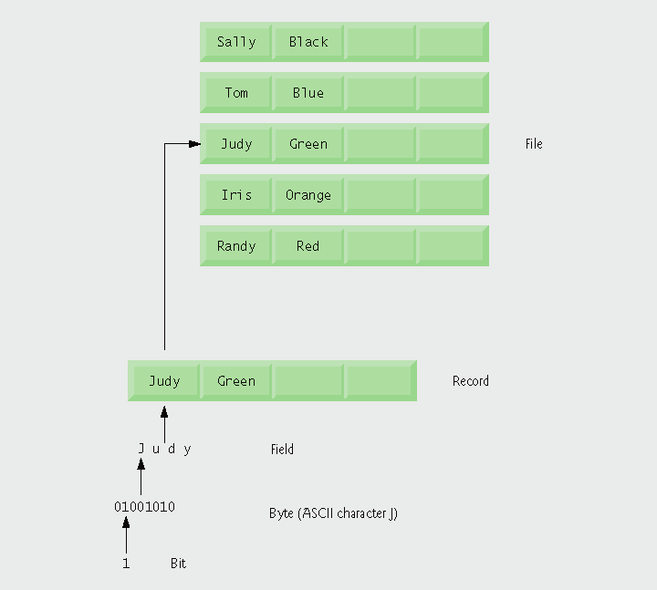
Fig. 17.1 | Data hierarchy.

Slide 9
Files and Streams
Files
Viewed by C++ as a sequence of bytes
Ends either with an end-of-file marker or at a system-recorded byte number
Communication between a program and a file is performed through stream objects
<fstream> header file
Stream class templates
basic_ifstream – for file input
basic_ofstream – for file output
basic_fstream – for file input and output
Files are opened by creating objects of stream template specializations

Slide 10

Fig. 17.2 | C++’s view of a file of n bytes.

Slide 11
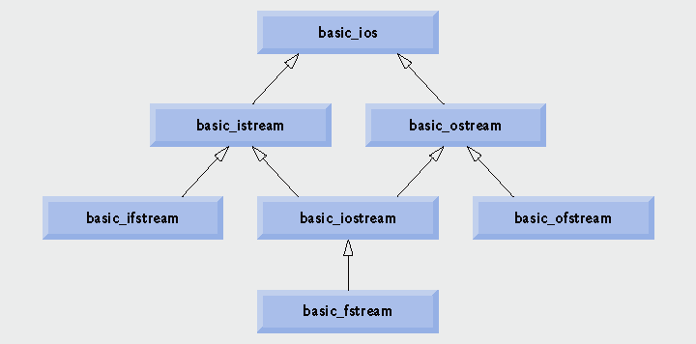
Fig. 17.3 | Portion of stream I/O template hierarchy.

Slide 12
02 Sequential File
File structure
The programmer must structure files
C++ does not impose structures on files

Slide 13
2.1 Creating a Sequential File (Cont.)
Creating an ofstream object
Opens a file for output
Constructor takes two arguments
A filename
If the file doe not exist, it is first created
A file-open mode
ios::out – the default mode
Overwrites preexisting data in the file
ios::app
Appends data to the end of the file
Can also use member function open on existing object
Takes same arguments as the constructor

Slide 14
2.1 Creating a Sequential File (Cont.)
Using an ofstream object
Writing to the file
Use the stream insertion operator
Member function close
Releases the file resource
Implicitly performed by ofstream’s destructor
ios operators (usable with ofstream)
Operator member function operator!
Returns true if either the failbit or badbit is set
Operator member function operator void *
Converts the stream to a pointer
The null pointer if either the failbit or badbit is set

Slide 15
Fig17_04.cpp
(1 of 2)
Open file client.dat for output
Overloaded operator! will return true if the file did not open successfully

Slide 16
Overloaded operator void * will return the null pointer 0 (false) when the user enters the end-of-file indicator
Fig17_04.cpp
(2 of 2)
Write data to client.dat using the stream insertion operator
ofstream destructor implicitly closes the file

Slide 17
Fig. 17.5 | File open modes.

Slide 18
Fig. 17.6 | End-of-file key combinations for various popular computer systems.

Slide 19
2.2 Reading Data from a Sequential File
Creating an ifstream object
Opens a file for input
Constructor takes two arguments
A filename
A file-open mode
ios::in – the default mode
Can only read from the file
Can also use member function open on an existing object
Takes same arguments as the constructor

Slide 20
2.2 Reading Data from a Sequential File (Cont.)
File-position pointer
The byte number of the next byte to be read or written
Member functions seekg and seekp (of istream and ostream, respectively)
Repositions the file-position pointer to the specified location
Takes desired offset argument as a long
A second argument can specify the seek direction
ios::beg – the default
Positioning relative to the beginning
ios::cur
Positioning relative to the current position
ios::end
Positioning relative to the end

Slide 21
2.2 Reading Data from a Sequential File (Cont.)
Member functions seekg and seekp (Cont.)
Examples
fileObject.seekg( n );
Position to the nth byte of fileObject
fileObject.seekg( n, ios::cur );
Position n bytes forward in fileobject
fileObject.seekg( n, ios::end );
Position n bytes back from end of fileObject
fileObject.seekg( 0, ios::end );
Position at end of fileObject

Slide 22
2.2 Reading Data from a Sequential File (Cont.)
File-position pointer (Cont.)
Member functions tellg and tellp (of istream and ostream, respectively)
Returns current position of the file-position pointer as type long
Example
location = fileObject.tellg();

Slide 23
Fig17_07.cpp
(1 of 3)

Slide 24
Open clients.dat for input
Fig17_07.cpp
(2 of 3)
Overloaded operator! returns true if clients.dat was not opened successfully
Overloaded operator void * returns a null pointer 0 (false) when the end of clients.dat is reached
ifstream destructor implicitly closes the file

Slide 25
Fig17_07.cpp
(3 of 3)

Slide 26
Fig17_08.cpp
(1 of 6)

Slide 27
Fig17_08.cpp
(2 of 6)

Slide 28
Fig17_08.cpp
(3 of 6)

Slide 29
Use ostream member function seekg to reposition the file-position pointer to the beginning
Fig17_08.cpp
(4 of 6)

Slide 30
Fig17_08.cpp
(5 of 6)

Slide 31
Fig17_08.cpp
(6 of 6)

Slide 32
2.3 Updating Sequential Files
Updating a record in a sequential file
The new record could be longer than the old record
If it is, it could overwrite the next sequential record
You would have to rewrite every record into another file
Copy over all records before this one
Write new version of this record
Copy over all records after this one
This might be acceptable if you are updating many records

Slide 33
03 Random-Access Files
Random-access files
Necessary for instant-access applications
Such as transaction-processing systems
A record can be inserted, deleted or modified without affecting other records
Various techniques can be used
Require that all records be of the same length, arranged in the order of the record keys
Program can calculate the exact location of any record
Base on the record size and record key

Slide 34
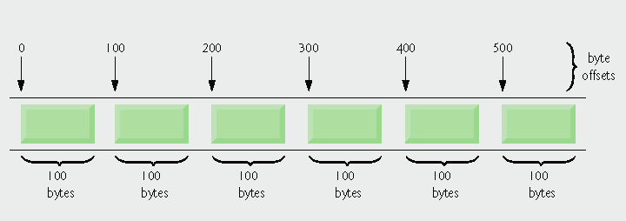
Fig. 17.9 | C++ view of a random-access file.

Slide 35
3.1 Creating a Random-Access File
ostream member function write
Writes a number of bytes from a location in memory to the stream
If the stream is associated with a file, the writing is at the “put” file-position pointer
First argument
A const char * pointing to bytes in memory
Second argument
A size_t specifying the number of bytes to write
Example
outFile.write( reinterpret_cast<const char *>( &number ), sizeof( number ) );

Slide 36
3.1 Creating a Random-Access File (Cont.)
Operator reinterpret_cast
Casts a pointer of one type to an unrelated type
Also converts between pointer and integer types
Is performed at compile time
Does not change the value of the object pointed to

Slide 37
ClientData.h
(1 of 2)

Slide 38
ClientData.h
(2 of 2)
Store the first and last name in fixed-length char arrays – we cannot use strings because they do not have uniform length

Slide 39
ClientData.cpp
(1 of 3)

Slide 40
ClientData.cpp
(2 of 3)
string member function data returns an array containing the characters of the string (not guaranteed to be null terminated)
string member function size returns the length of lastNameString

Slide 41
ClientData.cpp
(3 of 3)

Slide 42
Fig17_12.cpp
(1 of 2)

Slide 43
Open credit.dat in binary mode, which is required to write fixed-length records
Fig17_12.cpp
(2 of 2)
Write the data in blankClient to credit.dat as bytes

Slide 44
3.2 Writing Data Randomly to a Random-Access File
Writing data randomly
Opening for input and output in binary mode
Use an fstream object
Combine file-open modes ios::in, ios::out and ios::binary
Separate each open mode from the next with the bitwise inclusive OR operator (|)
Use function seekp to set the “put” file-position pointer to the specific position
Example calculation
( n – 1 ) * sizeof( ClientData )
Byte location for nth ClientData record
Use function write to output the data

Slide 45
Fig17_13.cpp
(1 of 4)
Create fstream outCredit to open credit.dat for input and output in binary mode

Slide 46
Fig17_13.cpp
(2 of 4)

Slide 47
Position the “put” file-position pointer to the desired byte location
Fig17_13.cpp
(3 of 4)
Write the ClientData record to the correct position in the file

Slide 48
Fig17_13.cpp
(4 of 4)

Slide 49
3.3 Reading from a Random-Access File Sequentially
Sequentially reading a random-access file
Ifstream member function read
Inputs a number of bytes from the current file position in the stream into an object
First argument
A char * pointing to the object in memory
Second argument
A size_t specifying the number of bytes to input
Additional benefit
Sequentially read-in records are sorted in order of ascending record keys
Space-time trade off: a fast sorting algorithm, but space-consuming

Slide 50
Fig17_14.cpp
(1 of 3)

Slide 51
Fig17_14.cpp
(2 of 3)
This loop-continuation condition evaluates to false if an error occurs when reading from the file or if the end of file is reached

Slide 52
Because outputLine takes an ostream reference as argument, it can be used with cout (an ostream object) or an ofstream object (derived from ostream) to output to the screen or to a file
Fig17_14.cpp
(3 of 3)

Slide 53
04 Case Study: A Transaction-Processing Program

Slide 54
Fig17_15.cpp
(1 of 10)

Slide 55
Fig17_15.cpp
(2 of 10)
“Or” together modes ios::in and ios::out for both reading and writing capabilities

Slide 56
Fig17_15.cpp
(3 of 10)

Slide 57
Fig17_15.cpp
(4 of 10)
fstream object argument for inputting data from credit.dat

Slide 58
Use istream member function seekg to ensure that the file-position pointer is at the beginning of the file
Fig17_15.cpp
(5 of 10)

Slide 59
Fig17_15.cpp
(6 of 10)
Read data into object client, using istream member function read
Determine whether the record contains information
Use function outputLine with the cout ostream object to display the record

Slide 60
Fig17_15.cpp
(7 of 10)

Slide 61
Fig17_15.cpp
(8 of 10)
Display an error message indicating that the account exists

Slide 62
Fig17_15.cpp
(9 of 10)
Copy an empty record into the file to reinitialize that account
If the specified account is empty, display an error message

Slide 63
Fig17_15.cpp
(10 of 10)

Slide 64
05 Overview of Object Serialization
When object data members are output to a disk file, we lose the object’s type information
Store only the values of the object’s attributes, not type information, on the disk
If the program that reads this data knows the object type to which the data corresponds, the program can read the data into an object of that type
Object serialization
A serialized object is represented as a sequence of bytes that includes the object’s data as well as information about the object’s type and the types of data stored in the object
After a serialized object has been written to a file, it can be read from the file and deserialized, the type information and bytes that represent the object and its data can be used to recreate the object in memory.

Slide 65
05 Overview of Object Serialization (cont.)
C++ does not provide a built-in serialization mechanism
There are third party and open source C++ libraries that support object serialization.
The open source Boost C++ Libraries provide support for serializing objects in text, binary and extensible markup language (XML) formats (www.boost.org/libs/serialization/doc/index.html).

