Slide 1
Object-Oriented
Programming:
Inheritance
Chapter 12
Lecture 11-1

Slide 2
OBJECTIVES
In this chapter you’ll learn:
To create classes by inheriting from existing classes.
How inheritance promotes software reuse.
The notions of base classes and derived classes and the relationships between them.
The protected member access specifier.
The use of constructors and destructors in inheritance hierarchies.
The differences between public, protected and private inheritance.
The use of inheritance to customize existing software.

Slide 3
Lecture 11-1
Contents
01
INTRODUCTION
02
BASE CLASSES AND DERIVED CLASSES
03
CONSTRUCTORS AND DESTRUCTORS IN DERIVED CLASSES
04
SOFTWARE ENGINEERING WITH INHERITANCE

Slide 4
01 Introduction
Inheritance
  Software reusability
  Create new class from existing class
    Absorb existing class’s data and behaviors
    Enhance with new capabilities
  Derived class inherits from base class
    Derived class
      More specialized group of objects
      Behaviors inherited from base class
        Can customize
      Additional behaviors

Slide 5
01 Introduction (Cont.)
Abstraction
  Focus on commonalities among objects in system
“is-a” vs. “has-a”
  “is-a”
    Inheritance
    Derived class object can be treated as base class object
    Example: Car is a vehicle
      Vehicle properties/behaviors also apply to a car
  “has-a”
    Composition
    Object contains one or more objects of other classes as members
    Example: Car has a steering wheel

Slide 6
01 Introduction (Cont.)
Class hierarchy
  Direct base class
    Inherited explicitly (one level up hierarchy)
  Indirect base class
    Inherited two or more levels up hierarchy
  Single inheritance
    Inherits from one base class
  Multiple inheritance
    Inherits from multiple base classes
      Base classes possibly unrelated
    More details in chapter 24

Slide 7
01 Introduction (Cont.)
protected member
  Intermediate level of protection between public and private
  protected members are accessible to
    Base class members
    Base class friends
    Derived class members
    Derived class friends

Slide 8
01 Introduction (Cont.)
Three types of inheritance
public inheritance
  Base class public members → derived class public members
  Base class protected members → derived class protected members
  Base class private members are not accessible
protected inheritance (not is-a relationship)
  Base class public and protected members → derived class protected members
private inheritance (not is-a relationship)
  Base class public and protected members → derived class private members

Slide 9
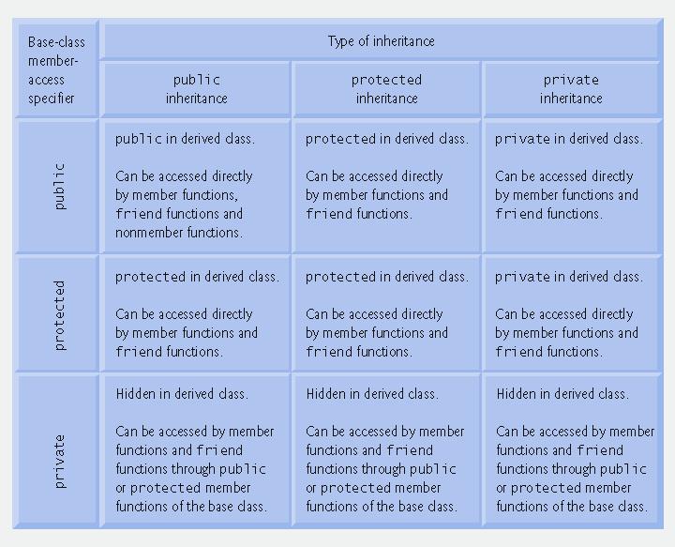
Fig. 12.27 | Summary of base-class member accessibility in a derived class.

Slide 10
02 Base Classes and Derived Classes
Base classes and derived classes
  Object of one class “is an” object of another class
    Example: Rectangle is quadrilateral
      Class Rectangle inherits from class Quadrilateral
        Quadrilateral is the base class
        Rectangle is the derived class
  Base class typically represents larger set of objects than derived classes
    Example:
      Base class: Vehicle
        Includes cars, trucks, boats, bicycles, etc.
      Derived class: Car
        Smaller, more-specific subset of vehicles

Slide 11
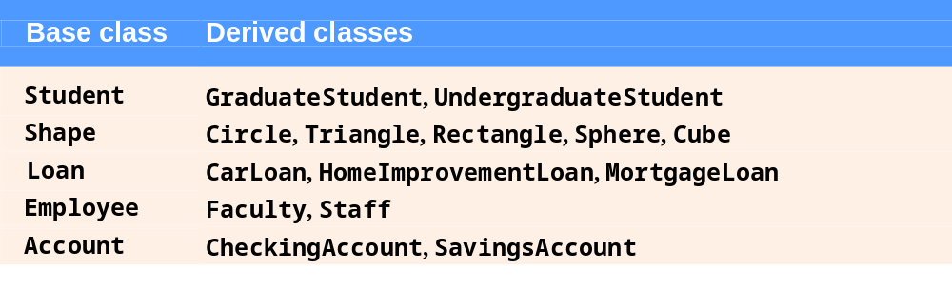
Fig. 12.1 | Inheritance examples.

Slide 12
02 Base Classes and
Derived Classes (Cont.)
Inheritance hierarchy
  Inheritance relationships: tree-like hierarchy structure
  Each class becomes
    Base class
      Supplies data/behaviors to other classes
    OR
    Derived class
      Inherits data/behaviors from other classes

Slide 13
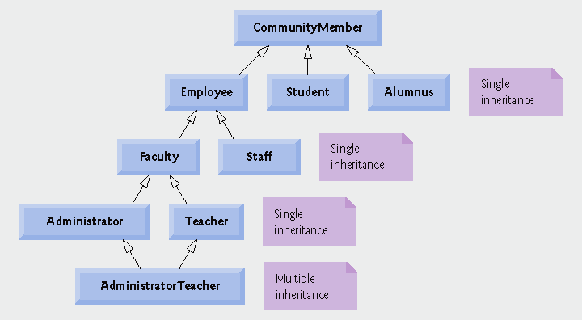
Fig. 12.2 | Inheritance hierarchy for university CommunityMembers.

Slide 14
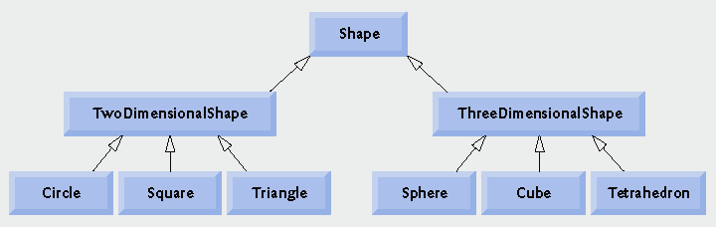
Fig. 12.3 | Inheritance hierarchy for Shapes.

Slide 15
02 Base Classes and Derived Classes (Cont.)
public inheritance
  Specify with:
  Class TwoDimensionalShape : public Shape
    Class TwoDimensionalShape inherits from class Shape
  Base class private members
    Not accessible directly
    Still inherited
      Manipulated through inherited public member functions
  Base class public and protected members
    Inherited with original member access
  friend functions
    Not inherited

Slide 16
2.1 Redefined Base-class Members
Derived-class members
  Refer to public and protected members of base class
    Simply use member names
  Redefined base class members can be accessed by using base-class name and binary scope resolution operator (::)
class base
{ public :
int a , b ;
} ;
class derived : public base
{ public :
int b , c ;
} ;
void f ()
{ derived d ;
d . a = 1 ;
d . base :: b = 2 ;
d . b = 3 ;
d . c = 4 ;
};
base a b
derived a b b c
derived d
1
2
3
4

Slide 17
2.2 Relationship between Base Classes and Derived Classes
Base class and derived class relationship
  Example: CommissionEmployee/BasePlusCommissionEmployee inheritance hierarchy
    CommissionEmployee
      First name, last name, SSN, commission rate, gross sale amount
    BasePlusCommissionEmployee
      First name, last name, SSN, commission rate, gross sale amount
      And also: base salary

Slide 18
2.2.1 Creating a BasePlusCommissionEmployee Class With Using Inheritance
Class CommissionEmployee
  CommissionEmployee header file
    Fig. 12.4
    Specify public services
      Constructor
      get and set functions
      Member functions earnings and print
  CommissionEmployee source code file
    Fig. 12.5
    Specify member-function definitions

Slide 19
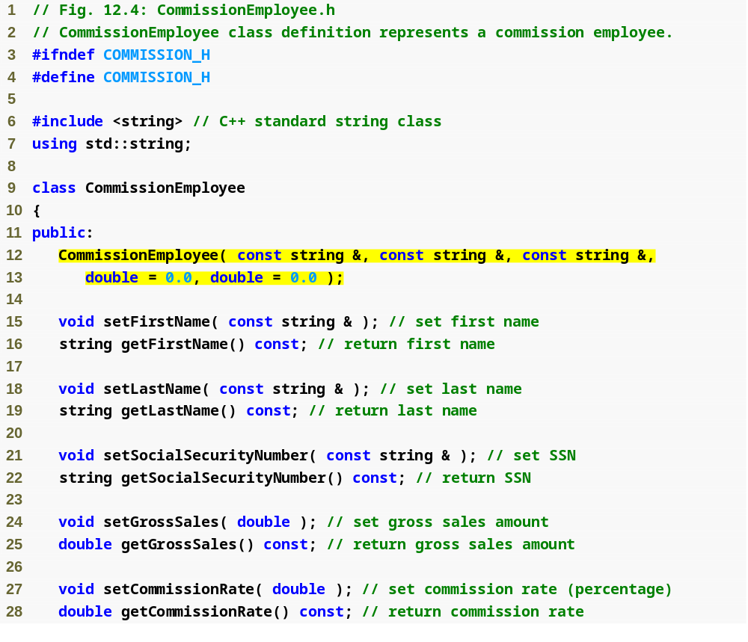
Commission
Employee.h
(1 of 2)
Class CommissionEmployee constructor

Slide 20
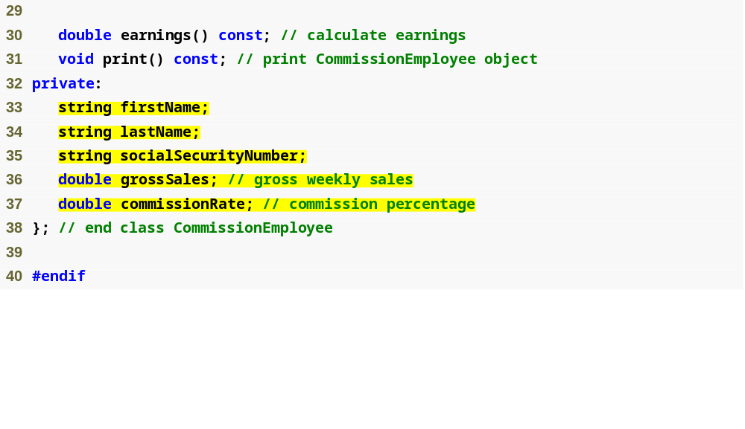
Declare private data members
Commission
Employee.h
(2 of 2)

Slide 21
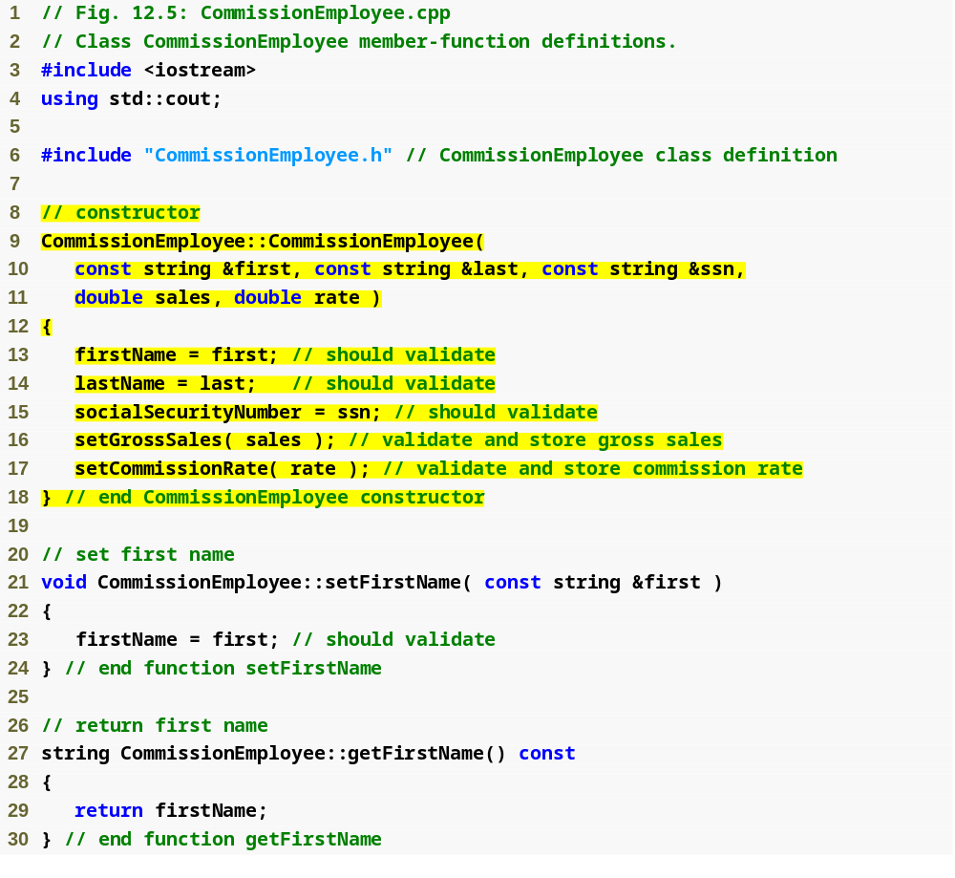
Commission
Employee.cpp
(1 of 4)
Initialize data members

Slide 22
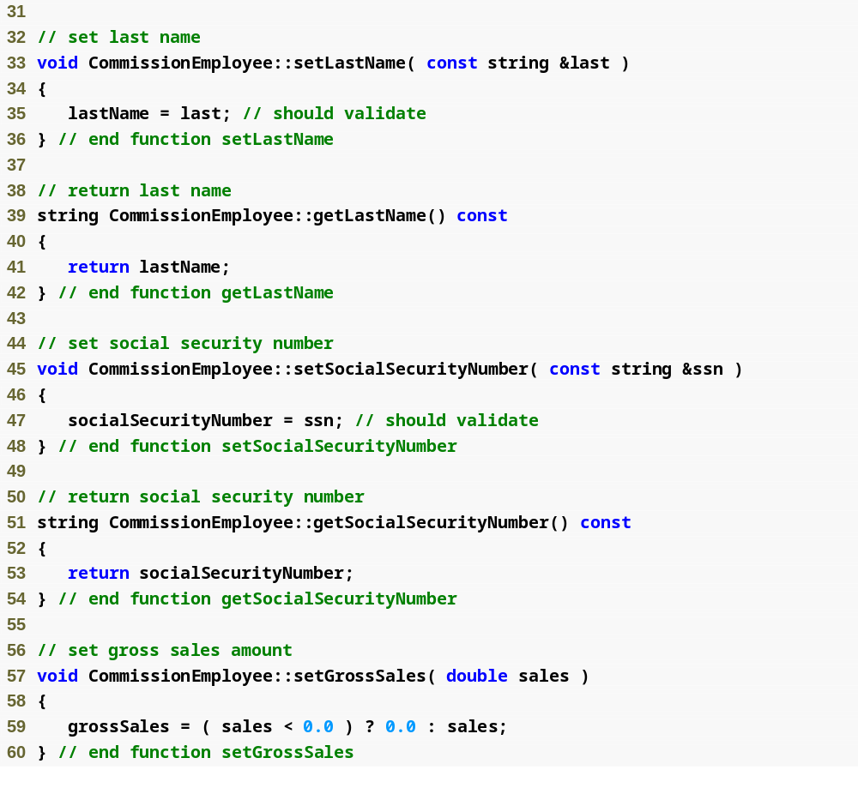
Commission
Employee.cpp
(2 of 4)
Function setGrossSales validates gross sales amount

Slide 23
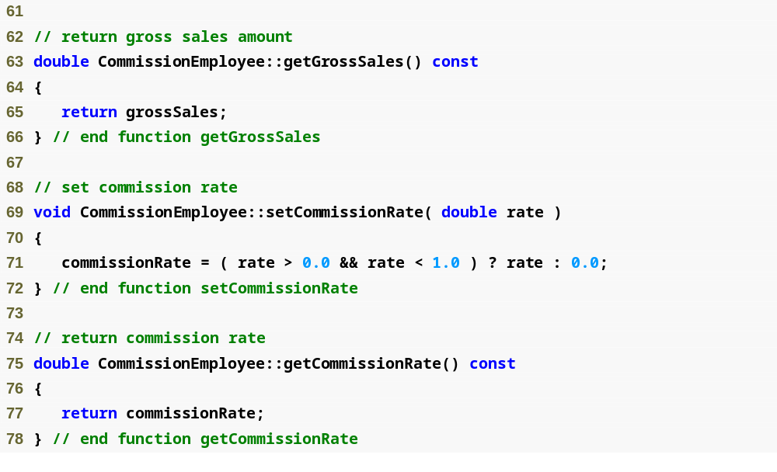
Function setCommissionRate validates commission rate
Commission
Employee.cpp
(3 of 4)

Slide 24
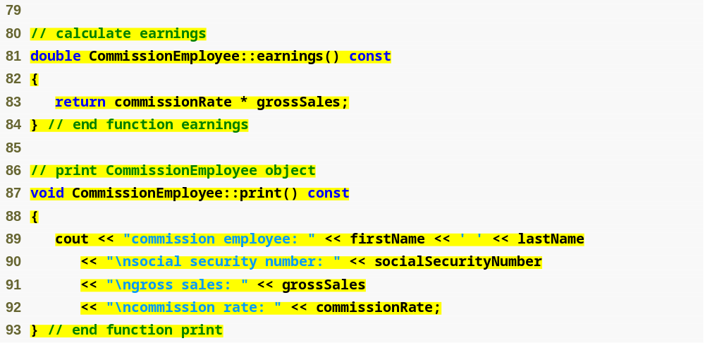
Function earnings calculates earnings
Commission
Employee.cpp
(4 of 4)
Function print displays CommissionEmployee object

Slide 25
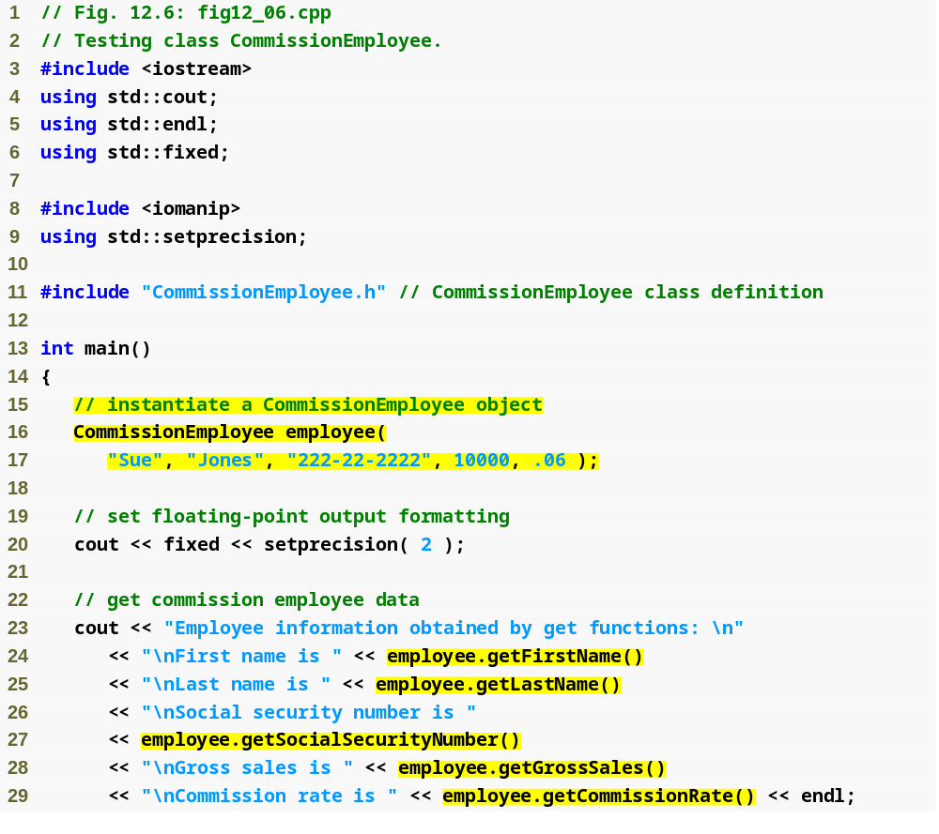
fig12_06.cpp
(1 of 2)
Instantiate CommissionEmployee object
Use CommissionEmployee’s get functions to retrieve the object’s instance variable values

Slide 26
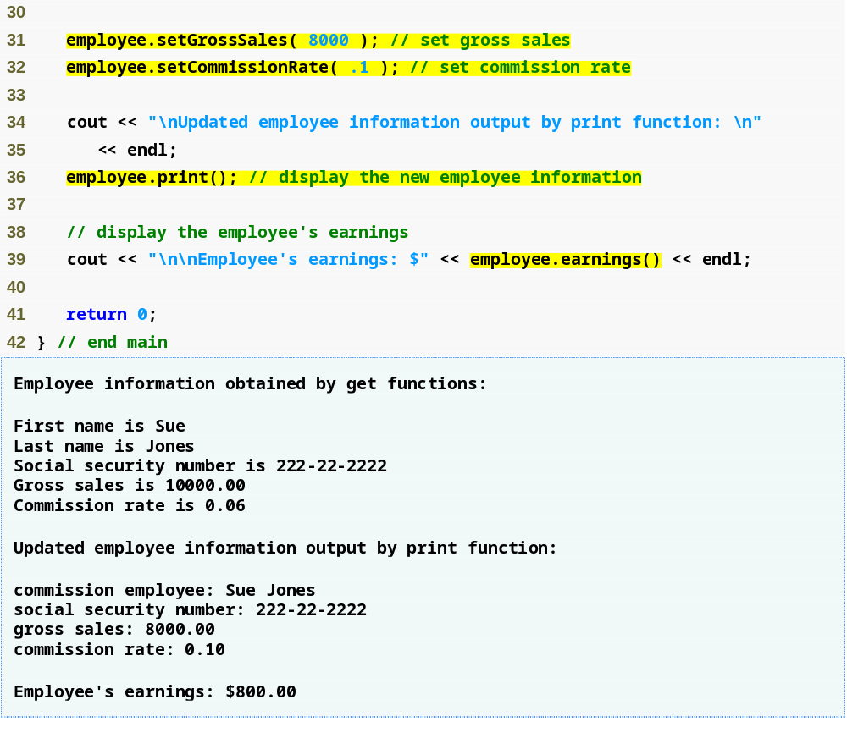
Use CommissionEmployee’s set functions to change the object’s instance variable values
fig12_06.cpp
(2 of 2)
Call object’s print function to display employee information
Call object’s earnings function to calculate earnings

Slide 27
2.2.2 Creating a BasePlusCommissionEmployee Class Without Using Inheritance
Class BasePlusCommissionEmployee
  Much of the code is similar to CommissionEmployee
    private data members
    public methods
    constructor
  Additions
    private data member baseSalary
    Methods setBaseSalary and getBaseSalary

Slide 28
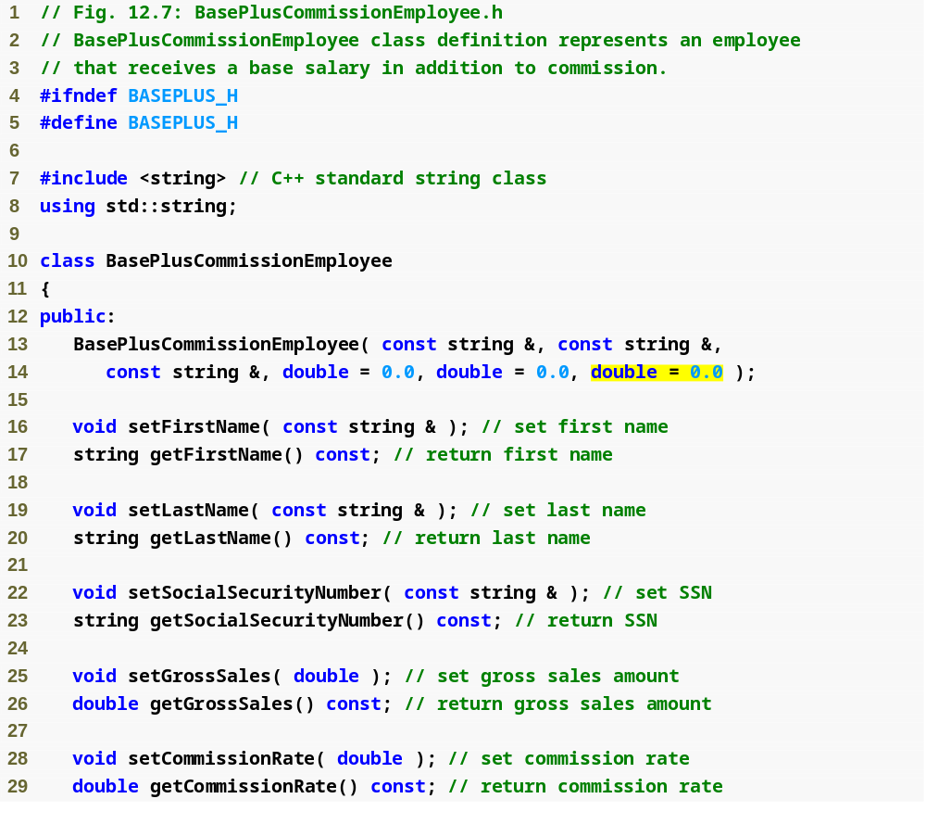
BasePlus
Commission
Employee.h
(1 of 2)
Constructor takes one more argument, which specifies the base salary

Slide 29
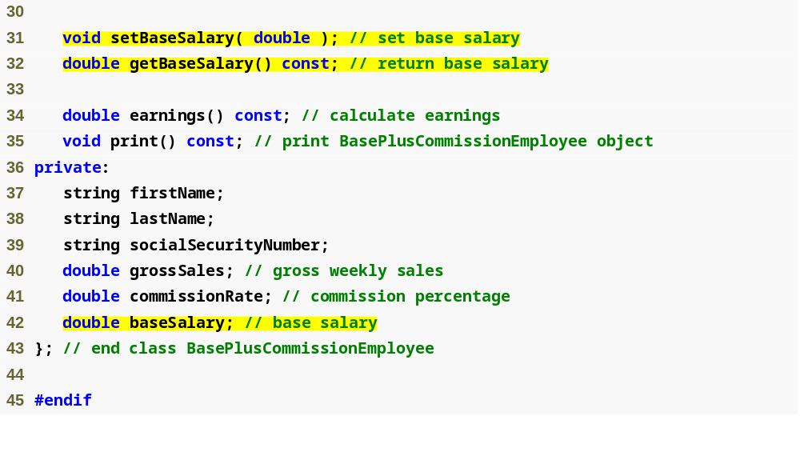
Define get and set functions for data member baseSalary
BasePlus
Commission
Employee.h
(2 of 2)
Add data member baseSalary

Slide 30
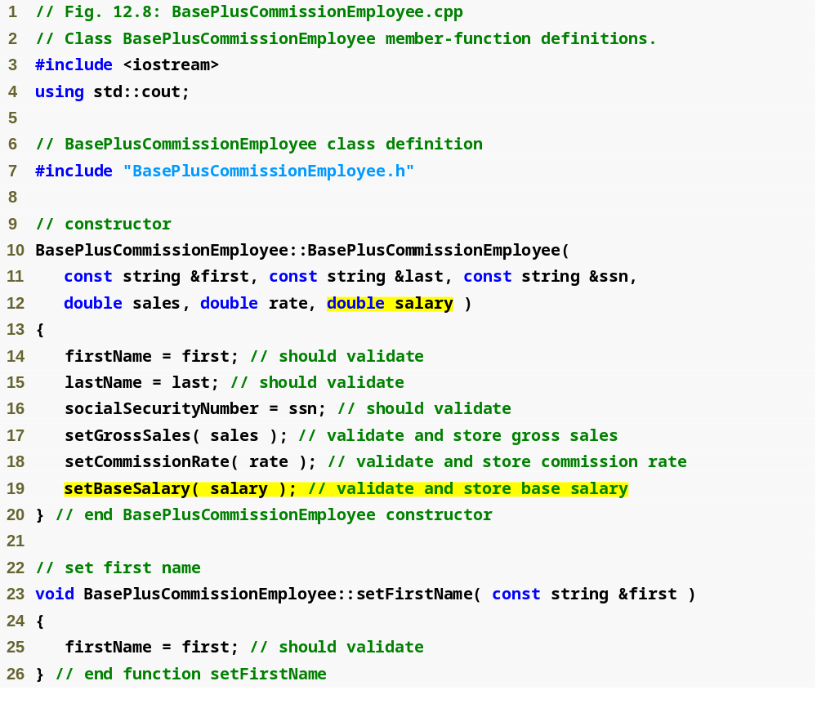
BasePlus
Commission
Employee.cpp
(1 of 4)
Constructor takes one more argument, which specifies the base salary
Use function setBaseSalary to validate data

Slide 31
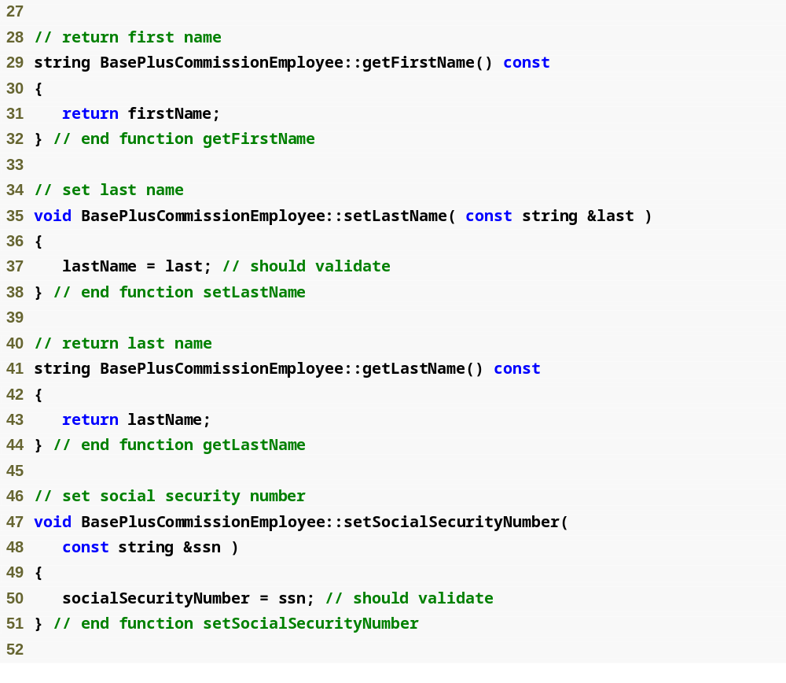
BasePlus
Commission
Employee.cpp
(2 of 4)

Slide 32
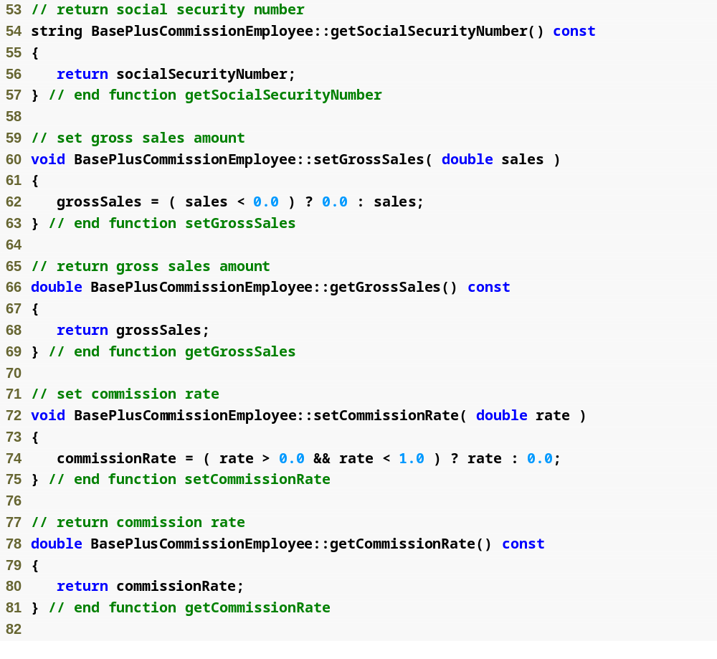
BasePlus
Commission
Employee.cpp
(3 of 4)

Slide 33
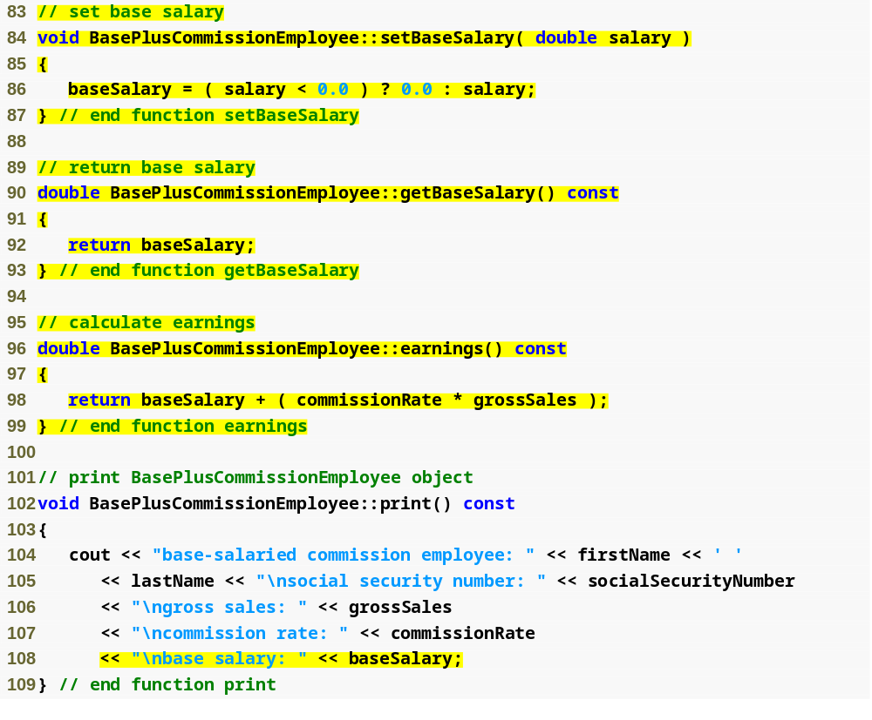
Function setBaseSalary validates data and sets instance variable baseSalary
BasePlus
Commission
Employee.cpp
(4 of 4)
Function getBaseSalary returns the value of instance variable baseSalary
Update function earnings to calculate the earnings of a base-salaried commission employee
Update function print to display base salary

Slide 34
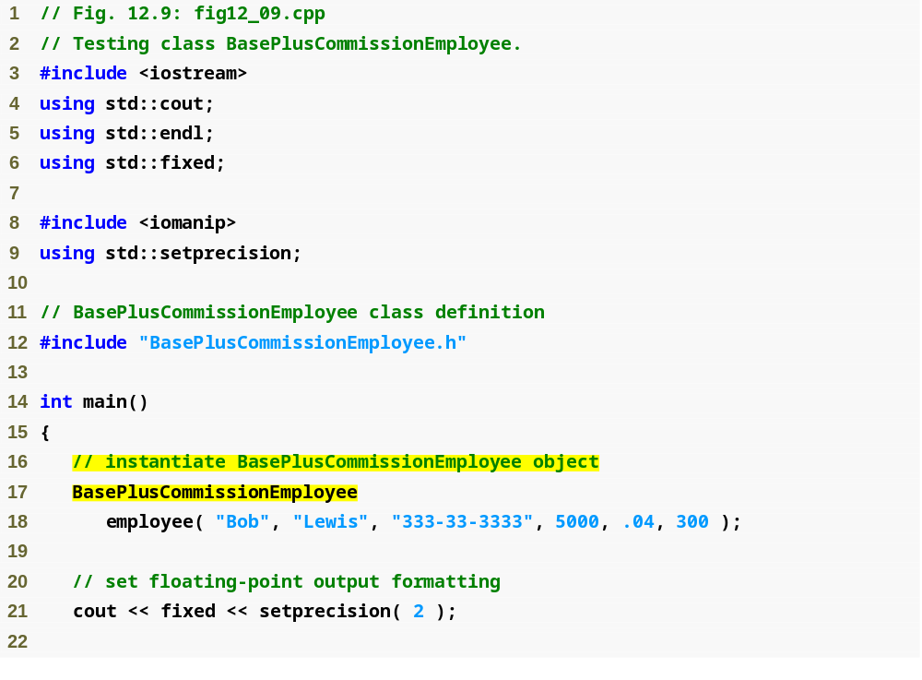
fig12_09.cpp
(1 of 3)
Instantiate BasePlusCommissionEmployee object

Slide 35
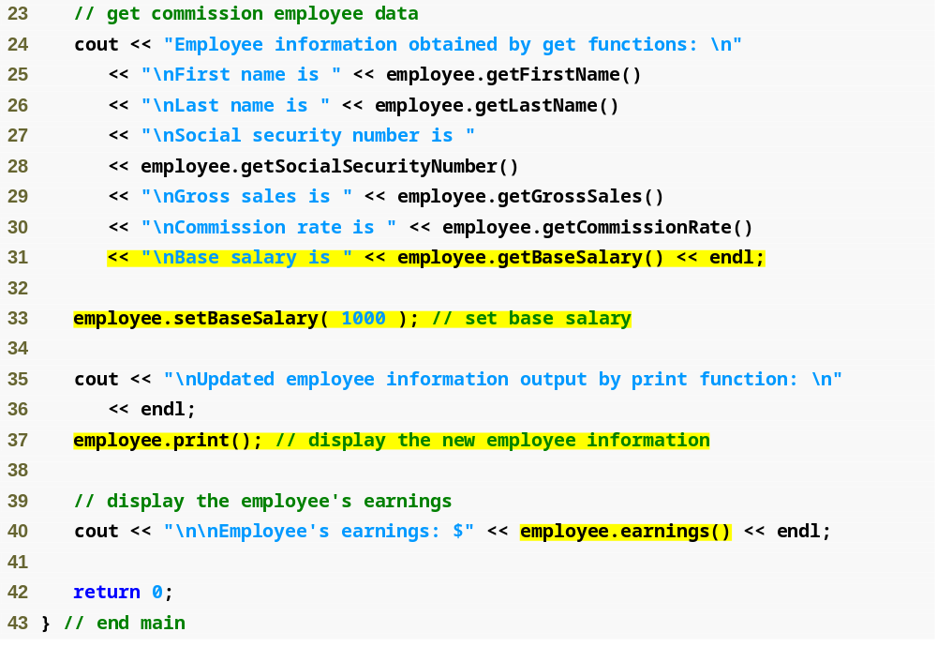
Use BasePlusCommissionEmployee’s get functions to retrieve the object’s instance variable values
fig12_09.cpp
(2 of 3)
Use BasePlusCommissionEmployee’s setBaseSalary function to set base salary
Call object’s print function to display employee information
Call object’s earnings function to calculate employee’s earnings

Slide 36
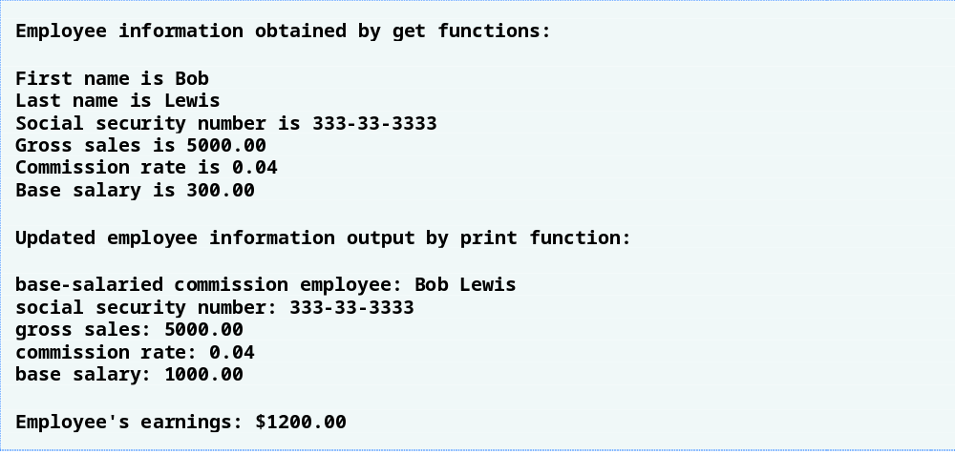
fig12_09.cpp
(3 of 3)

Slide 37
2.2.3 Creating a CommissionEmployee-BasePlusCommissionEmployee Inheritance Hierarchy
Class BasePlusCommissionEmployee
  Derived from class CommissionEmployee
    Is a CommissionEmployee
    Inherits all public members
  Constructor is not inherited
    Use base-class initializer syntax to initialize base-class data member
  Has data member baseSalary

Slide 38
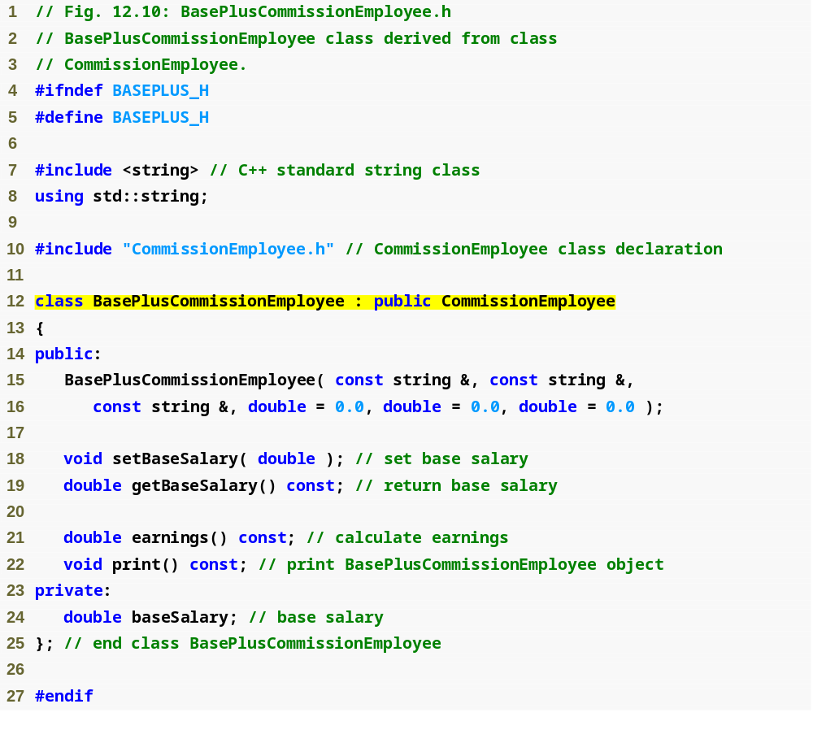
BasePlus
Commission
Employee.h
(1 of 1)
Include the base-class header file in the derived-class header file
Class BasePlusCommissionEmployee derives publicly from class CommissionEmployee

Slide 39
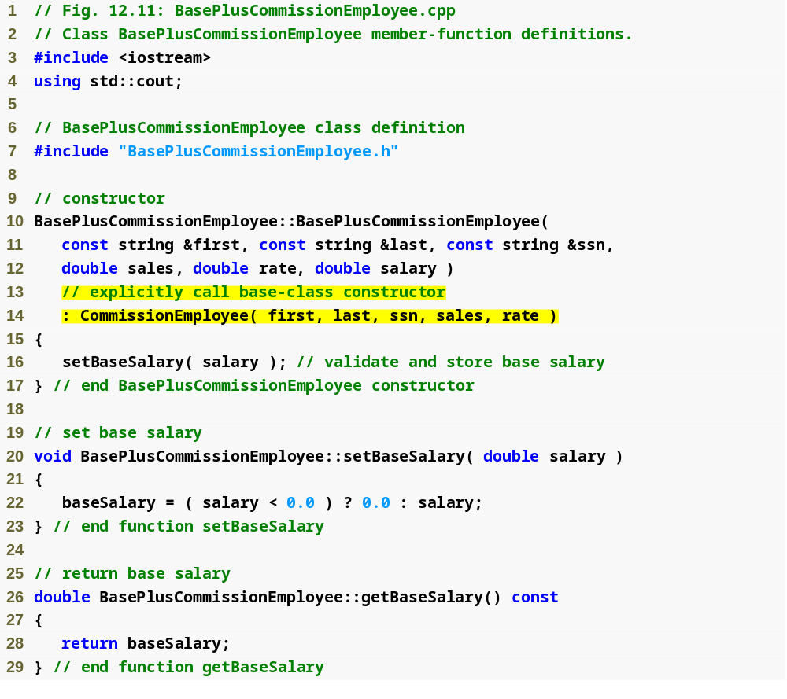
BasePlus
Commission
Employee.cpp
(1 of 4)
Initialize base class data member by calling the base-class constructor using base-class initializer syntax

Slide 40
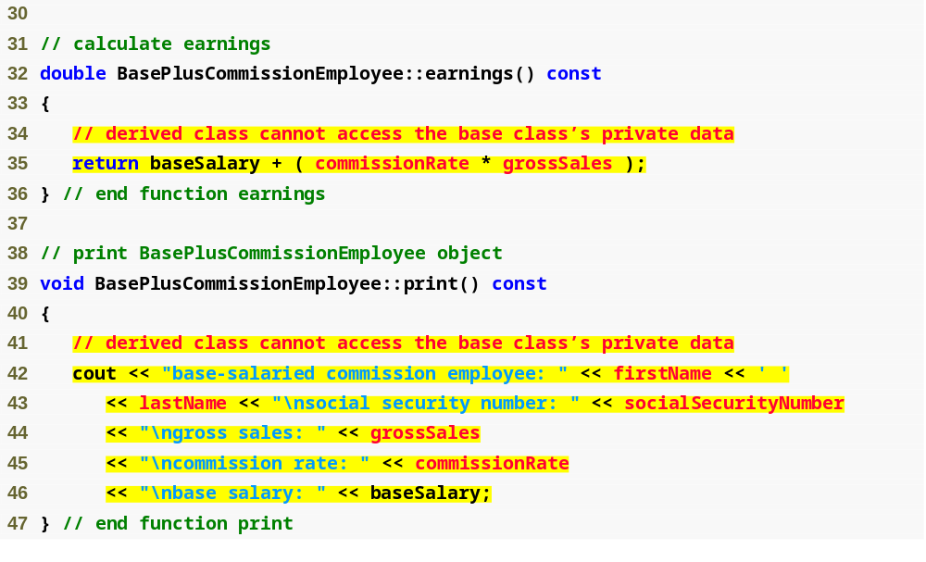
BasePlus
Commission
Employee.cpp
(2 of 4)
Compiler generates errors because base class’s data member commissionRate and grossSales are private
Compiler generates errors because the base class’s data members firstName, lastName, socialSecurityNumber, grossSales and commissionRate are private

Slide 41
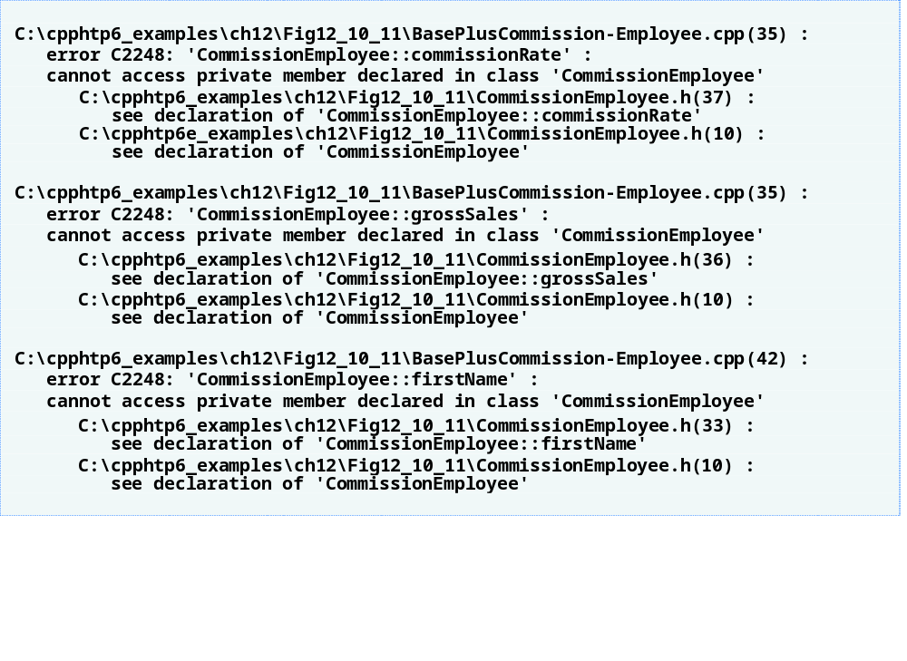
BasePlus
Commission
Employee.cpp
(3 of 4)

Slide 42
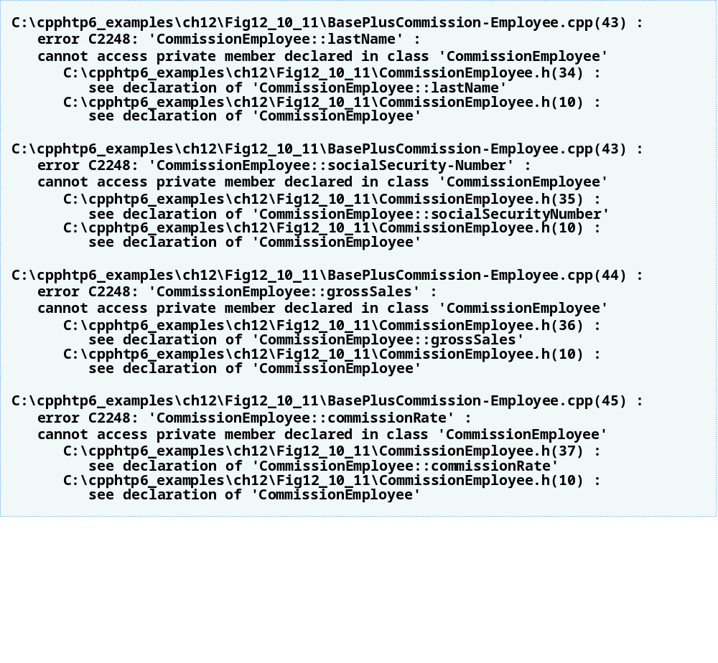
BasePlus
Commission
Employee.cpp
(4 of 4)

Slide 43
2.2.3 Creating a CommissionEmployee-BasePlusCommissionEmployee Inheritance Hierarchy (Cont.)
Including the base class header file
  Base class header file must be included in derived class header file for three reasons, the compiler must
    Know that base class exists
    Know size of inherited data members
    Ensure that inherited class members are used properly

Slide 44
2.2.4 CommissionEmployee-BasePlusCommissionEmployee Inheritance Hierarchy Using protected Data
Use protected data
  Enable class BasePlusCommissionEmployee to directly access base class data members
  Base class’s protected members are inherited by all derived classes of that base class

Slide 45
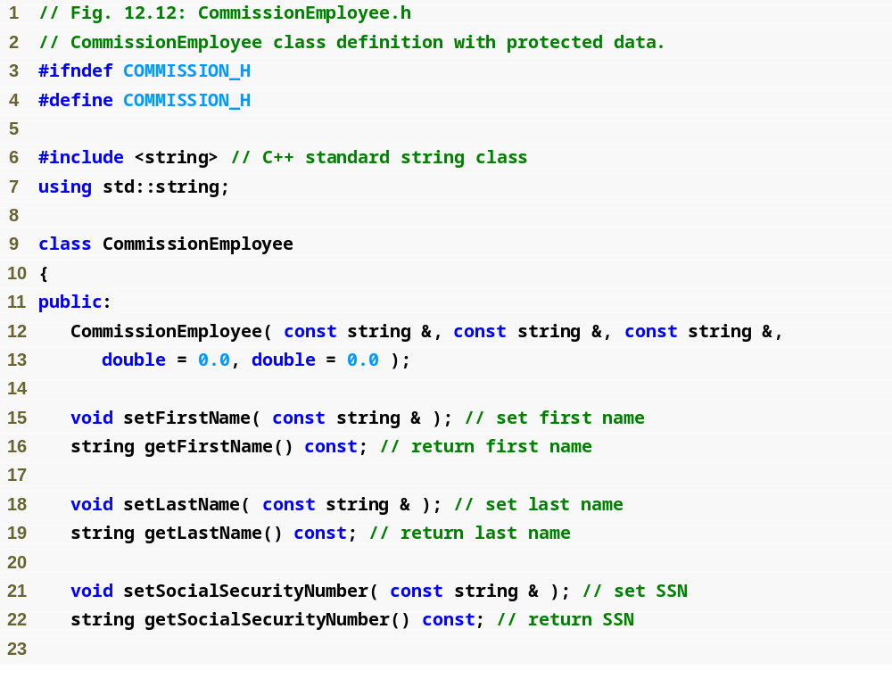
Commission
Employee.h
(1 of 2)

Slide 46
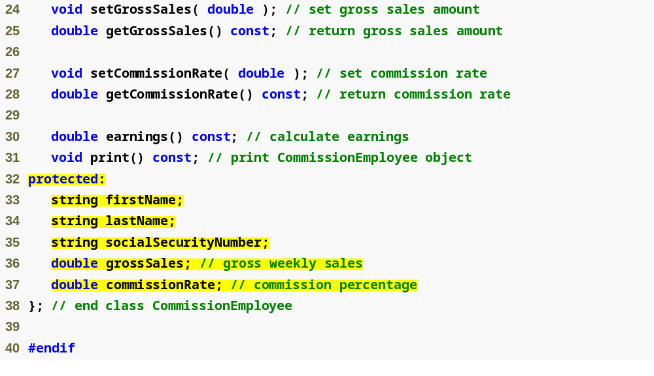
Commission
Employee.h
(2 of 2)
Declare protected data

Slide 47
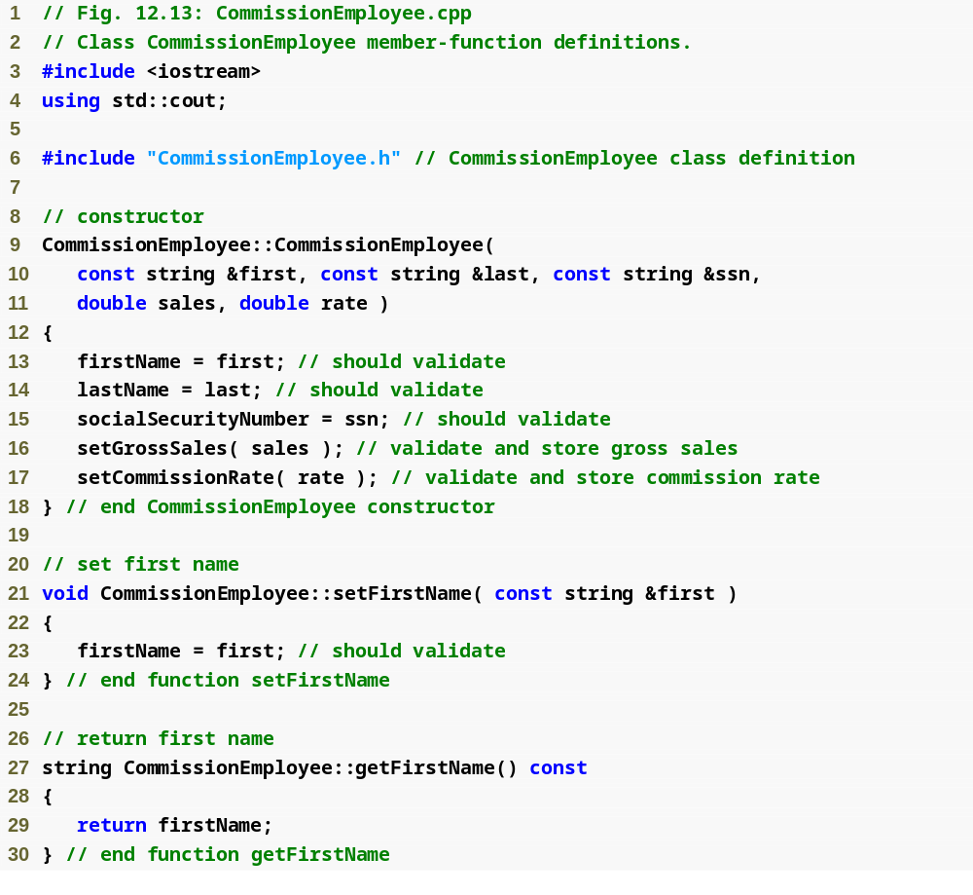
Commission
Employee.cpp
(1 of 4)

Slide 48
Commission
Employee.cpp
(2 of 4)

Slide 49
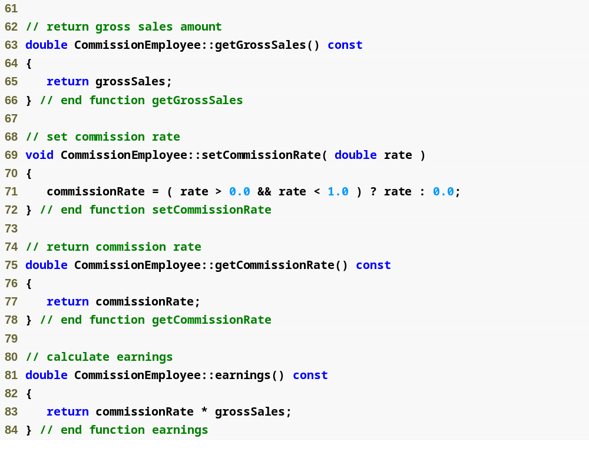
Commission
Employee.cpp
(3 of 4)

Slide 50
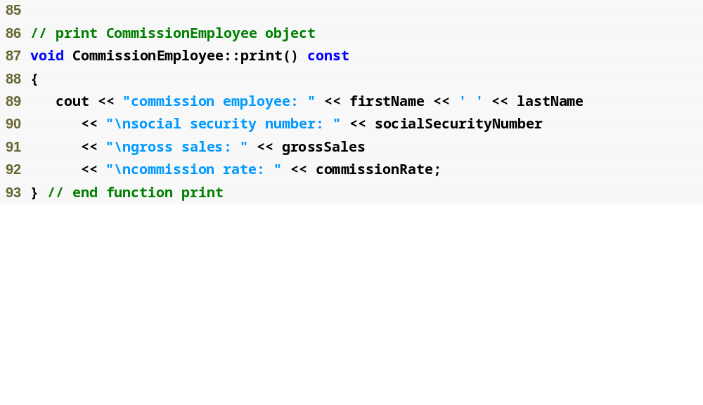
Commission
Employee.cpp
(4 of 4)

Slide 51
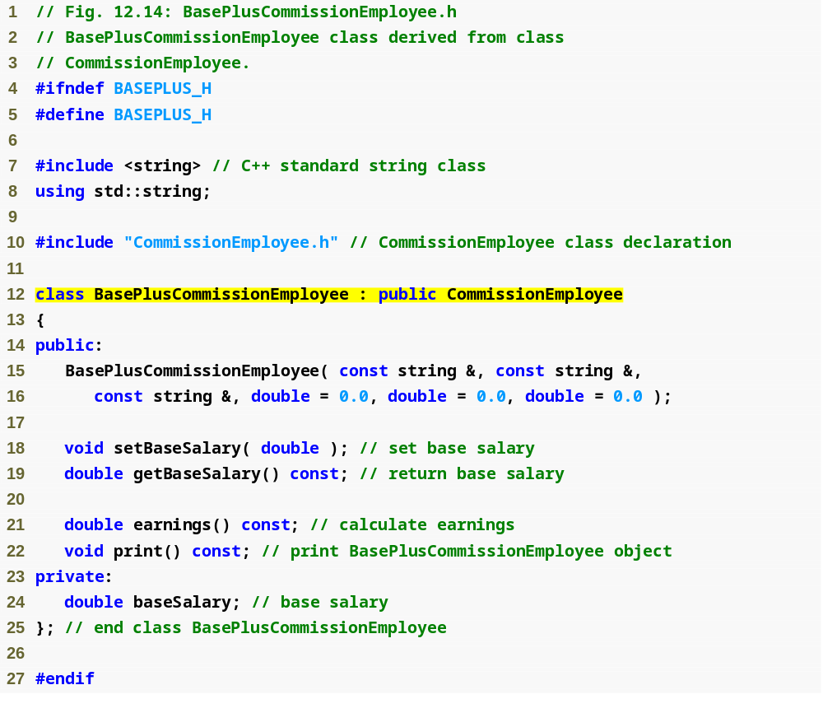
BasePlus
Commission
Employee.h
(1 of 1)
BasePlusCommissionEmployee still inherits publicly from CommissionEmployee

Slide 52

BasePlus
Commission
Employee.cpp
(1 of 2)
Call base-class constructor using base-class initializer syntax

Slide 53
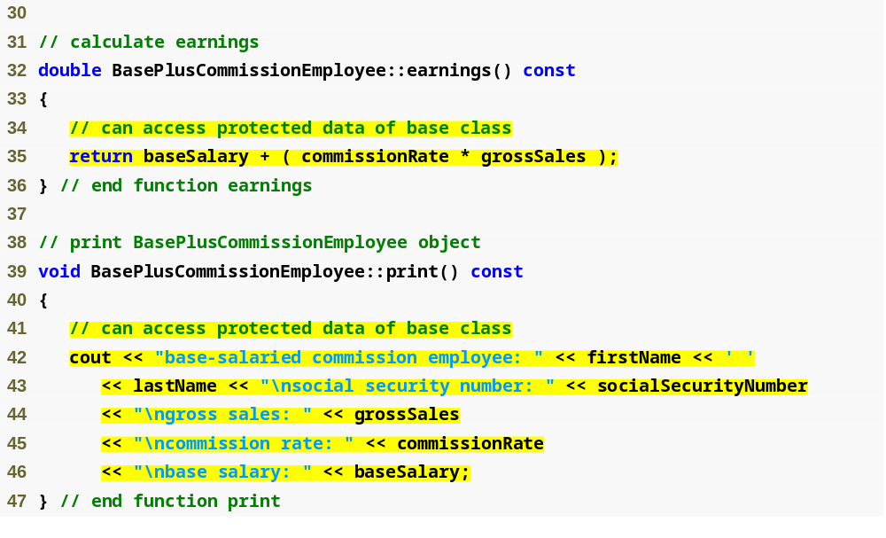
BasePlus
Commission
Employee.cpp
(2 of 2)
Directly access base class’s protected data

Slide 54

Fig12_16.cpp
(1 of 3)

Slide 55

Fig12_16.cpp
(2 of 3)

Slide 56
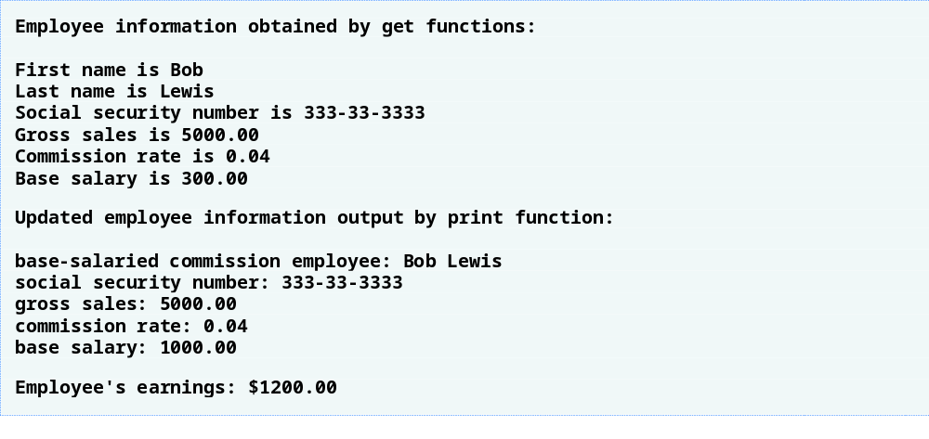
Fig12_16.cpp
(3 of 3)

Slide 57
2.2.4 CommissionEmployee-BasePlusCommissionEmployee Inheritance Hierarchy Using protected Data (Cont.)
Using protected data members
  Advantages
    Derived class can modify values directly
      Avoid set/get method call overhead
        Slight increase in performance
  Disadvantages
    No validity checking
      Derived class can assign illegal value
    Implementation dependent
      Derived class functions more likely dependent on base class implementation
      Base class implementation changes may result in derived class modifications
        Fragile (brittle) software

Slide 58
2.2.5 CommissionEmployee-BasePlusCommissionEmployee Inheritance Hierarchy Using private Data
Reexamine hierarchy
  Use the best software engineering practice
    Declare data members as private
    Provide public get and set functions
    Use get method to obtain values of data members

Slide 59
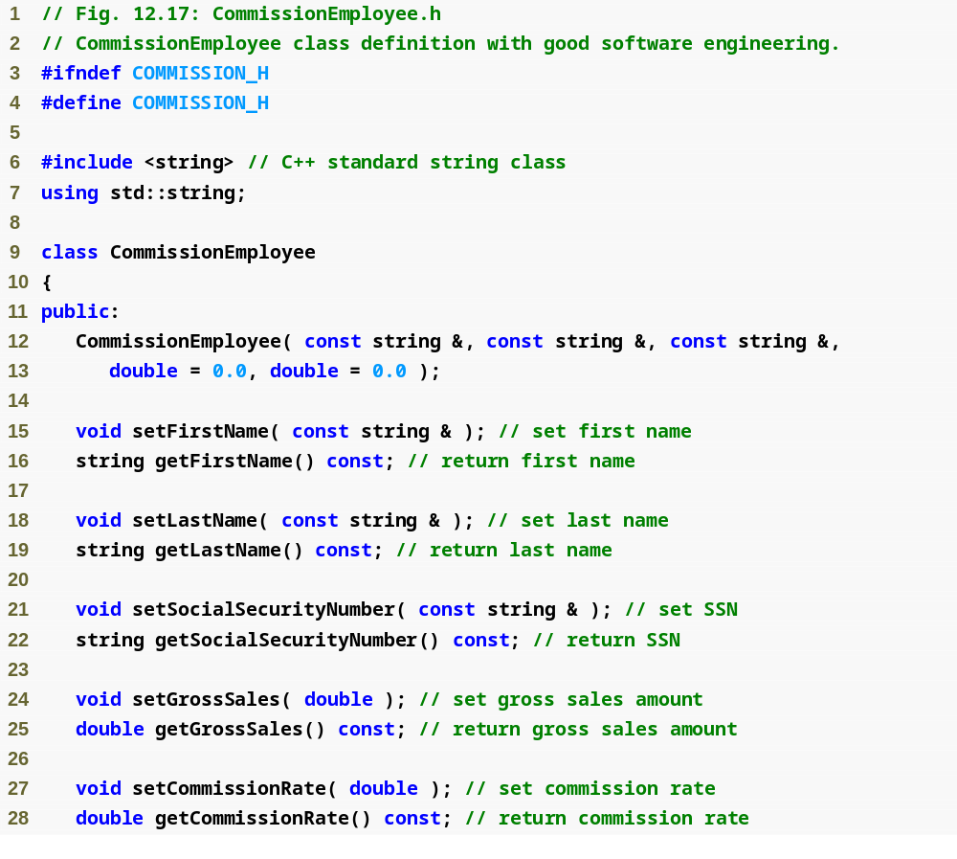
Commission
Employee.h
(1 of 2)

Slide 60
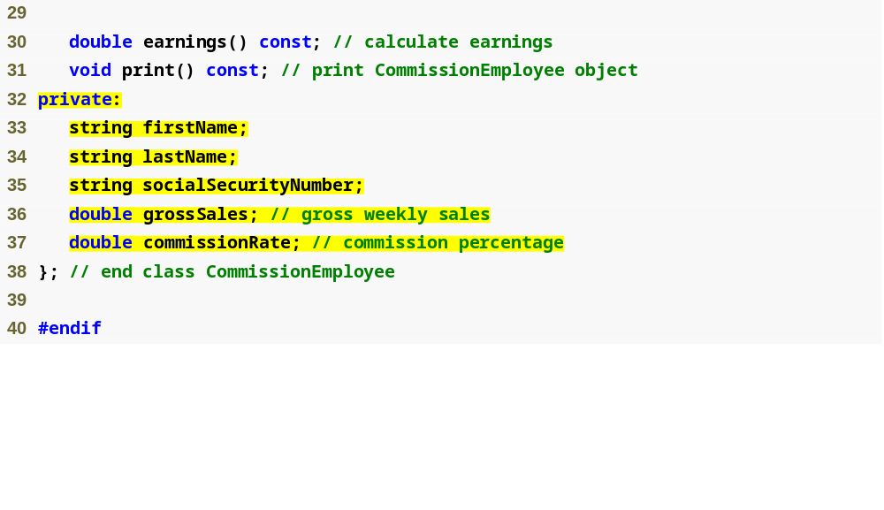
Declare private data
Commission
Employee.h
(2 of 2)

Slide 61
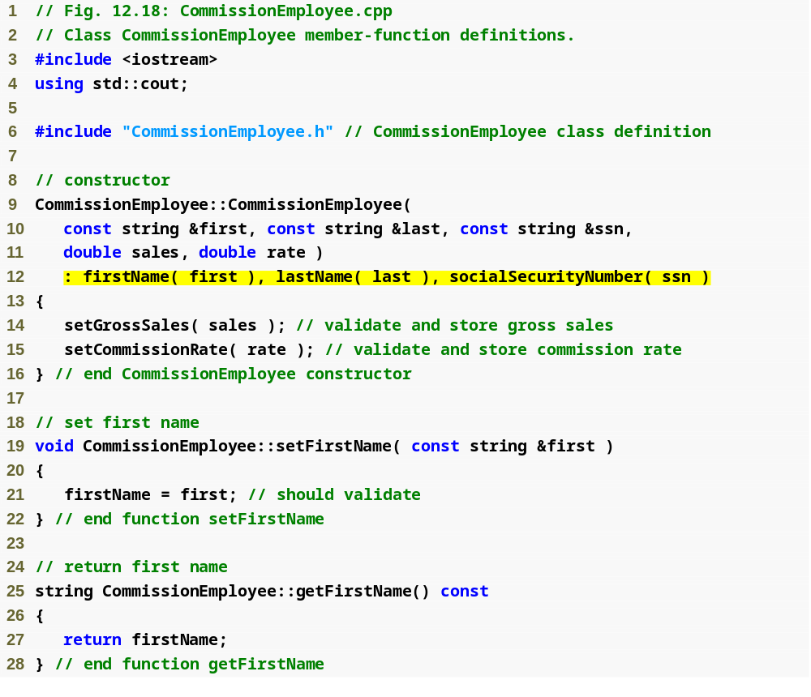
Commission
Employee.cpp
(1 of 4)
Use member initializers to set the values of members firstName, lastname and socialSecurityNumber

Slide 62
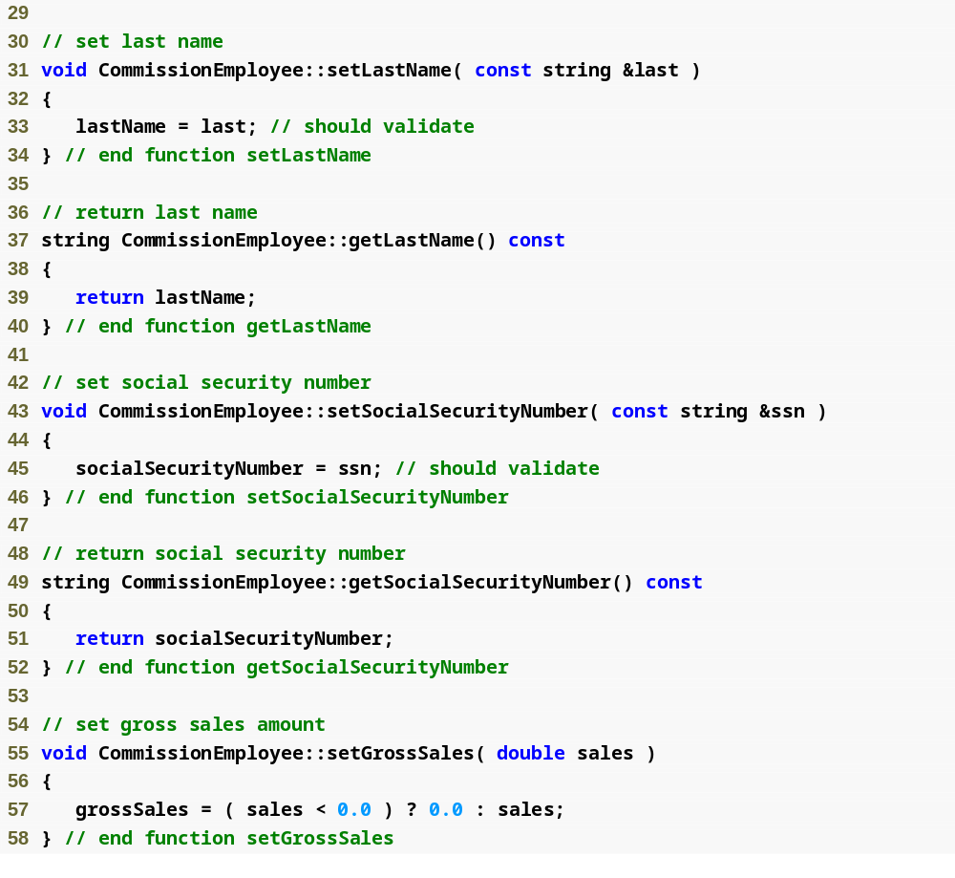
Commission
Employee.cpp
(2 of 4)

Slide 63
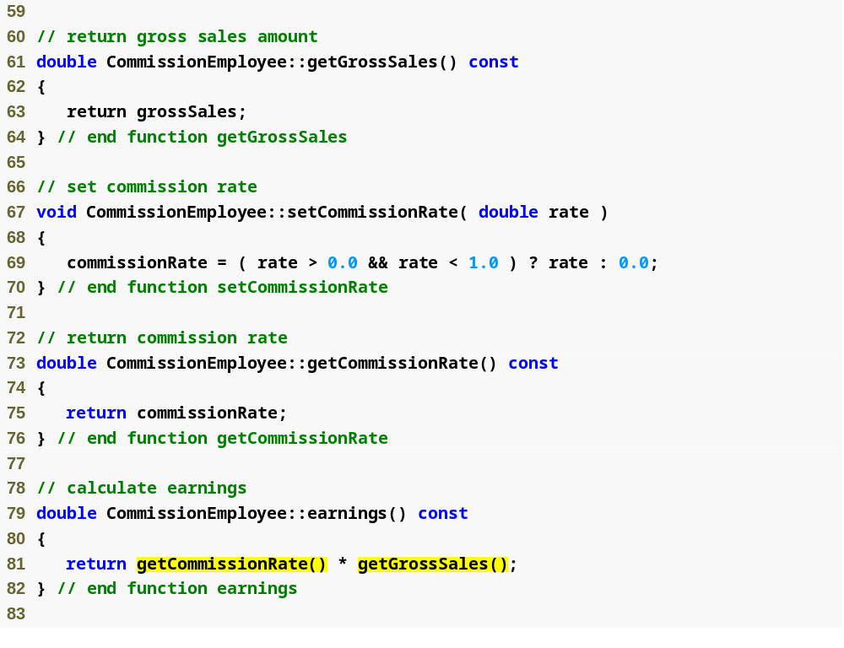
Commission
Employee.cpp
(3 of 4)
Use get functions to obtain the values of data members

Slide 64
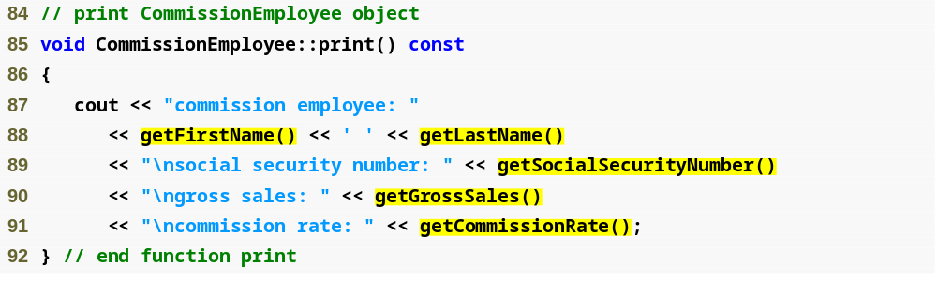
Commission
Employee.cpp
(4 of 4)
Use get functions to obtain the values of data members

Slide 65

BasePlus
Commission
Employee.h
(1 of 1)

Slide 66
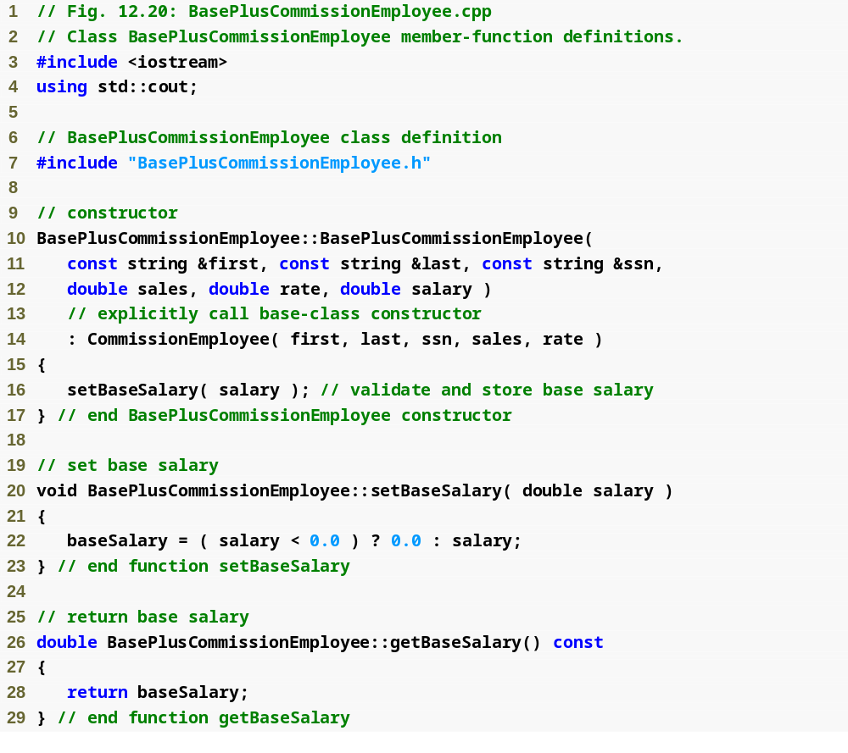
BasePlus
Commission
Employee.cpp
(1 of 2)

Slide 67
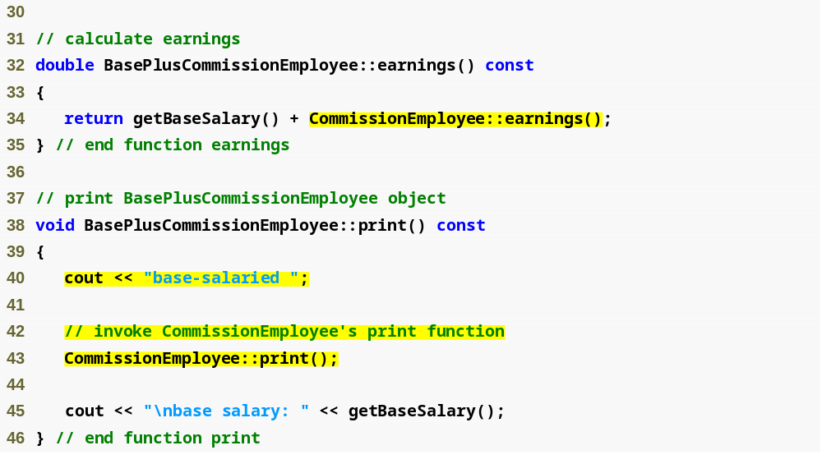
BasePlus
Commission
Employee.cpp
(2 of 2)
Invoke base class’s earnings function
Invoke base class’s print function

Slide 68
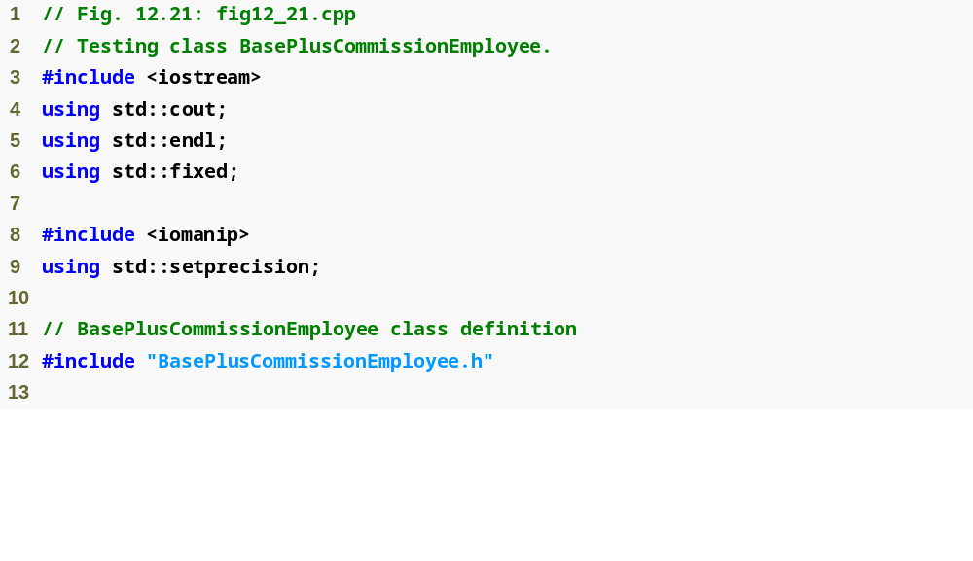
fig12_21.cpp
(1 of 3)

Slide 69
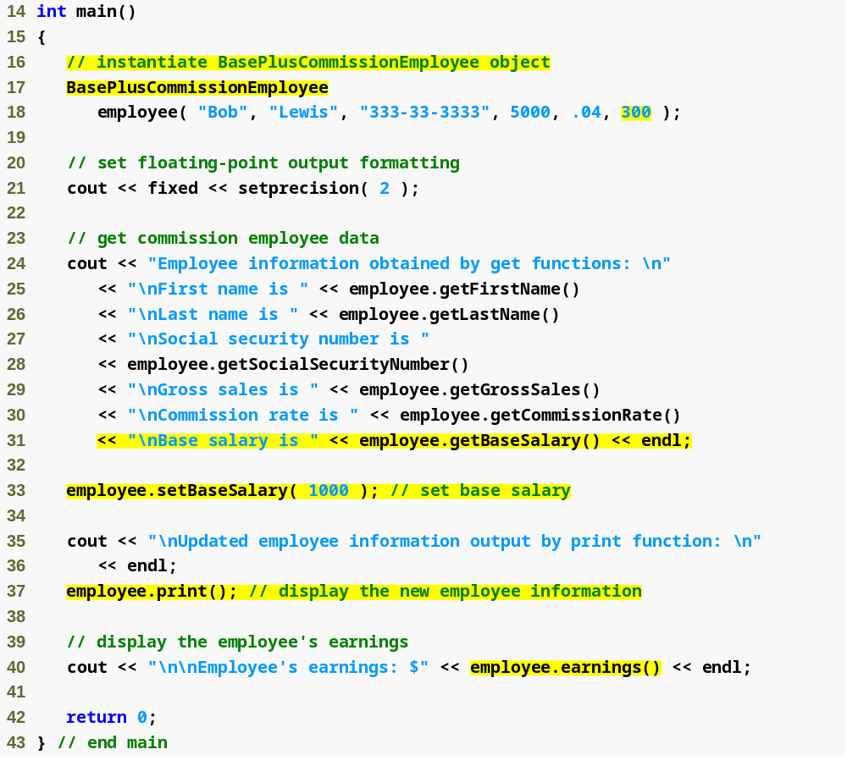
fig12_21.cpp
(2 of 3)
Create BasePlusCommissionEmployee object
Use inherited get methods to access base class private members
Use BasePlusCommissionEmployee get method to access private member
Use BasePlusCommissionEmployee set method to modify private data member baseSalary

Slide 70
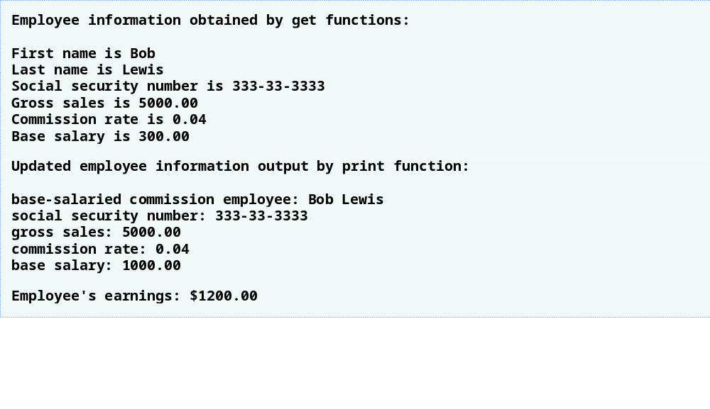
fig12_21.cpp
(3 of 3)

Slide 71
03 Constructors and Destructors in Derived Classes
Instantiating derived-class object
  Chain of constructor calls
    Derived-class constructor invokes base class constructor
      Implicitly or explicitly
    Base of inheritance hierarchy
      Last constructor called in chain
      First constructor body to finish executing
      Example: CommissionEmployee/BasePlusCommissionEmployee hierarchy
        CommissionEmployee constructor called last
        CommissionEmployee constructor body finishes execution first
    Initializing data members
      Each base-class constructor initializes its data members that are inherited by derived class

Slide 72
03 Constructors and Destructors in Derived Classes (Cont.)
Destroying derived-class object
  Chain of destructor calls
    Reverse order of constructor chain
    Destructor of derived-class called first
    Destructor of next base class up hierarchy next
      Continue up hierarchy until final base reached
        After final base-class destructor, object removed from memory
Base-class constructors, destructors, assignment operators
  Not inherited by derived classes

Slide 73
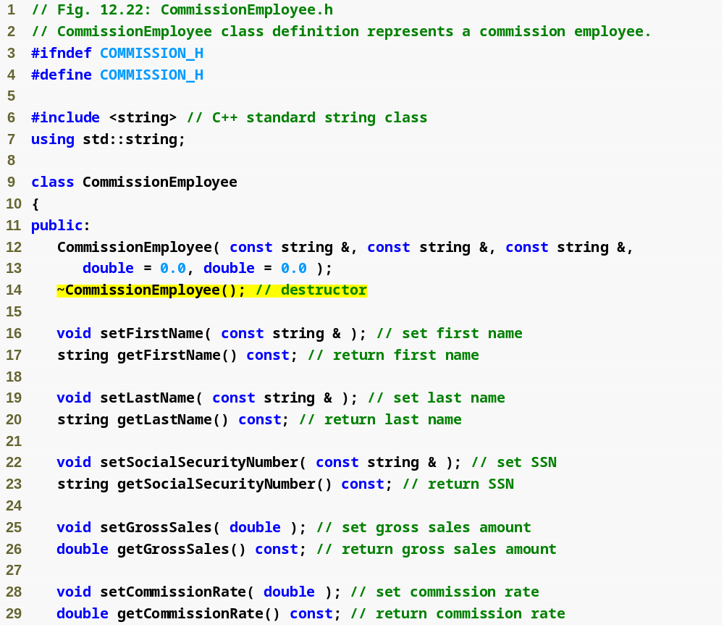
Commission
Employee.h
(1 of 2)
CommissionEmployee destructor

Slide 74
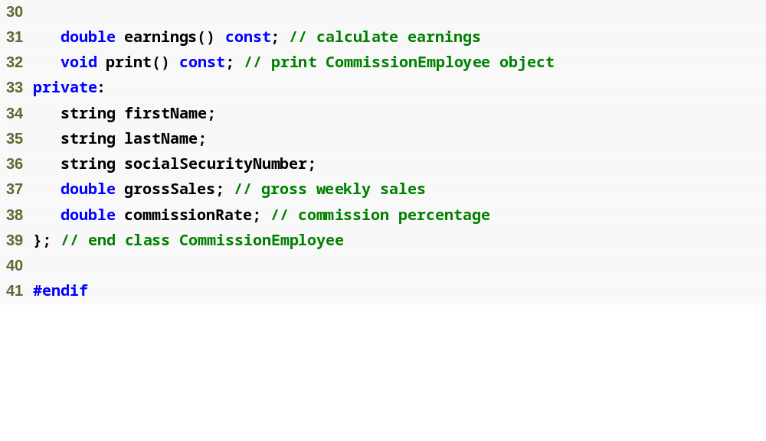
Commission
Employee.h
(2 of 2)

Slide 75
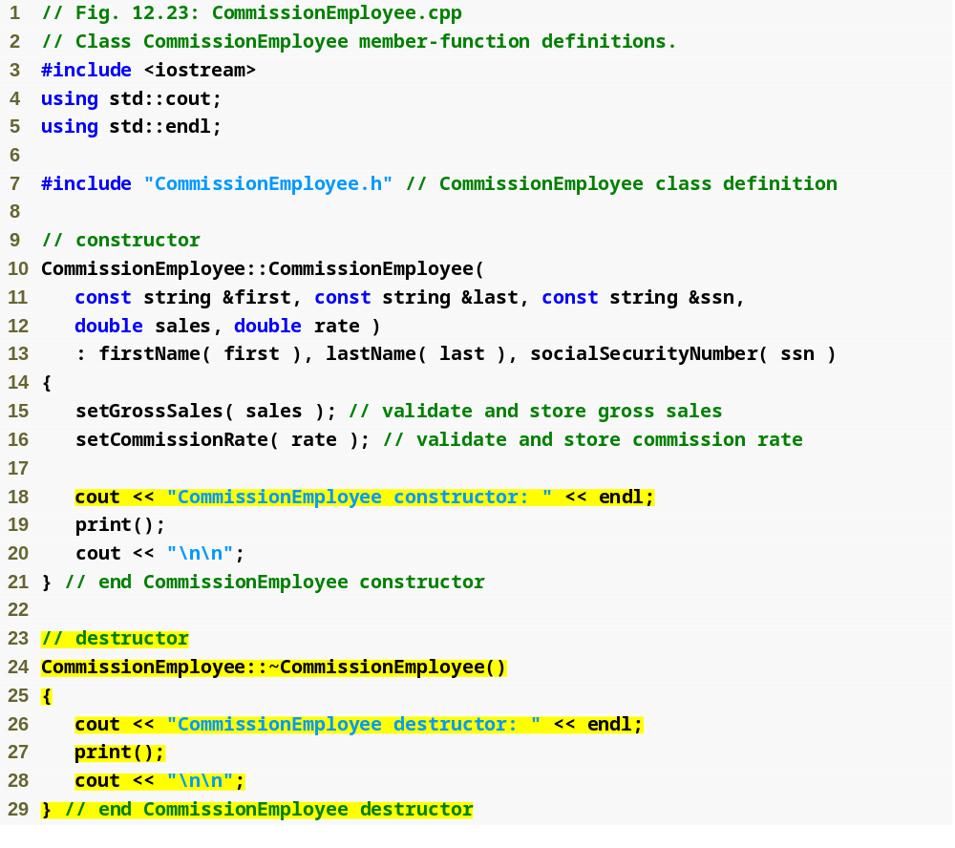
Commission
Employee.cpp
(1 of 4)
Constructor and destructor output messages to demonstrate function call order

Slide 76
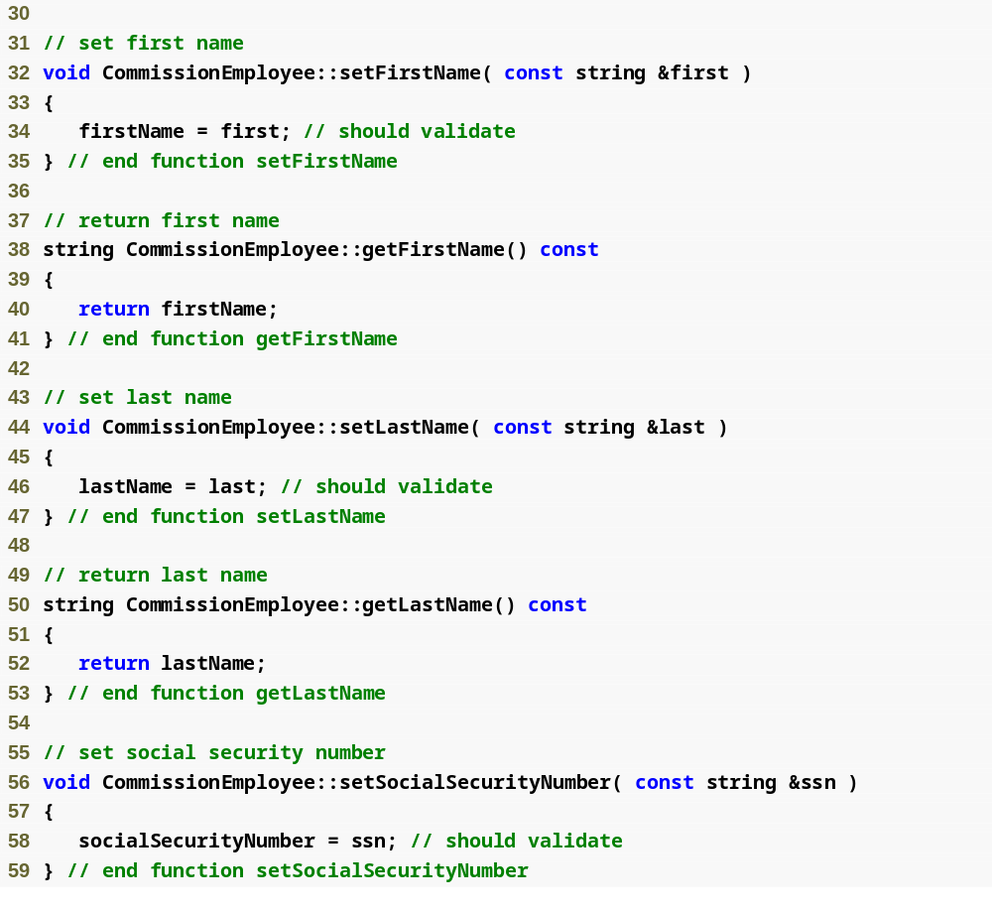
Commission
Employee.cpp
(2 of 4)

Slide 77
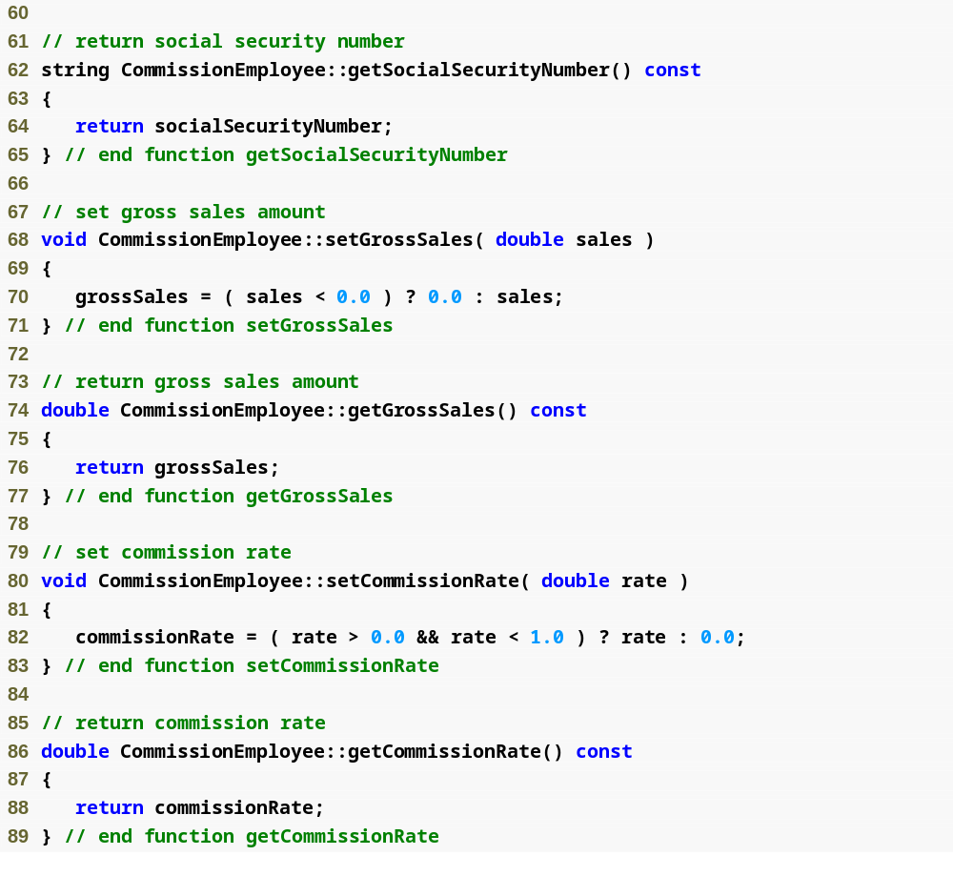
Commission
Employee.cpp
(3 of 4)

Slide 78

Commission
Employee.cpp
(4 of 4)

Slide 79

BasePlus
Commission
Employee.h
(1 of 1)
BasePlusCommissionEmployee destructor

Slide 80

BasePlus
Commission
Employee.cpp
(1 of 2)
Constructor and destructor output messages to demonstrate function call order

Slide 81

BasePlus
Commission
Employee.cpp
(2 of 2)

Slide 82

fig12_26.cpp
(1 of 4)

Slide 83

CommissionEmployee object goes in and out of scope immediately
fig12_26.cpp
(2 of 4)
Instantiate two BasePlusCommissionEmployee objects to demonstrate order of derived-class and base-class constructor/destructor function calls

Slide 84

fig12_26.cpp
(3 of 4)
CommissionEmployee constructor called for object in block; destructor called immediately as execution leaves scope
Base-class CommissionEmployee constructor executes first when instantiating derived-class BasePlusCommissionEmployee object
Derived-class BasePlusCommissionEmployee constructor body executes after base-class CommissionEmployee’s constructor finishes execution
Base-class CommissionEmployee constructor executes first when instantiating derived-class BasePlusCommissionEmployee object

Slide 85

Outline
Derived-class BasePlusCommissionEmployee constructor body executes after base-class CommissionEmployee’s constructor finishes execution
fig12_26.cpp
(4 of 4)
Destructors for BasePlusCommissionEmployee object called in reverse order of constructors
Destructors for BasePlusCommissionEmployee object called in reverse order of constructors

Slide 86
04 Software Engineering with Inheritance
Customizing existing software
  Inheriting from existing classes
    Can include additional members
    Can redefine base-class members
    No direct access to base class’s source code
      Only links to object code
  Independent software vendors (ISVs)
    Develop proprietary code for sale/license
      Available in object-code format
    Users derive new classes
      Without accessing ISV proprietary source code

