Slide 1
Object-Oriented Programming: Polymorphism
Chapter 13
Lecture 12-1

Slide 2
OBJECTIVES
In this chapter you’ll learn:
What polymorphism is, how it makes programming more convenient, and how it makes systems more extensible and maintainable.
To declare and use virtual functions to effect polymorphism.
The distinction between abstract and concrete classes.
To declare pure virtual functions to create abstract classes.
How to use run-time type information (RTTI) with downcasting, dynamic_cast, typeid and type_info.
How C++ implements virtual functions and dynamic binding "under the hood."
How to use virtual destructors to ensure that all appropriate destructors run on an object.

Slide 3
Lecture 12-1
Contents
01
Introduction
02
Relationships Among Objects in an Inheritance Hierarchy
03
Abstract Classes and Pure virtual Functions
04
Case Study: Payroll System Using Polymorphism
05
Virtual Destructors

Slide 4
01 Introduction
Polymorphism with inheritance hierarchies
“Program in the general” vs. “program in the specific”
Process objects of classes that are part of the same hierarchy as if they are all objects of the base class
Each object performs the correct tasks for that object’s type
Different actions occur depending on the type of object
New classes can be added with little or not modification to existing code

Slide 5
01 Introduction (Cont.)
Example: Animal hierarchy
Animal base class – every derived class has function move
Different animal objects maintained as a vector of Animal pointers
Program issues same message (move) to each animal generically
Proper function gets called
A Fish will move by swimming
A Frog will move by jumping
A Bird will move by flying

Slide 6
02 Relationships Among Objects in an Inheritance Hierarchy
Demonstration
Invoking base-class functions from derived-class objects
Aiming derived-class pointers at base-class objects
Derived-class member-function calls via base-class pointers
Demonstrating polymorphism using virtual functions
Base-class pointers aimed at derived-class objects
Key concept
An object of a derived class can be treated as an object of its base class

Slide 7
2.1 Invoking Base-Class Functions from Derived-Class Objects
Aim base-class pointer at base-class object
Invoke base-class functionality
Aim derived-class pointer at derived-class object
Invoke derived-class functionality
Aim base-class pointer at derived-class object
Because derived-class object is an object of base class
Invoke base-class functionality
Invoked functionality depends on type of the handle used to invoke the function, not type of the object to which the handle points
virtual functions
Make it possible to invoke the object type’s functionality, rather than invoke the handle type’s functionality
Crucial to implementing polymorphic behavior

Slide 8
Commission Employee.h
(1 of 2)

Slide 9
Function earnings will be redefined in derived classes to calculate the employee’s earnings
Commission Employee.h
(2 of 2)
Function print will be redefined in derived class to print the employee’s information

Slide 10
Commission Employee.cpp
(1 of 4)

Slide 11
Commission Employee.cpp
(2 of 4)

Slide 12
Commission Employee.cpp
(3 of 4)
Calculate earnings based on commission rate and gross sales

Slide 13
Commission Employee.cpp
(4 of 4)
Display name, social security number, gross sales and commission rate

Slide 14
BasePlus Commission Employee.h
(1 of 1)
Redefine functions earnings and print

Slide 15
BasePlus Commission Employee.cpp
(1 of 2)

Slide 16
BasePlus Commission Employee.cpp
(2 of 2)
Redefined earnings function incorporates base salary
Redefined print function displays additional BasePlusCommissionEmployee details

Slide 17
fig13_05.cpp
(1 of 5)

Slide 18
fig13_05.cpp
(2 of 5)
Aiming base-class pointer at base-class object and invoking base-class functionality

Slide 19
fig13_05.cpp
(3 of 5)
Aiming derived-class pointer at derived-class object and invoking derived-class functionality
Aiming base-class pointer at derived-class object and invoking base-class functionality

Slide 20
fig13_05.cpp
(4 of 5)

Slide 21
fig13_05.cpp
(5 of 5)

Slide 22
2.2 Aiming Derived-Class Pointers at Base-Class Objects
Aim a derived-class pointer at a base-class object
C++ compiler generates error
CommissionEmployee (base-class object) is not a BasePlusCommissionEmployee (derived-class object)
If this were to be allowed, programmer could then attempt to access derived-class members which do not exist
Could modify memory being used for other data

Slide 23
fig13_06.cpp
(1 of 2)
Cannot assign base-class object to derived-class pointer because is-a relationship does not apply

Slide 24
fig13_06.cpp
(2 of 2)

Slide 25
2.3 Derived-Class Member-Function Calls via Base-Class Pointers
Aiming base-class pointer at derived-class object
Calling functions that exist in base class causes base-class functionality to be invoked
Calling functions that do not exist in base class (may exist in derived class) will result in error
Derived-class members cannot be accessed from base-class pointers
However, this can be accomplished using downcasting (Section 13.8)

Slide 26
fig13_07.cpp
(1 of 2)
Cannot invoke derived-class-only members from base-class pointer

Slide 27
fig13_07.cpp
(2 of 2)

Slide 28
2.4 Virtual Functions
Which class’s function to invoke
Normally
Handle determines which class’s functionality to invoke
With virtual functions
Type of the object being pointed to, not type of the handle, determines which version of a virtual function to invoke
Allows program to dynamically (at runtime rather than compile time) determine which function to use
Called dynamic binding or late binding

Slide 29
2.4 Virtual Functions (Cont.)
virtual functions
Declared by preceding the function’s prototype with the keyword virtual in base class
Derived classes override function as appropriate
Once declared virtual, a function remains virtual all the way down the hierarchy
Static binding
When calling a virtual function using specific object with dot operator, function invocation resolved at compile time
Dynamic binding
Dynamic binding occurs only off pointer and reference handles

Slide 30
Commission Employee.h
(1 of 2)

Slide 31
Commission Employee.h
(2 of 2)
Declaring earnings and print as virtual allows them to be overridden, not redefined

Slide 32
BasePlus Commission Employee.h
(1 of 1)
Functions earnings and print are already virtual – good practice to declare virtual even when overriding function

Slide 33
fig13_10.cpp
(1 of 5)

Slide 34
fig13_10.cpp
(2 of 5)
Aiming base-class pointer at base-class object and invoking base-class functionality

Slide 35
fig13_10.cpp
(3 of 5)
Aiming derived-class pointer at derived-class object and invoking derived-class functionality
Aiming base-class pointer at derived-class object and invoking derived-class functionality via polymorphism and virtual functions

Slide 36
fig13_10.cpp
(4 of 5)

Slide 37
fig13_10.cpp
(5 of 5)

Slide 38
2.5 Summary of the Allowed Assignments Between Base-Class and Derived-Class Objects and Pointers
Four ways to aim base-class and derived-class pointers at base-class and derived-class objects
Aiming a base-class pointer at a base-class object
Is straightforward
Aiming a derived-class pointer at a derived-class object
Is straightforward
Aiming a base-class pointer at a derived-class object
Is safe, but can be used to invoke only member functions that base-class declares (unless downcasting is used)
Can achieve polymorphism with virtual functions
Aiming a derived-class pointer at a base-class object
Generates a compilation error

Slide 39
2.6 Type Fields and switch Statements
switch statement could be used to determine the type of an object at runtime
Include a type field as a data member in the base class
Enables programmer to invoke appropriate action for a particular object
Causes problems
A type test may be forgotten
May forget to add new types

Slide 40
03 Abstract Classes and Pure virtual Functions
Abstract classes
Classes from which the programmer never intends to instantiate any objects
Incomplete—derived classes must define the “missing pieces”
Too generic to define real objects
Normally used as base classes, called abstract base classes
Provides an appropriate base class from which other classes can inherit
Classes used to instantiate objects are called concrete classes
Must provide implementation for every member function they define

Slide 41
03 Abstract Classes and Pure virtual Functions (Cont.)
Pure virtual function
A class is made abstract by declaring one or more of its virtual functions to be “pure”
Placing “= 0” in its declaration
Example
virtual void draw() const = 0;
“= 0” is known as a pure specifier
Do not provide implementations
Every concrete derived class must override all base-class pure virtual functions with concrete implementations
If not overridden, derived-class will also be abstract
Used when it does not make sense for base class to have an implementation of a function, but the programmer wants all concrete derived classes to implement the function

Slide 42
03 Abstract Classes and Pure virtual Functions (Cont.)
We can use the abstract base class to declare pointers and references
Can refer to objects of any concrete class derived from the abstract class
Programs typically use such pointers and references to manipulate derived-class objects polymorphically
Polymorphism is particularly effective for implementing layered software systems
Reading or writing data from and to devices
Iterator class
Can traverse all the objects in a container

Slide 43
04 Case Study: Payroll System Using Polymorphism
Enhanced CommissionEmployee-BasePlusCommissionEmployee hierarchy using an abstract base class
Abstract class Employee represents the general concept of an employee
Declares the “interface” to the hierarchy
Each employee has a first name, last name and social security number
Earnings calculated differently and objects printed differently for each derived classe

Slide 44
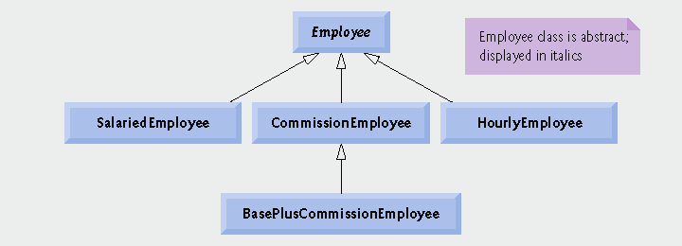
Fig.13.11 | Employee hierarchy UML class diagram.

Slide 45
4.1 Creating Abstract Base Class Employee
Class Employee
Provides various get and set functions
Provides functions earnings and print
Function earnings depends on type of employee, so declared pure virtual
Not enough information in class Employee for a default implementation
Function print is virtual, but not pure virtual
Default implementation provided in Employee
Example maintains a vector of Employee pointers
Polymorphically invokes proper earnings and print functions

Slide 46
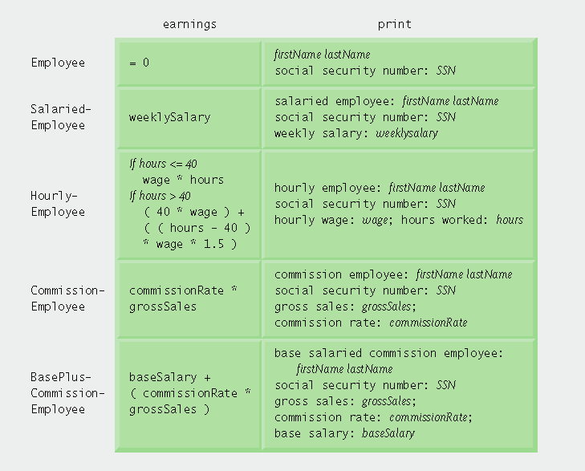
Fig.13.12 | Polymorphic interface for the Employee hierarchy classes.

Slide 47
Employee.h
(1 of 2)

Slide 48
Function earnings is pure virtual, not enough data to provide a default, concrete implementation
Employee.h
(2 of 2)
Function print is virtual, default implementation provided but derived-classes may override

Slide 49
Employee.cpp
(1 of 2)

Slide 50
Employee.cpp
(2 of 2)

Slide 51
4.2 Creating Concrete Derived Class SalariedEmployee
SalariedEmployee inherits from Employee
Includes a weekly salary
Overridden earnings function incorporates weekly salary
Overridden print function incorporates weekly salary
Is a concrete class (implements all pure virtual functions in abstract base class)

Slide 52
Salaried Employee.h
(1 of 1)
SalariedEmployee inherits from Employee, must override earnings to be concrete
Functions will be overridden (or defined for the first time)

Slide 53
Salaried Employee.cpp
(1 of 2)
Maintain new data member weeklySalary

Slide 54
Salaried Employee.cpp
(1 of 2)
Overridden earnings and print functions incorporate weekly salary

Slide 55
4.3 Creating Concrete Derived Class HourlyEmployee
HourlyEmployee inherits from Employee
Includes a wage and hours worked
Overridden earnings function incorporates the employee’s wages multiplied by hours (taking time-and-a-half pay into account)
Overridden print function incorporates wage and hours worked
Is a concrete class (implements all pure virtual functions in abstract base class)

Slide 56
Hourly Employee.h
(1 of 1)
HourlyEmployee inherits from Employee, must override earnings to be concrete
Functions will be overridden (or defined for first time)

Slide 57
Hourly Employee.cpp
(1 of 2)
Maintain new data member, hourlyWage

Slide 58
Maintain new data member, hoursWorked
Hourly Employee.cpp
(2 of 2)
Overridden earnings and print functions incorporate wage and hours

Slide 59
4.4 Creating Concrete Derived Class CommissionEmployee
CommissionEmployee inherits from Employee
Includes gross sales and commission rate
Overridden earnings function incorporates gross sales and commission rate
Overridden print function incorporates gross sales and commission rate
Concrete class (implements all pure virtual functions in abstract base class)

Slide 60
Commission Employee.h
(1 of 1)
CommissionEmployee inherits from Employee, must override earnings to be concrete
Functions will be overridden (or defined for first time)

Slide 61
Commission Employee.cpp
(1 of 2)
Maintain new data member, commissionRate

Slide 62
Maintain new data member, grossSales
Commission Employee.cpp
(2 of 2)
Overridden earnings and print functions incorporate commission rate and gross sales

Slide 63
4.5 Creating Indirect Concrete Derived Class BasePlusCommissionEmployee
BasePlusCommissionEmployee inherits from CommissionEmployee
Includes base salary
Overridden earnings function that incorporates base salary
Overridden print function that incorporates base salary
Concrete class, because derived class is concrete
Not necessary to override earnings to make it concrete, can inherit implementation from CommissionEmployee
Although we do override earnings to incorporate base salary

Slide 64
BasePlus Commission Employee.h
(1 of 1)
BasePlusCommissionEmployee inherits from CommissionEmployee, already concrete
Functions will be overridden

Slide 65
BasePlus Commission Employee.cpp
(1 of 2)
Maintain new data member, baseSalary

Slide 66
BasePlus Commission Employee.cpp
(1 of 2)
Overridden earnings and print functions incorporate base salary

Slide 67
4.6 Demonstrating Polymorphic Processing
Create objects of types SalariedEmployee, HourlyEmployee, CommissionEmployee and BasePlusCommissionEmployee
Demonstrate manipulating objects with static binding
Using name handles rather than pointers or references
Compiler can identify each object’s type to determine which print and earnings functions to call
Demonstrate manipulating objects polymorphically
Uses a vector of Employee pointers
Invoke virtual functions using pointers and references

Slide 68
fig13_23.cpp
(1 of 7)

Slide 69
fig13_23.cpp
(2 of 7)
Using objects (rather than pointers or references) to demonstrate static binding

Slide 70
vector of Employee pointers, will be used to demonstrate dynamic binding
fig13_23.cpp
(3 of 7)
Demonstrate dynamic binding using pointers, then references

Slide 71
fig13_23.cpp
(4 of 7)
Using references and pointers cause virtual functions to be invoked polymorphically

Slide 72
fig13_23.cpp
(5 of 7)

Slide 73
fig13_23.cpp
(6 of 7)

Slide 74
fig13_23.cpp
(7 of 7)

Slide 75
05 Virtual Destructors
Nonvirtual destructors
Destructors that are not declared with keyword virtual
If a derived-class object is destroyed explicitly by applying the delete operator to a base-class pointer to the object, the behavior is undefined
virtual destructors
Declared with keyword virtual
All derived-class destructors are virtual
If a derived-class object is destroyed explicitly by applying the delete operator to a base-class pointer to the object, the appropriate derived-class destructor is called
Appropriate base-class destructor(s) will execute afterwards

