Slide 1
Introduction to Classes and Objects
Chapter 3
Lecture 8-2

Slide 2
OBJECTIVES
In this chapter you’ll learn:
What classes, objects, member functions and data members are.
How to define a class and use it to create an object.
How to define member functions in a class to implement the class's behaviors.
How to declare data members in a class to implement the class's attributes.
How to call a member function of an object to make that member function perform its task.
The differences between data members of a class and local variables of a function.
How to use a constructor to ensure that an object's data is initialized when the object is created.
How to engineer a class to separate its interface from its implementation and encourage reuse.

Slide 3
Lecture 8-2
Contents
01
Initializing Objects with Constructors
02
Placing a Class in a Separate File for Reusability
03
Separating Interface from Implementation
04
Validating Data with set Functions
05
Time Class Case Study

Slide 4
01 Initializing Objects with Constructors
Constructors
Functions used to initialize an object’s data when it is created
Call made implicitly when object is created
Must be defined with the same name as the class
Cannot return values
Not even void
Default constructor has no parameters
The compiler will provide one when a class does not explicitly include a constructor
Compiler’s default constructor only calls constructors of data members that are objects of classes

Slide 5
fig03_07.cpp
(1 of 3)
Constructor has same name as class and no return type
Initialize data member

Slide 6
fig03_07.cpp
(2 of 3)

Slide 7
fig03_07.cpp
(3 of 3)
Creating objects implicitly calls the constructor

Slide 8
02 Placing a Class in a Separate File for Reusability
.cpp file is known as a source-code file
Header files
Separate files in which class definitions are placed
Allow compiler to recognize the classes when used elsewhere
Generally have .h filename extensions
Driver files
Program used to test software (such as classes)
Contains a main function so it can be executed

Slide 9
Class definition is in a header file
fig03_09.cpp
(1 of 2)

Slide 10
fig03_09.cpp
(2 of 2)

Slide 11
fig03_10.cpp
(1 of 1)
Including the header file causes the class definition to be copied into the file

Slide 12
02 Placing a Class in a Separate File for Reusability (Cont.)
#include preprocessor directive
Used to include header files
Instructs C++ preprocessor to replace directive with a copy of the contents of the specified file
Quotes indicate user-defined header files
Preprocessor first looks in current directory
If the file is not found, looks in C++ Standard Library directory
Angle brackets indicate C++ Standard Library
Preprocessor looks only in C++ Standard Library directory

Slide 13
03 Separating Interface from Implementation
Interface
Describes what services a class’s clients can use and how to request those services
But does not reveal how the class carries out the services
A class definition that lists only member function names, return types and parameter types
Function prototypes
A class’s interface consists of the class’s public member functions (services)
Separating interface from implementation

Slide 14
03 Separating Interface from Implementation (Cont.)
Separating interface from implementation
Client code should not break if the implementation changes, as long as the interface stays the same
Define member functions outside the class definition, in a separate source-code file
In source-code file for a class
Use binary scope resolution operator (::) to “tie” each member function to the class definition
Implementation details are hidden
Client code does not need to know the implementation
In the header file for a class
Function prototypes describe the class’s public interface

Slide 15
03 Separating Interface from Implementation (Cont.)
Member function declared in a class definition but defined outside that class definition
Still within the class’s scope
Known only to other members of the class unless referred to via
Object of the class
Reference to an object of the class
Pointer to an object of the class
Binary scope resolution operator
Member function defined in the body of a class definition
C++ compiler attempts to inline calls to the member function

Slide 16
fig03_11.cpp
(1 of 1)
Interface contains data members and member function prototypes

Slide 17
GradeBook implementation is placed in a separate source-code file
fig03_12.cpp
(1 of 2)
Include the header file to access the class name GradeBook
Binary scope resolution operator “ties” a function to its class

Slide 18
fig03_12.cpp
(2 of 2)

Slide 19
fig03_13.cpp
(1 of 1)

Slide 20
03 Separating Interface from Implementation (Cont.)
The Compilation and Linking Process
Source-code file is compiled to create the class’s object code (source-code file must #include header file)
Class implementation programmer only needs to provide header file and object code to client
Client must #include header file in their own code
So compiler can ensure that the main function creates and manipulates objects of the class correctly
To create executable application
Object code for client code must be linked with the object code for the class and the object code for any C++ Standard Library object code used in the application

Slide 21
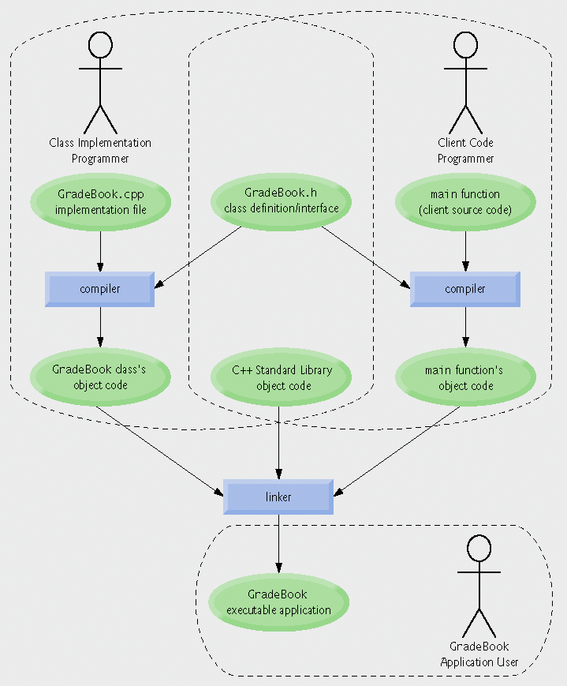
Fig.3.14 | Compilation and linking process that produces an executable application.

Slide 22
03 Separating Interface from Implementation (Cont.)
Separating a class definition and the class’s member-function definitions
Makes it easier to modify programs
Changes in the class’s implementation do not affect the client as long as the class’s interface remains unchanged
Things are not quite this rosy
Header files do contain some portions of the implementation and hint about others
Inline functions need to be defined in header file
private members are listed in the class definition in the header file

Slide 23
04 Validating Data with set Functions
set functions can validate data
Known as validity checking
Keeps object in a consistent state
The data member contains a valid value
Can return values indicating that attempts were made to assign invalid data
string member functions
length returns the number of characters in the string
Substr returns specified substring within the string

Slide 24
fig03_15.cpp
(1 of 1)

Slide 25
fig03_16.cpp
(1 of 2)
Constructor calls set function to perform validity checking
set functions perform validity checking to keep courseName in a consistent state

Slide 26
fig03_16.cpp
(2 of 2)

Slide 27
fig03_17.cpp
(1 of 2)
Constructor will call set function to perform validity checking

Slide 28
fig03_17.cpp
(2 of 2)
Call set function to perform validity checking

Slide 29
05 Time Class Case Study
Preprocessor wrappers
Prevents code from being included more than once
#ifndef – “if not defined”
Skip this code if it has been included already
#define
Define a name so this code will not be included again
#endif
If the header has been included previously
Name is defined already and the header file is not included again
Prevents multiple-definition errors
Example
#ifndef TIME_H #define TIME_H … // code #endif

Slide 30
Preprocessor directive #ifndef determines whether a name is defined
Time.h
(1 of 1)
Preprocessor directive #define defines a name (e.g., TIME_H)
Preprocessor directive #endif marks the end of the code that should not be included multiple times

Slide 31
Time.cpp
(1 of 2)
Ensure that hour, minute and second values remain valid

Slide 32
Using setfill stream manipulator to specify a fill character
Time.cpp
(2 of 2)

Slide 33
fig09_03.cpp
(1 of 2)

Slide 34
fig09_03.cpp
(2 of 2)

Slide 35
05 Time Class Case Study (Cont.)
Parameterized stream manipulator setfill
Specifies the fill character
Which is displayed when an output field wider than the number of digits in the output value
By default, fill characters appear to the left of the digits in the number
setfill is a “sticky” setting
Applies for all subsequent values that are displayed in fields wider than the value being displayed

Slide 36
05 Time Class Case Study (Cont.)
Using class Time
Once class Time has been defined, it can be used in declarations
Time sunset;
Time arrayOfTimes[ 5 ];
Time &dinnerTime = sunset;
Time *timePtr = &dinnerTime;

