Slide 1
状态图
林连南 博士
华南理工大学 软件学院

Slide 2
案例研究
案例研究
  古城堡里的藏宝箱
  一个对象的生命周期管理
状态迁移图
GoF 状态模式
从UML图到代码
  代码中出现一个操作中含有庞大的多分支的条件语句，且这些分支依赖于该对象的状态。
  如何消除?

Slide 3
State machine diagrams
State machine diagrams are a familiar technique to describe the behavior of a system. Various forms of state diagrams have been around since the 1960s and the earliest object-oriented techniques adopted them to show behavior. In object-oriented approaches, you draw a state machine diagram for a single class to show the lifetime behavior of a single object.

Slide 4
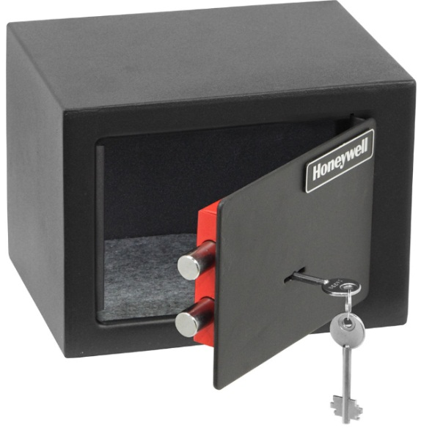

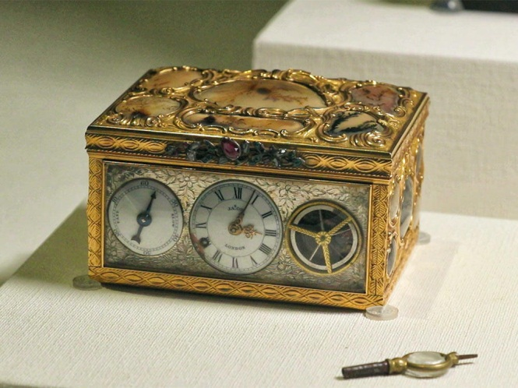
A secret panel in a Gothic castle
Notes:
Whenever people write about state machines, the examples are inevitably cruise controls or vending machines. As I'm a little bored with them, I decided to use a controller for a secret panel in a Gothic castle. In this castle, I want to keep my that's hard to find. So to reveal the lock to the safe, I have to remove a strategic candle from its holder, but this will reveal the lock only while the door is closed. Once I can see the lock, I can inservaluables in a safe t my key to open the safe. For extra safety, I make sure that I can open the safe only if I replace the candle first. If a thief neglects this precaution, I'll unleash a nasty monster to devour him.

Slide 5
A secret panel in a Gothic castle
Whenever people write about state machines, the examples are inevitably cruise controls or vending machines. As I'm a little bored with them, I decided to use a controller for a secret panel in a Gothic castle. In this castle, I want to keep my valuables in a safe that's hard to find. So to reveal the lock to the safe, I have to remove a strategic candle from its holder, but this will reveal the lock only while the door is closed. Once I can see the lock, I can insert my key to open the safe. For extra safety, I make sure that I can open the safe only if I replace the candle first. If a thief neglects this precaution, I'll unleash a nasty monster to devour him.
Notes:
1）系统具有三大属性：蜡烛candle，门door和锁lock；当蜡烛在支架上的时候，系统处于等待状态。
2）用户在系统某种当前状态下，提交了某类事件，而且满足某个监视条件，系统的当前状态就会迁移到下一个新的状态。
3）一个系统（对象）在不同的状态下，会有不同的行为。
4) 一个对象在不同的系统状态下，用户可以提交不同的事件，以得到不同的系统响应。

Slide 6
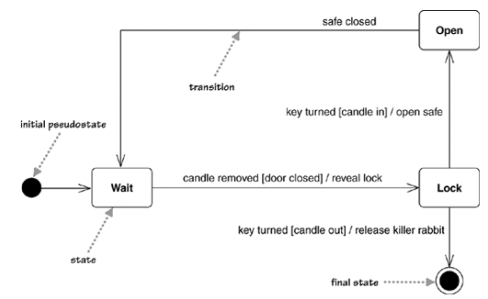
state diagram -1
Notes:
transition rule ::= [ event [guard] activity ] TR ::= E [G]A
transition rule ::= event [guard] / activity = e/g/a
(All of the them are optional. )
1）系统具有三大属性：蜡烛candle，门door和锁lock；当蜡烛在支架上的时候，系统处于等待状态。
2）用户在系统某种当前状态下，提交了某类事件，而且满足某个监视条件，系统的当前状态就会迁移到下一个新的状态。
3）一个系统（对象）在不同的状态下，会有不同的行为。
4) 一个对象在不同的系统状态下，用户可以提交不同的事件，以得到不同的系统响应。
public currentState handleEvent(System E){
switch(currentState){
case s1：
switch(E){
case e1:
if(g1){
revealLock();
currentState = SystemState.lock;
return(currentState);
break;
}
break;
}
case wait：
switch(E){
case key_turned:
if(candle_out){
release_killer_rabbit();
} else if(candle_in){
opensafe();
} break;
break;
}
}

Slide 7
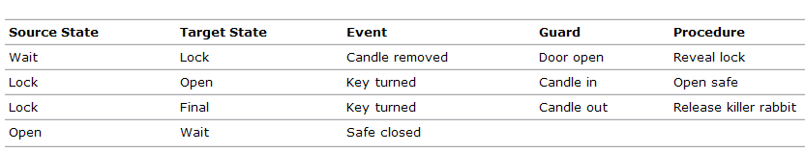
状态图

Slide 8
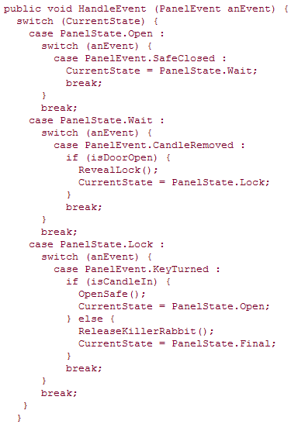
state diagram -1
Notes:
transition rule ::= [ event [guard] activity ]

Slide 9
state diagram -1
Notes:
transition rule ::= [ event [guard] activity ]
1.根据对象自身的情况将对象的状态作为一个对象。
2.对象的状态通常用一个或者多个枚举型常量表示。

Slide 10
GoF State Pattern
Allow an object to alter its behavior when its internal state changes.
The object will appear to change its class.
Notes:
允许一个对象在其内部状态改变时改变它的行为。对象看起来似乎修改了它的类。

Slide 11
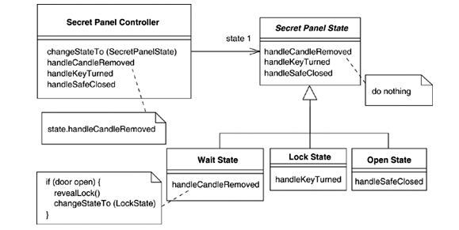
GoF State Pattern
GoF State Pattern Structure for Safe

Slide 12
GoF State Pattern
一个对象的行为取决于它的状态, 并且它必须在运行时刻根据状态改变它的行为。
一个操作中含有庞大的多分支的条件语句，且这些分支依赖于该对象的状态。这个状态通常用一个或多个枚举常量表示。通常, 有多个操作包含这一相同的条件结构。状态模式将每一个条件分支放入一个独立的类中。这使得你可以根据对象自身的情况将对象的状态作为一个对象，这一对象可以不依赖于其他对象而独立变化。

Slide 13
课后作业
请编写程序实现藏宝箱的状态管理
（1）请根据条件分支结构编写程序；
（2）请根据GoF状态模式结构编写程序；
（3）请比较两种实现方式的优点和缺点。
作业提交时间：4月18号
提交方式：个人独立完成后将电子版发送给课代表，课代表收集好后打包发送到QQ群：中澳班1班.rar。

