Slide 1
Decision Tree

Slide 2
Decision tree uses the tree representation to solve the problem
In which each leaf node corresponds to a class label and attributes are represented on the internal node of the tree.

Slide 3
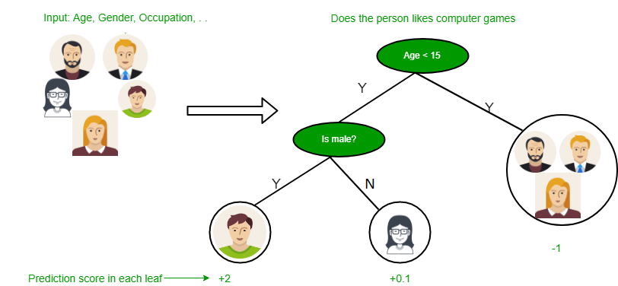

Slide 4
Attribute selection measures
The primary challenge in the Decision Tree implementation is to identify the attributes(Root). attributes selection.
There are 2 popular attribute selection measures.
Entropy
Gini index

Slide 5
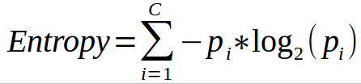
Entropy: Entropy is the measure of uncertainty of a random variable, it characterizes the impurity of an arbitrary collection of examples. The higher the entropy more the information content.

Slide 6

Information Gain:
Information gain is a measure of this change in entropy.

Slide 7
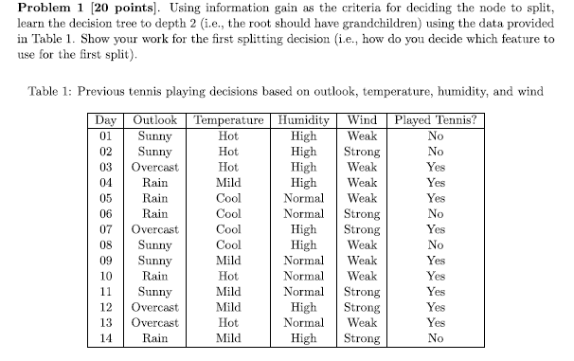

Slide 8
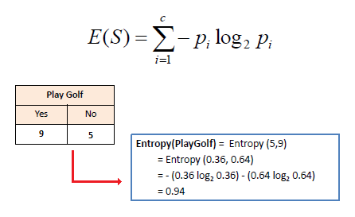

Slide 9
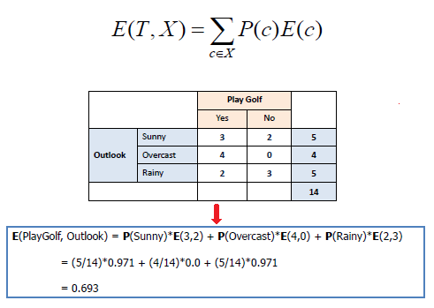

Slide 10
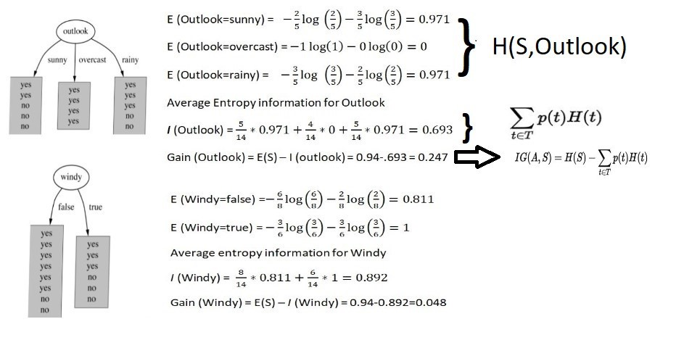

Slide 11
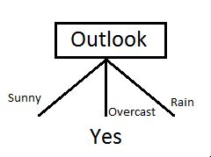
IG(S, outlook) = 0.94 - 0.693 = 0.247
IG(S, Temperature) = 0.940 - 0.911 = 0.029
IG(S, Humidity) = 0.940 - 0.788 = 0.152
IG(S, Windy) = 0.940 - 0.8932 = 0.048

Slide 12
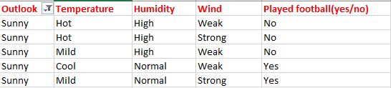
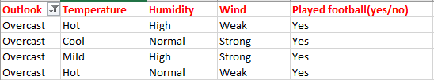
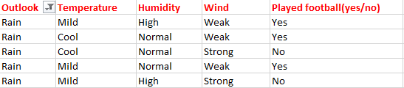

Slide 13
https://medium.com/datadriveninvestor/decision-tree-algorithm-with-hands-on-example-e6c2afb40d38.
https://stackabuse.com/decision-trees-in-python-with-scikit-learn/

Slide 14
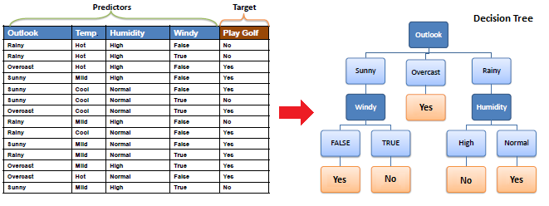

Slide 15
