Slide 1
Random Forests Classifiers

Slide 2
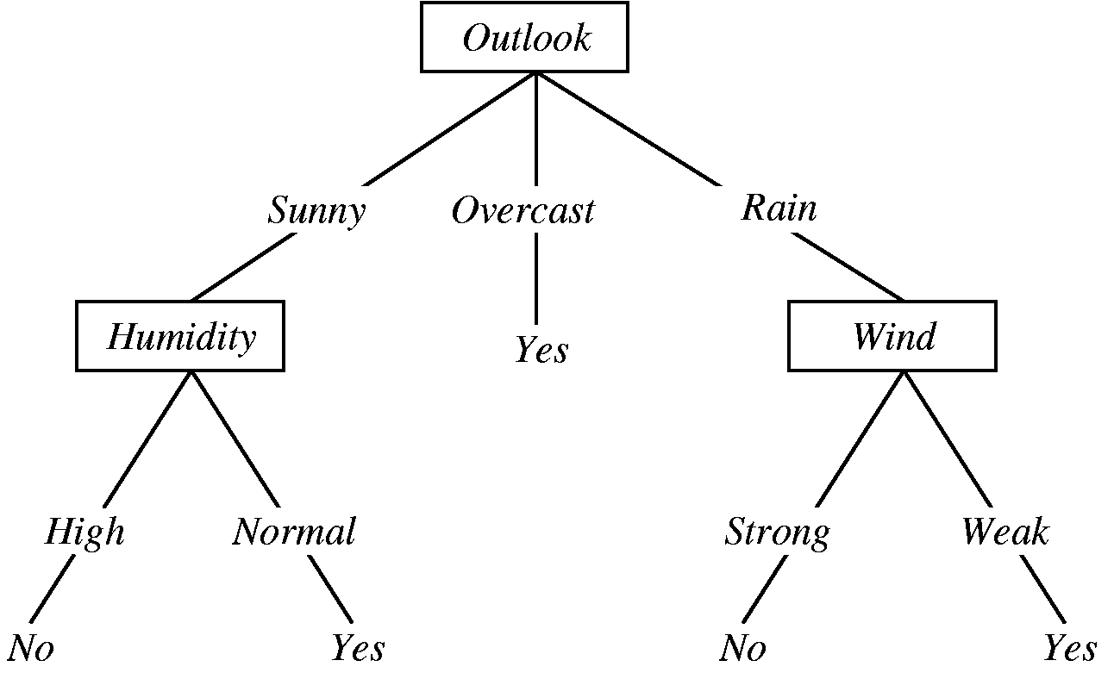

Slide 3
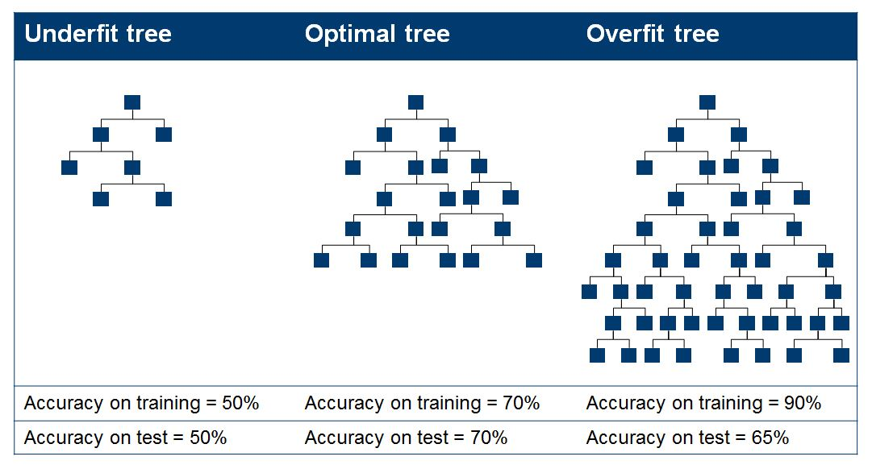
Overfitting

Slide 4
Two approaches:
1. Stop growing the tree when further splitting the data does not yield an improvement
2. Grow a full tree, then prune the tree, by eliminating nodes.

Slide 5
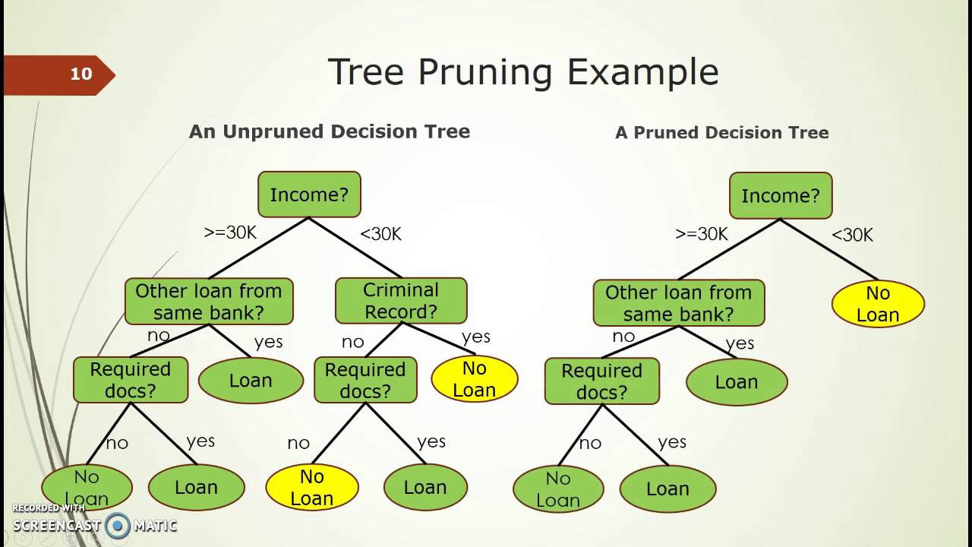

Slide 6
Bagging
create several subsets of data from training sample chosen randomly with replacement.
Now, each collection of subset data is used to train their decision trees.

Slide 7
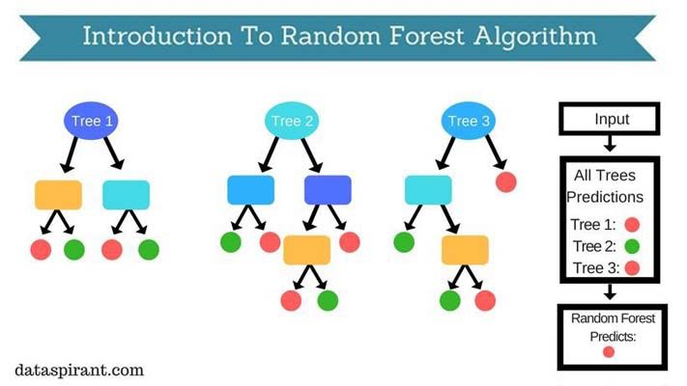

Slide 8
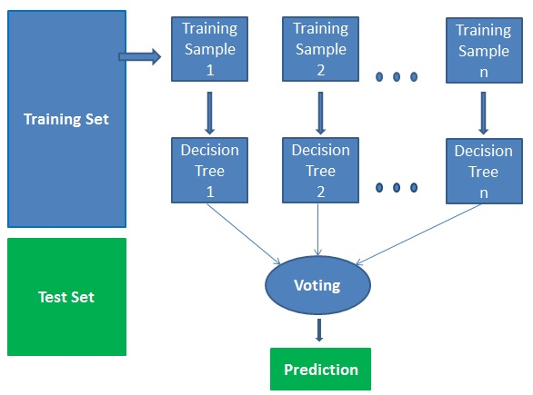
Row Sampling
Colum Sampling

Slide 9
Bagging
Create bootstrap samples
from the training data
M features
N examples
....…

Slide 10
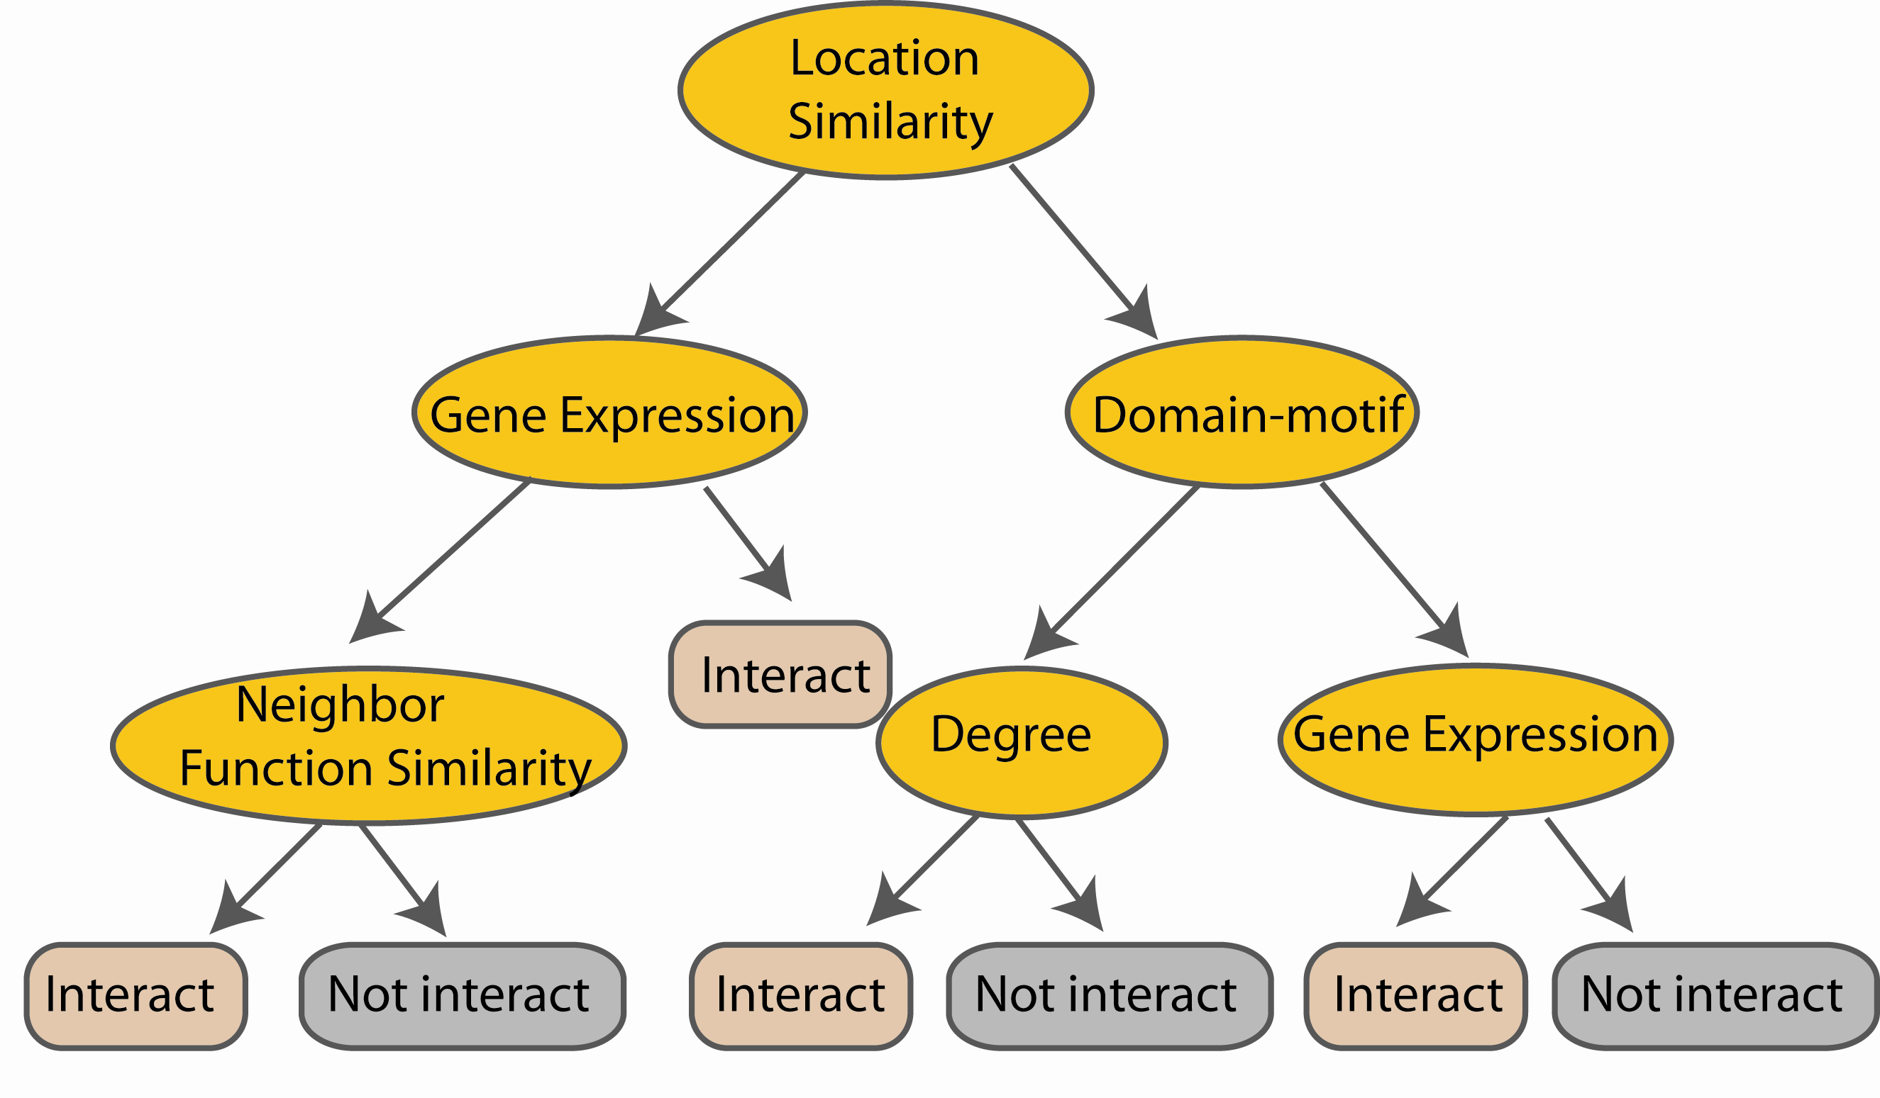
Random Forest Classifier
Construct a decision tree
M features
N examples
....…

Slide 11

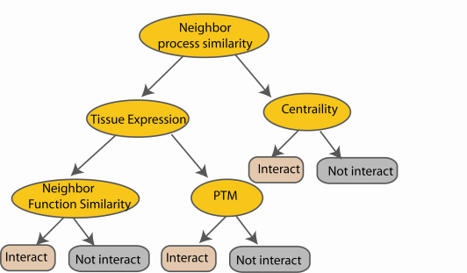
Random Forest Classifier
M features
N examples
Take the majority vote
....…
....…
Notes:
Finally the given an input data the decision is made as follows given an input data,

Slide 12
from sklearn.ensemble import RandomForestClassifier
clf=RandomForestClassifier(n_estimators=100)
This parameter defines the number of trees in the random forest

Slide 13


