Slide 1
Electronics Design Lab
Presented by
AKRIVIA AUTOMATION PVT. LTD
EMBEDDED SYSTEMS

Slide 2
Subjects covered so far . .
Network analysis
Electronic devices and circuits
Electronic circuit analysis
Switching theory and logic design
Pulse and digital circuits
Linear IC and Digital IC applications
Microprocessors and Microcontrollers Lab
Embedded Systems

Slide 3
Goal
To know the how and why of Basic electronics
To have hands-on experience with basic electronics
To analyze and design basic electronic circuits
To know how to solder your own basic circuits
To gain hands-on experience with PCB design and printing
To impart Practical orientation to already acquired theoretical knowledge.

Slide 4
Electronics
Electronics is the branch of science that deals with the study of flow and control of electrons (electricity) and the study of their behavior and effects in vacuums, gases, and semiconductors, and with devices using such electrons. This control of electrons is accomplished by devices that resist, carry, select, steer, switch, store, manipulate, and exploit the electron
Science of study of electron and its utilization

Slide 5
Applications
Entertainment
Communication
Defense
Healthcare
Industries
Daily life

Slide 6
Brief history
Vacuum diode by J.A. Fleming in 1897
Tetrode and pentode tubes dominated the world until the world war II.
Transistor era began with the junction transistor invention in 1948
    Led to the development of radio, television, early form of computer
JFETS and MOSFETS 1951 to 1958
IC 1958
Microprocessor in 1969

Slide 7
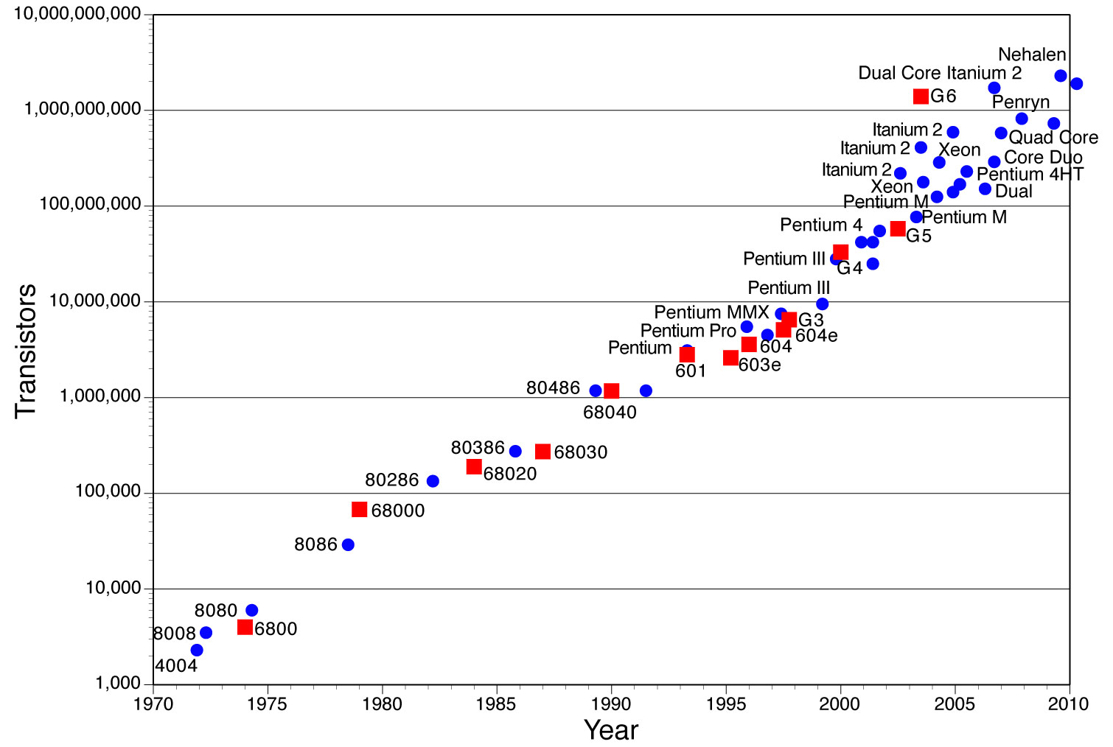
Moore’s law
The number of transistors incorporated in a chip will approximately double every 24 months.

Slide 8
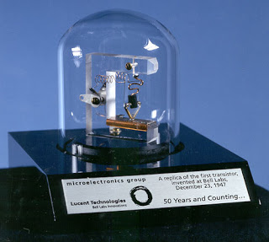
Electronics - Then
Unreliable
Computers made of vacuum diodes and relays
Power hungry
Heavy
Slow
Replica of first transistor

Slide 9
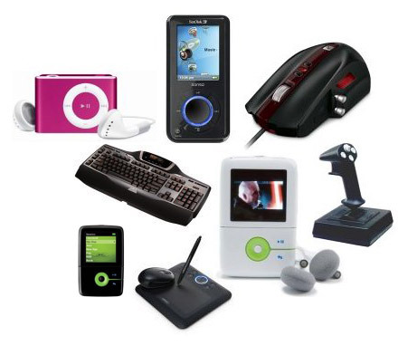
Electronics - Now
Newer
Smarter
Faster
Smaller
Better
Integrating more than 1,000,000,000 transistors in an IC

Slide 10

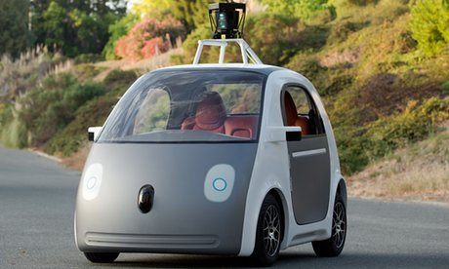
Electronics - Next
Self-driving cars Flexible electronics

Slide 11
Component selection
Choosing right components
Choosing wrong component results in heavy and unpredictable losses
Choosing components is based on parameters like electrical, mechanical, environmental, cost, reliability factor, availability (life cycle), etc

Slide 12
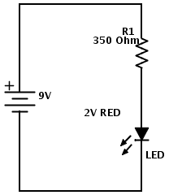
Example – find value of current limiting resistor
Glow a LED using 9V DC battery
Refer specifications /Data sheet
For LED:
  Rated max. current 20mA
  Voltage drop 2V
Use Ohm’s Law

Slide 13
Current limiting resistor
Voltage across be (9-2)V = 7V
V= R* I
R = V/I
R = Voltage across R / Max. current
R= 7V / 20mA = 350 ohms

