Slide 1

Solar-Peltier Coupled Water
Purification System
Group 18
Team Members
Avinash Kumar (150169)
Atul Bimbrahw (150162)
Rahul Kumar (150546)
Undergraduate Project
Department of Mechanical Engineering
IIT Kanpur
Project Supervisor
Dr. Sameer Khandekar

Slide 2

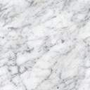
Working Principle
Solar PV
A
B
Porous structure over which the air will pass through
Hot
DRY air
Atmospheric Air
Peltier Element
D
C
Cold DRY air
Less hot but humid air
Impure water from different sources
condensation
Passive Humidifier
Drinkable water

Slide 3
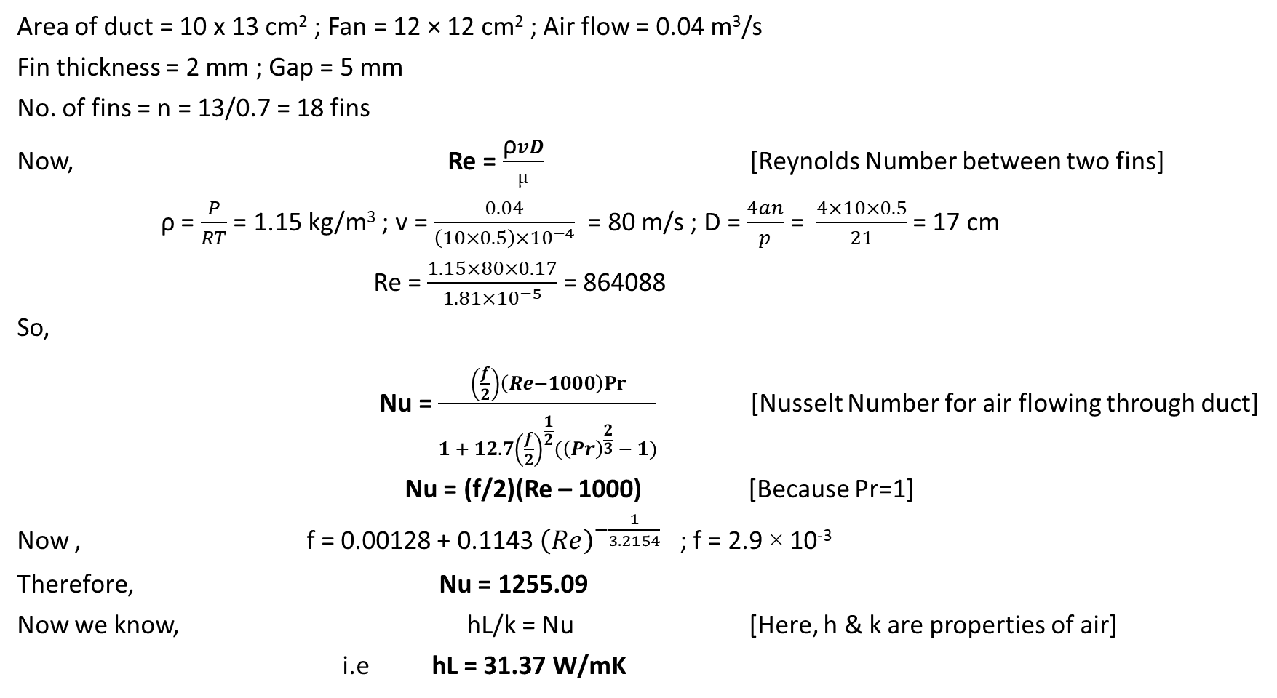
Design Calculations
Area of duct = 10 x 13 cm² ; Fan = 12 × 12 cm² ; Air flow = 0.04 m³/s
Fin thickness = 2 mm ; Gap = 5 mm
No. of fins = n = 13/0.7 = 18 fins
Now, Re = $\frac{\text{ρ}vD}{µ}$ [Reynolds Number between two fins]
ρ = $\frac{P}{RT}$ = 1.15 kg/m³ ; v = $\frac{0.04}{\left(10×0.5\right)×{10}^{−4}}$ = 80 m/s ; D = $\frac{4an}{p}$ = $\frac{4×10×0.5}{21}$ = 17 cm
Re = $\frac{1.15×80×0.17}{1.81×{10}^{−5}}$ = 864088
So,
Nu = $\frac{\left(\frac{f}{2}\right)\left(Re−1000\right)Pr⁡}{1 + 12.7{\left(\frac{f}{2}\right)}^{\frac{1}{2}}(\overset{}{{\left(Pr\right)}^{\frac{2}{3}}}{− 1)}}$ [Nusselt Number for air flowing through duct]
Nu = (f/2)(Re – 1000) [Because Pr=1]
Now , f = 0.00128 + 0.1143 ${\left(Re\right)}^{−\frac{1}{3.2154}}$ ; f = 2.9 × 10⁻³
Therefore, Nu = 1255.09
Now we know, hL/k = Nu [Here, h & k are properties of air]
i.e hL = 31.37 W/mK

Slide 4
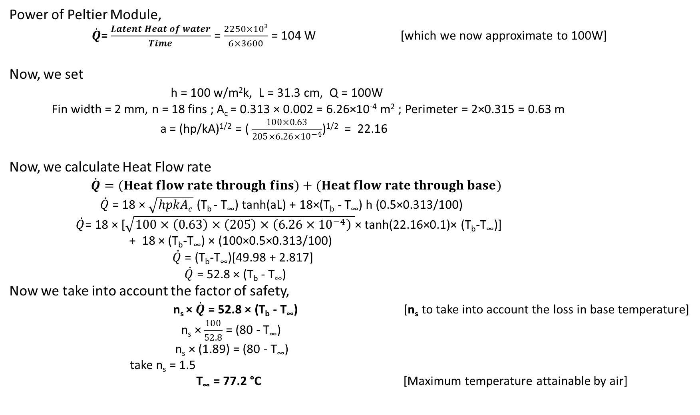
Design Calculations
Power of Peltier Module,
$\dot{Q}$= $\frac{Latent Heat of water}{Time}$ = $\frac{2250×103}{6×3600}$ = 104 W [which we now approximate to 100W]
Now, we set
h = 100 w/m²k, L = 31.3 cm, Q = 100W
Fin width = 2 mm, n = 18 fins ; A_{c} = 0.313 × 0.002 = 6.26×10⁻⁴ m² ; Perimeter = 2×0.315 = 0.63 m
a = (hp/kA)^{1/2} = ( $\frac{100×0.63}{205×6.26×{10}^{−4}}$)^{1/2} = 22.16
Now, we calculate Heat Flow rate
$\dot{Q}=(Heat flow rate through fins)+(Heat flow rate through base)$
$\dot{Q}$ = 18 × $\sqrt{hpkAc}$ (T_{b} - T∞) tanh(aL) + 18×(T_{b} - T∞) h (0.5×0.313/100)
$\dot{Q}$= 18 × [$\sqrt{100×\left(0.63\right)×\left(205\right)×\left(6.26×{10}^{−4}\right) }$× tanh(22.16×0.1)× (T_{b}-T∞)]
+ 18 × (T_{b}-T∞) × (100×0.5×0.313/100)
$\dot{Q}$ = (T_{b}-T∞)[49.98 + 2.817]
$\dot{Q}$ = 52.8 × (T_{b} - T∞)
Now we take into account the factor of safety,
n_{s} × $\dot{Q}$ = 52.8 × (T_{b} - T∞) [n_{s} to take into account the loss in base temperature]
n_{s} × $\frac{100}{52.8}$ = (80 - T∞)
n_{s} × (1.89) = (80 - T∞)
take n_{s} = 1.5
T∞ = 77.2 °C [Maximum temperature attainable by air]

Slide 5
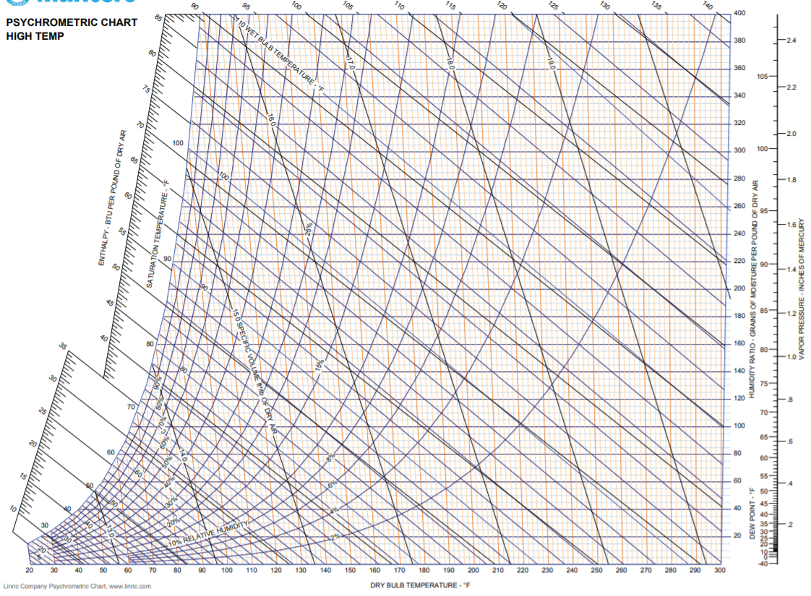
Design Calculations
At A
T_{A} = 30 °C ; RH_{A} = 40 %
At B
T_{B} = 77.4 °C ; R_{H} = 4 %
At C
T_{sat} = 77.2 °C ; w₂ = 200
At D
T = 5 °C ; w₁ = 40
w₂ – w₁ = 160 × 0.143 = 22.88 g/kg of dry air
density of water = 1g/cc
0.0228 L 1 kg of air
1 L 43.859 kg of air [We are able to heat 43.859 kg of air in 6 hours to give 1 Ltr of water]
Taking factor of safety n_{s} = 1.5
43.859 kg of air gives 666 ml of water in 6 hours
C
w2
A
B
D
w1

Slide 6
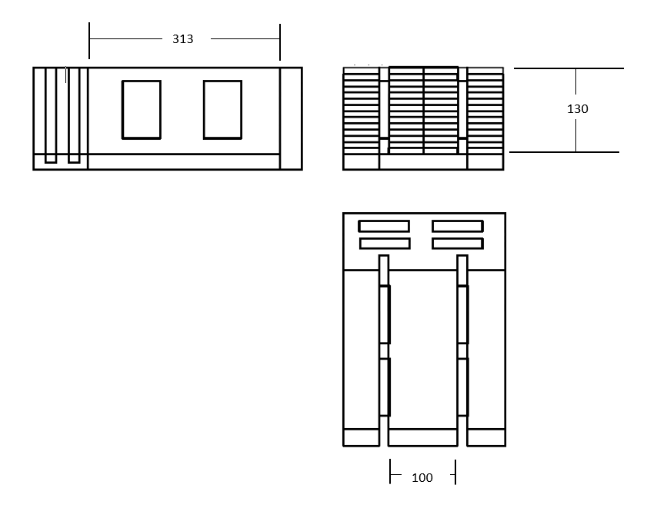
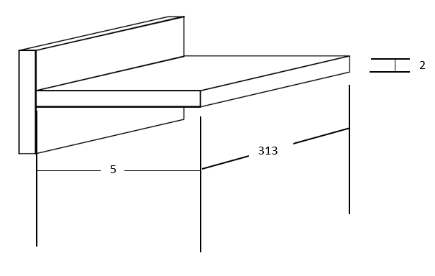
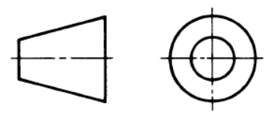
Orthographic Projections
Fin Diagram
All dimensions in mm

Slide 7
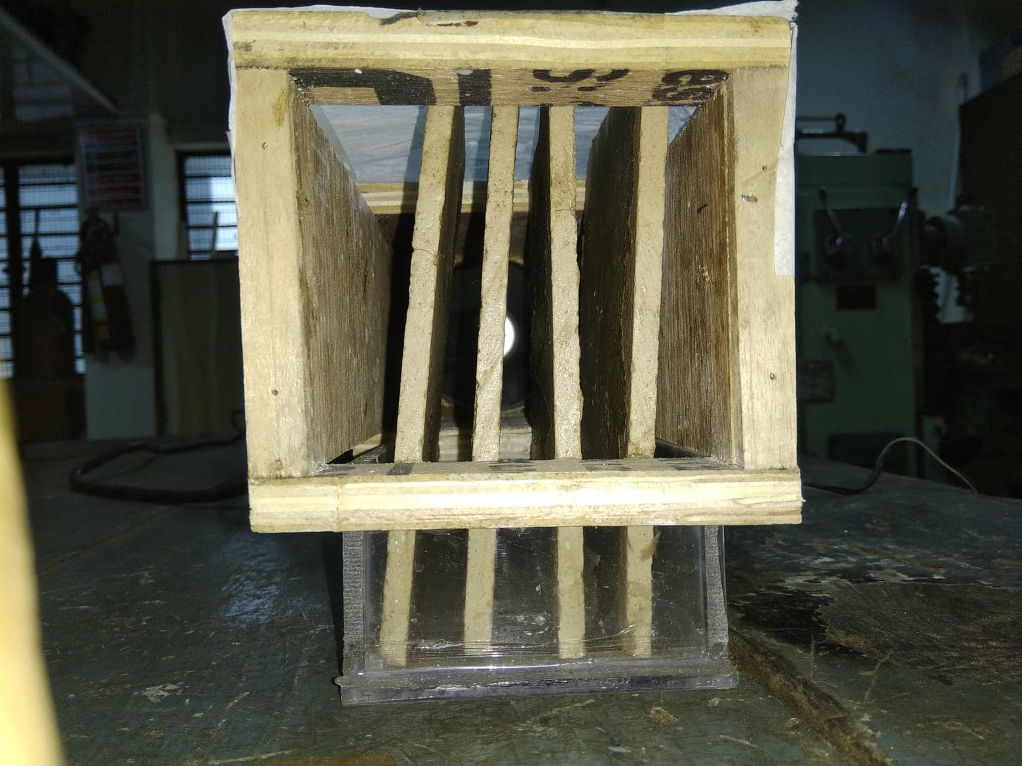
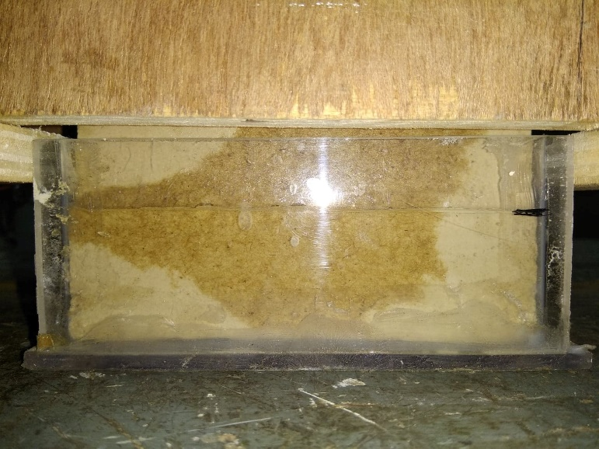
Experimental Data
DBT: 21 °C ; WBT: 24 °C
Length of Container: 11.05cm ; Breadth: 8.11cm
Experiment No. | Material | No. of plates | Height of water evaporated (mm) | Time (min) | Volume Flow rate (cm³/min)
1 | POP | 4 | 13.2 | 300 | 0.394
2 | POP | 4 | 22 | 444 | 0.444
3 | Clay | 5 | 11.8 | 168 | 0.63
4 | Clay | 5 | 10 | 150 | 0.597
5 | Clay (with holes) | 3 | 7.3 | 170 | 0.385

