Slide 1
Academic Reading

Slide 2
Reading for quick understanding (Skimming)
Reading for specific information (Scanning and skimming )
Reading for detailed understanding
Reading for critiquing, evaluating and justifying
Reading for pleasure

Slide 3
Reading for Quick Understanding - Skimming
Determine what a text is about and whether or not to spend more time on it
In case of a difficult/ long text, skim to have a sense of where the text will lead us and what we may need to understand it
Work through many texts to decide which texts to focus on
Under intense pressure to complete reading in short span of time

Slide 4
Look at important words
To identify important words, focus on nouns, verbs, adjectives and adverbs; ignore articles, prepositions, or auxiliaries
Before reading in any detail, skim through the materials quickly, simply to get a general impression of it.
The aim at this stage is not to get to grips with its detailed arguments, simply to understand how many sections it has, which of them require careful reading and which you can read through quickly, etc.
Check the contents pages to see how many sections there are. Check headings, images and summaries

Slide 5
Read the following news item and choose the most appropriate title
A Korean airbus with 199 passengers crashed 4.8 km away from Tripoli airport in Libya today, and burst into flames, killing at least 100 people.
The official Libyan News Agency, Jana, said that the plane fell on two houses, killing four persons in one of them. Jana reported that 80 to 100 people, including the Captain survived the crash. The crash occurred at 7 am local time, 25 minutes before the expected time of landing.

Slide 6
Hundred feared killed in plane crash
Plane crashes before landing
Tragedy near Tripoli
Captain survives plane crash
Plane falls on houses
Airbus in flames

Slide 7
Distinguish between main and subsidiary information. Delete most details and examples, unimportant information, anecdotes, examples, illustrations, data etc.
Examples:
People whose professional activity lies in the field of politics are not, on the whole, conspicuous for their respect for factual accuracy. Politicians often lie.
Failure to assimilate an adequate quantity of solid food over an extended period of time is absolutely certain to lead, in due course, to a fatal conclusion. If you do not eat, you die.

Slide 8
Sum up the main idea in a sentence each
It is undeniable that the large majority of non-native learners of English experience a number of problems in attempting to master the phonetic patterns of the language.
It is not uncommon to encounter sentences which, though they contain a great number of words and are constructed in a highly complex way, none the less turn out on inspection to convey very little meaning of any kind.

Slide 9
Read these sentences from three paragraphs. Can you guess what the contents of each paragraph could be?
Para 1: This is the age of communication.
Para 2: Two persons seated net to each other can communicate in several ways.
Para 3: Around 1835, a method was invented for sending messages by means of electrical signals that travelled through a wire.

Slide 10
Here are some keywords taken from a paragraph. Can you guess what the paragraph is about?
second class | difficult | no room
passenger | push | ticket
crowd | book | train
The pleasures of travelling
The booking of tickets
The problems of second class passengers
Crowds in trains

Slide 11
Read sentences from Column 1. Choose from Column 2 the sentence which is most likely to follow it
I had an interesting experience last week, when I travelled in the Grand Trunk Express from Delhi to Chennai
I often travel to Madras
I had gone to Delhi for a conference
A few minutes after I entered the compartment, a noisy family – carrying large tiffin carriers – entered the compartment

Slide 12
2. They opened their tiffin carriers immediately
I watched them intently
I was happy that the train had started on time
The baby started crying

Slide 13
Here’s a short text with some parts missing. Choose the most appropriate main idea for the missing parts.

Slide 14
1. Once upon a time, a Dutch family settled in America. One of their great grandsons became the President of the United States of America. His name was Theodore Roosevelt.
2. (a) This describes the qualities of Roosevelt (b) This describes the forefathers of Roosevelt
3. One day when he was hunting, he came across a baby bear. When the dogs surrounded it and started barking, the bear was frightened. It knew that it could not run away.
4. (a) Roosevelt was sorry for the bear and allowed it to escape. (b) Roosevelt felt happy and shot the bear.
5. But those who saw it laughed at him. They could not understand why he let the bear escape when he could have easily shot it.
6. (a) The Americans were proud of their President and decided to honour him. (b) Americans were ashamed of their President and condemned him for his weakness

Slide 15
7. Toy shop owners who heard the story of ‘Teddy Roosevelt’ and called their toy bears ‘teddy bears’. This is how one of the most popular toys got its name!

Slide 16
Reading for specific information - Scanning and Skimming
Run your eye quickly over the text to locate specific words or phrases that are of interest. You can scan
headings and subheadings
images and artwork
the body text for authors' names
the contents page itself
the index for specific words
This will help you focus on specific parts to get more details.

Slide 17
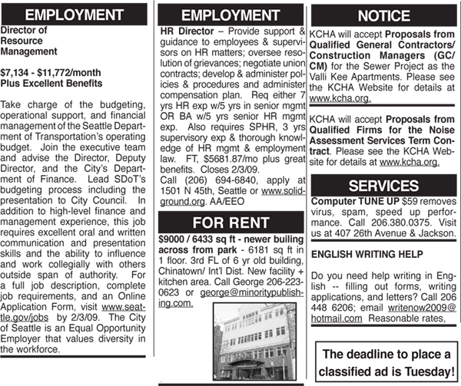
Let’s look at these ads

Slide 18
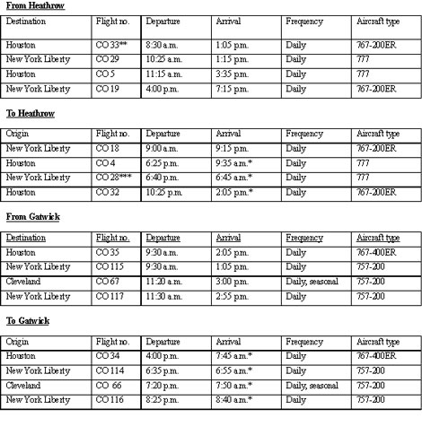

Slide 19
A skimming task
A scanning task

Slide 20
Reading for detailed understanding
Once you have a general overview of the material, read it in more detail.
Take notes, add margin comments or highlight sections.
Pay attention to the structure of a text to understand the writer's purpose and argument. Take notice of headings and sub-headings, of opening and closing paragraphs and of other signposts.

Slide 21
Analysis: Patterns of organisation
Looking at the parts to detect patterns. Analyse the arguments of the author
What is the thesis or overall theory?
What are the supporting points? How do they relate to each other and to the main thesis?
What are the examples used? How do they relate to the points they support? To each other? To the thesis?

Slide 22
What rhetorical strategies are used (e.g. definition, explanation, description, narration, elaboration, argumentation, evaluation)?
What modes of analysis are used (illustration, comparison/contrast, cause and effect, process analysis, classification/division, definition)?

Slide 23
Interpretation: What do the patterns of the argument mean?
Read ideas as well as sentences. Be aware of the cultural and historical context (author’s life, the context of debates within the discipline at that time and today)
What debates were the author and the text engaging with at that time?
What kinds of reasoning (historical, psychological, political, philosophical, scientific, etc.) are employed?
What methodology is employed and what theory is developed?

Slide 24
Text

Slide 25
Reading to critique, evaluate and assess
Indeed, critiquing theories, arguments, and evidence often gains significant marks in assignments. It is important to be able to develop some critical thinking skills and to communicate these in your writing.

Slide 26
Understanding author’s position on an issue
Deciphering author’s ideology/ background – attitude towards the issue
Looking at the ways a particular topic has been dealt with and what alternatives exist
Asking if author has deliberately left out/ undermined/ overlooked something in favour of something else
Rational, moral or emotional appeal?

Slide 27
How language is used
Bertrand Russell : ‘I am firm, you are obstinate, and he is a pig-headed fool’.
I am sparkling. You are usually talkative. He is drunk.
I am a creative writer. You have a journalistic flair. He is a prosperous hack.
I day dream. You are an escapist. He ought to see a psychiatrist.

Slide 28
Foregrounding and backgrounding
When her mother was in the hospital for two months and her father was on the edge of a breakdown, Brenda showed great courage.
Brenda showed great courage when her mother was in the hospital for two months and her father was on the edge of a breakdown.

Slide 29
The average recruit has just won his freedom from his parents. He objects violently to the whole idea of discipline.
The average recruit, who has so recently won his freedom from parental authority, violently objects to the whole idea of discipline.

Slide 30
A Father’s Dreams, Recast by His Daughters in ‘Dangal’
Sure, Nitesh Tiwari’s Bollywood crowd-pleaser “Dangal” follows a formula: Father abandons his dream of being an international wrestling champion. Father hopes for a son who will live out his dream for him. Father ends up with four daughters. Father discovers that two of his daughters are dexterous brawlers. Father declares, “From now on, they will only wrestle.” Father trains those daughters, in defiance of the villagers’ tut-tutting and assumptions about women’s roles, to mud wrestle, and instills in them a spirit of feminism.
Demonetisation be damned, watch Dangal.
In the story department, Dangal offers few surprises because Geeta and Babita's historic wins at the Commonwealth Games and following championships are common knowledge. However, this screen adaptation serves as a recap of their arduous journey and it vigorously recaptures their stubborn father's resolve to make them professional wrestlers against the odds. Since it encapsulates the historic wins of the Phogats, who brought India glory, the film is also bound to inspire more women to seriously consider kushti as a sport.

Slide 31
Evaluation Asks: How well does the text do what it does? What is its value?
How does it contribute to the discipline? Are its main conclusions original?
Does the evidence and reasoning adequately support the theory/theories presented?
Are the sources reliable?
Is the argument logically consistent? Convincing?
Were the tools designed and executed in accordance with the accepted standards of the relevant discipline?

Slide 32
What are the strengths and weaknesses of the theory?
How would competing theories criticize this text? How could the author reply?
Overall, is the theory/approach in this text better than competing theories/approaches? In other words, what are its comparative strengths and weaknesses? In reading critically we need to keep competing theories in mind.

Slide 33
Let’s read a text critically.

