Slide 1
Description

Slide 2
Descriptive writing (factual/ imaginary)
Descriptive studies
Descriptive statistics

Slide 3
Descriptive writing
Describe a place – an object/ ideology – a person

Slide 4
The sound of hot dogs sizzling on a grease-spattered grill gave way to the whirling buzz of a cotton-candy machine. Fascinated, we watched as the white cardboard cone was slowly transformed into a pink, fluffy cloud. Despite their fiberglass appearance, the sticky puffs dissolved on my tongue into a sugar-like sweetness. Soon our faces and hands were gummed with a sticky mess.

Slide 5
A small description of a county fair.
Sensory impressions – sight, sound, taste, smell, and touch
Create word pictures of objects, persons, scenes, events or situations

Slide 6
Descriptive essays help us see places we might not be able to go ourselves, hear new things, taste different flavors, smell foreign smells, or touch different textures.
Descriptive essays do this through the use of more concrete concepts, which most often include our five senses.

Slide 7
Descriptive writing creates an impression in the reader’s mind of an event, a place, a person, or thing. The writing will be such that it will set a mood or describe something in such detail that if the reader saw it, they would recognize it. Descriptive writing will bring words to life and makes the text interesting.

Slide 8
Purpose
Merely create images and mood
Can also stimulate understanding or lead to action
Persuasion (e.g. advertisements)

Slide 9
Sensory impressions
Close observation – beginning point
Most descriptions blend several sense impressions rather than focussing on one

Slide 10
'As the waves leisurely collided with the shore, I could hear the delicate lapping of the water as it met the sand. The smell of salt air and a warm afternoon wafted through the sky. Slowly, I awoke from my slumber, cuddled in a hammock that surrounded me like a cocoon. The warm sun brightly shone on my face and greeted me, 'Good afternoon'.'

Slide 11
Based on the description, we can see waves hitting the shore as the tide comes in, hear the water as it hits the sand, smell the salty air, and feel the warm sun.
See how the senses use concrete things we've all probably experienced to some degree in our own lives to help you visualize a new scene.
This is how a descriptive essay uses things we are familiar with - in this case, our five senses - to take us to a tropical paradise.

Slide 12
Showing vs. Telling
Even more, the description helps set a mood by using more vivid language to complement the sensory-based description.

Slide 13
Rather than saying, 'I heard the waves as the tide came in,' the author says, 'As the waves leisurely collided with the shore, I could hear the delicate lapping of the water as it met the sand.'
The extra detail really helps us visualize the scene that the author is trying to create. They show us what it's like to be out there on the beach when the tide comes in during the afternoon, rather than just giving us a play-by-play.

Slide 14
The same vivid language also helps the author to create a mood for this description.
We can begin to experience the same peacefulness through the use of words like 'leisurely' and 'delicate'. Again, rather than just telling us it was a really relaxing and peaceful day, they let the descriptive language show us.

Slide 15
Good descriptive writing often makes use of figurative language such as analogies, similes and metaphors to help paint the picture in the reader's mind.

Slide 16
Setting a mood by using similes and metaphors.
A simile is a phrase comparing two unlikely things using 'like' or 'as' in order to make a description more vivid. You've probably heard the phrase, 'running like the wind' before. This is an example of a simile. Rather than saying, 'running really fast,' you replace the speed with something that might represent running quickly, like the wind.

Slide 17
A metaphor has the same function as a simile, but the comparison between objects is implicit, meaning there is no 'like' or 'as' used to signal the comparison.
For instance, 'All the world's a stage and the men and women merely players'
Rather than saying life is just like a play, Shakespeare compares the world to where a play is acted out.

Slide 18
Good descriptive writing uses precise language. General adjectives, nouns, and passive verbs do not have a place in good descriptive writing.
Use specific adjectives and nouns and strong action verbs to give life to the picture you are painting in the reader's mind.

Slide 19
Words describing people
Descriptive words can be used to describe physical appearance as well as personality traits.
Positive and negative connotations

Slide 20
Instead of saying ‘a good person…’
Agreeable Amusing cooperative conscientious meticulous passionate outspoken reliable helpful modest brilliant analytical

Slide 21
Instead of saying ‘a bad person…’
Childish conceited cranky hesitant picky quirky superficial unbalanced

Slide 22
How many ways can you ‘walk’ in English?
Amble = walk leisurely
Falter = move hesitatingly
Limp = walk impeded because of some injury
Lurch = move suddenly
Meander = move in circular course
Stroll = walk without specific aim

Slide 23
Dominant impression
Select and express sensory perceptions to create a dominant impression – an overall mood or feeling such as joy, anger, terror or distaste
May be explicit or implicit

Slide 24
Vantage point
Fixed vantage point – the narrator remains in one place and reports what can be perceived from there

Slide 25
On the last Thursday in November, I could stay in bed only until the night chill left the house, hearing first the clash of the heavy grates in the huge black iron range, with its flowery scrolls and nickled decorations, as Mother shook down the ashes. Then, in their proper sequence came the sounds of the fire being made – the rustle of newspaper, the snap of kindling, the rush of smoke up the chimney when Mother opened the damper…
Marilyn Kluger ‘A time of plenty’

Slide 26
Moving vantage point – observer views things from a number of positions

Slide 27
On a Winter day some years ago, coming out of Pittsburgh on one of the expresses of the Pennsylvania Railroad, I rolled eastward for an hour through the coal and steel towns of Westmoreland county. It was a familiar ground… But somehow I had never quite sensed its appalling desolation.

Slide 28
Select details that deliberately point toward the mood or feeling you intend to create
Must have a clear pattern of organization
Spatial arrangement – from top to bottom, left to right, front to back etc.
Time sequence – winter – spring - summer

Slide 29
Coffee Home
A food inlet set up by the Delhi Tourism Board in Connaught Place, Cafe Home is an example of getting the basics right. With a quaint and breezy outdoor dining space, complete with a towering banyan tree, as well as a large cafeteria-like indoor setting, this bustling eatery is never empty. The highlight here is the authentic filter coffee – simple, straightforward and freshly brewed. A large bowl of crystal sugar is placed on the self-service counter, allowing the patrons to adjust sweetness to taste. The aromatic brew can be paired with a smattering of south Indian dishes, including masala dosa and sambar vada.
Coffee for two: Rs 80
(Indian Express)

Slide 30
Planning and drafting a description
Select a familiar topic
What is my purpose? Create one or more impressions? Help the reader understand something? Persuade the reader to act?
Who is my audience and what might interest them?

Slide 31
Sounds of kitchen at breakfast
Breakfast
stove
hissing sound
gas whoosh
coffee
gurgling water
hum of flame
gloop sound

Slide 32
Sure signs of a new day are the sounds in the kitchen as breakfast is prepared. The high sigh of the gas just before it whooshes into flame and settles into a whispering hum blends with the gurgling of the water for the morning coffee. Soon, the gloop, gloop, gloop of the coffee sets up a perky beat. Then in mingles the crackle of creamy butter on a hot skillet and the shush of an egg added to the pan… The soft rustle of plastic as bread is removed from its wrapper contributes to the medley.

Slide 33
Choose one of the following and write a description in about 250-300 words. Include as many sensory images as you can.
My favourite food
The dirtiest place I have seen
The movie I will never watch (again)
The person I consider as my role model

Slide 34
Picture description
Look carefully at the photo.
Scan the picture and identify the topic.
When comparing the pictures, talk about the similarities and differences between them.
Use a wide range of vocabulary.

Slide 35
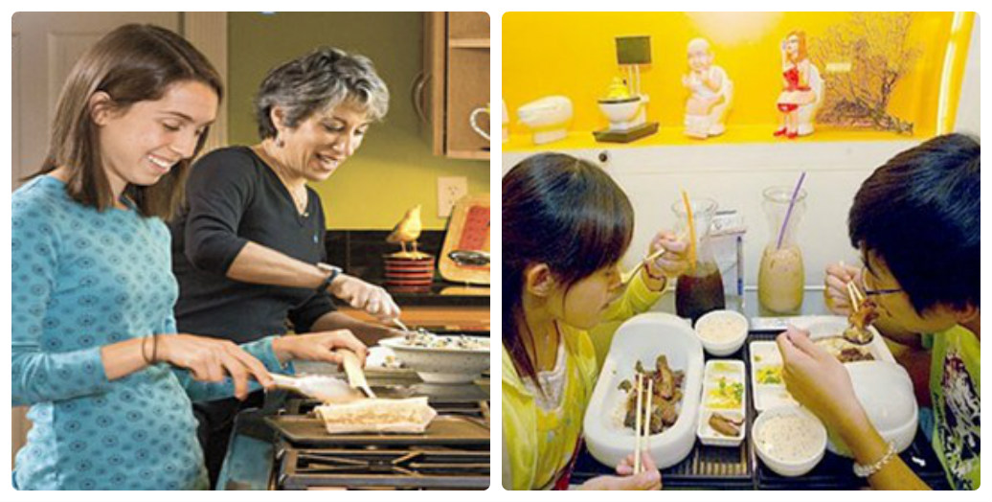

Slide 36
These pictures are clearly both connected with the topic of food.
The picture on the left shows two women who are cooking in a kitchen. One of them is younger than the other, but they seem to get on well; I’d say that they have a lot in common, they could be mother and daughter or have a close relationship.
In the picture on the right, we can see a young couple eating. I think they are in a restaurant, an oriental restaurant because the decoration that can be seen in the background.

Slide 37
We all need to eat to live, but It‘s clear that the food, in our society, is something more than nutrition. Nowadays, we all use the meals to socialize. We have family meals, business meal, and we all enjoy eating with friends. Sometimes we prefer eating at home, like in the photo on the left, but other times, we eat out.
However, the main problem isn’t where, but what we eat. In my view, today people tend to eat fast food because they don’t have enough time to prepare a meal and they are always in a hurry. This food isn`t always healthy, it is many times junk food which contains many calories and carbohydrates and there is a good chance people will get overweight.
If I had to choose one of the photos, I’m sure I’d choose the first, because it makes me remember old times with my mother , and in addition, I believe that it’s a good way to enjoy eating and cooking.

Slide 38

Compare and contrast these photos.

Slide 39
Description in research papers
Information about participants
Objective and undisputable

Slide 40
The 14 participants were professional English translators whose native language was Italian. All had studied English a minimum of 10 years. They were judged to be advanced learners. They were enrolled in a special, short-term program at a major university in the USA. The purpose of the program was to provide advanced instruction in English and in US culture.

Slide 41
Descriptive Statistics
In contrast with inferential stats
First level of analysis
Usually talks about number of participants, mean, median, mode, etc.

Slide 42
The participants took a pretest on the first day. In Spite of their advanced level of English proficiency, the test revealed a number of gaps in their knowledge of the extended meanings of all three prepositions. They scored an average of 19.5 out of a possible 40 points (range 13-28, SD = 4). They were particularly weak on the extended meanings of at, scoring an average of 17.9% correct, as well as to, scoring an average of 49.2% correct. They had the greatest knowledge of for, scoring on average 72% correct.

Slide 43
Descriptive studies
Descriptive studies, primarily concerned with finding out "what is"
Involves observing and describing the behavior of a subject without influencing it in any way
Do teachers hold favorable attitudes toward using computers in schools? How many people use the AECT gopher server, and what do they use if for?

Slide 44
Observational Method/ Field observation
There are two main categories of the observational method — naturalistic observation and laboratory observation.
Naturalistic method - view participants in their natural environments
Laboratory observation - more control in the laboratory; less time-consuming and cheaper than naturalistic observations

Slide 45
Purpose is often to investigate the relationship between two variables
Do taller people make more money?
Do magnets help relieve pain?
Explanatory variable – causes changes
Response variable – undergoes changes

Slide 46
Observational Study: data are observed and collected on each subject; NO manipulation of the subjects’ environment
Experiment: Manipulate the subjects’ environment

Slide 47
Does exercise prevent colds?
Observational study
Randomly select a sample of subjects
Record data for each subject on amount of exercise and number of colds last year.
Compare the groups

Slide 48
Randomized Experiment
Obtain a group of study participants (often volunteers)
Manipulate: randomly assign the participants to the treatment (exercise) and control groups (no exercise).
After a set amount of time, record amount of exercise and the number of colds for each person

Slide 49
Social Media and Anxiety
A study showed that Facebook increases people’s anxiety levels by making them feel inadequate and generating excess worry and stress. Social media provides constant updates. This motivates many people to continually check their status and newsfeed on mobile devices. Some people feel a constant impulse to check for updates, only feeling relief when they turn off the mobile device. In this study, over half of the respondents felt uneasy when they were unable to access their social media and email accounts.
Additionally, two-thirds had difficulty sleeping due to anxiety and other negative emotions after they had used the sites. The constant updates also led many respondents to frequently compare themselves to others, leading to feelings of inadequacy. This anxiety and worry creates chronic stress that could lead to health problems, including mental health issues.
(psychcentral.com)

Slide 50
Case Study Method
In-depth study of an individual or group of indviduals
Case studies often lead to testable hypotheses and allow us to study rare phenomena

Slide 51
A sample case study

Slide 52
Survey Method
Participants answer questions administered through interviews or questionnaires. After participants answer the questions, researchers describe the responses given.
In order for the survey to be both reliable and valid it is important that the questions are constructed properly. Questions should be written so they are clear and easy to comprehend.

Slide 53
Extracts from a survey
Communicating About Oceans: Results of a National Survey
Conducted for The Ocean Project
By Belden Russonello & Stewart and American Viewpoint
October 1999

Slide 54
Aim and Sampling
In a national telephone survey for The OCEAN Project, Belden Russonello & Stewart (BRS), in collaboration with American Viewpoint, explored the public’s connections, values, attitudes, and knowledge relating to the oceans. Our goal was to better understand what needs to be communicated to build awareness and to increase Americans’ concerns about the health of the oceans.
The national survey for The OCEAN Project was conducted among 1,500 adults in the continental United States from July 24 to August 8, 1999.

Slide 55
A sample question
Q1-Q5. Here are some issues the country will be facing over the next few years. I’d like to ask you how big of a priority each issue should be. Let’s start with____. Should it be an extremely high priority, a high, a middle, a low, or an extremely low priority for the country to address?
Improving public education
Improving the health care system
Lowering crime rates
Preserving social security
Protecting the environment

Slide 56
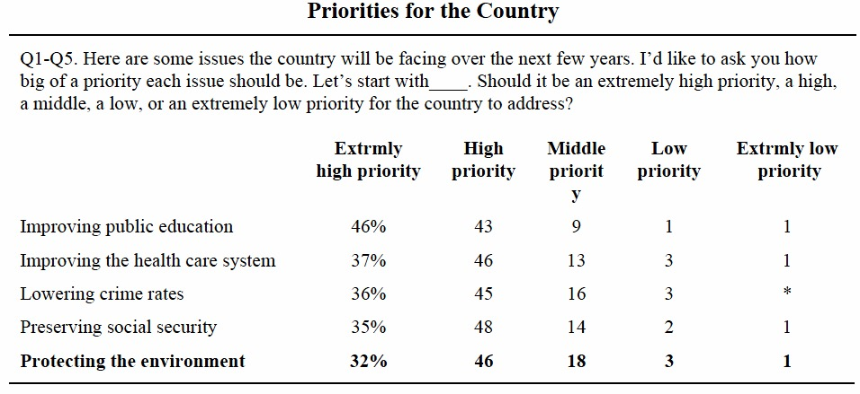
Descriptive stats

Slide 57
Descriptive account of responses
The top priority for Americans is improving education, with nearly half of Americans (46%) saying it is an extremely high priority. Following closely are improving health care (37%), lowering crime rates (36%), and preserving social security (35%). Protecting the environment, while considered a top priority by about a third of the public (32%) takes somewhat of a backseat to these more immediate concerns.

Slide 58
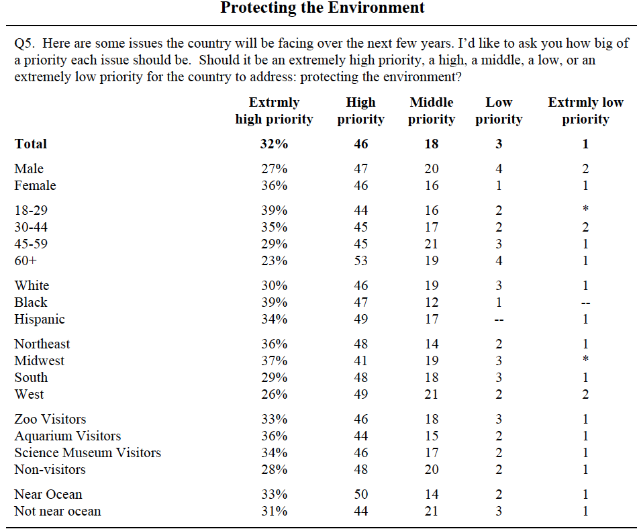

Slide 59
Protecting the environment is a higher priority for women, younger Americans (<45), blacks, residents of the Northeast and Midwest, and those who have visited a zoo, aquarium, or science museum in the last year than their counterparts in society.
Four in 10 (38%) Americans have visited a zoo in the last year, and three in 10 have visited an aquarium (30%) or science museum (28%). Visitors to zoos, aquariums, and science museums are more likely than the population as a whole to be younger (<45), to have children, to have high household incomes, high levels of education and to work in white collar or professional jobs.

Slide 60
You want to find out to what extent IIT students are interested in politics. Prepare questions for a survey.

