Slide 1
ME321: Advanced Mechanics of Solids
Sumit Basu
Room no NL 211
Department of Mechanical Engng
IIT Kanpur
Email: sbasu@iitk.ac.in
Ph: +91 (0) 512 259 7506 (O)
+91 (0) 512 259 8511 (R)

Slide 2

Course Objectives
Learn to handle the mechanics of deformable bodies, as opposed to rigid body mechanics (Most materials are deformable).
Build on what we have learnt in ESO204. Local approach vs global approach, the language of forces/moments and displacements/rotations replaced by the language of stresses and strains.
Learn experimental techniques to measure strains and stresses in realistic structures.

Slide 3

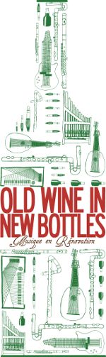
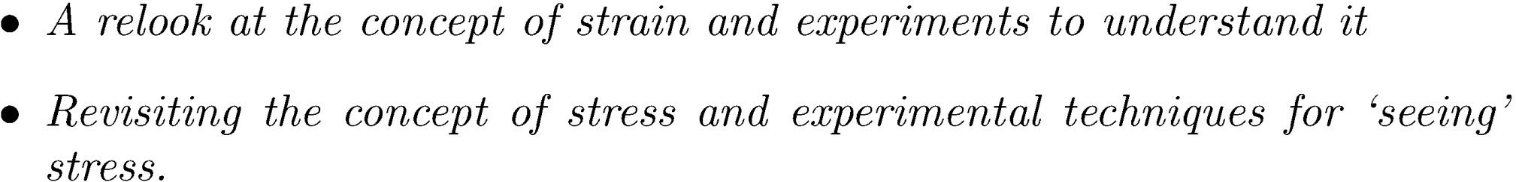

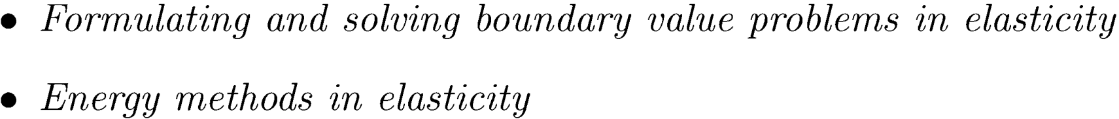
Course Outline

Slide 4
Books
Martin H. Sadd: Elasticity: Theory, Applications, and Numerics, Elsevier, 2009
Allan F Bower, Applied Mechanics of Solids 1st Edition, CRC Press, 2009.
http://www.solidmechanics.org
Coursenotes and assignments will be posted on http://www.usebackpack.com. Joining code for the course is 0f6e6d.

Slide 5
Evaluation
Mid semester examination: 30%
End semester examination: 40%
Lab experiments: 30%
The course calendar is available on:
https://calendar.google.com/calendar/embed?src=dr.sumit.basu%40gmail.com&ctz=Asia/Calcutta

Slide 6
Attendance!!!!
About 6 assignments and tutorial sessions will be held.
No attendance will be marked. However,
If you do not attend the tutorials and classes, it is very unlikely that you will be able to do well in the course.
Lack of knowledge of the mechanics of deformable bodies can be costly for a Mechanical engineer.

Slide 7










How good is your MOS?
What is the state of stress at the red dot?

Slide 8
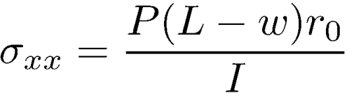


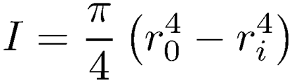

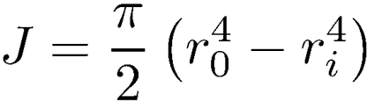
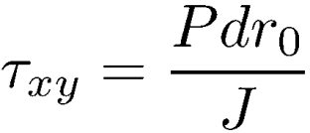

Slide 9




Slide 10

Introduction to Cartesian tensors

Slide 11

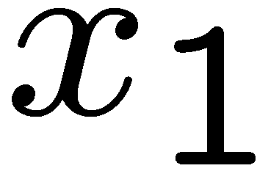
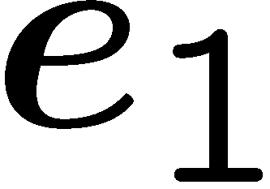

QIP Course on Recent trends in Nano-composites, IIT Kanpur November, 2006
IIT Kanpur

Slide 12
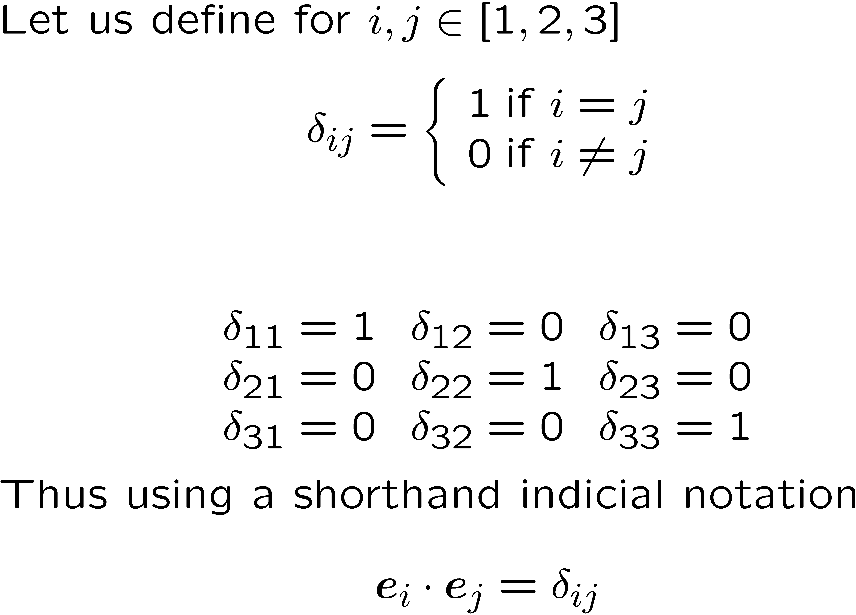
Kronecker delta

Slide 13
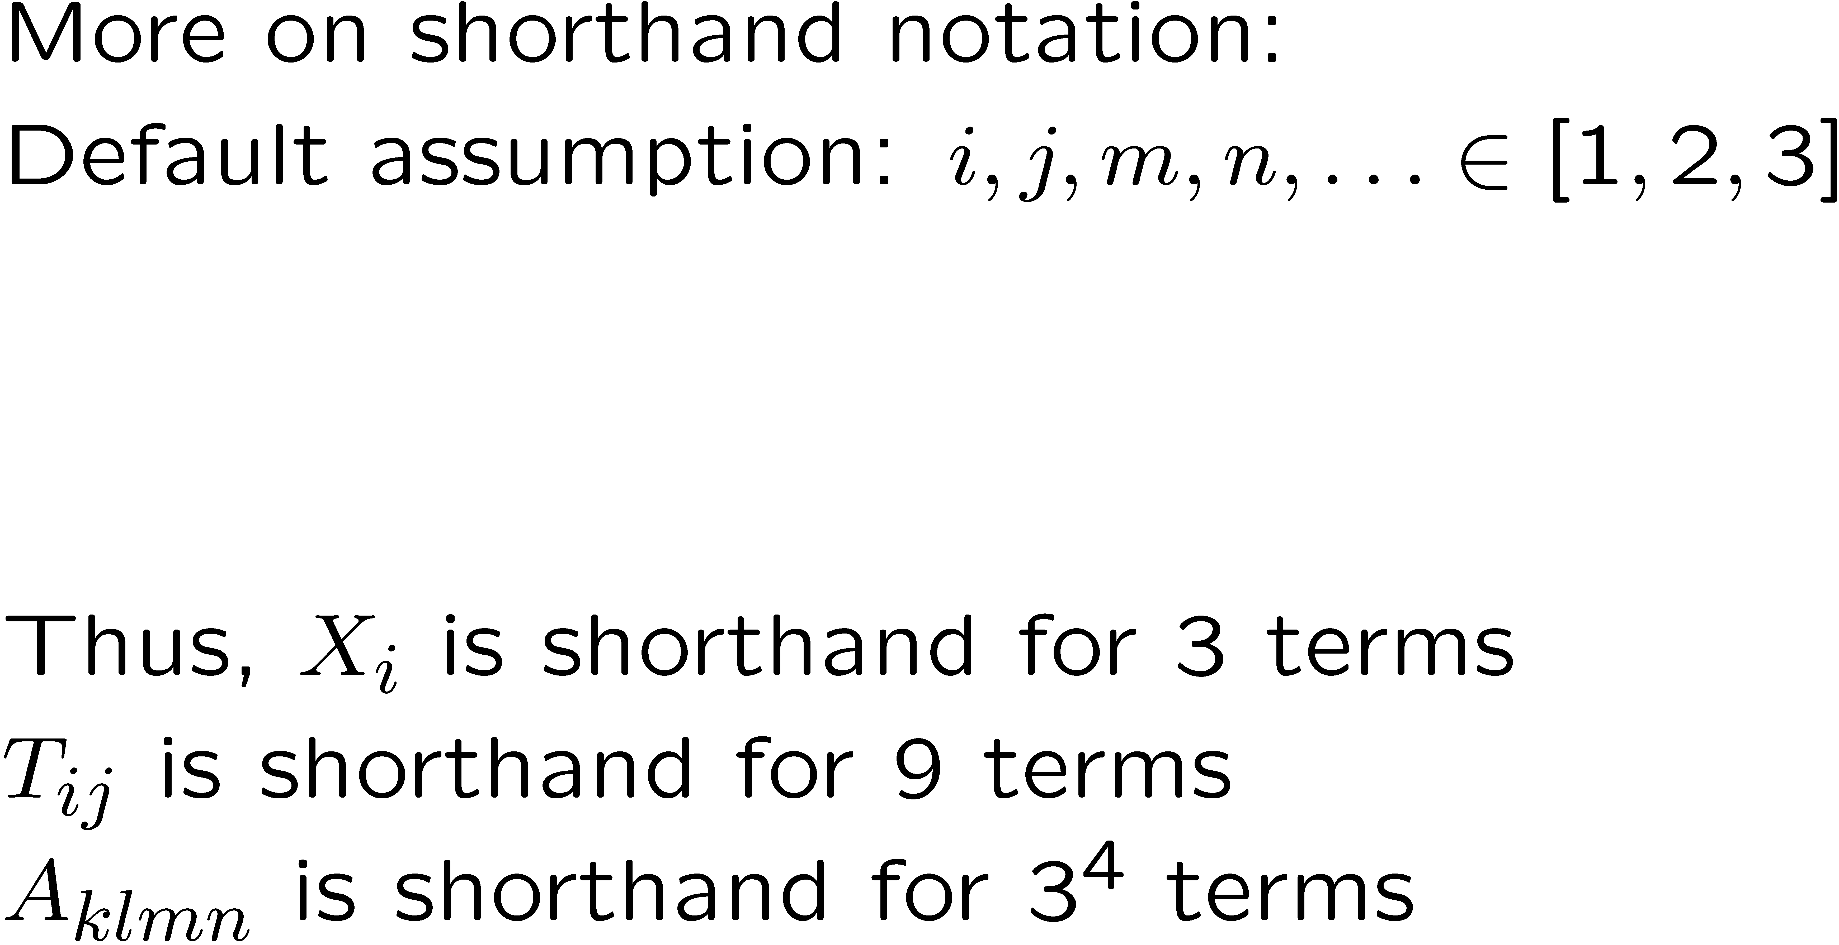

Slide 14
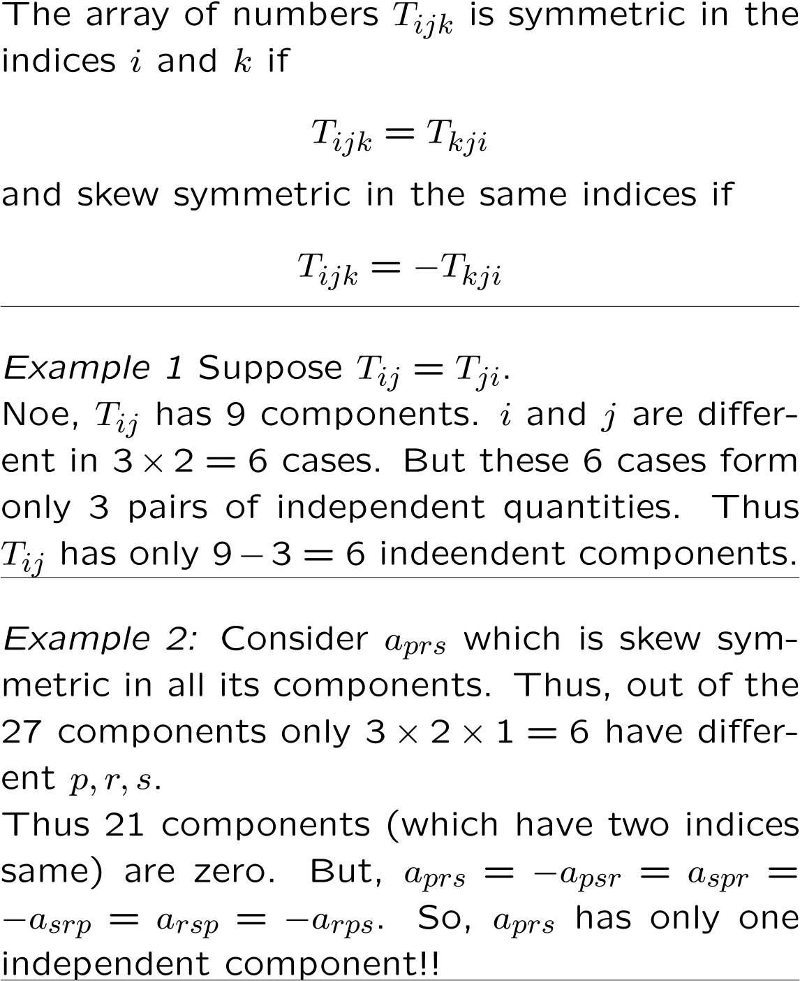
Symmetry and skew-symmetry
Symmery or skew symmetry reduces the number of independent components of the tensor.

Slide 15
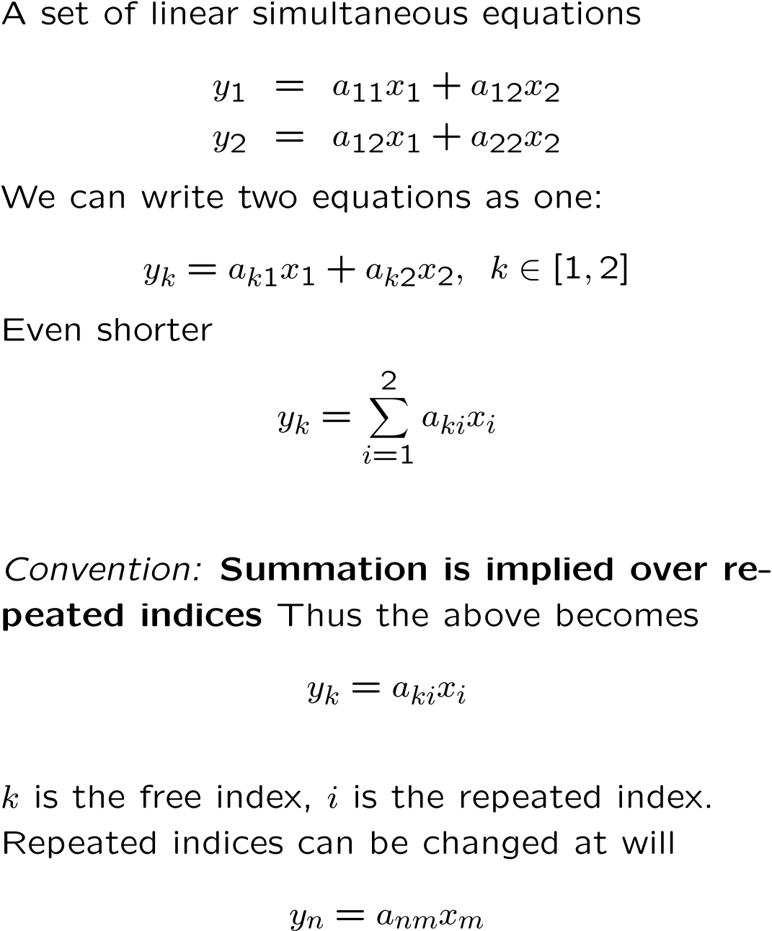
Summation convention
Summation over repeated indices obviates the need to use the summation symbol.

Slide 16
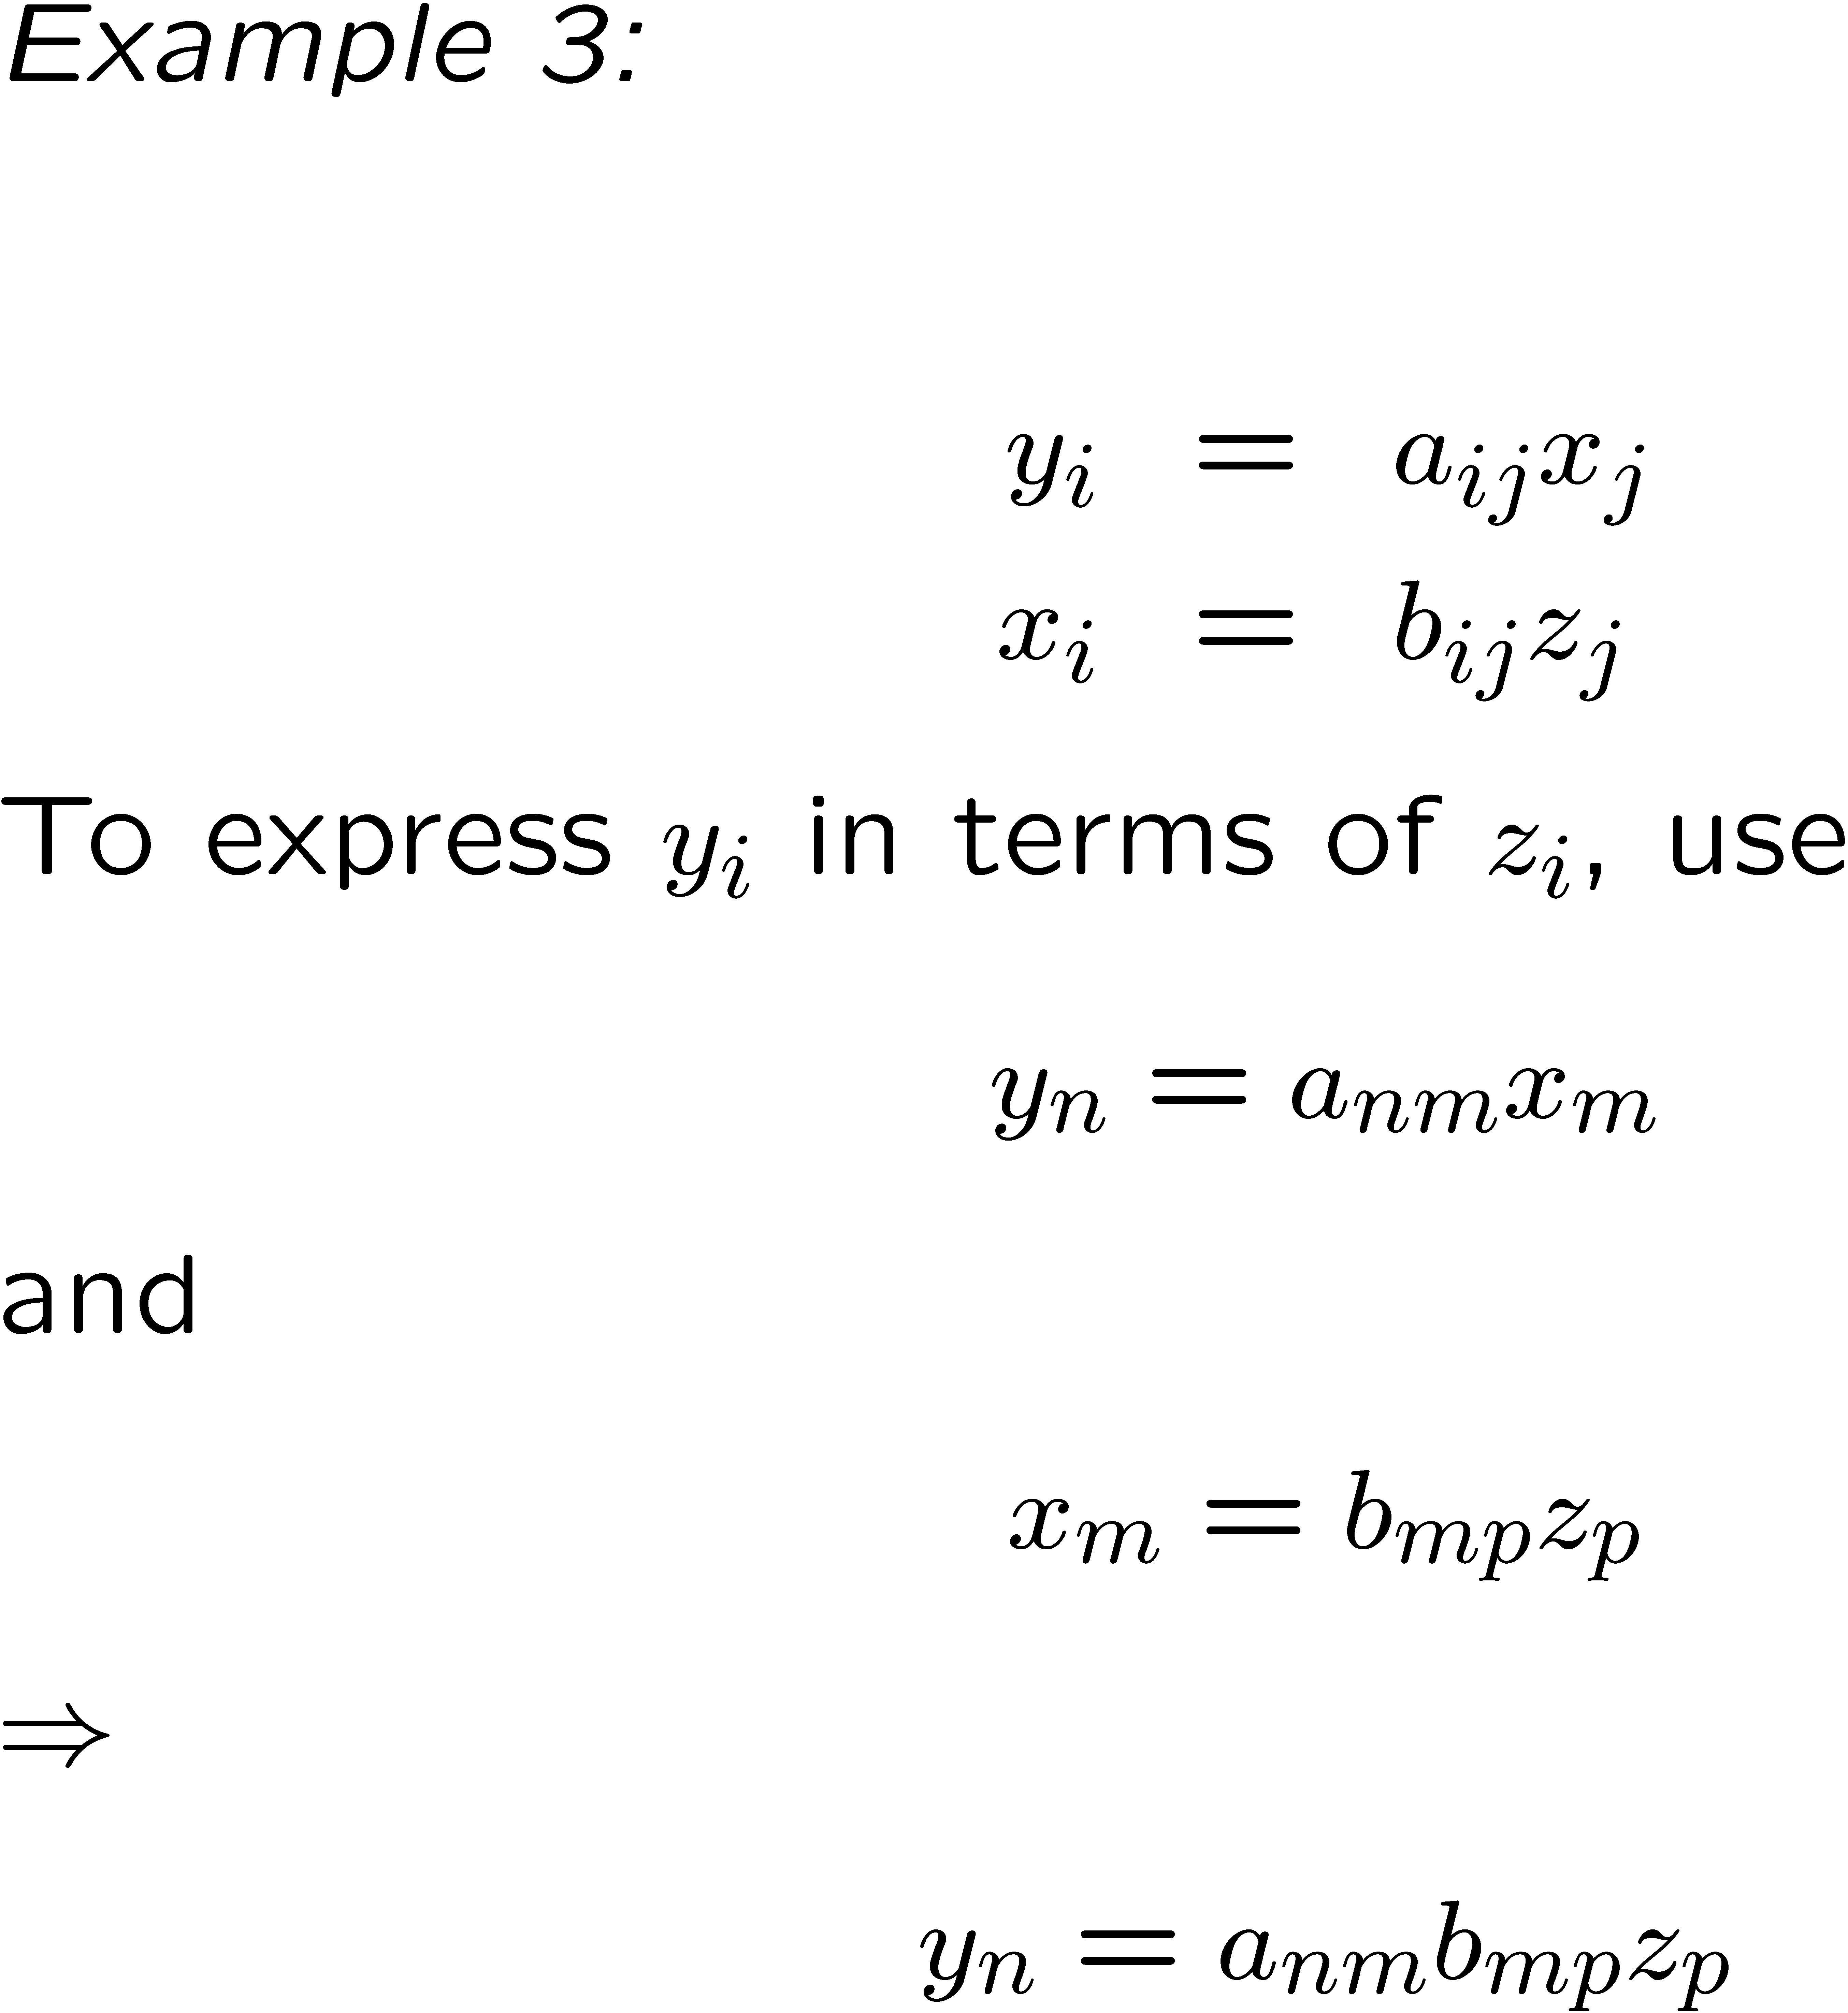
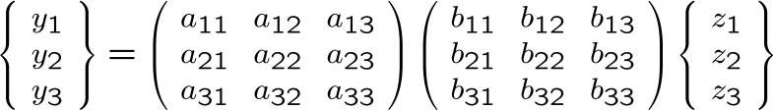
The exercise is equivalent to writing:

Slide 17
Tensor sum
Contraction

Slide 18
Permutation symbol
1
3
2
Permutations
Clockwise: even
Counter clockwise: odd

Slide 20
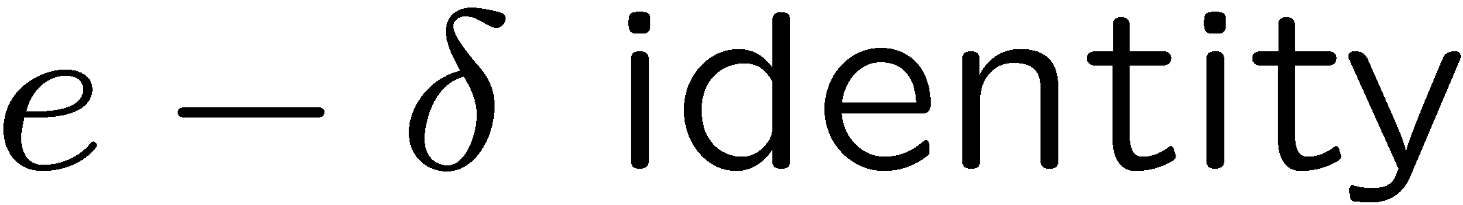
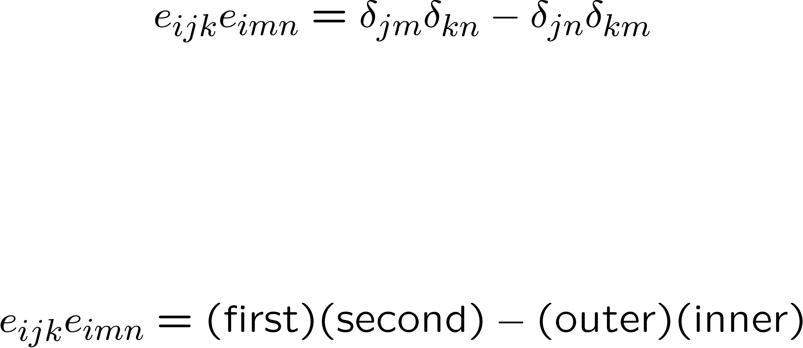
inner
outer
i j k i m n
first
second

