Slide 1
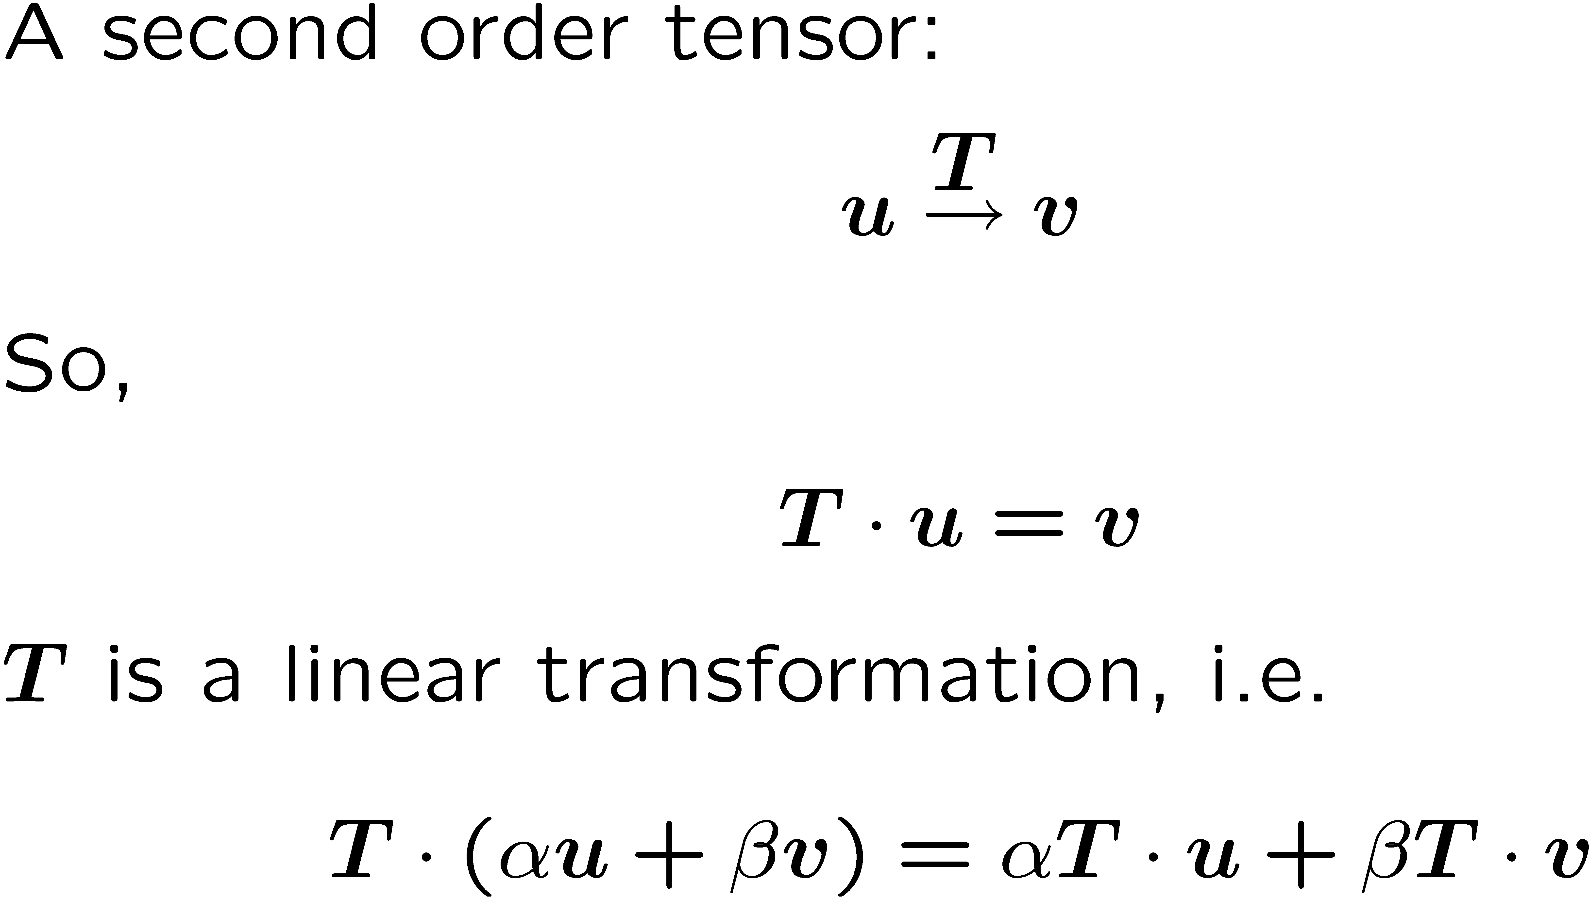
Second order tensors

Slide 2
Components of the second order tensor

Slide 3
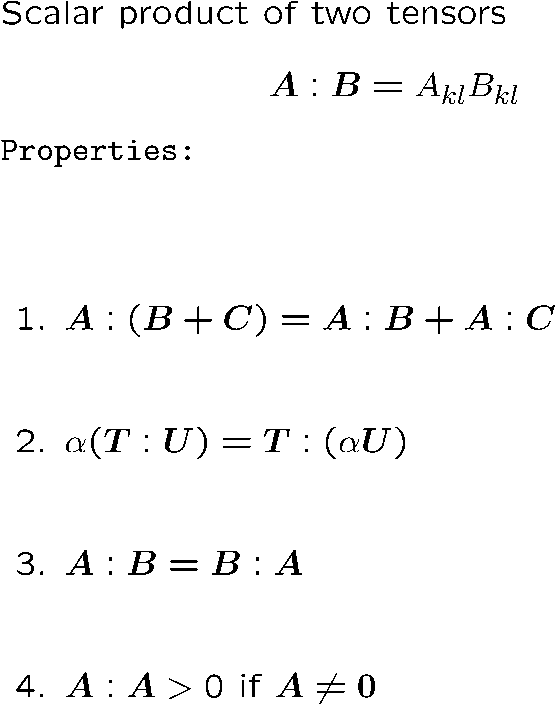
Scalar product of second order Tensors

Slide 4
Dyadic (tensor) product of two vectors

Slide 5
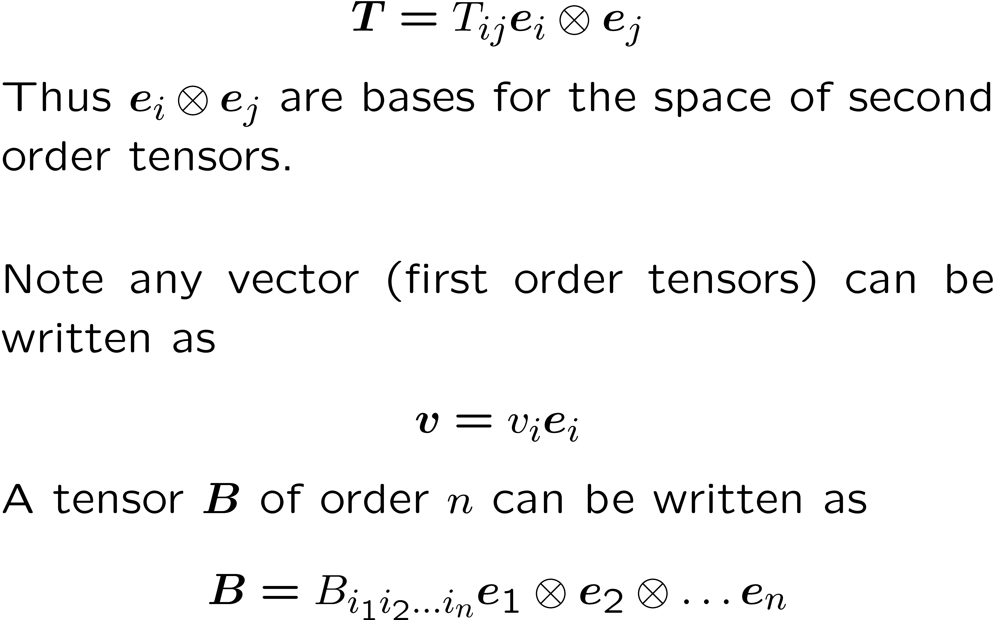
Any second order tensor can be written as:

Slide 6
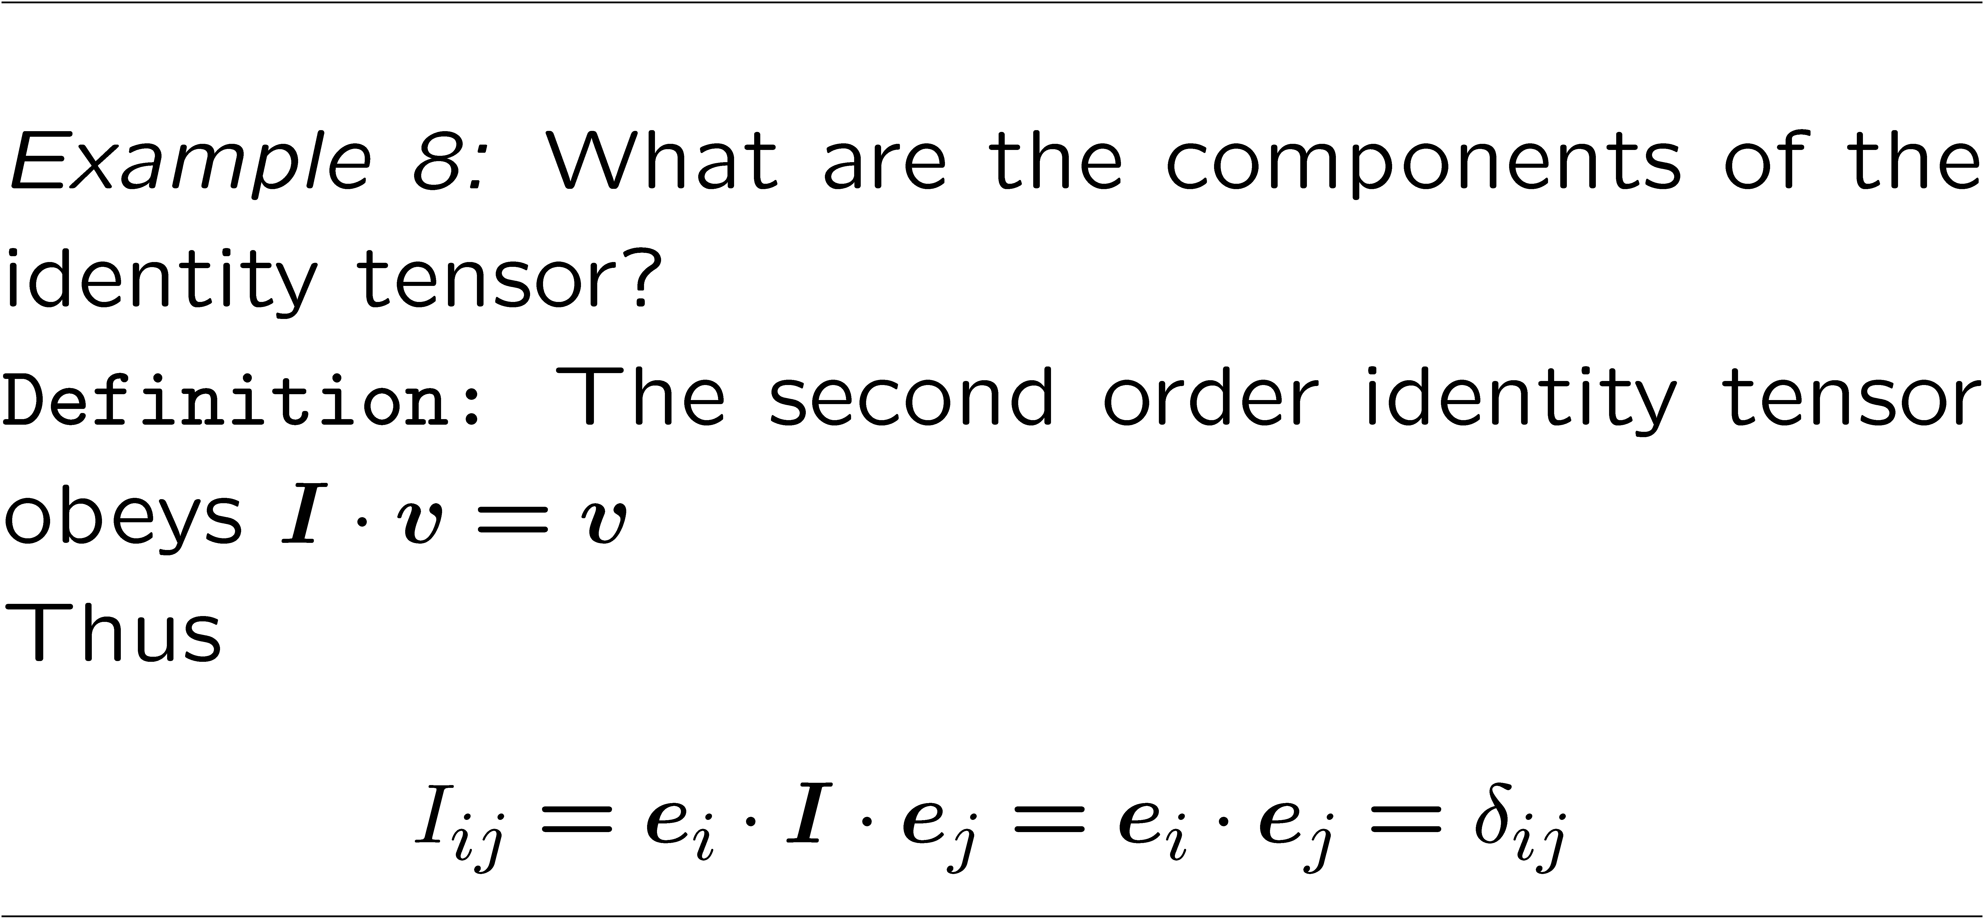

Slide 7



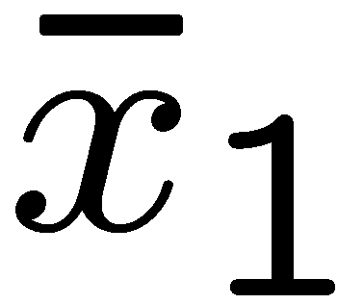
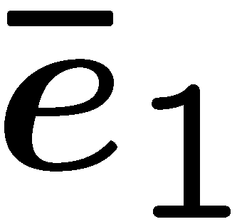
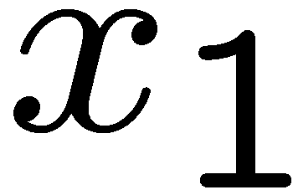

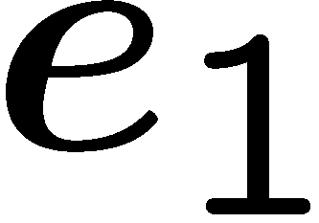

Transformation of vectors and tensors

Slide 8
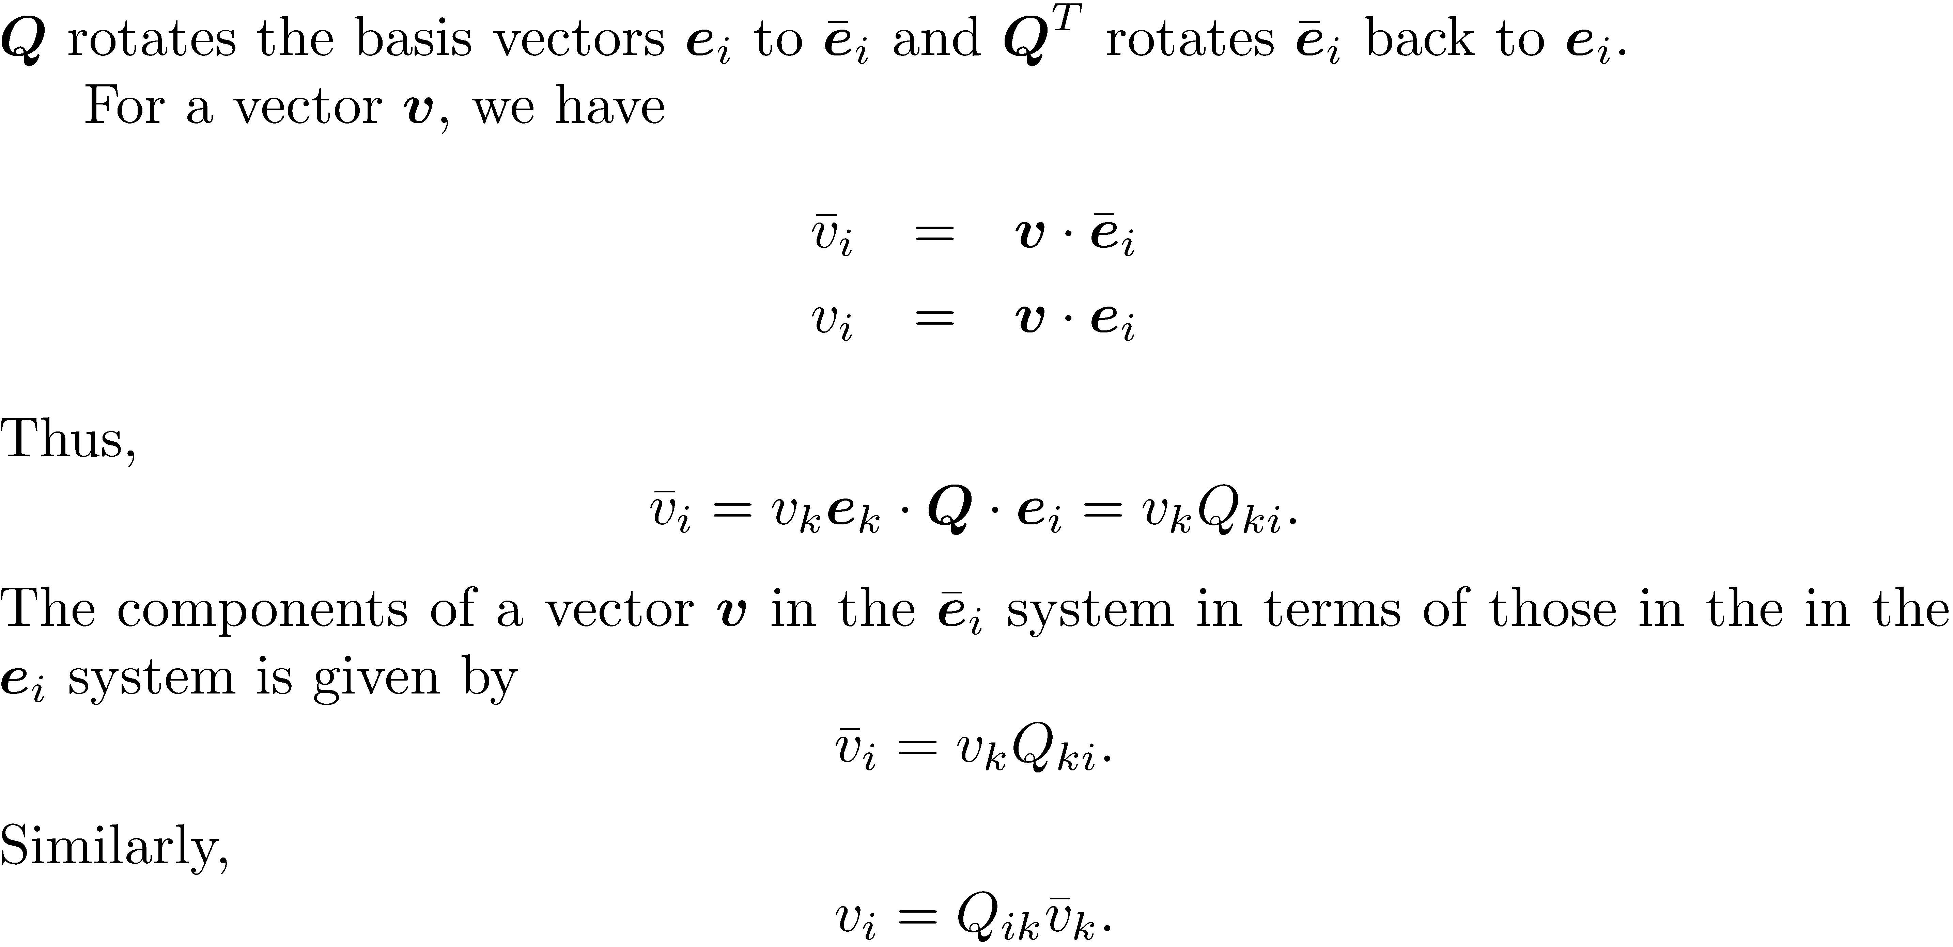
Transformation tensors
Can be done directly by inverting i and k of Q

Slide 9
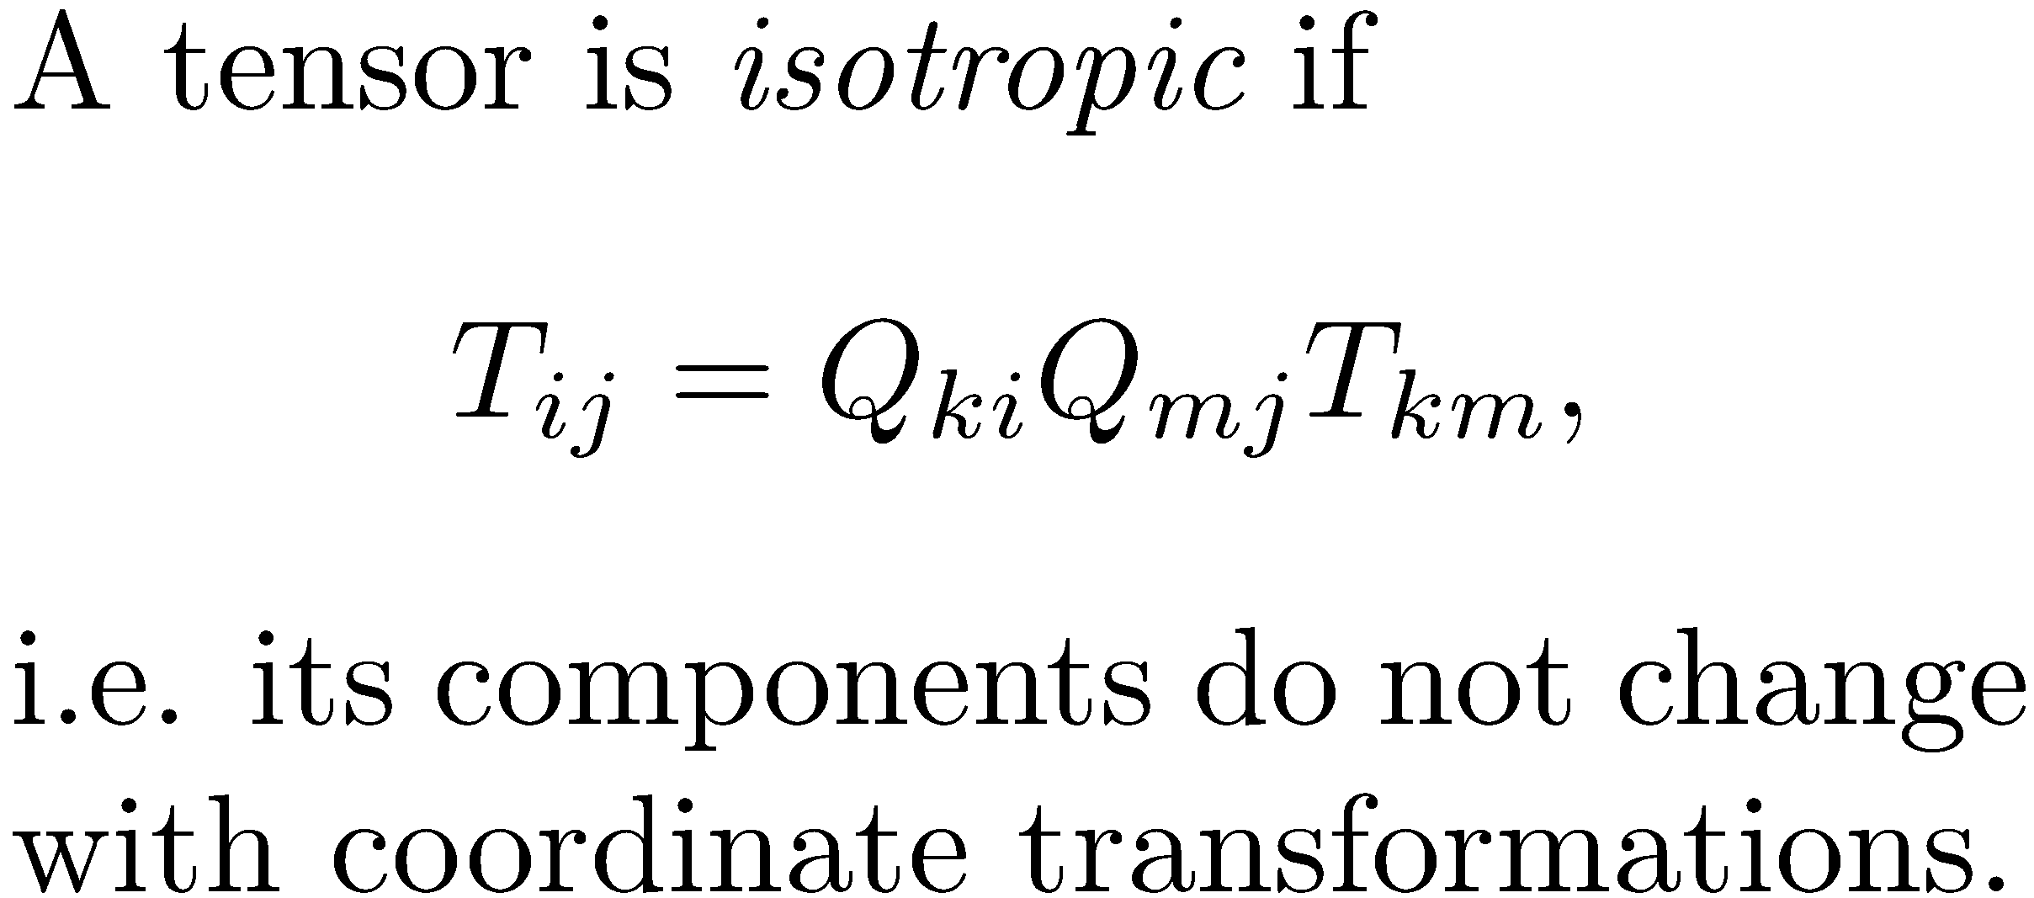

Slide 10
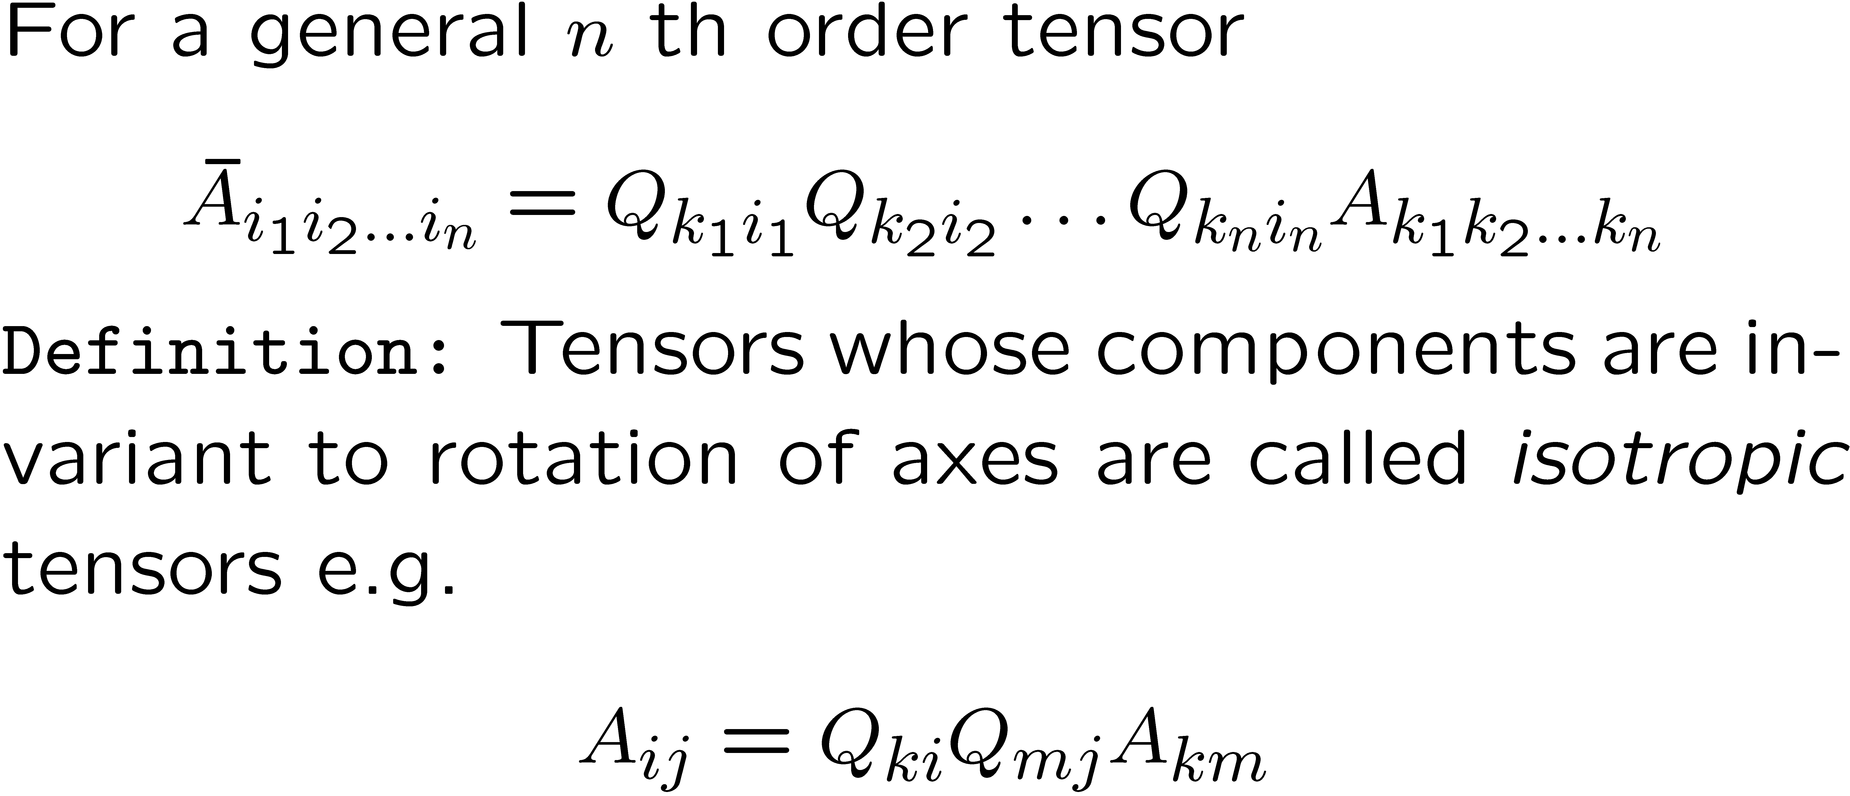

Slide 11
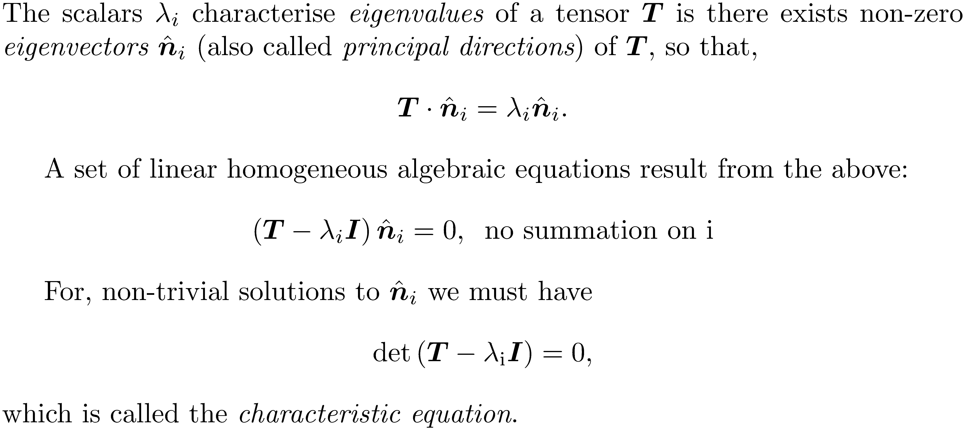
Eigenvalues and eigenvectors of tensors

Slide 12
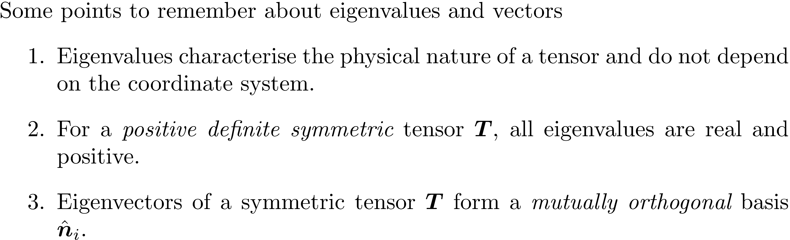
Eigenvalues and eigenvectors (contd.)

Slide 13
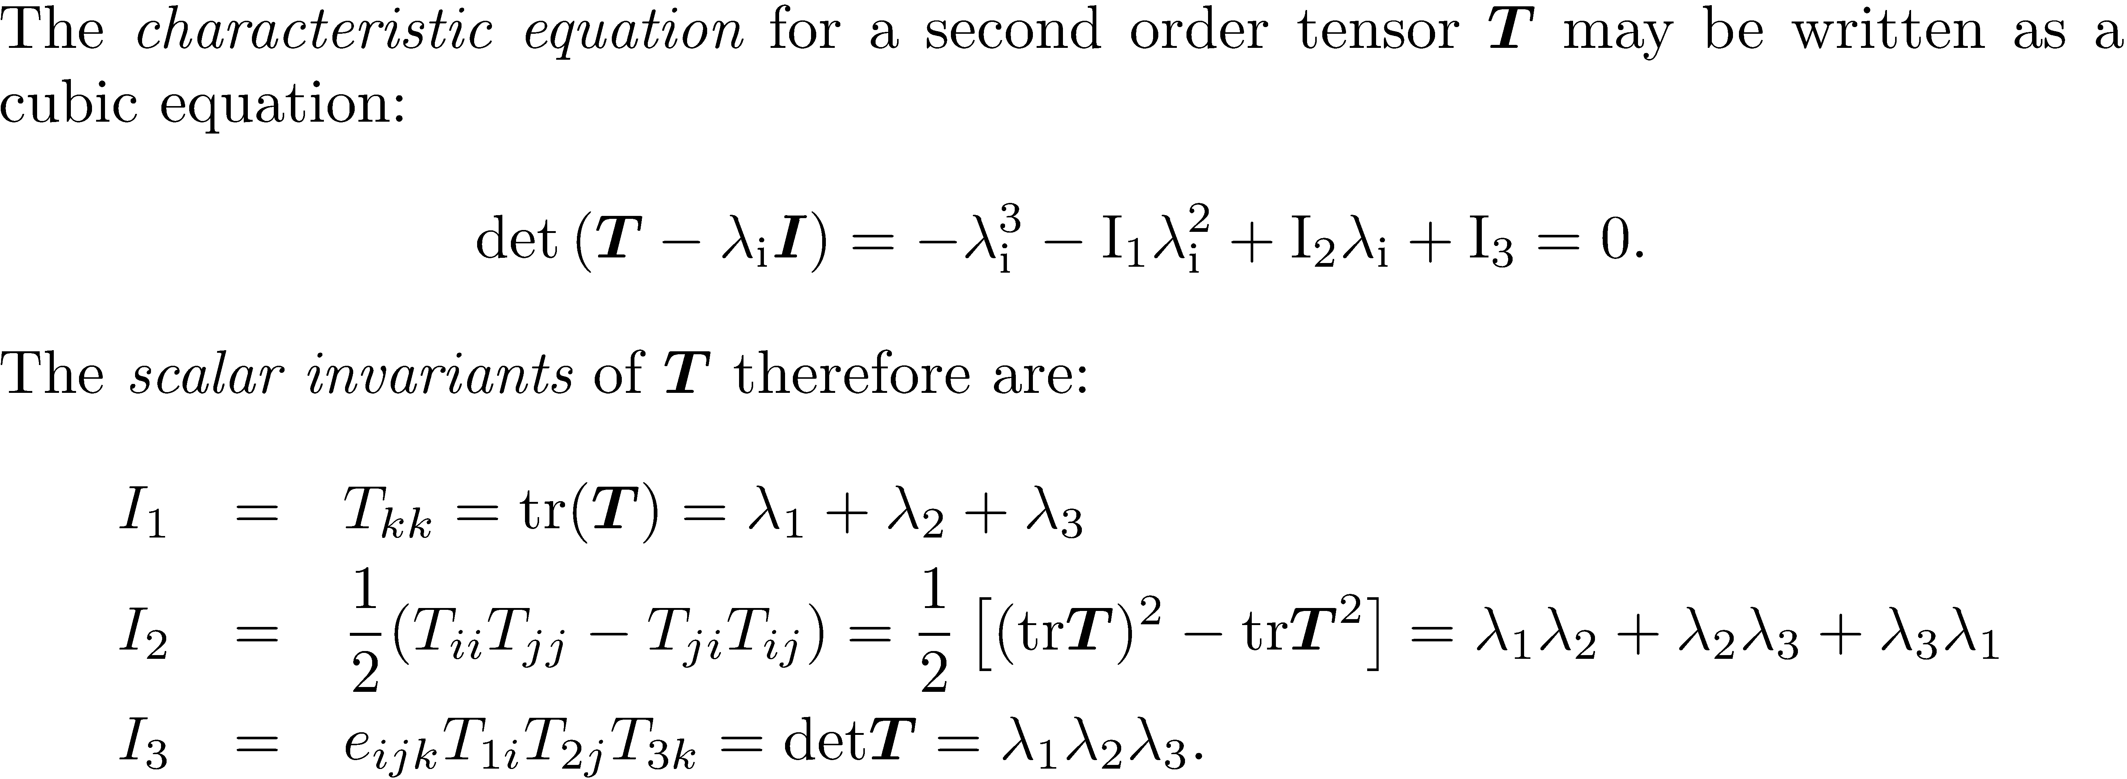
Invariants of a tensor

Slide 14
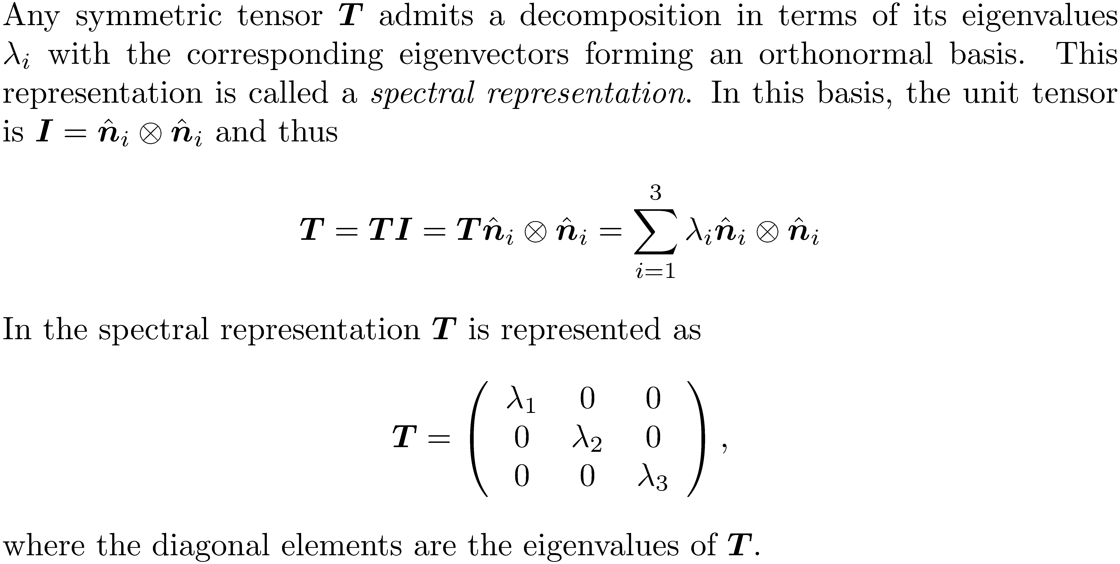
Spectral decomposition

Slide 15
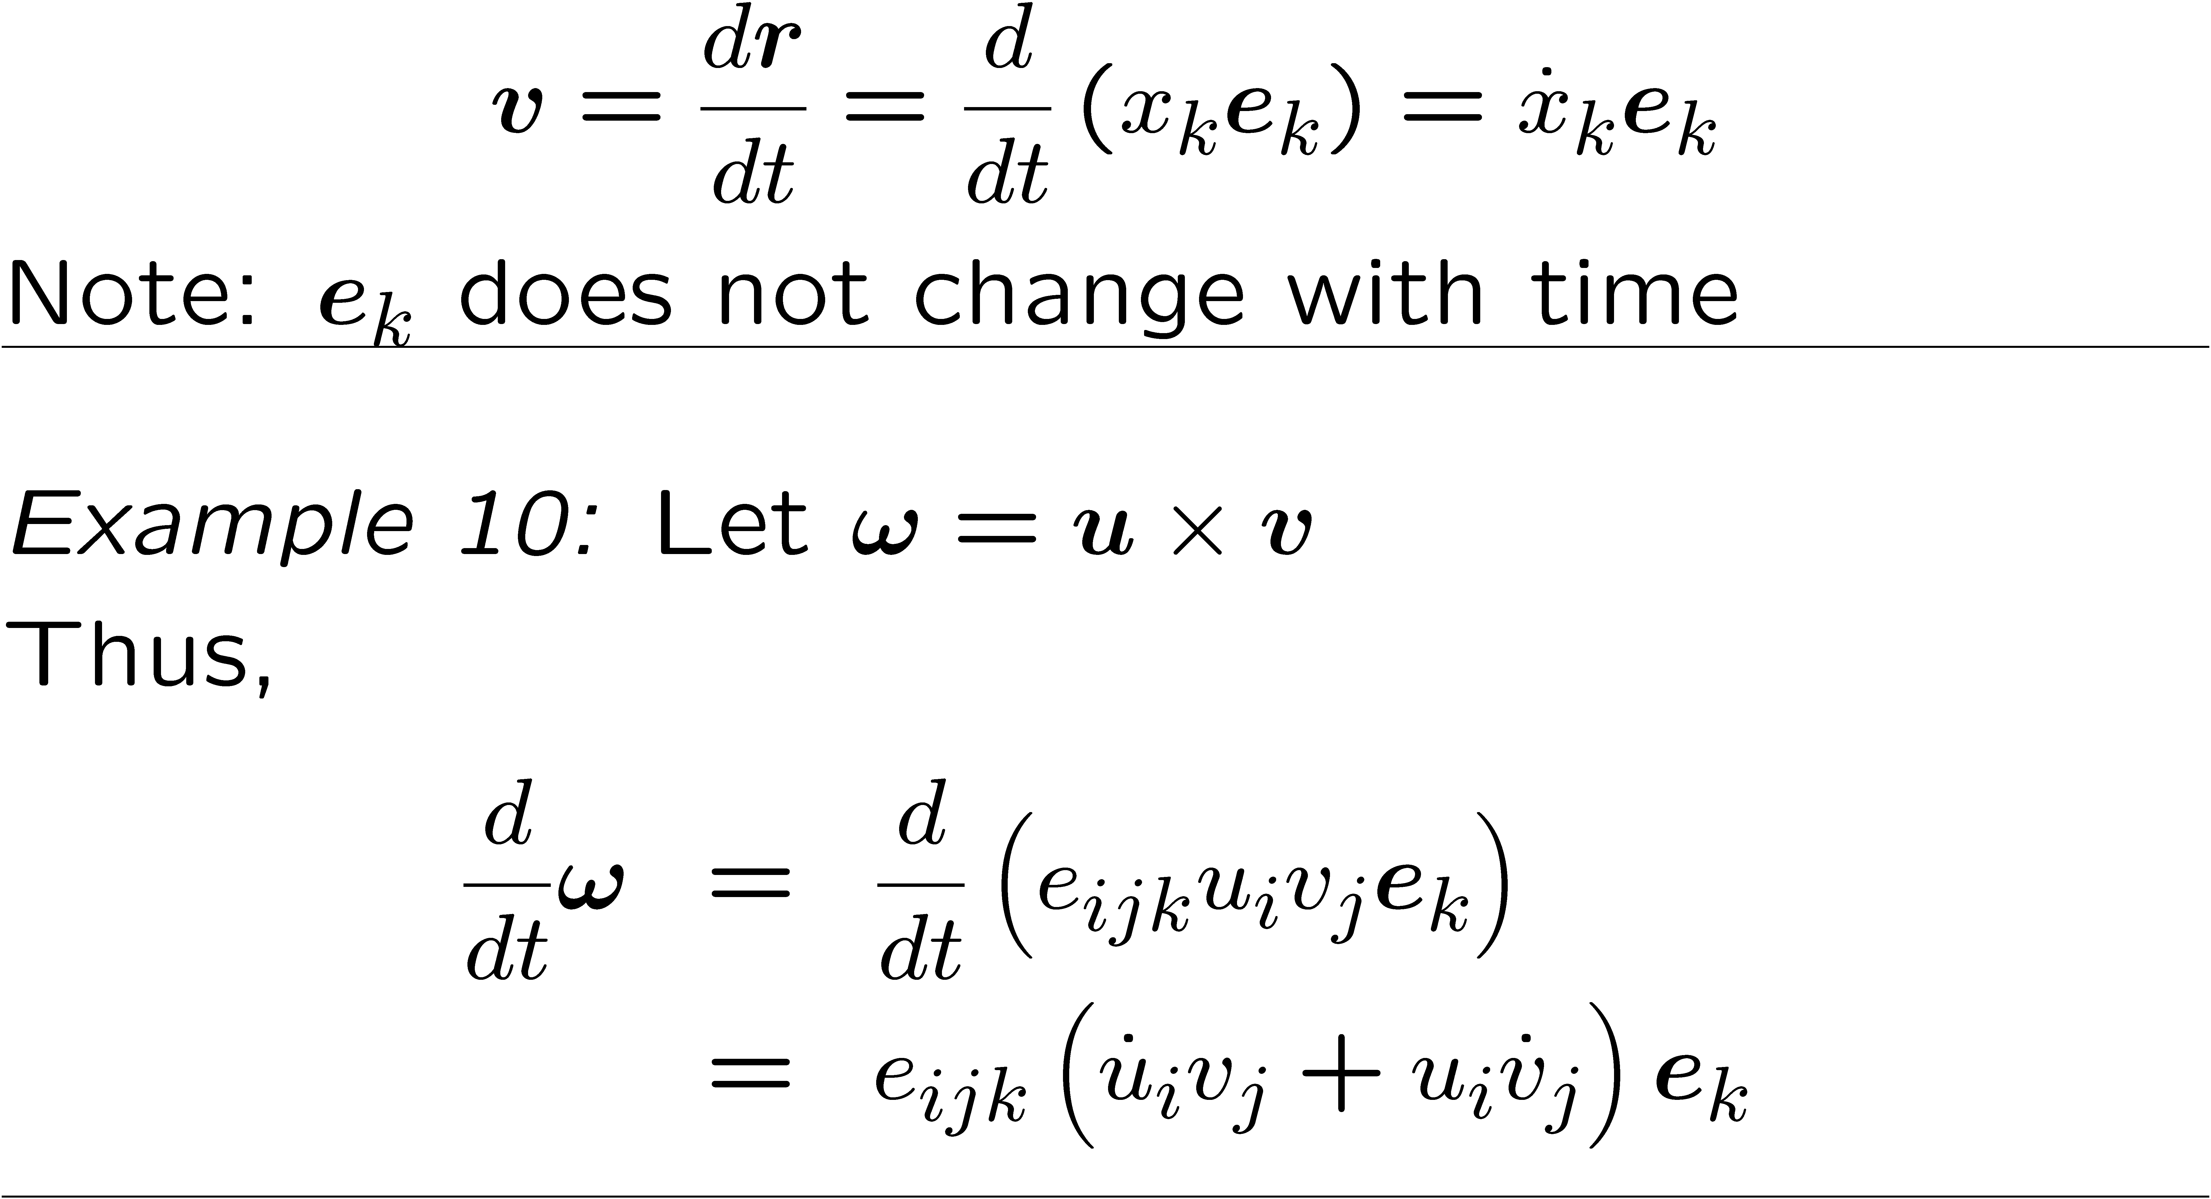
Tensor calculus

Slide 16
Scalar, vector and tensor fields

Slide 17
Symbolic operator

Slide 18
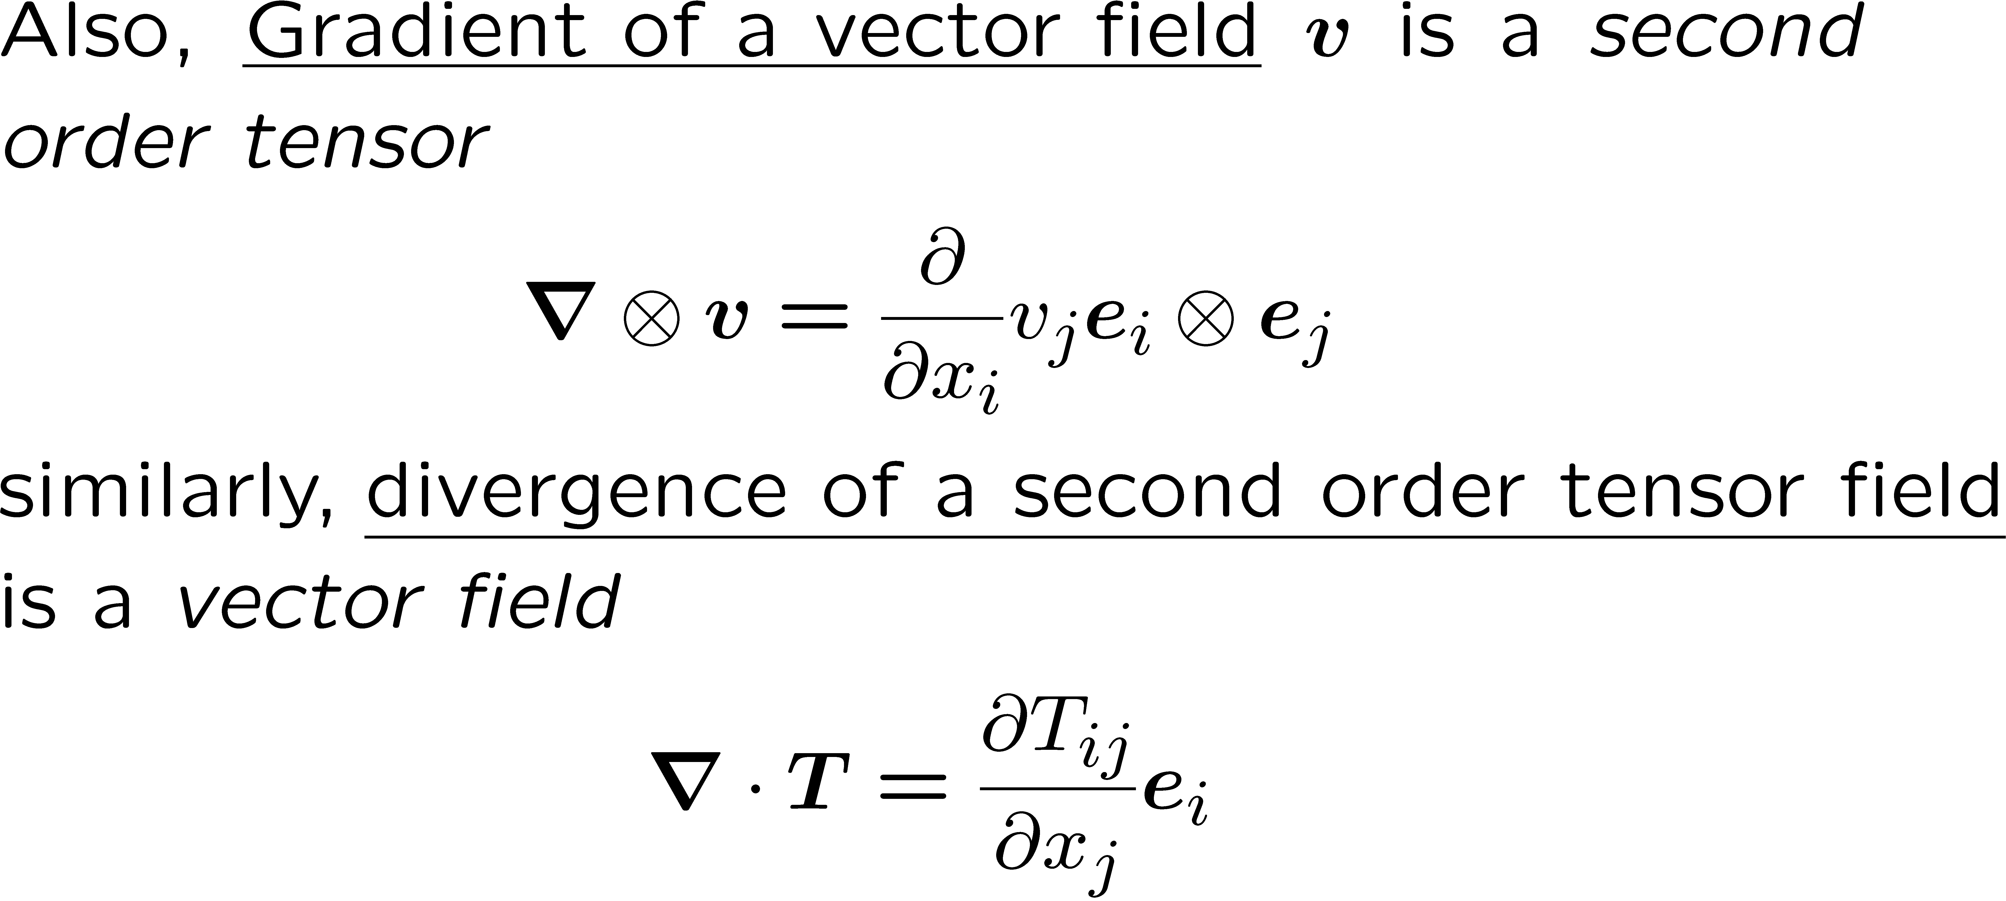

Slide 19
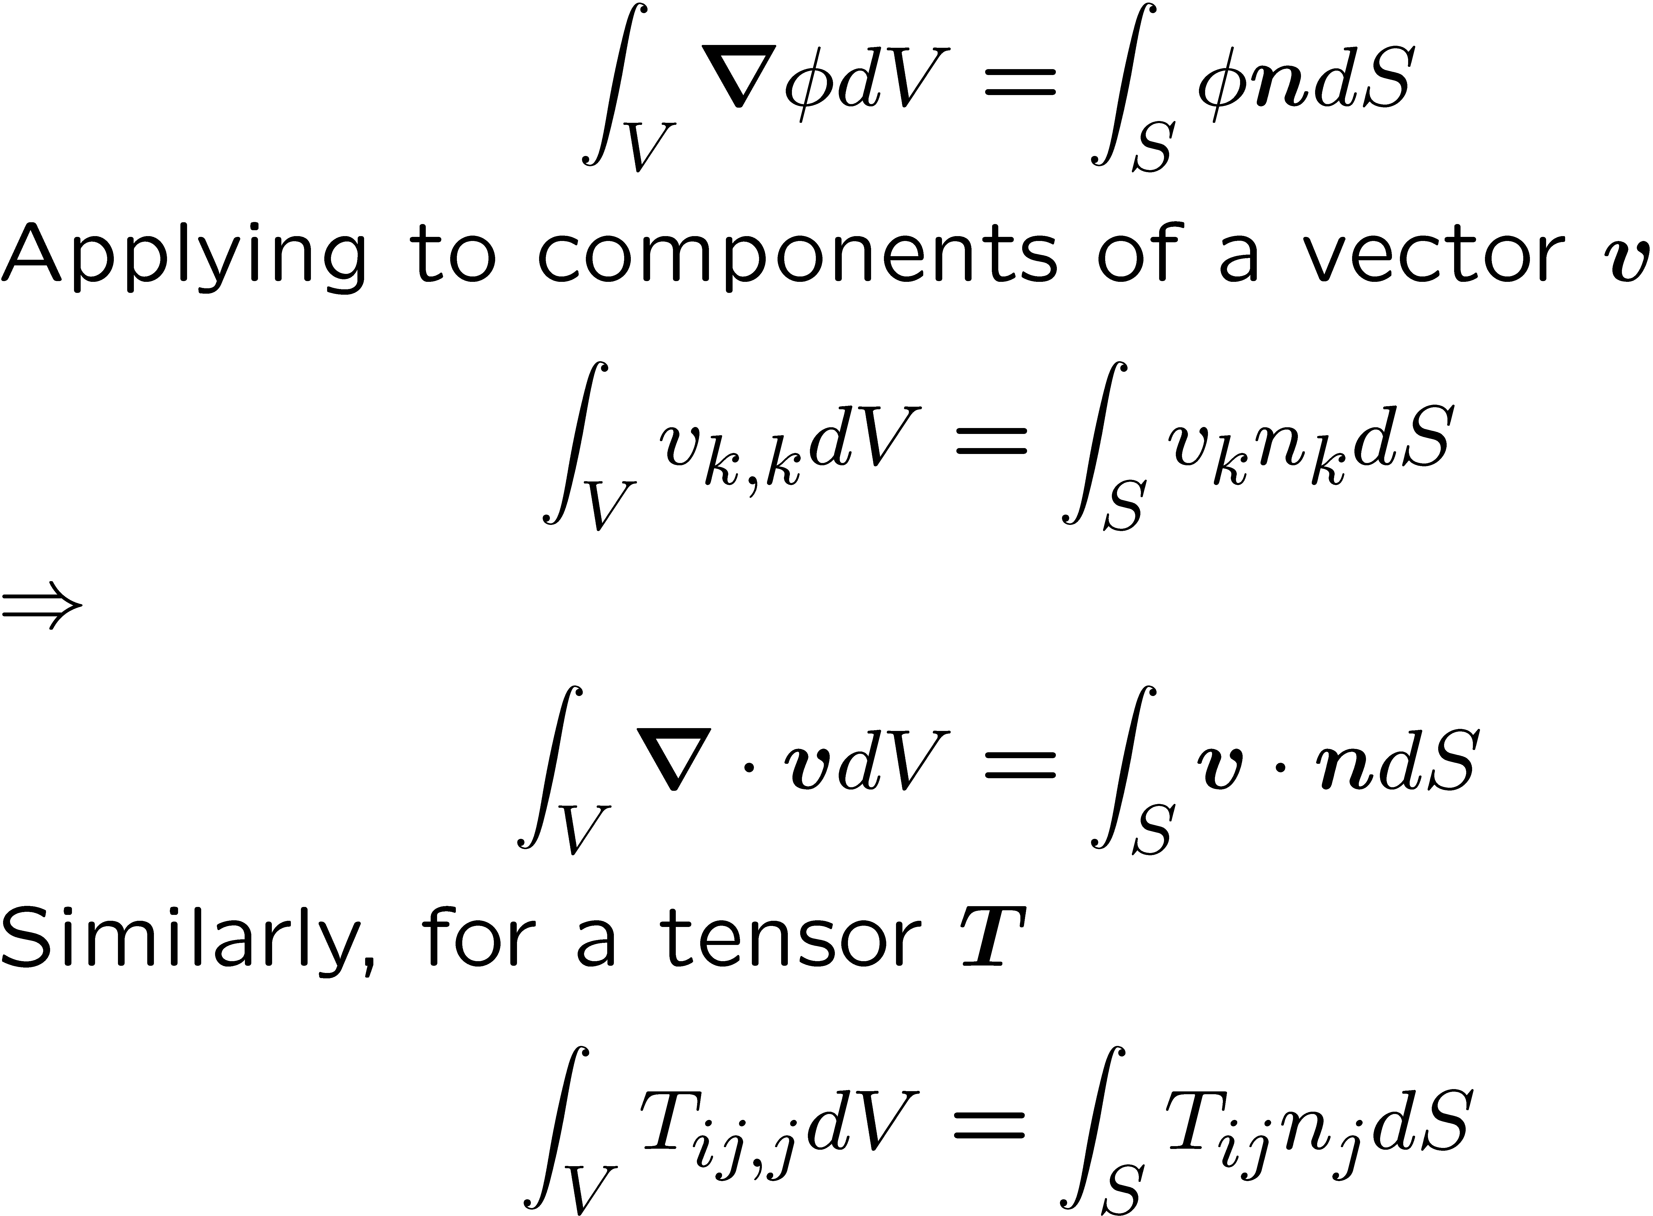
Gauss Divergence theorem
n
V
S

