Slide 1
Conclusion
ESC101: Fundamentals of Computing
Purushottam Kar

Slide 2
Working in Linux Environment
Can store your stuff in files
File names have extensions telling us what kind of a file it is
Files that store C programs often have names that end with .c for example hello.c, pointers.c etc
Files that store images often have names that end with .jpg or .png or .bmp
Files that store videos often have names that end with .avi or .mp4
Files that store PHP programs (another language) end with .php
Files that store SQL commands (another language) end with .sql
.c, .jpg, .avi, .php are the extensions that tell us what that file stores
Files arranged in folders/directories
Directories can contain files as well as other directories
Directories are used to organize your files neatly

Slide 3
Moving Around Directories
pwd (print working directory) – print name of the directory you are currently sitting inside
ls (list) – print all files and directories inside current directory
ls -al (list all with nice list format) – same as ls but with more details and a more neat format
cd <dirname> (change directory) – move to the directory with name dirname
cd .. (change to parent directory) – move to the directory that contains the current directory
cd ~ (jump to home directory) – jump directly to home directory no matter what the current working directory

Slide 4
Directories and Files
mkdir <newdir> (make directory) create a directory with name newdir. Make sure a directory with this name does not already exist
rmdir <olddir> (remove directory) delete the directory with name olddir. Make sure olddir exists and is empty (i.e. does not contain any files or folders)
You can create .c files using your favorite editor e.g. gedit, vi, emacs, vim, nano, kate etc
rm <filename> remove the file with name filename
rm –r <dirname> remove the directory dirname (and all that it contains), recursively, even if the directory is not empty. WARNING: use with care.

Slide 5
Creating and Running C programs
Write C programs exactly as we did on Prutor
Have to work with the gcc compiler now (unless you install the clang compiler yourself)
Warning: gcc does not give as helpful warning messages
Some differences may exist between gcc and clang
Major difference: need to give output after running code (in Prutor, input was given before executing code)
Your microprocessor cannot run C programs directly. It can only run what is known as an executable file

Slide 6
Compilation and Execution
Suppose your C program is in the file test.c
To compile the C program type gcc test.c
It will create an executable file called a.out
Can execute that file by typing ./a.out
If you want to give the executable a nice name, use the following command gcc –o myname test.c
An executable called myname will get created
Can execute that file by typing ./myname

Slide 7
C files and Executable Files
#include <stdio.h>
int main(){
int a = 2, b = 3, c;
c = a + b;
printf("%d\n", c);
return 0;
}
400526: 55 push %rbp
400527: 48 89 e5 mov %rsp,%rbp
40052a: 48 83 ec 10 sub $0x10,%rsp
40052e: c7 45 f4 02 00 00 00 movl $0x2,-0xc(%rbp) ; Mr C is doing a = 2 here (in hexadecimal)
400535: c7 45 f8 03 00 00 00 movl $0x3,-0x8(%rbp) ; Mr C is doing b = 3 here (in hexadecimal)
40053c: 8b 55 f4 mov -0xc(%rbp),%edx
40053f: 8b 45 f8 mov -0x8(%rbp),%eax
400542: 01 d0 add %edx,%eax ; Mr C is doing c = a + b here
400544: 89 45 fc mov %eax,-0x4(%rbp)
400547: 8b 45 fc mov -0x4(%rbp),%eax
40054a: 89 c6 mov %eax,%esi
40054c: bf f4 05 40 00 mov $0x4005f4,%edi
400551: b8 00 00 00 00 mov $0x0,%eax
400556: e8 a5 fe ff ff callq 400400 <printf@plt> ; Mr C is calling the printf function here
40055b: b8 00 00 00 00 mov $0x0,%eax
400560: c9 leaveq
400561: c3 retq
400562: 66 2e 0f 1f 84 00 00 nopw %cs:0x0(%rax,%rax,1)
400569: 00 00 00
40056c: 0f 1f 40 00 nopl 0x0(%rax)
Your microprocessor cannot execute a C program so I convert your C program to an executable
On the right is a more human readable version of the executable file corresponding to the C program

Slide 8
Linux and Windows
On Linux systems, gcc compiler will always be available
Can install clang too if you own that machine
On Windows, can install gcc via the Cygwin or the MinGW routes
https://sourceforge.net/projects/tdm-gcc/
Can install Clang on Windows too
http://releases.llvm.org/download.html
However, easier to install Visual Studio on Windows
https://visualstudio.microsoft.com/vs/community/

Slide 9
Pursue your Interest
If interested in problem solving – take up competitive programming
https://www.hackerrank.com/
https://leetcode.com/
https://www.codechef.com/
https://www.geeksforgeeks.org/
http://codeforces.com/
Many application areas require heavy programming
Fluid dynamics (AE, CHE), Particle accelerators (PHY), Data Analysis (MTH, CSE), Wireless communications (EE), Optimization (IME, ECO, MTH, CSE)
Several applications within CSE
Architecture, Operating Systems, Compilers, Theory, Algorithm Design, Databases, Web Programming, Machine Learning and AI, and many more

Slide 10
There is no Mr C ☺
We introduced the character of Mr C to make the discussion fun and engaging – no Mr C in reality
When we said Mr C, some times we were referring to the compiler, sometimes the runtime environment, and sometimes the Prutor application
Please use the term “compiler” from now on. People will not understand you if you keep referring to Mr C
Also, no clones of Mr C are born when functions get called
When functions are invoked, the control gets passed from one function to another along with arguments as input

Slide 11
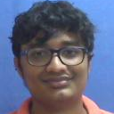
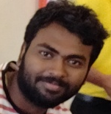
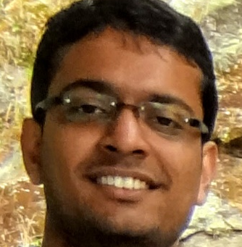
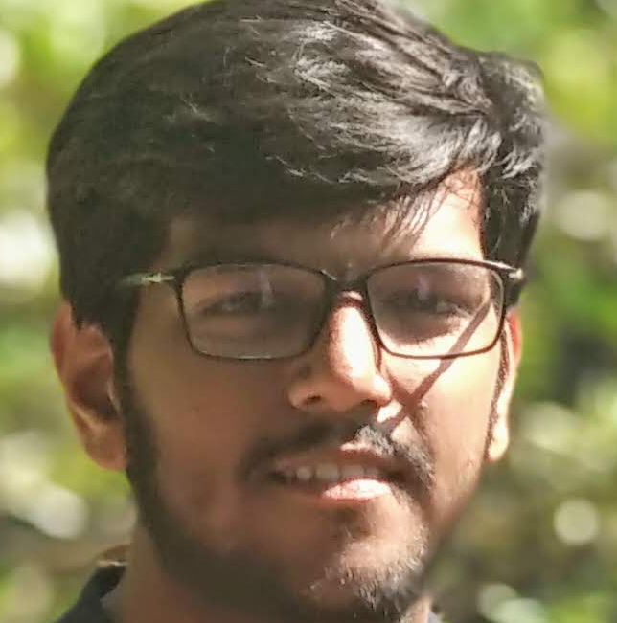
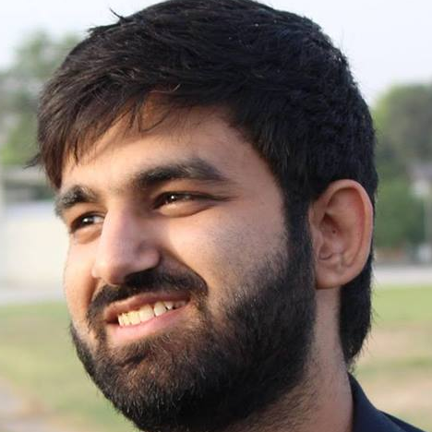
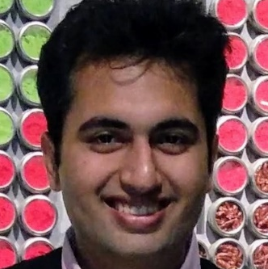
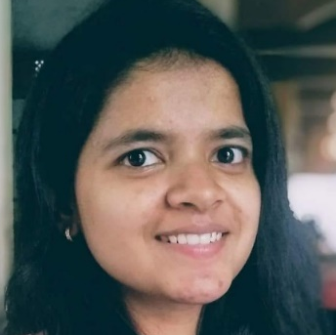
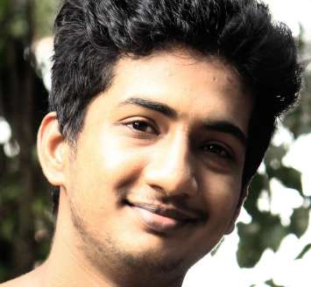
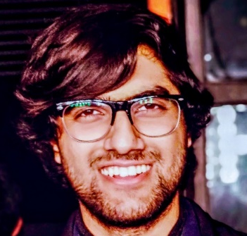
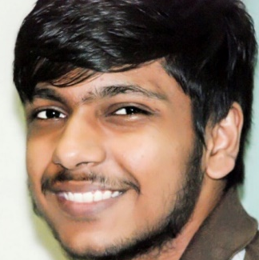

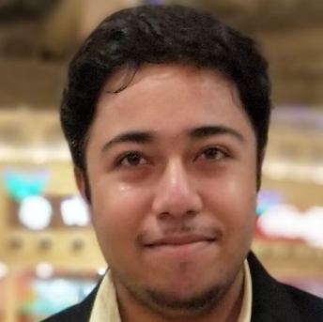

Acknowledgements - Tutors
Abhibhav Garg
Abhisek Panda
Ankit Jalan
Ayush Tulsyan
Kunal Kapila
Massand Sagar Sunil
Nikita Awasthi
Paramkusam Niranjan
Parth Sharma
Prakhar Agarwal
Sanket Gandhi
Shashank Shekhar
Siddharth Mittal

Slide 12
Acknowledgements – TAs
THEORY TAs
AMIT CHANDAK
AVIDEEP MUKHERJEE
DESAI ANERI HIREN
DIXIT KUMAR
GOURAV TAKHAR
NIRJHAR ROY
PANKAJ SIWAN
PRAFULLA SAXENA
PRATEEK DWIVEDI
RAHUL SHARMA
SOUMYA BANERJEE
VIKAS MAURYA
WASEEM AKRAM
LAB TAs
ABHISHEK GUPTA
ABHISHEK KUMAR
ADITYA JAIN
AMIT KUMAR
ANKIT KUMAR
ANKIT SHARMA
ANKUR
APPU B
ARUNKUMAR VEDIAPPAN
ASHISH PAL
AVIJIT ROY
BIDYA SARKAR
DARSHAK CHHATBAR
DARSHIT SHAILESH VAKIL
DEEPAK YADAV
DEEPAK YADAV
HARIKRISHNAN BALAGOPAL
HARIOM
HARSHIT GUPTA
HEMANT PARIHAR
HIMANSHU SARAIYA
HIMANSHU SINGLA
I G PRASAD
JATIN ASWAL
JATIN DEV
JIMMY KUMAR
KAPIL KUMAR
KULDEEP SAHU
MANISH MAZUMDER
MAYANK RAWAT
MIRIYALA JEEVAN KUMAR
MOHIT MALHOTRA
NAMAN NARANG
NIKHIL SHAGRITHAYA
NITIN VIVEK BHARTI
NITISH MANGESH KALAN
PRABHATH NAMPALLY
PRANJAL JAIN
PRATEEK SAMAIYA
RAHUL KUMAR SINGH
RAJAT
SAGAR
SURAJIT GHOSH

Slide 13
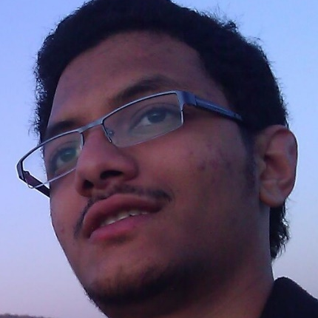
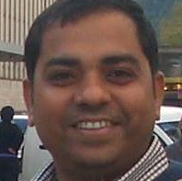
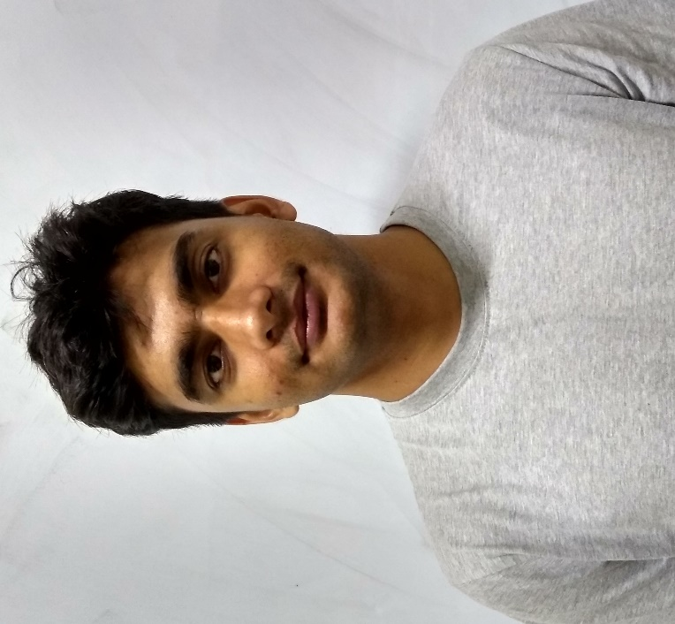
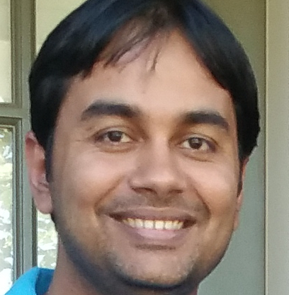
Acknowledgements - Admins
Umair Z. Ahmed
Prof. Amey Karkare
Bhaskar
Mukhoty
Prof. Piyush Rai
Prutor Admin and Co-creator of Prutor
Head CC and Co-creator of Prutor
Workflow Admin
Faculty Tutor

Slide 14
Acknowledgements – Staff Members
CC staff members: Mr Gopesh Tiwari, Mr Soumitri Mishra
NCL staff members: Mr Awanish Kumar
CSE Office staff members: Mr Prashant Kumar Sahu, Mr Rajesh Kumar, Mr Ranjan Kumar, Mr Anubhav Kumar Arya, Mr Amit Kumar Bharti

Slide 15
Acknowlegements
Prutor Team: Prof. Karkare, Umair
Previous instructors: Prof. Sumit Ganguly, Prof. Nitin Saxena, Prof. Amey Karkare, Prof. Indranil Saha, Prof. Nisheeth Srivastava, Prof. Rajat Mittal (Hindi lectures), Prof. Vinay Namboodiri
Material in this offering was based on their material ☺
Piazza Team: helpful for discussions and clearing doubts
Gradescope Team: extremely vital for massive courses

