Slide 1
Serial Peripheral Interface(SPI) Communication Protocol
Notes:
1

Slide 2
Introduction
SPI is synchronous, used for short distance.
Developed by motorola in 1980s.
SPI devices communicate in full duplex mode using a master-slave architecture with a single master
Multiple slaves are supported through selection with individual slave select(SS) lines.
Notes:
2

Slide 3
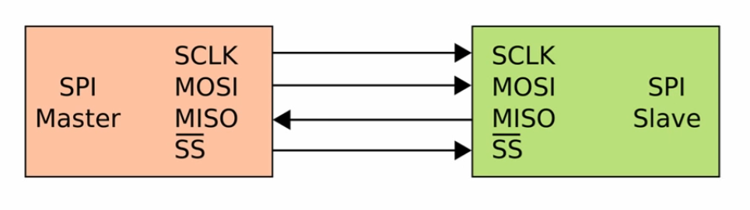
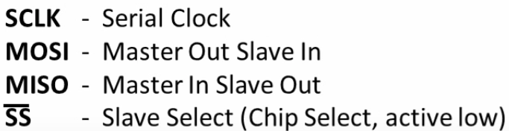
Basics of SPI
Notes:
3

Slide 4
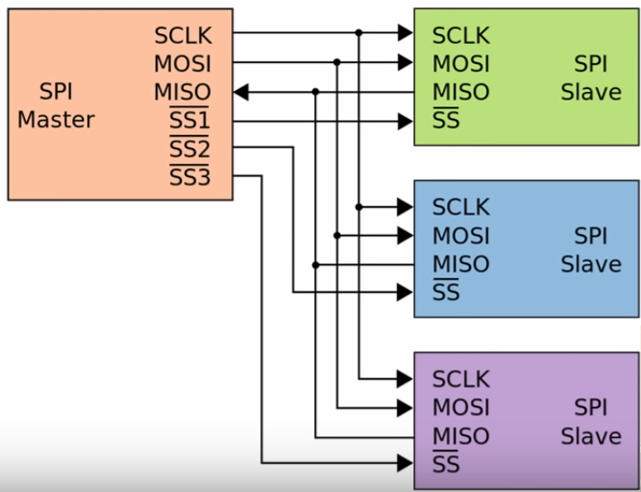
Basics of SPI
Notes:
4

Slide 5
SPI Protocol
Devices communicating via SPI are in a master- slave relationship.
In SPI only one side generates the clock signal.
The side that generates the clock is called “Master” and the other side is called “Slave”.
The Master is the controlling device(usually a uC), while the slave (usually a sensor, display or memory chip) takes instuction from the master
There is always only one master but there can be multiple slaves
Notes:
5

Slide 6
SPI protocol
The master can chooose which slave it wants to communicate to by setting the slave’s CS/SS line to a low voltage level.
In the idle, SS line is kept at a high volatge level
Multiple SS pins may be available on master , which allows for multiple slaves to be wired in parallel
Notes:
6

Slide 7
SPI Protocol
To begin communication, master configures the clock, using the frequency supported by the slave device, typically up to a few Mhz.
Master then selects the slave device with a logic 0 on the select line.
During each SPI clock cycle, a full duplex data transmission occurs.
Notes:
7

Slide 8
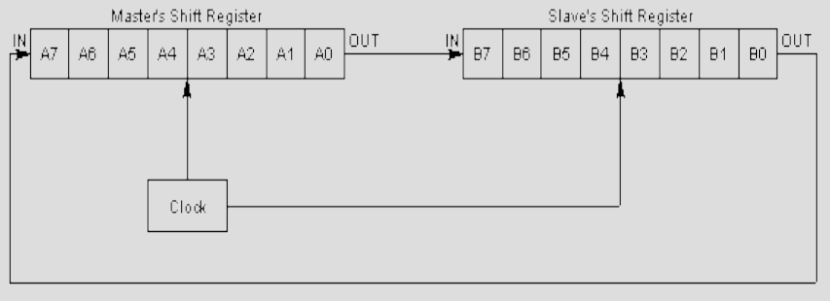
Data Transmission in SPI
Transmissions normally involve two Shift Registers of some given word size, one in the master and one in the slave.
Notes:
8

Slide 9
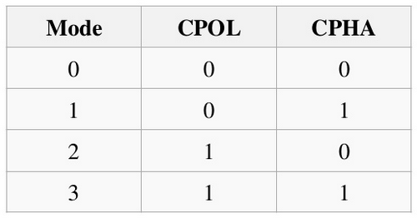
Clock Polarity and Phase
CPOL: Clock polarity -> when this bit is written to one , SCK is high when idle. When CPOL is written to zero , SCK is low when idle
CPHA: Clock Phase -> The settings of the clock phase bit(CPHA) determines if data is sampled on the leading(first) or trailing(last) edge of SCK.
Modes numbers :
Notes:
9

Slide 10
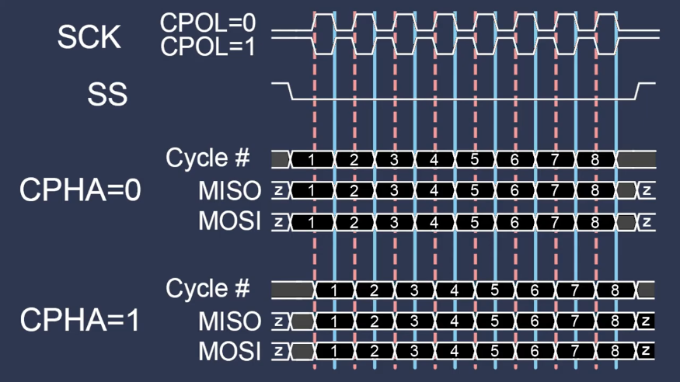
Notes:
10

Slide 11
Advantages
Full duplex
Not limited to any maximum clock speed, enabling potentially high speed.
Not limited to 8-bit words
Slaves do not need a unique address – unlike I2C.
Notes:
11

Slide 12
Disadvantages
Requires more pins
No Hardware slave acknowledgement
No error-checking protocol is defined.
Limited to connecting small distances(upto 0.25m)
Notes:
12

Slide 13
Applications
Sensors: temperature, pressure
Control devices: audio codecs, DAC
Memory: flash and EEPROM
LCD, sometimes even for managing image data
Any MMC or SD card
Notes:
13

Slide 14
SPI support in Raspberry pi board

Slide 15
SPI protocol in raspberry pi board
The BCM2835 core common to all Raspberry Pi devices has 3 SPI Controllers:
SPI0, with two hardware chip selects, is available on the header of all Pis.
SPI1, with three hardware chip selects, is available on 40-pin versions of Pis.
SPI2, also with three hardware chip selects, is only usable on a Compute Module because the pins aren't brought out onto the 40-pin header.
Notes:
15

Slide 16
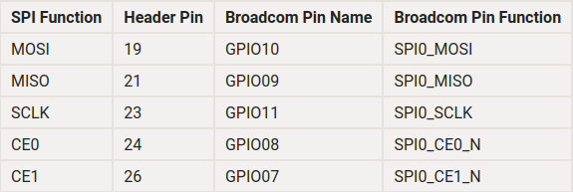
SPI protocol in rasperry pi board
Notes:
16

Slide 17
Configuring SPI
Installing Kernel Support (with Raspi-Config)

Slide 18
SPI protocol in pi board(Software)
The default Linux driver is now the standard spi-bcm2835.
SPI0 is disabled by default.
Run “sudo raspi-config” command to enable SPI0
Notes:
18

Slide 19
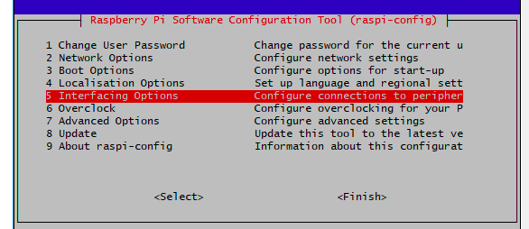
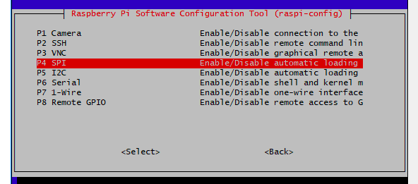
raspi-config
Notes:
19

Slide 20
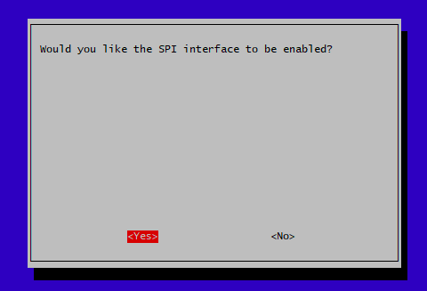
raspi-config
After the above steps, reboot your Pi to make the SPI interface appear
To see the devices use command “ls -l ​/dev/spidev*”
Notes:
20

Slide 21
API’s for SPI driver Implementation

Slide 22
Flowchart
Userspace app /dev/spidev
User space
Spi slave driver
SPI core
Spi master controller driver
Kernel space
SCLK MOSI SPI Master MISO SS
SCLK MOSI BMP280 MISO SS
Notes:
22

Slide 23
Important structures to implement SPI slave driver
Struct spi_device
Struct spi_driver
Struct spi_device _id
struct spi_transfer
struct spi_message
Notes:
23

Slide 24
This structure reprasents the device driver of spi
struct spi_driver {
const struct spi_device_id *id_table;
int (*probe)(struct spi_device *spi);
int (*remove)(struct spi_device *spi);
void (*shutdown)(struct spi_device *spi);
struct device_driver driver;
};
Notes:
24

Slide 25
struct spi_device_id {
char name[SPI_NAME_SIZE];
kernel_ulong_t driver_data;
};
Notes:
25

Slide 26
API’s to implement spi slave
spi_register_driver(driver);
spi_unregister_driver(struct spi_driver *sdrv);
module_spi_driver();
spi_async();
spi_sync()
spi_write()
spi_read()
int spi_write_then_read()
int spi_setup()
Notes:
26

Slide 27
This function register the our driver as spi driver
spi_register_driver(struct spi_driver *);
This function unrigister our driver.
spi_unregister_driver(struct spi_driver *);
We can do both registeration & unrigistration process with single kernel macro.
module_spi_driver(struct spi_driver);
Notes:
27

Slide 28
synchronous SPI data transfers
int spi_sync(struct spi_device * spi, struct spi_message * message)
asynchronous SPI transfer
int spi_async(struct spi_device * spi, struct spi_message * message)
Notes:
28

Slide 29
SPI synchronous write
spi_write(struct spi_device *spi, const void *buf, size_t len);
SPI synchronous read
spi_read(struct spi_device *spi, void *buf, size_t len);
Notes:
29

Slide 30
SPI synchronous write followed by read
int spi_write_then_read(struct spi_device * spi, const void * txbuf, unsigned n_tx,
void * rxbuf, unsigned n_rx);
setup SPI mode and clock rate
int spi_setup(struct spi_device * spi)
Notes:
30

Slide 31
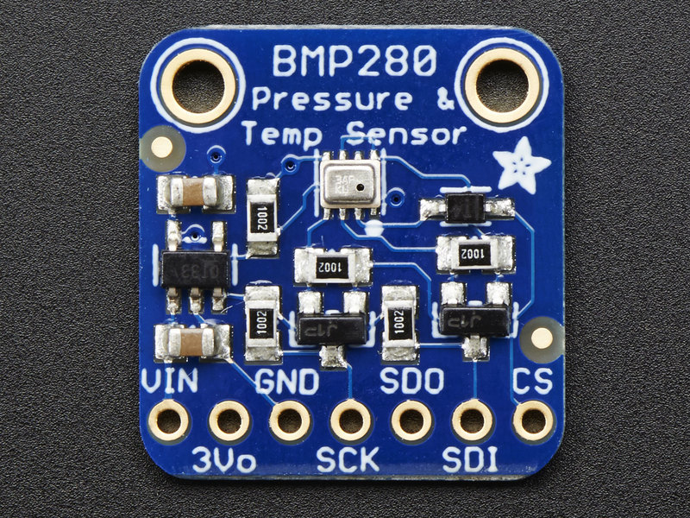
BMP280 Details
Notes:
31

Slide 32
It has two seperate pins for power supply: VDD is the main power supply for all the internal blocks while VDDIO is a seperate power supply pin for digital interface.
BMP280 measurement consists of temperature or pressure measurement with selected oversampling.
Notes:
32

Slide 33
Pressure measurement
While using BMP280 as the pressure sensor it can be used with oversampling option. The oversampling increases sampling rate reducing quantisation error which results in increasing resolution.
Oversampling options can be accessed by setting osrs_p bits 0-2 in control register 0xF4. The additional oversampled bits are stored in XLSB data register OXF9.
Notes:
33

Slide 34
Temperature measurement:
Working of this sensor for temperature measurement is similar to that of pressure measurement.
Oversampling options can be accessed by setting osrs_t bits 0-2 in control register 0xF4. The additional oversampled bits are stored in XLSB data register OXFC.
Notes:
34

Slide 35
Power modes
The BMP280 operates in three modes:
i)Sleep mode
ii)Forced mode
iii)Normal mode
The above modes can be selected using mode bits in control register 0xF4.
Notes:
35

Slide 36
i)Sleep mode
Sleep mode is default mode after power on reset. In sleep mode, no measurements are performed and power consumption is at minimum.
All registers are accessible. Chip-ID andcompensation coefficients can be read.
Notes:
36

Slide 37
ii)Forced mode and normal mode
When the single measurement is completed in forced mode according to filter selection and type of measurement, for the next measurement we need to invoke forced mode again.
While in normal mode measurement is done once for every 16 continuous cycles.
Notes:
37

Slide 38
The time taken for 16 cycles is standby period. In both the modes, the last measurement results can be obtained from the data registers.
In normal mode, the standby time is determined by the contents of the t_sb 0-2 bits in control register 0xF5.
Notes:
38

Slide 39
Data readout and Data register shadowing
Burst read is recommended for data reading as it provides data consistency. Data readout is done by starting a burst read from 0xF7 to 0xFC in an unsigned 20-bit format both for pressure and for temperature.
The timing for data readout in forced mode should be done so that the maximum measurement times. In normal mode, readout can be done at a speed similar to the expected data output rate.
Notes:
39

Slide 40
But in normal mode measurement is not neccessarily synchronised to readot because of availability of shadow data registers.
If a new measurement is finished and the data registers are still being read, the new measurement results are transferred into shadow data registers.
Notes:
40

Slide 41
The content of shadow registers is transferred into data registers as soon as the user ends the burst read, even if not all data registers were read. The end of the burst read is marked bythe rising edge of CSB pin in SPI.
Notes:
41

Slide 42
Registers
Registers have width of 8 bits.
i) id register(0xD0)
The“id”register contains the chip identification number chip_id[7:0], which is 0x58.This number can be read as soon as the device finished the power-on-reset.
Notes:
42

Slide 43
ii) reset register(0xE0)
The “reset” register contains the soft reset word reset[7:0]. If the value 0xB6 is written to the register,the device is reset using the complete power-on-reset procedure.
Writing other values than 0xB6 has no effect.The read out value is always 0x00.
Notes:
43

Slide 44
iii) status register(0xF3)
The status register contains two bits which indicate the status of the device. Bit 3 automatically set to ‘1’ whenever a conversion is running and back to ‘0’ when the results have been transferred to the data registers.
iv) ctrl_meas register(0xF4)
The “ctrl_meas” register sets the data acquisition options of the device.
Notes:
44

Slide 45
By setting bits (0-7) and osrs_p, osrs_t, mode registers we can control oversampling of pressure data, temperature data and power mode of the device.
v) config register(0xF5)
The “config” register sets the rate, filter and interface options of the device. It controls in active duration tstandby in normal mode,time constant of the IIR filter, enables 3-wire SPI interface.
Notes:
45

Slide 46
vi) pressure register(0xF7-0xF9)
The pressure register contains the raw pressure measurement output data.
vii) temperature register(0xFA-0xFC)
The temperature register contains the raw temperature measurement output data.
Notes:
46

Slide 47
BMP280 configurations
struct bmp280_calib : consists of values of calibration data of registers from address 0Xa1 to 0X88 each of 8 bits.
In bmp280_read_calib API used to read calibration parameters of temperature, pressure, humidity the calibration registers to be read are 0X88, 0X8E and 0XA1 respectively.
Notes:
47

Slide 48
BMP_CHIP_ID is placed in chip_id register at 0X58.
bmp280_read_temp which reads multiples register values takes MSB value from register located at 0XFA. bmp280_read_press it reads msb value from 0XF7 register.
In bmp280_chip_config we set data acquisition options by writing BMP280_REG_CTRL_MEAS (0XF4) which is a 8-bit register.
Notes:
48

Slide 49
Bits 0-1 for selecting mode, bits 2-4 controls oversampling data of pressure, bits 5-7 controls oversampling data of temperature.
Notes:
49

Slide 50
References
SPI support in RPI board Hardware -> https://www.raspberrypi.org/documentation/hardware/raspberrypi/spi/README.md
Configuring SPI with raspi-config -> https://learn.adafruit.com/adafruits-raspberry-pi-lesson-4-gpio-setup/configuring-spi
BMP280 data sheet
Notes:
50

Slide 51
THANK YOU
Notes:
51

