Slide 1


INTRODUCTION TO EMBEDDED SYSTEMS
Mr. Ram Prasath S, AP/ECE

Slide 2
Course Code & LTPC
21TD11 EMBEDDED SYSTEMS
L | T | P | C
3 | 0 | 2 | 4

Slide 3
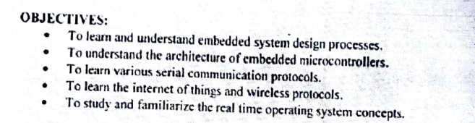
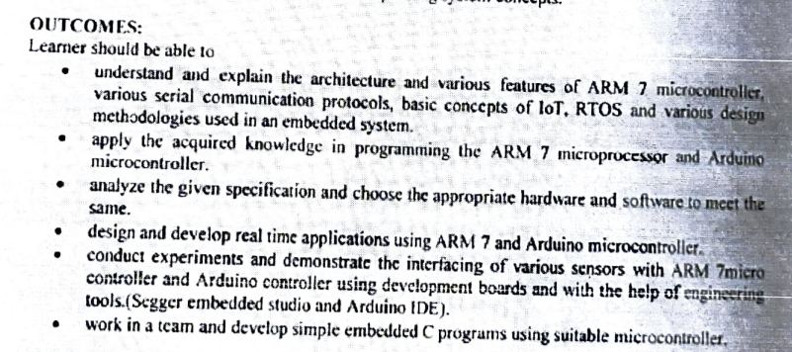

Slide 4
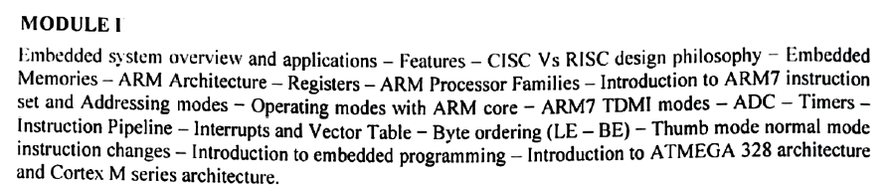
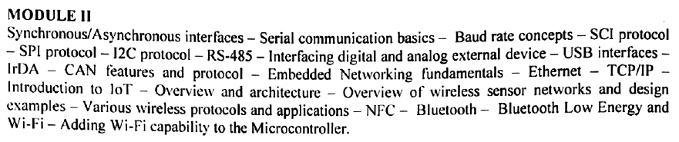
Syllabus

Slide 5
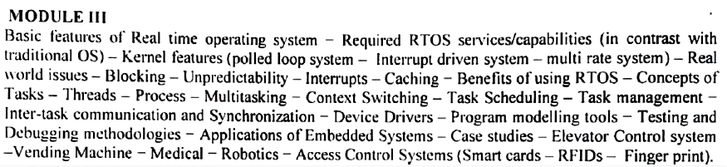
Syllabus

Slide 6
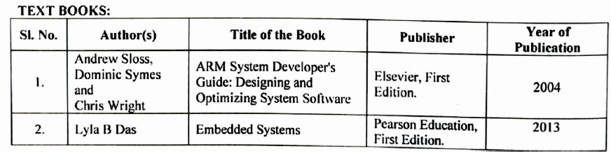

Slide 7
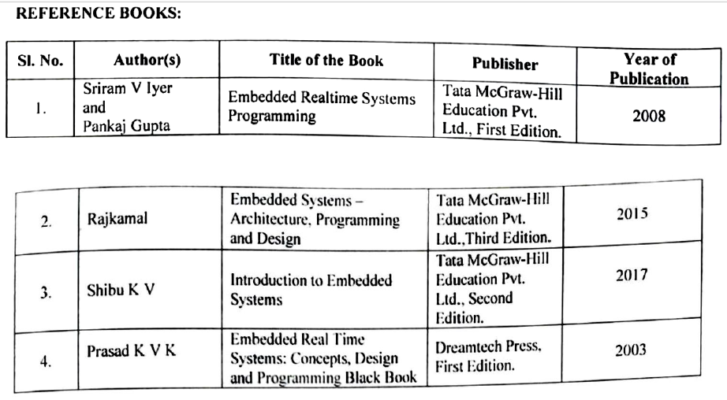

Slide 8
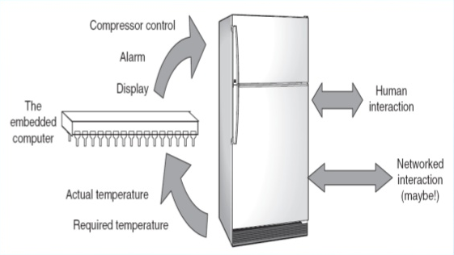
An embedded system is an electronic/electro-mechanical system designed to perform a specific function and is combination of both hardware and firmware.
electronic/electro-mechanical system
specific function
both hardware and firmware

Slide 9

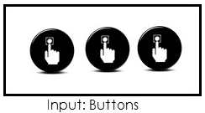

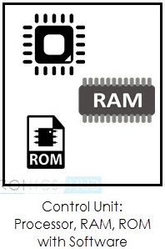
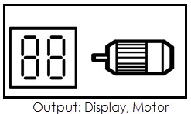
An Embedded system is any electronic device that incorporates a computer in its implementation.
The user of an embedded device is often not even aware that a computer is present in the device. The computer may refer to a microprocessor or a microcontroller.

Slide 10
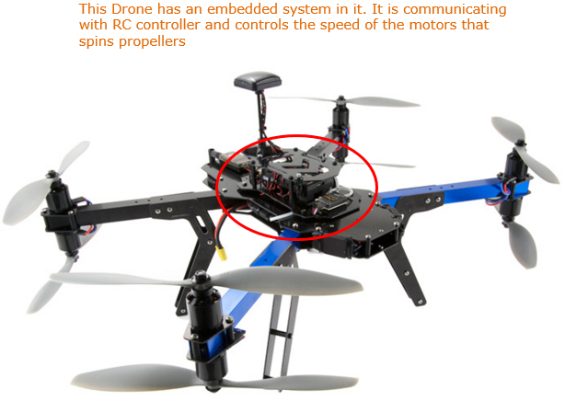

Slide 11
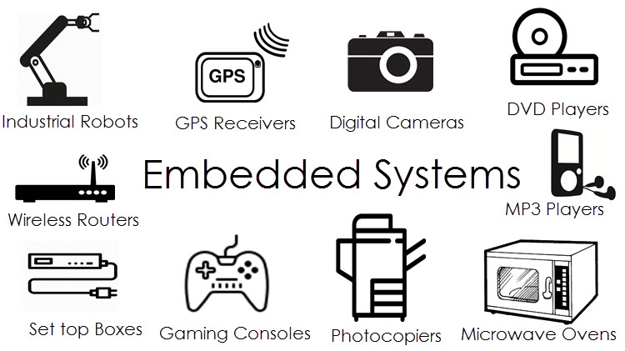

Slide 12
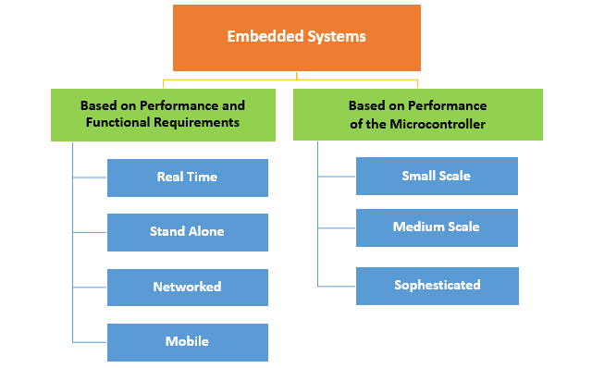
Classifications of Embedded systems

Slide 13
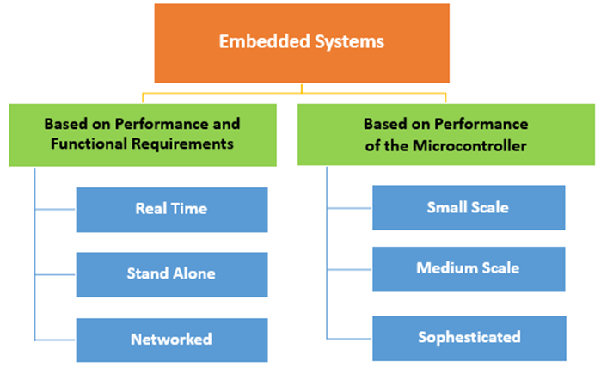

Slide 14
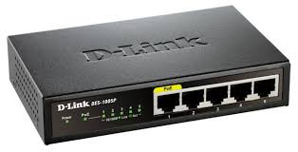
Example for an embedded system as a standalone system
The network router is a standalone embedded system.
It has a specialized communication processor, memory, a number of network ports and special software that implements packet routing algorithms.
In other words, the network router is a standalone embedded system that routes packets coming from one port to another, based on a programmed routing algorithm.

Slide 15
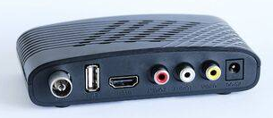
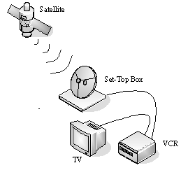
Example for an embedded system as a part of larger system
The digital set-top box (DST) found in many home entertainment systems nowadays.
The digital audio/video decoding system, called the A/V decoder, which is an integral part of the DST, is an embedded system.
The A/V decoder accepts a single multimedia stream and produces sound and video frames as output.
The signals received from the satellite by the DST contain multiple streams or channels.
The transport stream decoder in DST de-multiplexes the incoming multimedia streams into separate channels and feeds only the selected channel to the A/V decoder.
Therefore, the A/V decoder works in conjunction with the transport stream decoder, which is yet another embedded system.

Slide 16
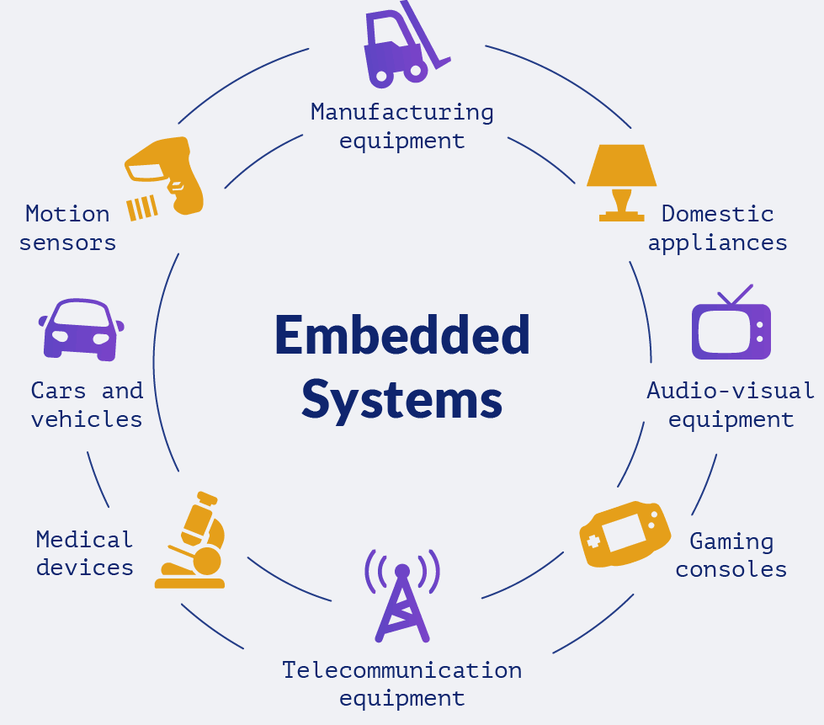

Slide 17
Recap
An embedded system is
An electronic or electro-mechanical system
Has a computer in it.
Can be a standalone system or a part of a larger system
Specific hardware, Specialized software meant for specific application

Slide 18
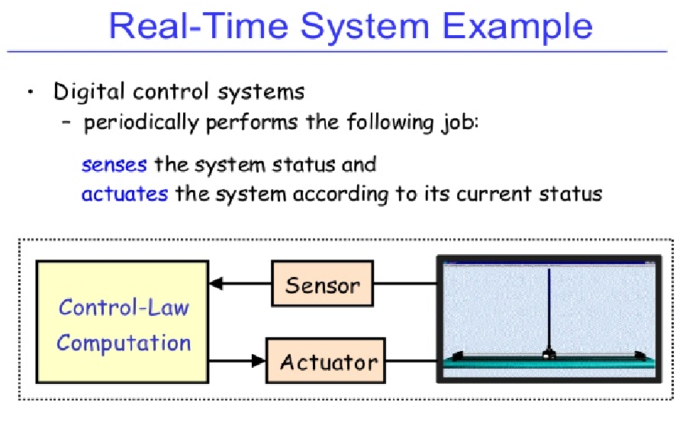
Real time Systems
A real-time system must respond to external inputs and produce new outputs in a limited amount of time. Systems must finish operations by deadline.
RTS characteristics
Deterministic output
within specified time

Slide 19
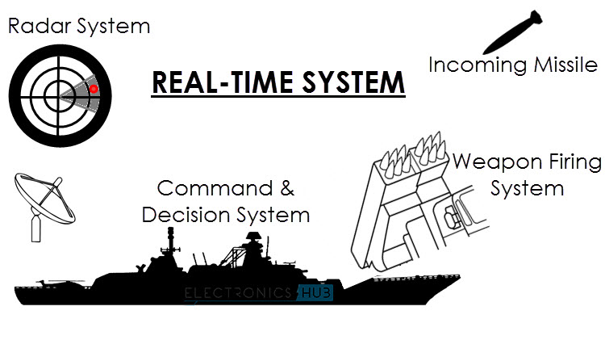

Slide 20
Real time systems
Hard Real time systems
Soft Real time systems
Classification of Real time Systems

Slide 21

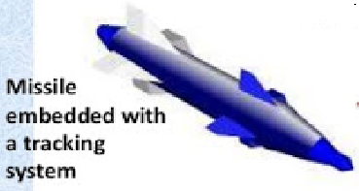
A hard real-time system is a real-time system that must meet its deadlines with a near-zero degree of flexibility. The deadlines must be met, or catastrophes occur. The cost of such catastrophe is extremely high and can involve human lives.
Deterministic output in specific time
Zero Tolerance
Otherwise Catastrophic effect

Slide 22
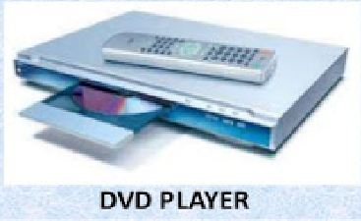
A soft real-time system is a real-time system that must meet its deadlines but with a degree of flexibility. The deadlines can contain varying levels of tolerance.
Missing deadline may result in a degraded performance.
In a soft real-time system, a missed deadline does not result in system failure.
A typical soft real-time example is a multimedia player.
The player could occasionally skip a video frame or audio sample and a user might not even notice as long as it ran correctly the vast majority of the time.

Slide 23
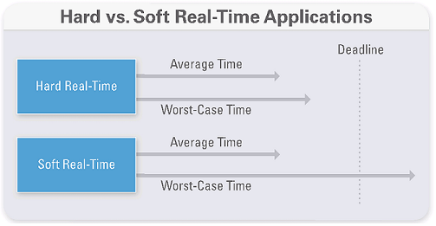

Slide 24
Recap
Real time system characteristics
Hard Real time systems | Soft Real time systems
Zero Tolerance. Otherwise Catastrophic effect | Slightly flexible tolerance. May result in a slightly degraded performance
Example: ABS, Aircraft Control | Example : DVD player

Slide 25
Classroom
Quizzes
Handouts
Lab
Projects

