Slide 1


Introduction to Embedded Systems
Mr. Ram Prasath S

Slide 2

Couse Code & LTPC
21TD11 - Embedded systems

Slide 3
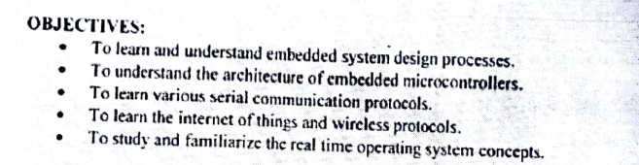
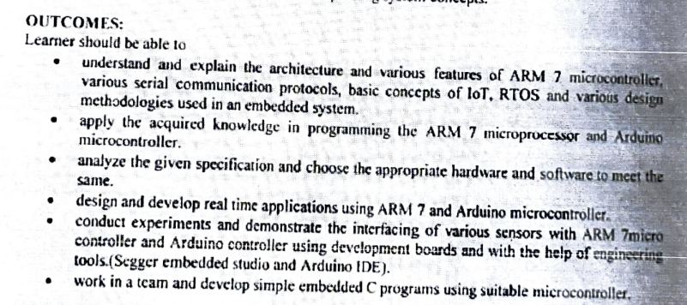

Slide 4
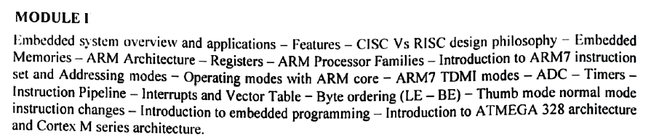
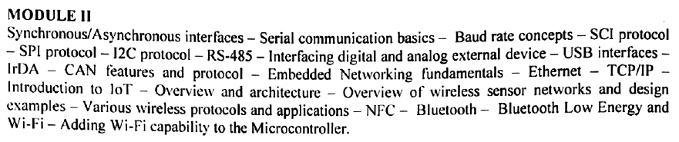
Syllabus

Slide 5
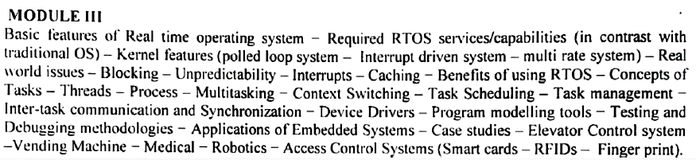
Syllabus

Slide 6
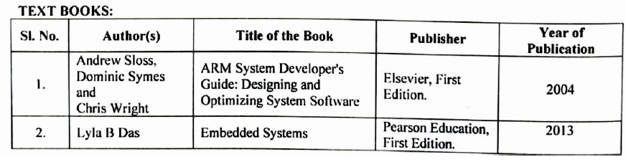

Slide 7
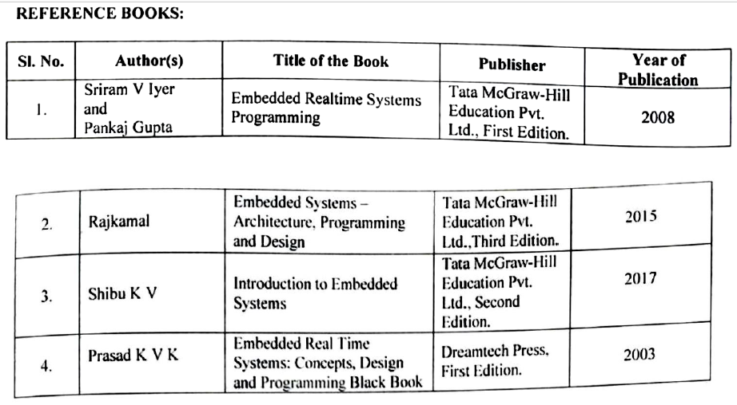

Slide 8
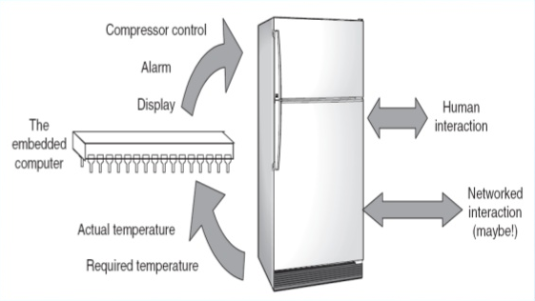
electronic/electro-mechanical system
specific function
both hardware and firmware
An embedded system is an electronic/electro-mechanical system designed to perform a specific function and is combination of both hardware and firmware.

Slide 9

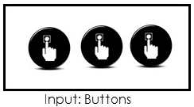

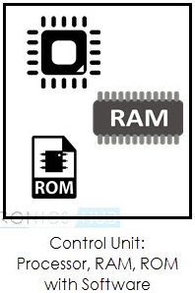
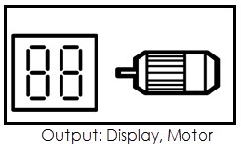
An Embedded system is any electronic device that incorporates a computer in its implementation.
The user of an embedded device is often not even aware that a computer is present in the device. The computer may refer to a microprocessor or a microcontroller.

Slide 10
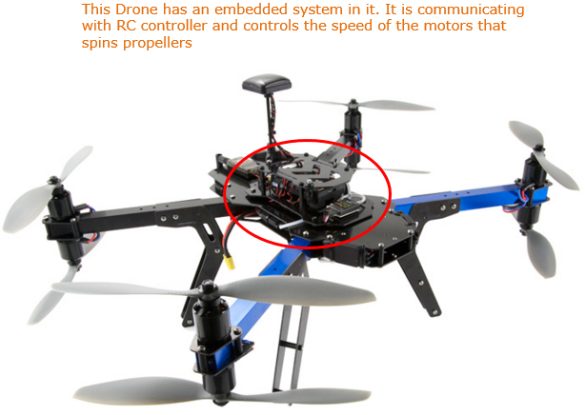

Slide 11
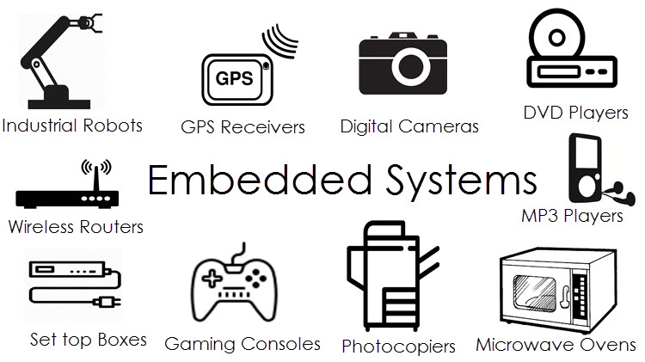

Slide 12
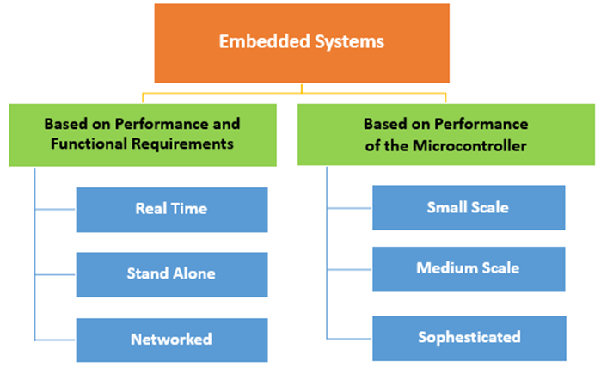

Slide 13
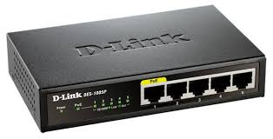
Example for an embedded system as a standalone system
The network router is a standalone embedded system.
It has a specialized communication processor, memory, a number of network ports and special software that implements packet routing algorithms.
In other words, the network router is a standalone embedded system that routes packets coming from one port to another, based on a programmed routing algorithm.

Slide 14
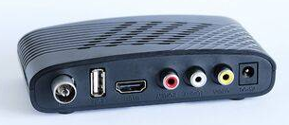
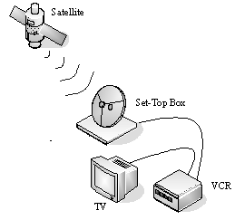
Example for an embedded system as a part of larger system
The digital set-top box (DST) found in many home entertainment systems nowadays.
The digital audio/video decoding system, called the A/V decoder, which is an integral part of the DST, is an embedded system.
The A/V decoder accepts a single multimedia stream and produces sound and video frames as output.
The signals received from the satellite by the DST contain multiple streams or channels.
The transport stream decoder in DST de-multiplexes the incoming multimedia streams into separate channels and feeds only the selected channel to the A/V decoder.
Therefore, the A/V decoder works in conjunction with the transport stream decoder, which is yet another embedded system.

Slide 15
