Slide 1
NeuroScan AI
Capstone Project - Phase 2
Student Details
Guide Details
Name : Ramya
SRN : PES1PG23CA283
MS. Sumitha Chandran
Department of Computer Applications,
PES University

Slide 2
Abstract
Brain tumors are serious health concerns that require accurate and timely diagnosis. The NeuroScan AI project leverages medical imaging techniques, such as MRI scans, combined with advanced AI algorithms to detect and categorize different types of brain tumors.
Notes:
Refer: https://undergradresearch.missouri.edu/how-to-write-an-abstract/

Slide 3
Introduction
Problem Scenario:
Brain tumors are dangerous and need to be diagnosed quickly and accurately. Traditional methods depend on doctors manually analyzing medical scans, which can take a lot of time, may have mistakes, and require skilled experts. This project aims to create an AI-based system to automatically detect brain tumors from scans, making the process faster and more accurate.
Proposed Solution:
Develop an AI-powered system using convolutional neural networks (CNNs) to accurately detect and classify Tumor and U-Net for segmenting the tumor region.
Notes:
Refer: https://www.betterup.com/blog/problem-statement

Slide 4
Introduction
Purpose:
The purpose of the NeuroScan AI project is to provide user with a reliable, accurate, and automated tool for diagnosing brain tumors .
Scope : The system is designed to process and analyze one image at a time. It does not support batch processing or real-time video analysis. It does not provide insights into tumor growth prediction.
Notes:
Refer: https://www.betterup.com/blog/problem-statement

Slide 5
Domain Survey
Medical Imaging and Tumor Detection
Medical imaging plays a crucial role in the early diagnosis and treatment of brain tumors. Techniques such as Magnetic Resonance Imaging (MRI) produce high-resolution images of brain tissues, making them essential in tumor detection. Traditional diagnosis relies on radiologists to manually examine MRI scans, which is time-consuming and prone to human error. This limitation has led to the development of automated systems using Artificial Intelligence (AI) and Machine Learning (ML).

Slide 6
Domain Survey
Role of Machine Learning and Deep Learning
Convolutional Neural Networks (CNNs) have become the standard for image classification tasks in medical imaging. CNNs can learn complex features from MRI images and classify tumor types such as Glioma, Meningioma, and Pituitary tumors. This reduces the diagnostic burden on clinicians and improves accuracy and speed
For precise tumor localization, image segmentation techniques are employed. U-Net, a deep learning-based segmentation model, is widely adopted due to its ability to accurately capture spatial information and outline tumor boundaries. It uses an encoder-decoder architecture with skip connections, making it particularly effective on medical images with limited training data.

Slide 7
Introduction
Comparative Study
Feature | NeuroScan AI | Brain Tumor Detection Using Deep Learning Techniques | Deep Learning Based Brain Tumor Detection and Classification | Detection of Brain Tumor Types Using Deep Learning
Dataset | Brain tumor images categorized into four folders (Glioma, Meningioma, Pituitary, No Tumor) | 253 MRI images (155 tumor, 98 no tumor) | Various deep learning models tested on MRI datasets | 3,264 MRI images (Glioma, Meningioma, Pituitary, No Tumor)
Model Used | CNN for tumor classification, U-Net for segmentation | CNN | YOLO, VGG16, ResNet, FastAi-based CNN | Custom CNN, VGG-16
Classification Accuracy | 89.47% | 94.58% | FastAi-based CNN: 90.78%, YOLOv5: 85.95% | Custom CNN: 90.22%, VGG-16: 87.21%
Tumor Segmentation | U-Net model segments tumor regions | Highlights tumor regions for radiologists | YOLO used for tumor detection but no segmentation | No segmentation performed
Preprocessing | Noise reduction, contrast enhancement, resizing, normalization | Basic preprocessing applied | Image preprocessing included augmentation | Image normalization and enhancement
User Features | Image Upload, Preprocessing, Classification, Segmentation, tumor Size Calculation, Report Generation, Download Option | No user interface described | No user interface described | No user interface described
Tumor Types | Glioma, Meningioma, Pituitary, No Tumor | Tumor vs. No Tumor | Tumor classification using multiple architectures | Glioma, Meningioma, Pituitary, No Tumor

Slide 8
Literature Survey
[1] Title:Brain Tumor Detection Using Deep Learning Techniques
Authors : Munagalapalli Thanuj , Panidapu Ravi Teja , Pallam John David Living Stun , Dr. K. Kranthi Kumar , R. Sudha Kishore
Publisher: IEEE Xplore on 08 February 2021
Summary:This study focuses on applying deep learning, particularly Convolutional Neural Networks (CNNs), to detect brain tumors from MRI scans effectively and accurately. The aim is to assist radiologists and clinicians in making timely diagnoses while overcoming the limitations of traditional methods. Includes 253 MRI images categorized into two folders:
Yes folder: 155 images with brain tumors.
No folder: 98 images without tumors.
The model achieved an accuracy of 94.58% in tumor classification.
Tumor regions were highlighted effectively, making it easier for radiologists to interpret results.
Notes:
Refer: https://www.betterup.com/blog/problem-statement

Slide 9
Literature Survey
[2] Title: Deep Learning Based Brain Tumor Detection and Classification
Authors : Nadim Mahmud Dipu , Sifatul Alam Shohan , K. M. A. Salam
Publisher: IEEE Xplore on 04 August 2021
Summary:This paper investigates the use of deep learning techniques, specifically Convolutional Neural Networks (CNNs), for detecting and classifying brain tumors from medical imaging, particularly MRI scans. It emphasizes the effectiveness of CNNs in automating the tumor detection process and improving accuracy . The paper evaluates several deep learning architectures for their performance in classifying brain tumors : YOLO (You Only Look Once): A state-of-the-art object detection model.VGG16 and ResNet : Popular models for image classification tasks, modified to suit brain tumor detection.
FastAi-based CNN achieved an accuracy of 90.78% for classification.
YOLOv5 achieved an accuracy of 85.95% in tumor detection.
Notes:
Refer: https://www.betterup.com/blog/problem-statement

Slide 10
Literature Survey
[3] Title: Detection of Brain Tumor Types Using Deep Learning
Authors: Y. Mohana Roopa , G. Naveen Kumar, Yanamandra Venkata Sree Harsha , Potukuchi Sreeram Aditya
Publisher: IEEE Xplore 2020
Summary:Used Convolutional Neural Network (CNN) for classifying brain tumor types.It compares the performance of the custom CNN with the pre-trained VGG-16 model.The dataset includes 3,264 samples, with four categories: glioma, meningioma, pituitary tumors, and non-tumor images.The custom CNN outperforms VGG-16 in both accuracy and computational efficiency.The custom CNN achieved 90.22% accuracy, while VGG-16 achieved 87.21%.
Notes:
Refer: https://www.betterup.com/blog/problem-statement

Slide 11
Literature Survey
[4] Title : Brain Tumor Detection and Classification Using Deep Learning Approaches
Authors : Ankitha G , Hafsa Tuba J , Akhilesh J , Archana Bhanu , Naveen IG
Publisher: Published in the 2023 4th International Conference for Emerging Technology (INCET), IEEE Xplore
Summary:This paper explores brain tumor detection and classification using deep learning, specifically CNN architectures ResNet50 and Xception , on MRI images to classify tumors into Glioma, Meningioma, and Pituitary Adenomas. The methodology includes preprocessing (cropping, resizing, noise reduction), model training on 7,023 images, and performance evaluation. Xception achieved the highest accuracy of 98.32%, outperforming ResNet50 (98.02%) with lower computational time and better loss values.
Notes:
Refer: https://www.betterup.com/blog/problem-statement

Slide 12
Literature Survey
[5] Title: Accurate Detection and Classification of Brain Tumors using U-Net and Extreme Learning
Authors: B. Ramu and Sandeep Bansal
Publisher: IEEE, as part of the 5th International Conference on Smart Electronics and Communication (ICOSEC 2024)
Summary:The study proposes an automated approach for brain tumor segmentation and classification usingU-Net and Extreme Learning Machine (ELM). U-Net is employed to segment MRI images of brain tumors, while ELM classifies the tumors based on features extracted by U-Net. Tested on the BRATS 2020 dataset, the method achieves exceptional performance metrics, including 99.87% accuracy, 99.58%
sensitivity, 98.96% specificity, and 98.75% precision. The research emphasizes the potential of automated techniques to improve the efficiency and accuracy of brain tumor diagnosis.
Notes:
Refer: https://www.betterup.com/blog/problem-statement

Slide 13
Literature Survey
[6] Title : Brain Tumor Classification and Detection Using Machine Learning Algorithm
Author :Monisha Barakala , Venkata Ramana , Cristin
Publisher : Published in the International Conference on Augmented Intelligence and Sustainable Systems (ICAISS-2022), IEEE Xplore.
Summary:The paper presents an automated method for brain tumor detection and classification using machine learning algorithms, with a focus on Convolutional Neural Networks (CNNs) for MRI-based tumor detection. The proposed method is tested on MRI datasets and achieves an accuracy of 84%. The study claims that the model performs better than existing approaches while requiring lower computational resources.
Notes:
Refer: https://www.betterup.com/blog/problem-statement

Slide 14
Literature Survey
[7] Title: Automated Brain Tumor Segmentation and Classification in MRI Using YOLO-Based Deep Learning.
Authors: Maram Fahaad Almufareh, Muhammad Imran, Abdullah Khan, Mamoona Humayun, and Muhammad Asim
Publisher: IEEE Access on 6 February 2023
Summary: The paper presents a deep learning approach for segmenting and classifying brain tumors using MRI images. Two YOLO models, YOLOv5 and YOLOv7, are evaluated for their efficiency in detecting and segmenting three types of brain tumors: meningiomas, gliomas, and pituitary tumors. The study employs advanced preprocessing techniques and uses the BT dataset. YOLOv5 achieves precision and recall scores of 0.94 and 0.905, while YOLOv7 scores slightly better in some areas. Both models are compared with traditional methods like RCNN and Mask RCNN, demonstrating significant accuracy improvements. The paper concludes by highlighting the potential of YOLO-based models in medical imaging applications.
Notes:
Refer: https://www.betterup.com/blog/problem-statement

Slide 15
Literature Survey
[8] Title : Brain Tumor Detection by Using Artificial Neural Network
Authors : Hussna Elnoor Mohammed Abdalla , M. Y. Esmail
Publisher:2018 International Conference on Computer, Control, Electrical, and Electronics Engineering (ICCCEEE).
Summary : The study proposes a method for detecting brain tumors using MRI and artificial neural networks (ANN). It involves preprocessing to enhance image clarity, segmentation to identify
tumor area . A supervised feed-forward ANN model classifies the images as tumor or non-tumor, achieving 99% accuracy and 97.9% sensitivity.
Notes:
Refer: https://www.betterup.com/blog/problem-statement

Slide 16
Literature Survey
[9] Title :Brain Tumor Detection Using Deep Neural Network and Machine Learning Algorithm
Authors : Masoumeh Siar , Mohammad Teshnehlab
Publisher : Presented at the 9th International Conference on Computer and Knowledge Engineering (ICCKE 2019), held in Mashhad, Iran.
Summary:The study focuses on brain tumor detection using MRI images from a dataset consisting of 1,892 images from 153 patients (80 healthy and 73 with tumors), divided into training and testing sets. Preprocessing techniques included cropping images to remove noise and employing a clustering algorithm to enhance accuracy. The classification model used was a Convolutional Neural Network (CNN) based on AlexNet, featuring five convolutional layers. This model effectively classified images into "normal" or "tumor" categories, demonstrating the potential of CNNs for precise and automated brain tumor detection.
Notes:
Refer: https://www.betterup.com/blog/problem-statement

Slide 17
Tools & Technologies
Hardware Requirements:
Software Requirements:
Processor | Intel Core i3
Memory | Minimum 8GB
Disk | 258GB SSD
Frameworks and libraries | OpenCV, Numpy, Tensorflow, Keras
IDE | VS Code version 1.96.4
Frontend | React version 19.0.0
Backend | Flask version 5.1.5

Slide 18
Functional Requirements
Data Collection:
The brain tumor dataset is collected from publicly available sources such as Kaggle and medical imaging repositories. The dataset includes MRI images labeled according to tumor types (e.g., glioma, meningioma, pituitary) and also includes non-tumor images to support accurate classification and segmentation.
2. Image Preprocessing:
MRI images undergo preprocessing techniques such as normalization, resizing, contrast enhancement, and data augmentation methods including rotation, flipping, and zooming. These techniques enhance image quality, increase dataset variability, and improve the performance and robustness of the model.

Slide 19
Functional Requirements
3. Tumor Segmentation :
For segmentation, models such as U-Net are integrated to localize and segment tumor regions within the brain images.
4.Tumor Type Detection :
A deep learning model CNN is employed for classifying MRI scans into different tumor types. This combined approach provides both classification and visual localization, aiding in better diagnosis and treatment planning
5. Tumor Size Calculation :
Size Calculation in NeuroScan AI project involves determining the area (in cm² or pixels) of the segmented tumor region from MRI images.
6.Report Generation:
Click on report generation it will create a report with all details like segmented tumor , tumor type tumor size and click on download to download that report.

Slide 20
Non-Functional Requirements
Performance:
The system should process and return results after image submission.
2.Scalability:
The backend should support concurrent image uploads and processing for at least 100 users simultaneously without performance degradation.
3.Usability:
The interface should be intuitive and require no more than 3 clicks for users to upload an image and view results.
4. Security
User-uploaded images must be securely transmitted and stored, with compliance to relevant data privacy standards.

Slide 21
1. Data Collection & Preprocessing
Image Dataset: Collected Brain tumor images from Kaggle.
Data Labeling: Ensure each image is labeled with tumor type.
Data Cleaning: Image sharpening, resize images, and apply augmentations (rotation, flipping, brightness adjustments).
2. Model Development
Segmentation Model: U-Net is trained from scratch using annotated brain MRI images to segment tumor regions accurately.Classification Model: A custom Convolutional Neural Network (CNN) is developed to classify the segmented tumor region into one of the tumor types (e.g., glioma, meningioma, pituitary, or no tumor).
Training & Optimization: Data Split: Train (80%), Test (20%) using ImageFolder.
Methodology

Slide 22
Methodology
3. Backend Development
Implement Flask API to:
Accept an image upload.
Pass it to the model for segmentation and classification.
5. Frontend Development
Uploading images.
Displaying tumor segmentation and classification results.
Disaplayimg tumor size
Showing tumor details dynamically.

Slide 23
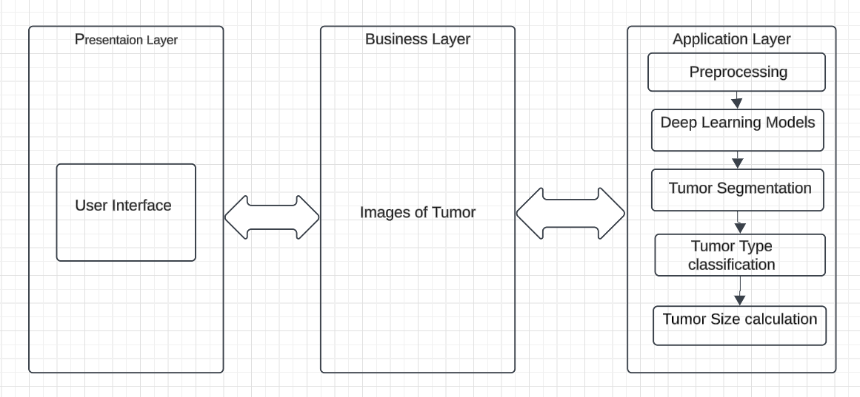
Initial Design
Architecture Diagram

Slide 24
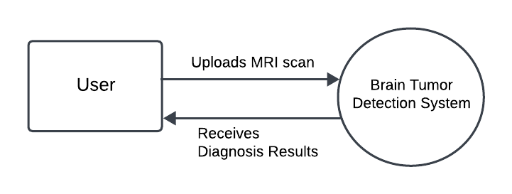
Initial Design
Context Diagram

Slide 25
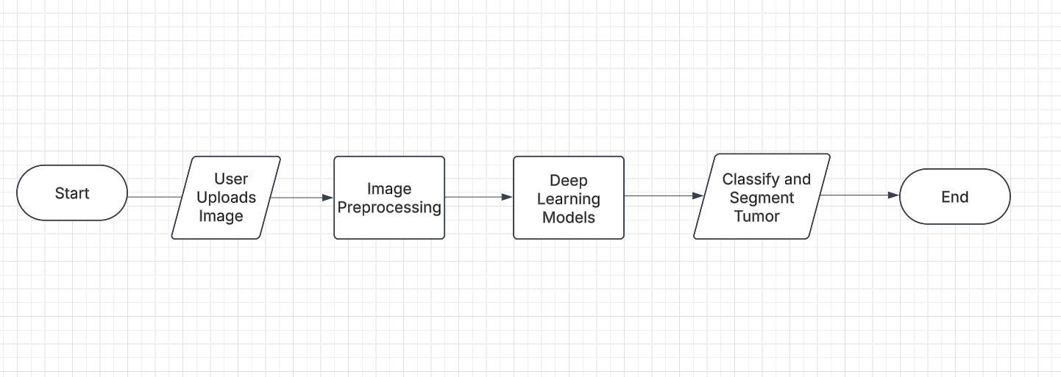
Initial Design
Process Flow Diagram

Slide 26
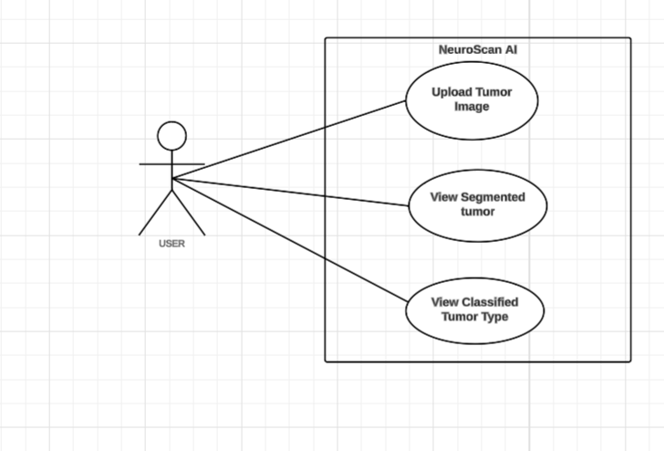
Initial Design
Use Case Diagram

Slide 27

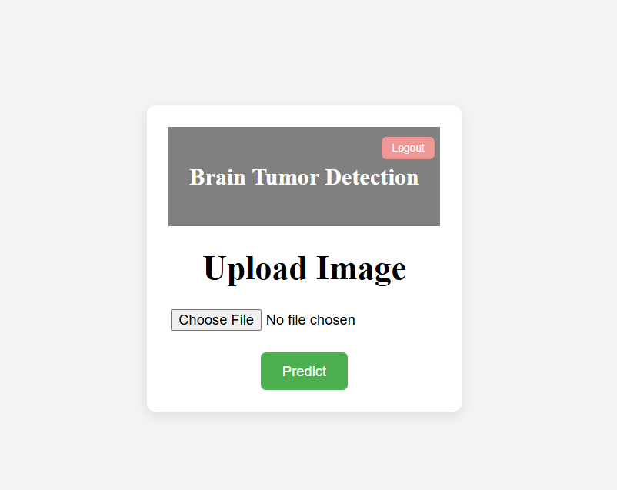
Screenshots

Slide 28

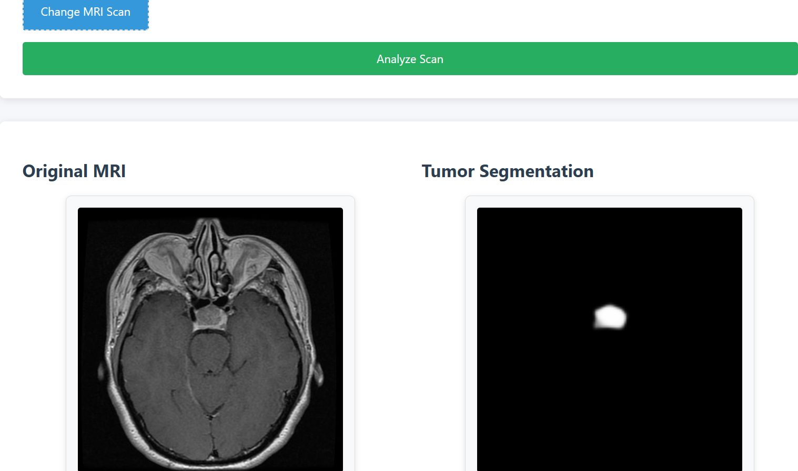
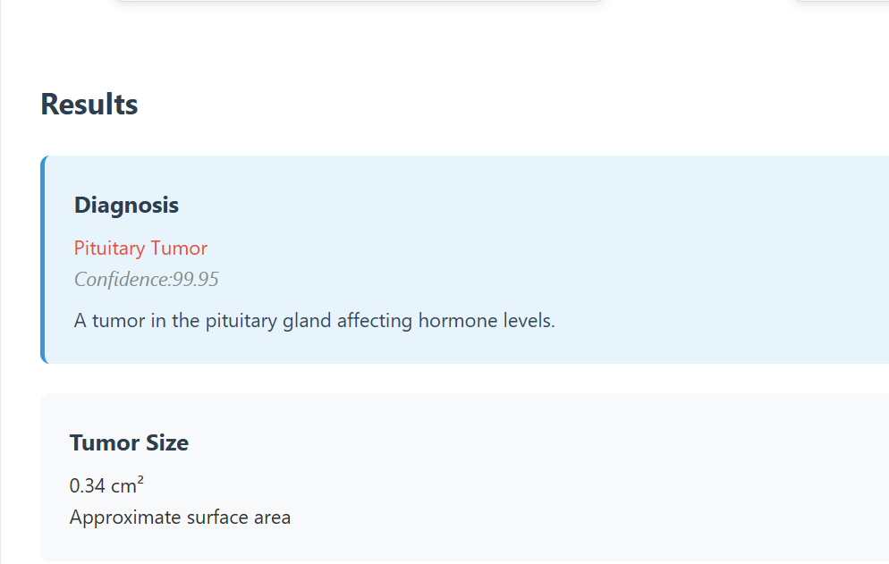
Screenshots

Slide 29
Pseudocode
Step 1: Data Collection function collect data images ← load images from directory(”brain dataset/”) labels ← {”Glioma”, ”Meningioma”, ”Pituitary”, ”No Tumor”} ensure class balance(images, labels) return images, labels end function
Step 2: Image Preprocessing function preprocess images(images) for each image in images do image ← resize(image, (256, 256)) image ← normalize(image) image ← enhance contrast(image) end for return images end function

Slide 30
Pseudocode
Step 3: Tumor Classification using CNN function predict tumor class(cnn model, uploaded image) image ← preprocess images([uploaded image]) prediction ← cnn model.predict(image) tumor class ← get class label(prediction) return tumor class end function Step 4: Tumor Segmentation using U-Net function segment tumor(unet model, uploaded image) image ← preprocess images([uploaded image]) mask ← unet model.predict(image) refined mask ← postprocess mask(mask) return refined mask end function

Slide 31
Pseudocode
Step 5: Web Interface function web interface uploaded image ← user upload() tumor class ← predict tumor class(cnn model, uploaded image) if tumor class̸ = ”No Tumor” then mask ← segment tumor(unet model, uploaded image) tumor size ← calculate tumor area(mask) display result(tumor class, mask, tumor size) else display result(”No Tumor”, None, ”No segmentation needed”) end if end function
Step 6: Main Execution 1 images , labels = collect_data () 2 preprocessed_images = preprocess_images ( images ) 3 cnn_model = train_cnn_model ( preprocessed_images , labels ) 4 unet_model = train_unet_model ( preprocessed_images , labels ) 5 web_interface ()

Slide 32
Test Cases
Test Case – Image Upload & Preprocessing
TCID | Test Details | Expected Result | Actual Result | Status
TC01 | Upload Valid MRI Image | Image displayed in preview section | Image displayed correctly | Pass
TC02 | Upload Invalid File Format | System shows error: “Unsupported file format” | Appropriate error message shown | Pass
TC03 | Upload with No File Selected | Prompt: “Please select an image” | Prompt shown | Pass

Slide 33
Test Cases
Test Case – Tumor Classification and Segmentation
TCID | Test Details | Expected Result | Actual Result | Status
TC04 | Submit Valid MRI Image | System predicts tumor type (e.g., Glioma, Meningioma) | Tumor type predicted and displayed | Pass
TC05 | Submit Image Without Tumor | Model returns: “No Tumor Detected” | Correct message shown | Pass
TC06 | Attempt Classification without Upload | System prompts user to upload image | Prompted with error | Pass
TC07 | Segment Valid Tumor Image | Tumor mask generated and overlaid on image | Tumor segmented and mask displayed | Pass
TC08 | Attempt Segmentation without Upload | System prompts error: “No image selected” | Appropriate error message shown | Pass

Slide 34
Test Cases
Test Case – Tumor Detection Result Reporting
TCID | Test Details | Expected Result | Actual Result | Status
TC09 | Generate Tumor Report After Detection | Report displays tumor type, size, and location | Report generated correctly | Pass
TC10 | Download Report as PDF | PDF is downloaded with correct formatting and data | PDF downloaded successfully | Pass

Slide 35
Future Enhancement
3D MRI Volume Support: Extend the system to analyze 3D volumetric scans for more accurate tumor size estimation and spatial localization.
Multi-Region Segmentation: Enhance segmentation to differentiate between tumor sub-regions (e.g., edema, necrotic core, enhancing tumor) for improved clinical insights.
Clinical Data Integration: Combine MRI analysis with patient clinical data (age, symptoms, genetic markers) to provide a more holistic diagnosis.
Security & Compliance: Enhance data privacy and compliance with medical data standards such as HIPAA or GDPR for real-world hospital integration.

Slide 36
References
J. Amin, M. Sharif, A. Haldorai, M. Yasmin and R. S. Nayak, "Brain tumor detection and classification using machine learning: a comprehensive survey", Complex Intell. Syst., vol. 8, no. 4, pp. 3161-3183, Aug. 2022.
Zheshu Jia and Deyun Chen, "Brain Tumor Detection and Classification of MRI images using Deep Neural Network" in IEEE acess, IEEE, 2020.
Nadim Mahmud Dipu Sifatul Alam Shohan , K.M.A Salam ,” Deep Learning Based Brain Tumor Detection and Classification” in IEEE acess, IEEE, 2021.
Adithya Miglani , Hrithik Madan, Saurabh Kumar , Sanjay Kumar,” A Literature Review on Brain Tumor Detection and Segmentation” in in IEEE acess, IEEE, 2021.
Maram Fahaad Almufareh, Muhammad Imran, Abdullah Khan, Mamoona Humayun, and Muhammad Asim ,“Automated Brain Tumor Segmentation and Classification in MRI Using YOLO-Based Deep Learning.” in in IEEE acess, IEEE, 2023.

Slide 37
Thank You !!

